Slide 1
Rates of Chemical Reaction and Rate Laws
The rate of a reaction is an indication of how many moles of a reactant or product are reacted or produced over a period of time. Rates of reactions are a central issue in kinetics. Understand that it is difficult to predict before the fact how fast a reaction will be (although we will explore some of the factors that influence the rate of reactions). A lot of information
about kinetics of reactions is experimentally determined. Reaction rates also provide the fundamental information needed to deduce the individual actions that reactant species take in order to make products.
Extents of reaction
The rate of a reaction at this extent
is called the rate of initial reaction or the initial reaction rate

Slide 2
A rate of reaction can be expressed mathematically, this is
where the Greek letter capital delta implies “change.” If amounts were expressed in moles and time in seconds, a rate would have units of mol/s. Moles of what? This is a necessary distinction.
there are 2 moles of hydrogen reacting with every mole of oxygen to make water. because of the stoichiometry of the balanced chemical reaction, rates of reactions in terms of individual reactants and products are related.

Slide 3
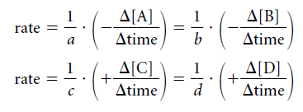
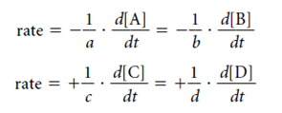
For a general chemical reaction
where A and B are the reactants, C and D are the products, and a, b, c, and d are the coefficients of the balanced reaction
The rate of reaction can express the rate of the reaction in terms of four different changing amounts:

Slide 4
The numerical value of the rate of the reaction differs depending on the species used to express the rate as well as the coefficients in the balanced chemical reaction.
First order kinetic rate laws
Type of reaction
In exponential form

Slide 5
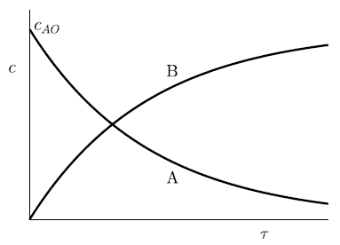
First-order radioactive decay.
In the logarithmic form of the first-order equation above
which is the definition of the half-time.

Slide 6
Second-order reactions
From the simple physical picture of a reacting mixture of reagents of two different kinds, say A and B, in which molecules collide to produce one or more products, the reaction must go slowly because fewer A–B collisions take place even though the total number of collisions may still be large.
In the form of a rate law, the rate is proportional to both A and B concentrations, hence it is proportional to the AB product²:
2The identity of the molecules is given in regular type AB, but the concentration variable referring to the different species is italic AB.

Slide 7
If the reactants are mixed so that the initial concentrations A and B are equal, they will remain equal throughout, because for each molecule of one that reacts, a molecule of the other has also reacted. As a result, AB = A2 throughout, giving the special case of the rate equation

Slide 8
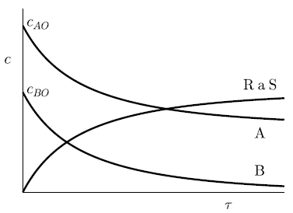
Reaction half life for second order reactions

