Slide 1
Molecular Geometry and Naming of Organic Compounds

Slide 2
When carbon makes four bonds, it adopts the tetrahedral geometry.
In the tetrahedral geometry, only two bonds can occupy a plane simultaneously.
The other two bonds point in back or in front of this plane.
In order to represent the tetrahedral geometry in two dimensions, solid wedges are used to represent bonds pointing out of the plane of the drawing toward the viewer, and dashed wedges are used to represent bonds pointing out of the plane of the drawing away from the viewer.

Slide 3
Representation of Structures In Organic Chemistry
Skelatal Structures In organic chemistry, skeletal formulae are the most abbreviated diagrammatic descriptions of molecules in common use. They look very bare because in skeletal formulae the hydrogen atoms (attached directly to carbons) are removed, leaving just a "carbon skeleton" with functional groups attached to it.

Slide 4
Skeletal Structure

Slide 5
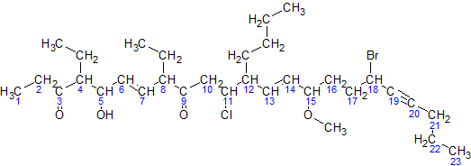
Nomenclature (Naming Organic Compounds)
For naming organic compounds a few basic names have to be memorized.
In general, the base part of the name reflects the number of carbons in what you have assigned to be the parent chain.
The suffix of the name reflects the type(s) of functional group(s) present on (or within) the parent chain.
Other groups which are attached to the parent chain are called substituents.

Slide 6
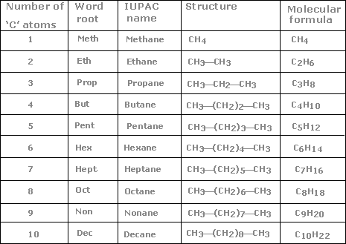
Alkanes - saturated hydrocarbons
Alkanes- Chemical Formula (CnH2n+2)
The names of the straight chain saturated hydrocarbons for up to a 10 carbon chain are given.
The names of the substituents formed by the removal of one hydrogen from the end of the chain is obtained by changing the suffix -ane to -yl.

Slide 7
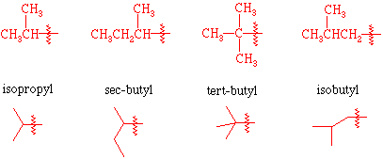
Branched substituents that has to be known.
If it connects at one of the two terminal carbon atoms, it is normal butyl or n-butyl: CH₃–CH₂–CH₂–CH₂–
If it connects at one of the non-terminal (internal) carbon atoms, it is secondary butyl or sec-butyl: CH₃–CH₂–CH(CH₃)–
If it connects at one of the three terminal carbons, it is isobutyl: (CH₃)₂CH–CH₂–
If it connects at the central carbon, it is tertiary butyl, tert-butyl or t-butyl: (CH₃)3C–

Slide 8
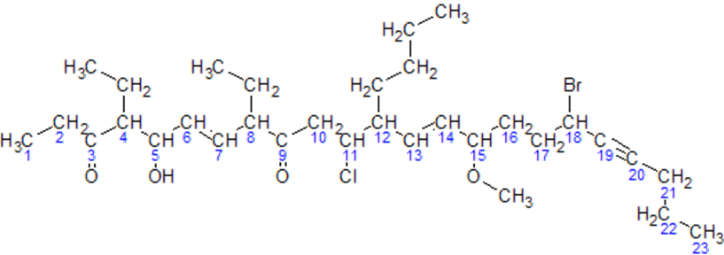
Rules to follow
Identify the longest carbon chain. This chain is called the parent chain.
Identify all of the substituents (groups appending from the parent chain).

Slide 9
Number the carbons of the parent chain from the end that gives the substituents the lowest numbers. When compairing a series of numbers, the series that is the "lowest" is the one which contains the lowest number at the occasion of the first difference. If two or more side chains are in equivalent positions, assign the lowest number to the one which will come first in the name.

Slide 10
If the same substituent occurs more than once, the location of each point on which the substituent occurs is given. In addition, the number of times the substituent group occurs is indicated by a prefix (di, tri, tetra, etc.).

Slide 11
If there are two or more different substituents they are listed in alphabetical order using the base name (ignore the prefixes). The only prefix which is used when putting the substituents in alphabetical order is iso as in isopropyl or isobutyl. The prefixes sec- and tert- are not used in determining alphabetical order except when compared with each other.

Slide 12
If chains of equal length are competing for selection as the parent chain, then the choice goes in series to: a) the chain which has the greatest number of side chains. b) the chain whose substituents have the lowest- numbers. c) the chain having the greatest number of carbon atoms in the smaller side chain. d)the chain having the least branched side chains.

Slide 13
In summary, the name of the compound is written out with the substituents in alphabetical order followed by the base name (derived from the number of carbons in the parent chain). Commas are used between numbers and dashes are used between letters and numbers. There are no spaces in the name.

Slide 14
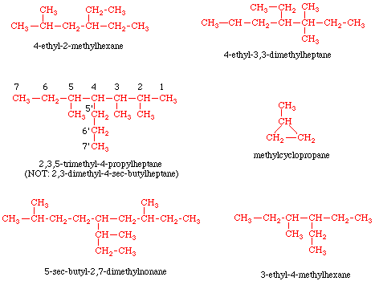
Examples

Slide 15
Alkyl halides
The halogen is treated as a substituent on an alkane chain. The halo- substituent is considered of equal rank with an alkyl substituent in the numbering of the parent chain. The halogens are represented as follows
F fluoro-
Cl chloro-
Br bromo-
I iodo-

Slide 16
Conformations
A conformational analysis is a study of the energetics of different spatial arrangements of atoms relative to rotations about bonds. Conformational analyses are assisted greatly by a representation of molecules in a manner different to skeletal structures. A representation of a molecule in which the atoms and bonds are viewed along the axis about which rotation occurs is called a Newman projection

Slide 17
In a Newman projection, the molecule is viewed along an axis containing two atoms bonded to each other and the bond between them, about which the molecule can rotate. In a Newman projection, the "substituents" of each atom composing the bond, be they hydrogens or functional groups, can then be viewed both in front of and behind the carbon-carbon bond. Specifically, one can observe the angle between a substituent on the front atom and a substituent on the back atom in the Newman projection, which is called the dihedral angle or torsion angle.

Slide 18
In ethane specifically, we can imagine two possible "extreme" conformations. In one case, the dihedral angle is 0° and the hydrogens on the first carbon line up with or eclipse the hydrogens on the second carbon. When the dihedral angle is 0° and the hydrogens line up perfectly, ethane has adopted the eclipsed conformation.
The other extreme occurs when the hydrogens on the first carbon are as far away as possible from those on the second carbon; this occurs at a dihedral angle of 60° and is called the staggered conformation

Slide 19
Stereoisomerism
Isomers are group of compunds which have the same molecular formula but different arrangements of atoms.
ISOMERS Structural Stereoisomers
1. Geometrical
2. Optical

Slide 20
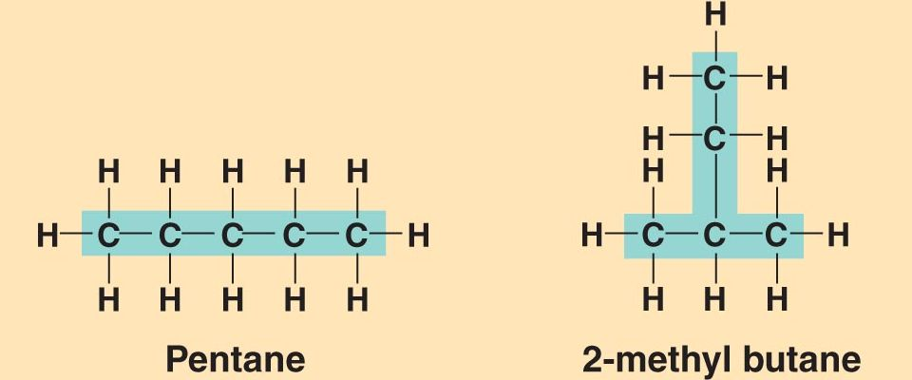
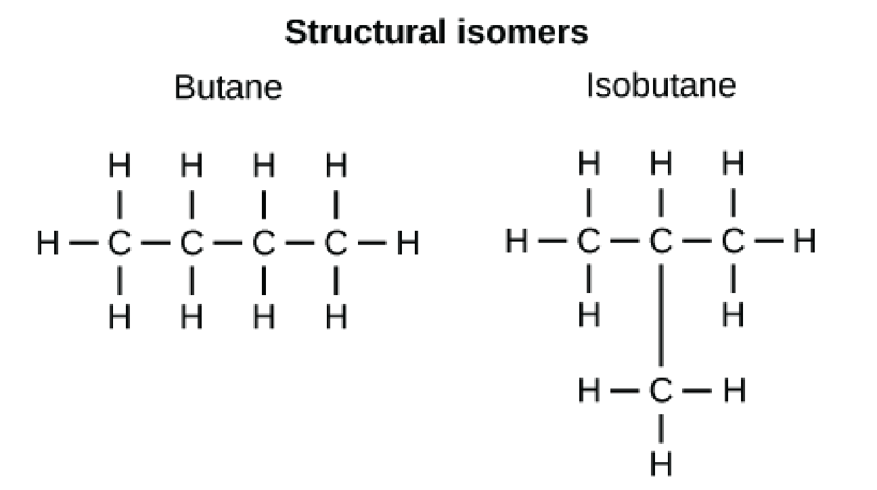
Structural isomers have different molecular formula but their atoms are linked together in different sequences.

Slide 21
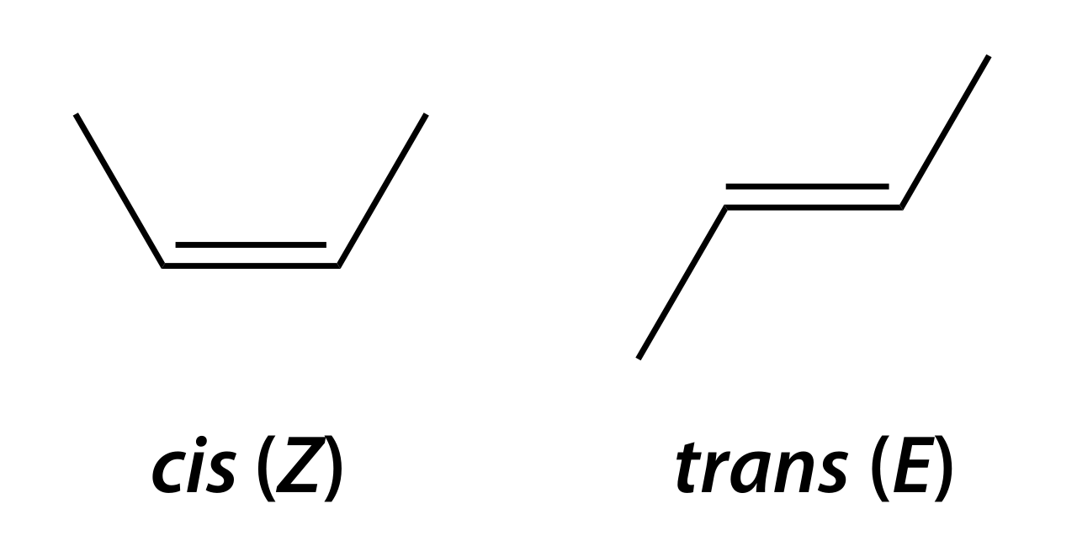
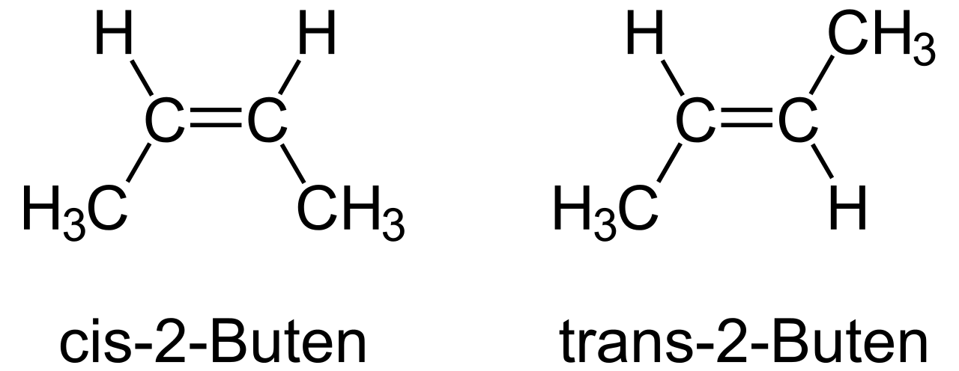
Stereoisomers also have the same molecular formula but they have different spatial arrangements of their atoms.
Geometrical isomers differ in the geometrical arrangements of their atoms
Cis: On the same side
Trans: On the opposite sides

Slide 22
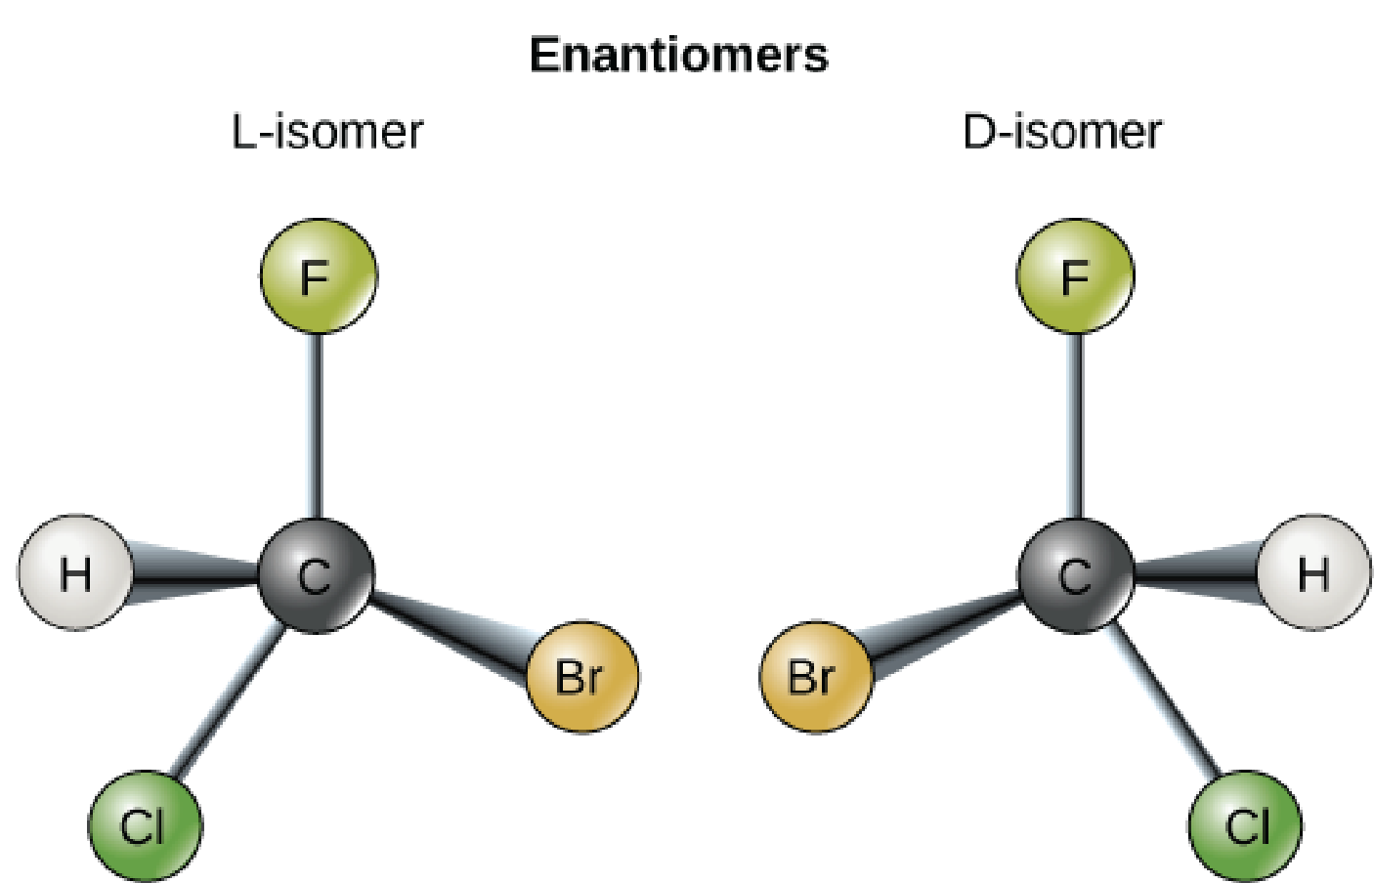
The arragement of atoms that characterizes a particular stereoisomer (isomers different from each other only in the way the atoms are oriented in space) is called configuration.
Cis
Trans
L or D configurations of optical stereoisomers

Slide 23
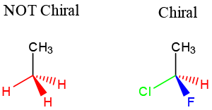
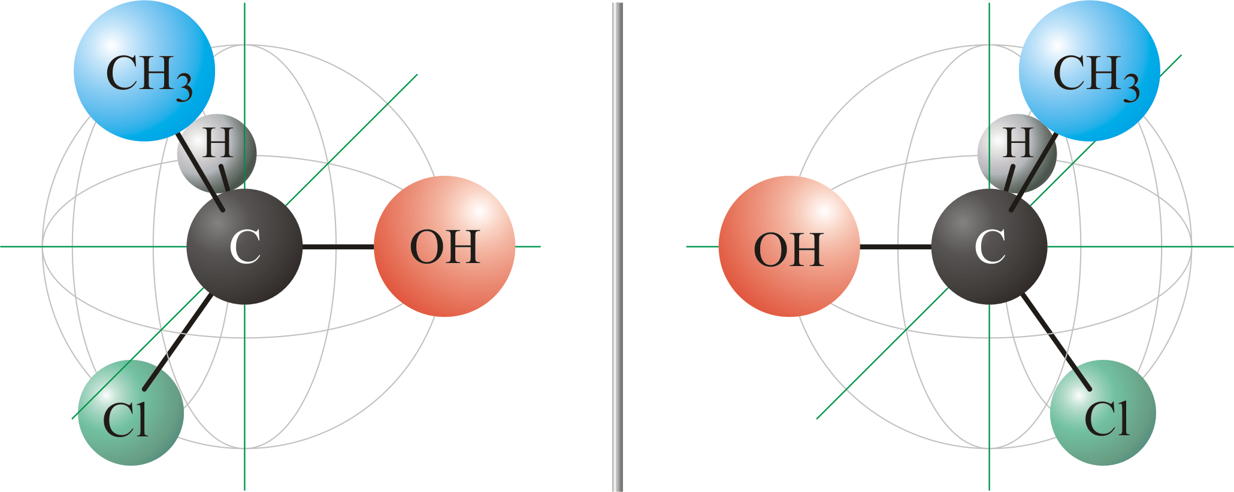
Any carbon atom with four different atoms or groups attached to it, is asymmetric or chiral.

Slide 24
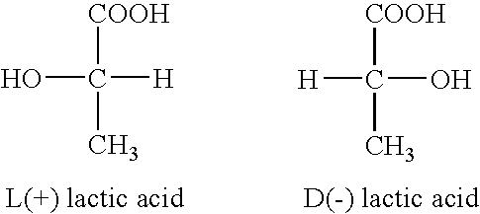
A molecule containing on or more assymetric carbon atom is usually-although not always- also assymetric.
The central carbon in Lactic acid assymetric since it is bonded to four different atoms or groups.

Slide 25
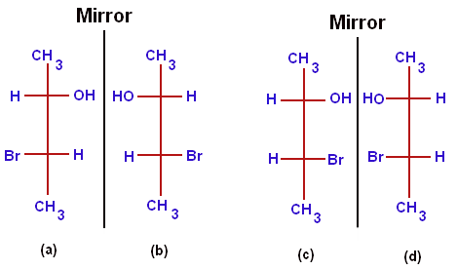
The two molecules which are miror images each other are thus isomers, called enantiomers.
Stereoisomers that are not mirror images of each other called diasteromers.
a is the mirror image of b, and C is the mirror image of d. Thus, four isomers are two pairs of enantiomers
Compare a and c. They are neither super imposable nor are they mirror images they are called as diastereomers. Thus, a and C and b and d are diastereomers. So, stereo isomers, which are not mirror images are diastereomers.

Slide 26
