Slide 1
Secularism and State Policies Week 5 Course Materials
By Asst. Prof. Dr. Selman Yılmaz

Slide 2
Assertive Secularism
Turkey until late 2000s
France

Slide 3
Passive Secularism
The USA

Slide 4
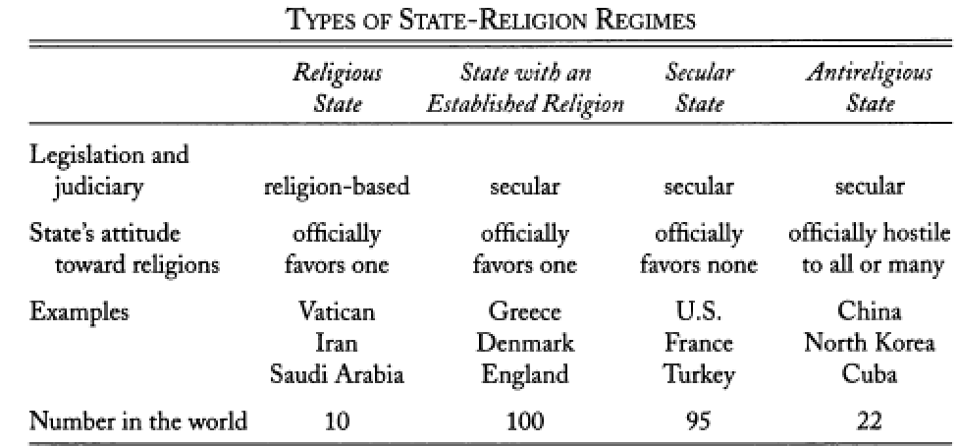
Types of State-Religion Regimes

Slide 5
State-Religion Regimes in Muslim Countries

Slide 6
State Policies Toward Religion in Schools as Late 2000s

Slide 7
Review
Any further comments and questions?

Slide 8
References
Kuru, Ahmet T (2009). Secularism and State Policies Toward Religion: The United States, France and Turkey. New York: Cambridge University Press.
Yılmaz, Selman (2013). State, Politics, and Religion: Effects of Political and Social Change on the Relationship between State and Religion in Turkey, 2002-2012. Dissertation in Sociology. University of Pittsburgh. Pittsburgh.

