Slide 1
Jamestown, plymouth, the pilgrim fathers and the puritans
AKE 117: American History
Dr. Gamze Katı Gümüş

Slide 2
Native philosophy
Landownership: Land was not owned, but it was inherited from the ancestors to be used collectively, and it needed to be protected for future generations.
Warfare: War was not meant for the complete destruction of the enemy.

Slide 3
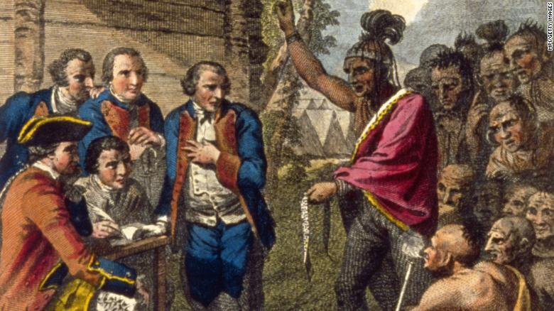
What happened?
Wars
Epidemics
Forcefully relocated
Some academics estimate that approximately 20 million people may have died in the years following the European invasion – up to 95% of the population of the Americas.*
Notes:
https://www.pbs.org/gunsgermssteel/variables/smallpox.html
Picture: Pontiac, an Ottawa Indian, confronts Colonel Henry Bouquet, a leader of the British forces, who had authorized his officers in the 1700s to spread smallpox amongst Native Americans by infecting blankets. From https://edition.cnn.com/2020/04/14/us/native-americans-coronavirus-blake/index.html

Slide 4
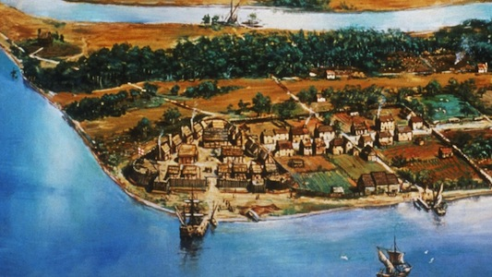
JAMESTOWN & The Virginia company

Slide 5
Jamestown (1606-1624)
The Virginia Company sent three ships, which held 144 men:
the Susan Constant
the Godspeed
the Discovery
In May 1607, 104 survivors disembarked on a spot close to swamps and dirty water. However, this spot was safe from attacks.

Slide 6
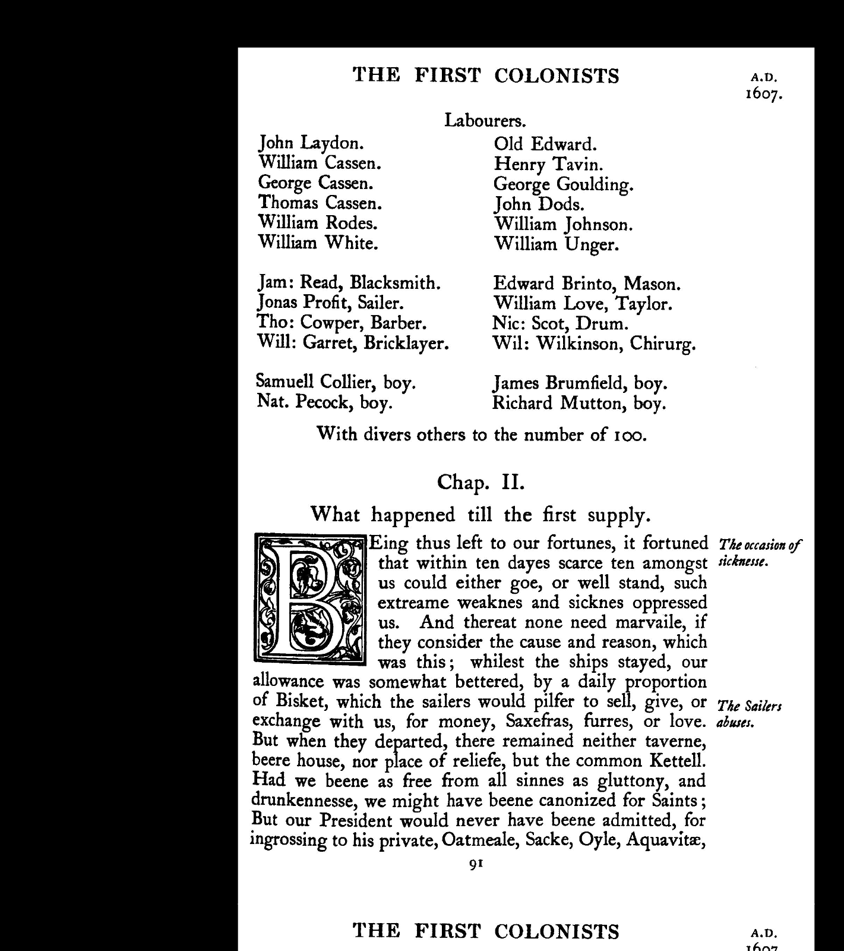

Slide 7
Sickness strikes
Swamps
Typhoid
Dysentery
Lack of basic hygiene
Contaminated water supply
Malnutrition

Slide 8
Economics
In the beginning:
Easily mined minerals
A passage to the Pacific
Native labor force
Then:
More settlers
Production of grapes, sugar, tobacco, cotton and dye woods to be sold in England

Slide 9
1609
The company began selling public shares (previously it was financed by contributions of its contibutors and friends)
People could buy shares, if they pledged personal service in the colony as a settler. How many shares the settler would receive depended on his social standing and skills.

Slide 10
June 1609
More settlers arrived—without leaders, for the vessel that carried the appointed officers was wrecked.
In May 1610, the officers arrived only to find 60 out of 400 settlers alive.
Jamestown was in ruins, there were neither agricultural goods nor domestic animals, and settlers had resorted to cannibalism during the starving times.
During the starving times they also ate various animals (dogs, horses, rats, snakes), and leather from their shoes and belts.

Slide 11
Relations with the natives
In 1609, the Native chief Powhatan realized the aims of the English, and they attacked the settlers, killed their livestock and burned their crops.
Captain John Smith played an important role in the colony. He saved it from more drudgery, and yet he thought the Natives should be turned to slaves, and fought with them for food.

Slide 12
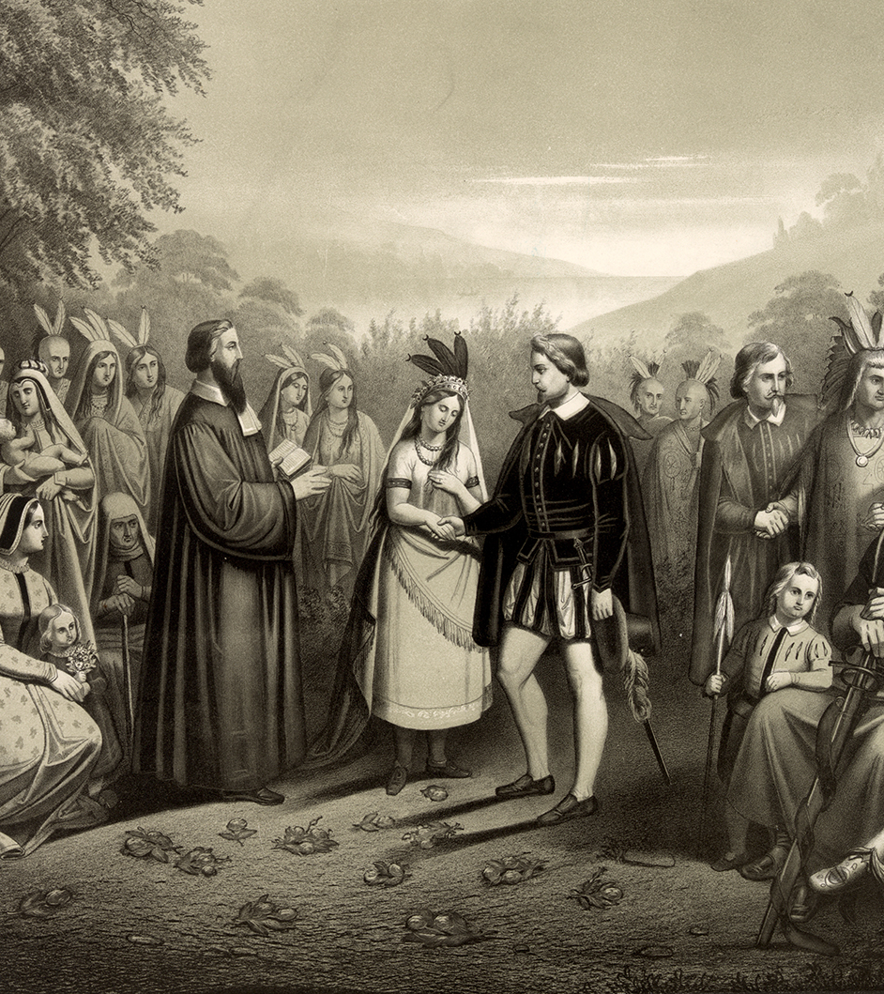
Pocahontas
Colonists captured Powhatan’s favorite daughter Pocahontas in 1613, and she married John Rolfe. This marriage helped the relations between the Natives and the colonists.
She was baptized as Rebecca, and upon her return from her voyage to England, she fell ill and died in 1617.

Slide 13
Lord De la warr
The new governor restored discipline, created a sound agriculture, and established profitable relations with the Natives.
Lawes Divine, Morall and Martiall (1612): Settlers had to perform service, or otherwise they were subjected to severe penalties.
This harsh social discipline led to the shipment of goods—furs, timber, sassafras, iron, and tobacco—to England.
… and still this was not enough to flourish the colony and improve the financial situation of the company.

Slide 14
1618- Sir edwin sandys
Sir Edwin Sandys became the new company treasurer of the colony.
The Virginia Headright System granted sub-patents to land:
50 acres of land to each who paid for his/her own way
50 acres more for each additional person they brought along

Slide 15
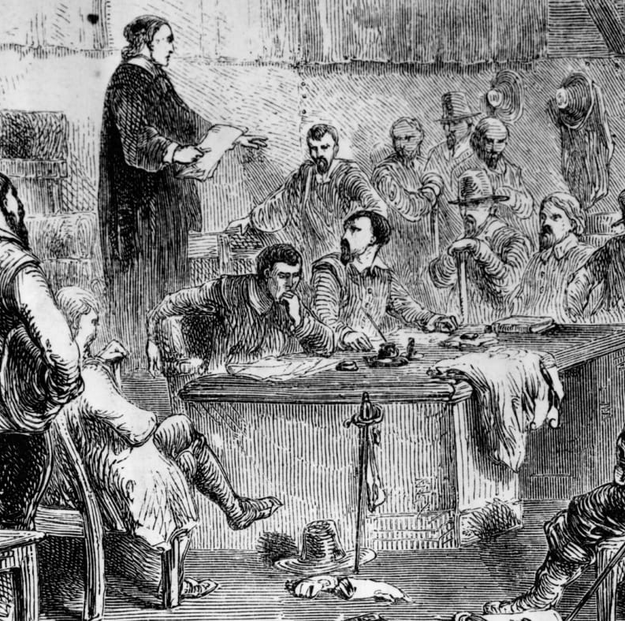
Governance
The Lawes of 1612 were replaced by a system of civil courts operating under English common law.
An assembly was convened in the colony, the representatives of which were elected by inhabitants.
It consisted of a governor, his council, and the representatives of four projected urban communities.
Notes:
Drawing from https://www.history.com/.image/c_limit%2Ccs_srgb%2Cfl_progressive%2Cq_auto:good%2Cw_1400/MTY2MDEwMjAxMjA2NDMzNzM5/jamestown-house-of-burgesses-gettyimages-51086230.jpg

Slide 16
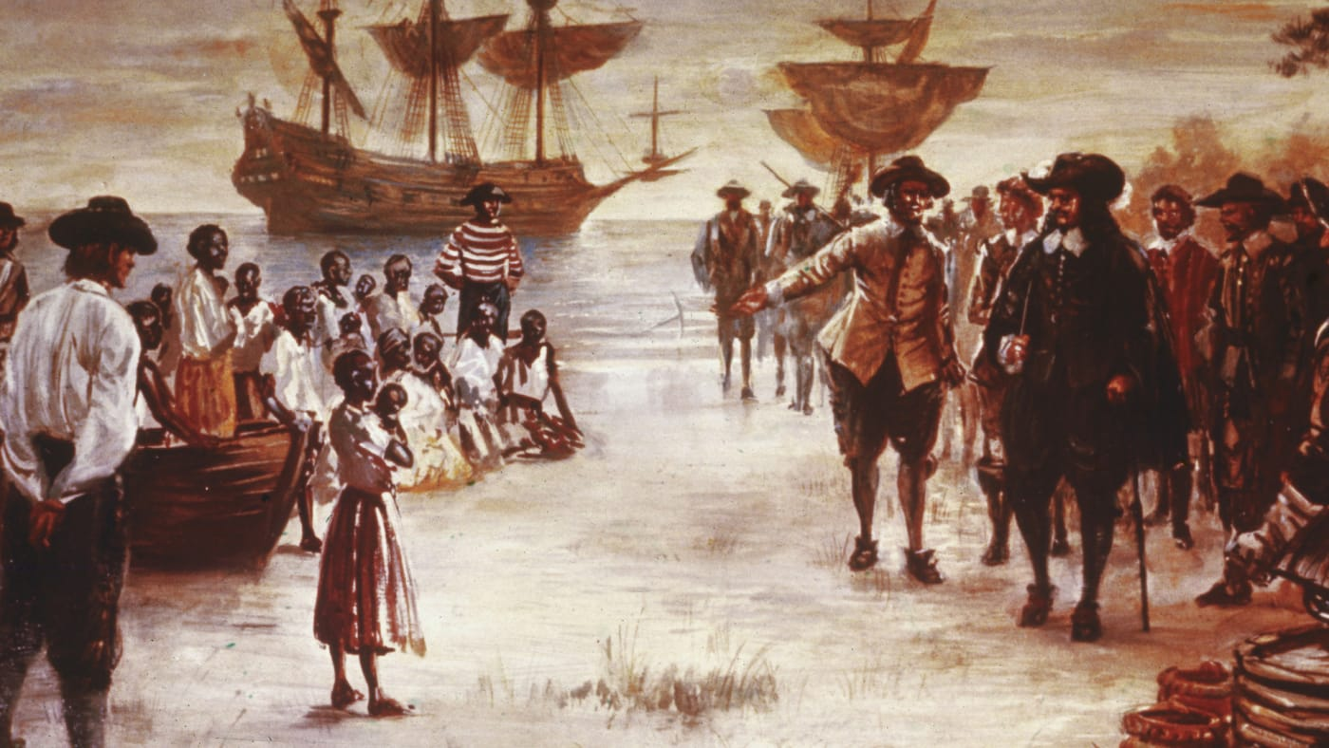
1619
A Dutch man-of-war brought first captive Africans to the colony as indentured servants, and African slave labor became the social and economic foundation of the colonies.

Slide 17
1622
The Natives killed at least 347 settlers.
As the settlers sought revenge, they neglected to plant their crops, which resulted in a near famine and sickness in the winter of 1622-23.
In 1624, only 1,275 out of 8,500 settlers were alive.
The company went bankrupt, and the Crown took over direct control of the colony.

Slide 18
The Colony suffered from a constant Lack of…
Food
Laborers

Slide 19
The gentry was not eager to work as mere laborers, therefore the colony trusted on
African slavery
Native slavery
Involuntary servitude (4 years for adults, 5-7 years for minors)
…to do the hard work in colony-building.

Slide 20
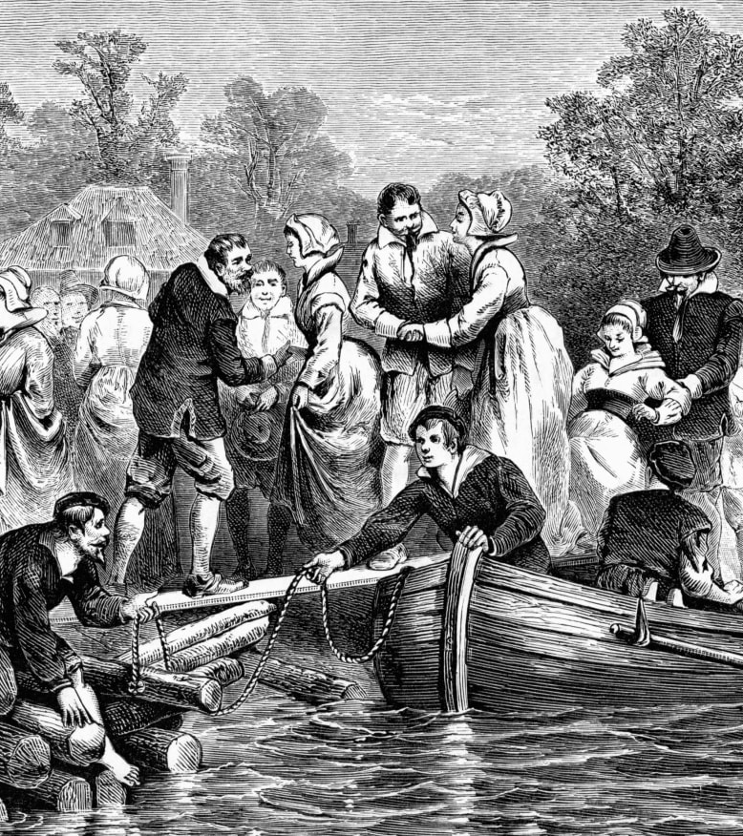
women
Mail-order brides
Indentured servants-who endured physical labor in the fields and sexual abuse.
The presence of women was essential for the sustainment of the colonies. England thought women would prevent men from abandoning the colony.*
Notes:
https://www.history.com/news/jamestown-colony-daily-life

Slide 21
MAIL-ORDER BRIDES
The Virginia Company offered attractive incentives for would-be wives:
free transportation
a plot of land
a dowry of clothing and furnishings
They also allowed the women to choose their husbands after entertaining the eager suitors*
Notes:
https://www.history.com/news/jamestown-colony-settlement-facts

Slide 22
1640
In 1640, there were 150 black slaves.
1704
In 1704, theire numbers increased to 10,000.

Slide 23
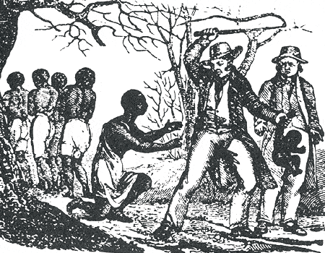
Chattel slavery
When white servitude became less profitable, laws specified that blacks would serve for life. But why?
Offspring automatically became slaves—maternal lineage
Conversion to Christianity did not mean freedom
The severity of punishment was up to the master
Racially mixed marriages were forbidden
Thus, African slaves became to be defined as property (chattel) rather than human beings.
Notes:
Image from https://www.ocf.berkeley.edu/~arihuang/academic/abg/slavery/history.html

Slide 24
Pilgrim fathers
The Separatists, who considered the Church of England to be corrupted, left the country with hopes of building a church purified of rituals and corruptions.
First, they went to Netherlands in 1609.
Then, they immigrated to Virginia in 1620.

Slide 25
They arrived at Provincetown in 1620, after a perilous voyage on Mayflower.
Of the 102 passengers on the Mayflower, there were 50 men, 19 women and 33 young adults and children. Just 41 were true Pilgrims, religious separatists.
The others were considered common folk and included merchants, craftsmen, indentured servants and orphaned children—the Pilgrims called them “strangers.”*
Notes:
From https://www.history.com/topics/colonial-america/mayflower-compact

Slide 26
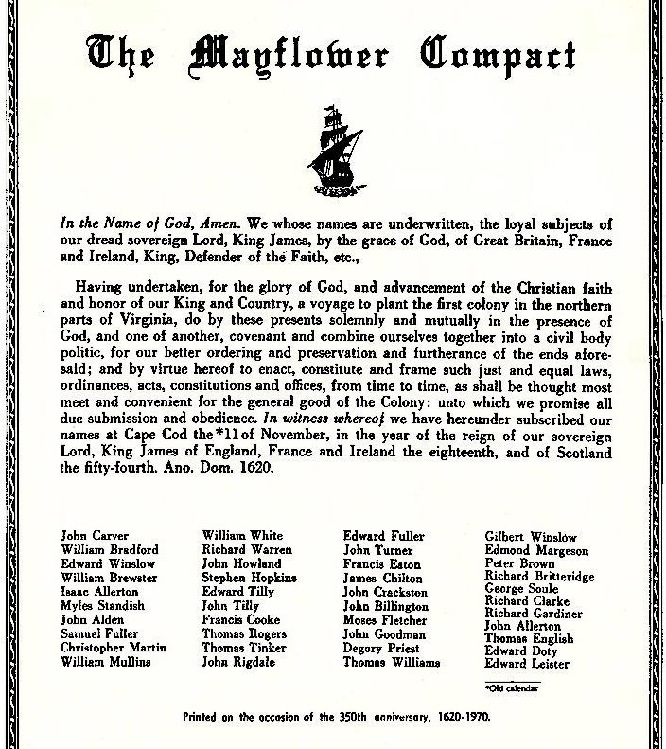
When the Mayflower landed in Massachusetts instead of Virginia, discord began before the colonists even left the ship. The strangers argued the Virginia Company contract was void. They felt since the Mayflower had landed outside of Virginia Company territory, they were no longer bound to the company’s charter.
The Mayflower Compact is important because it was the first social contract to establish self-government in the New World.

Slide 27
William Bradford was elected governor for thirty times. He wrote Of Plymouth Plantation.
Though started out as a religious community, the colony was already showing signs of corruption when it was absorbed into the Puritan-dominated Massachusetts Bay Colony.
Pilgrims were known as forefathers or first-comers when they came to Virginia. The term “Pilgrim” did not appear until 1800s.

Slide 28
tHE ONLY WAY TO LIVE ACCORDING TO THE BIBLE IS
Pilgrims
Puritans
To leave the Church of England
To reform the Church of England

Slide 29
The Church of England
The British Monarch is the supreme governor of the Church.
The Church claims to be both Catholic and Reformed.
Since this Reformed Church retained many of the Catholic elements such as the Catholic order system (bishops, priests, deacons) and rituals, some people believed it was not reformed enough.

Slide 30
PURITANS
1628
In 1628, a group of religious dissenters formed the New England Company.
Within weeks, more than 200 Puritan settlers sailed to the New World.
In 1629, they obtained a Crown charter that created the Massachusetts Bay Company.

Slide 31
According to the charter
The colonists could trade and settle within the lands already given to the New England Company.
But most importantly, the company could “govern and rule all of His Majesty’s subjects that reside within the limis of the plantation.”

Slide 32
John Winthrop was elected governor in 1629.
The Puritan leaders were self-confident, determined and authoritative.
They had a strict religious commitment.
They desired to transfrom the Church of England as well as the society.
”By persuasion if possible but by force if necessary”*
Notes:
From The Great Republic p. 40

Slide 33
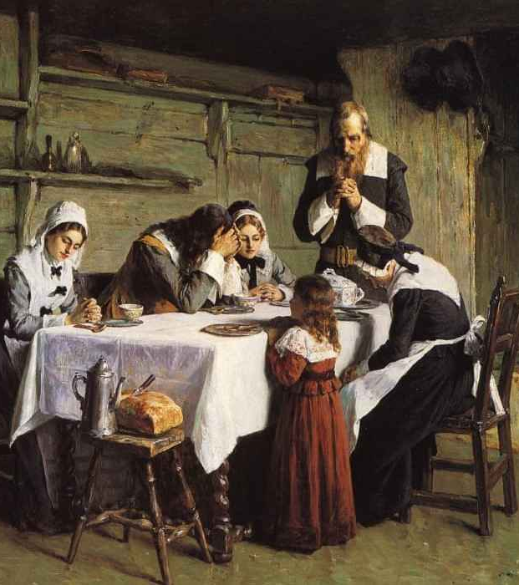
The Puritan belief focused on the family. Unlike other European migrations, which were mainly composed of young unattached men, Puritan immigration was a migration of families.

Slide 34
The Great migration
1630
In 1630, the Puritan migration began with more than 1,000 settlers within the year.
1630–1643
During the Puritan Exodus (1630-43) more than 20,000 settlers migrated to the New England.

Slide 35
Economics, religion, and power
After the colonists got the approval of the General Assembly to establish towns, they received the legal right to create a limited jurisdiction, and to send representatives to the General Court.
The land of a town was divided among the heads of the households in proportion to their wealth and status.
As founding members of their local church, they dominated the religious realm.
These men also had a voting membership in the town’s political assembly, which led them to regulate the everyday affairs of the community.

Slide 36
The Initial general court
The governor
The Council of Magistrates
Freemen (voters)

Slide 37
In 1631, a new rule was introduced which said that only church members could vote. Therefore, the colonial government could continue to represent primarily those loyal to the Puritan ideas.
The founders’ rights were not automatically granted to the newcomers, but only to their direct heirs.

Slide 38
ACHIEVEMENTS
Cleared wilderness
Organized towns
Organized courts
Created a general government
Expanded the coastal and transatlantic commerce

Slide 39
CHRONOLOGY
1607
Jamestown is established
1619
First Africans arrive in Virginia
1620
Mayflower Compact is signed
1620
Plymouth Colony is established
1625–1649
Reign of Charles I
1626
Dutch settle Manhattan
1630–1643
Puritan emigration

