Slide 1
SOLUTIONS OF THE NUMERICAL INTEGRATION
METHOD EXAMPLES IN PYTHON

Slide 4
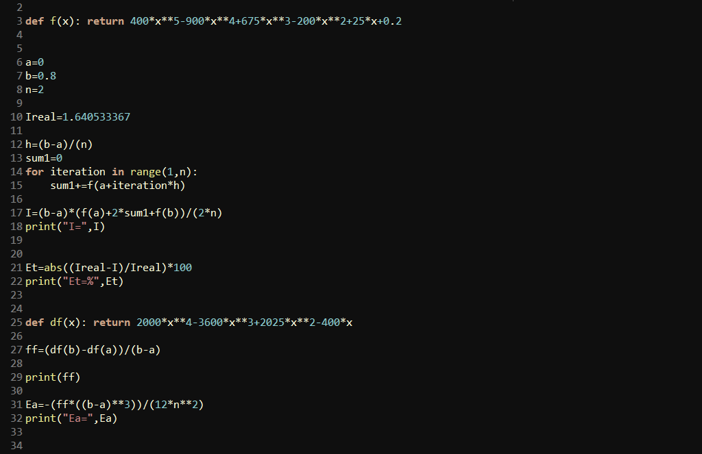

Slide 6
