Slide 1
EEE322 COMMUNICATION THEORY – I
ANKARA UNIVERSITY
FACULTY OF ENGINEERING
ELECTRICAL AND ELECTRONICS ENGINEERING DEPARTMENT

Slide 2
EEE322 COMMUNICATION THEORY - I
LECTURE 3
PERIODIC SIGNALS AND AVERAGE POWER,
FOURIER SERIES

Slide 3
Periodic Signals and Average Power
Sinusoids and phasors are members of the general class of periodic signals.
$$v\left(t±mT_{0}\right)=v(t)$$
$T_{0}$is the fundamental signal period, $m$ is any integer.

Slide 4
Periodic Signals and Average Power
Given any time function v(t), its average value over all time is defined as
$$\left\langle v(t)\right\rangle =\lim_{T→∞}{\frac{1}{T}\int_{−T/2}^{T/2}{v\left(t\right)dt}}$$

Slide 5
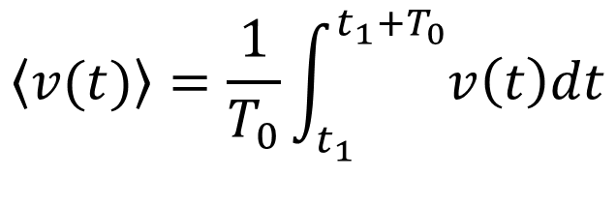
Periodic Signals and Average Power
In the case of a periodic signal, the average over any interval of
duration $T_{0}$ is defined as
$$\left\langle v(t)\right\rangle =\frac{1}{T_{0}}{\int_{t_{1}}^{t_{1}+T_{0}}{v\left(t\right)dt}}$$

Slide 6
Periodic Signals and Average Power
The average power associated with an arbitrary periodic signal is defined as
$$P=\left\langle {\left|v(t)\right|}^{2}\right\rangle =\frac{1}{T_{0}}{\int_{t_{1}}^{t_{1}+T_{0}}{{\left|v(t)\right|}^{2}dt}}$$

Slide 7
Periodic Signals and Average Power
As a specific example take the sinusoid
$$v\left(t\right)=A cos(w_{0}t+∅)$$
which has
$\left\langle v(t)\right\rangle$ $=$ 0 P $=$ $\frac{A^{2}}{2}$

Slide 8
Fourier Series
Let v(t) be a power signal with period $T_{0}=1/f_{0}$. Its exponential Fourier series expansion is
$$v\left(t\right)=\sum_{n=−∞}^{∞}{c_{n}e^{j2πnf_{0}t}} n=0, 1, 2,…$$

Slide 9
Fourier Series
The series coefficients are related to v(t) by
$c_{n}=\frac{1}{T_{0}}\int_{t_{1}}^{t_{1}+T_{0}}{v(t)}$ $e^{−j2πnf_{0}t}dt$
so $c_{n}$ equals the average of the product ${v(t)e}^{−j2πnf_{0}t}$

Slide 10
References
Communication Systems, An Introduction to Signal and Noise in Electrical Communication, 5th edition, A.B. Carlson, P.B. Crilly, J.C. Rutledge, Mc Graw Hill.
An Introduction to Analog and Digital Communications, 2nd edition, S. Haykin, M. Moher, Wiley.

