Slide 1
Estrus Synchronisation
Estrus=Heat
Syn=Together
Chronos=Time
Bring a group of animals into oestrus at predetermined time with exogenous hormones or conventional strategies
Hormonal
Conventional
Prostoglandins (PG)
Progesterone
GnRH
Melatonin
Photoperiod
Flusing
Male effect

Slide 2
How conventional syncronisation works ?
Photoperiod
Using light-dark regime to increase the melatonin production
Male effect
Olfactoric effect by male pheromones
Increasing energy uptake with feeding in result with increased
ovarian function
Flushing

Slide 3
Photoperiod
Dark days breeders
8h of light-16h dark
Increase melatonin production=Sexual Activity

Slide 4
Flushing
Flusing increase the BCS from 2 to 3 for 6-8 weeks
Increase the protein and carbohydrate intake
%35 of glucose requirements from amino acids
Energy intake-in response to increased ovarian function
500 g/head/day of concentrate diet of 16% crude protein and 2600 Kcal / kg energy for 2-8 weeks pre-mating.

Slide 6
Male effect
Sudden exposure to ram
The duration of exposure (6 days for goats, 15 days for sheep)
Isolation Period (At least 3 weeks)
Distance of isolation (100-500 m)

Slide 7
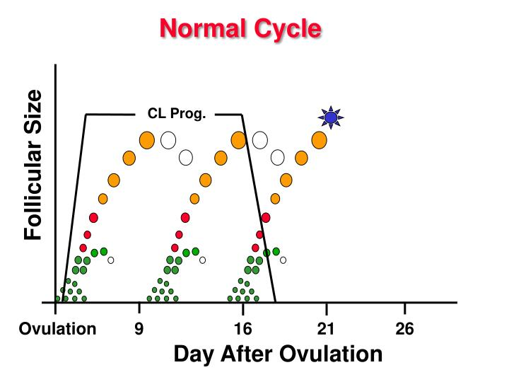
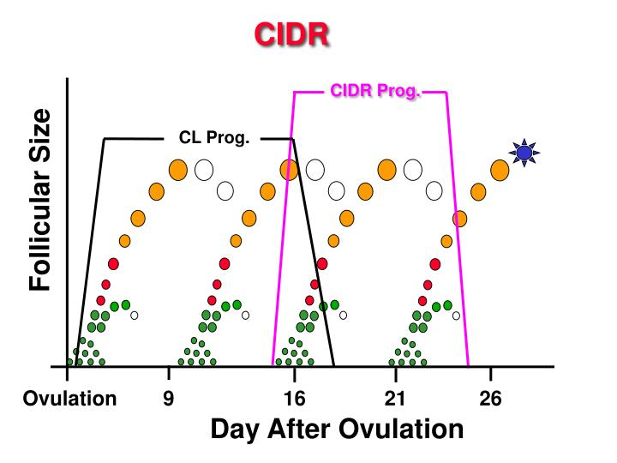
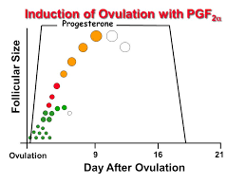
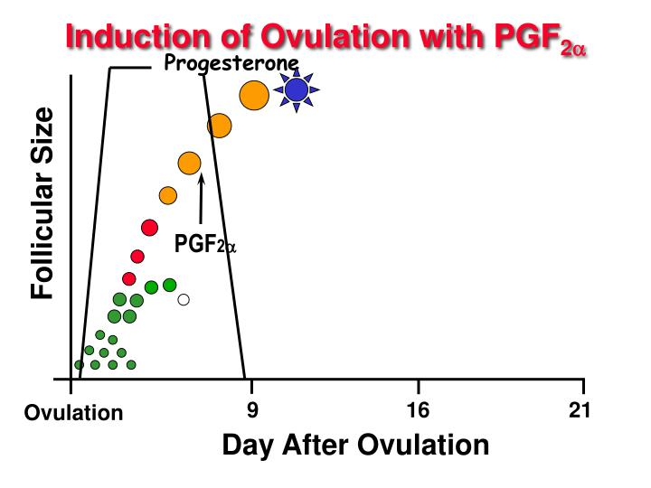
How hormonal syncronisation works ?
Synchronisation products control the esters cycle by influencing structures that are present on the ovary
Prolonging luteal phase with Progesterone
Shortening the life span of CL with PGF2a

