Slide 1
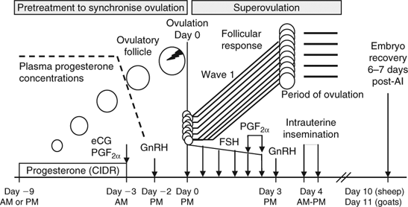
Superovulation

Slide 2
Reminder

Slide 3
Signs

Slide 4
Factors ?

