Slide 1
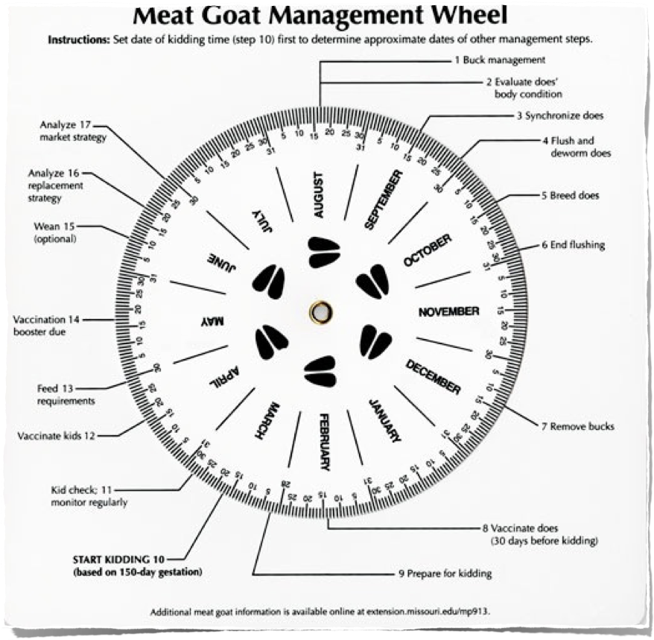
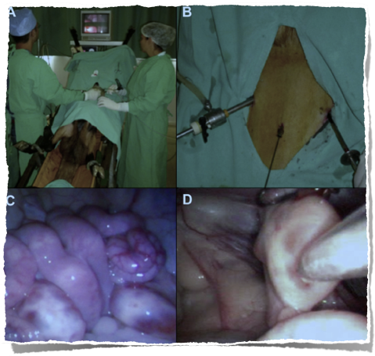
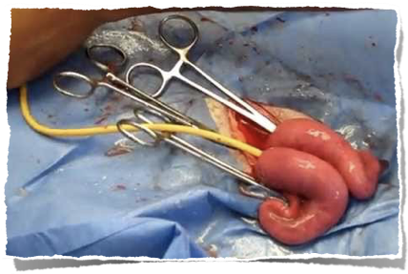
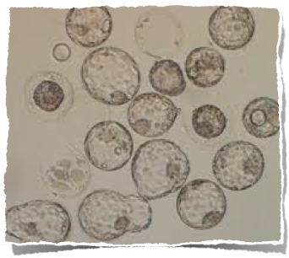
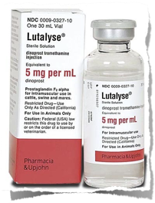
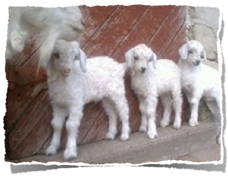
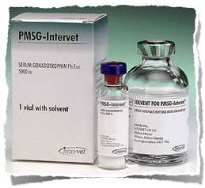
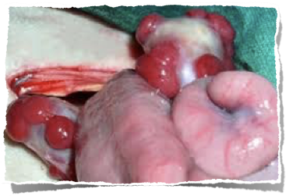
Which are the 5 steps for ET ?
What ET is?
Management of donor and recipient
Estrus synch. of recipient and Superovulation of donors
Breeding natural or AI
Embryo collection and evaluation
Transfer of embryo
Embryo transfer is a way to produce an animal of certain genetic qualities faster.
5
Includes basic steps;
http://www.google.com.tr/imgres?imgurl=http://1.bp.blogspot.com/-bnzeFlLc2pM/Ti8_mFnwLzI/AAAAAAAAADE/eP4VUJ4WFeo/s640/Fig.2.JPG&imgrefurl=http://videocirurgiavet.blogspot.com/p/videocirurgia-em-animais-de-ompanhia.html&h=349&w=584&tbnid=Wef3TYMx3JbwDM:&zoom=1&docid=hc27gDd3dK18lM&itg=1&ei=C5LtVJGKEefEygP80YDAAg&tbm=isch&client=safari&ved=0CEkQMyglMCU
http://www.vhhms.com/index.php/LAPAROSCOPIC_AI_and_ET_in_SHEEP,_GOATS_and_DEER;http://extension.missouri.edu/p/MP913

