Slide 1
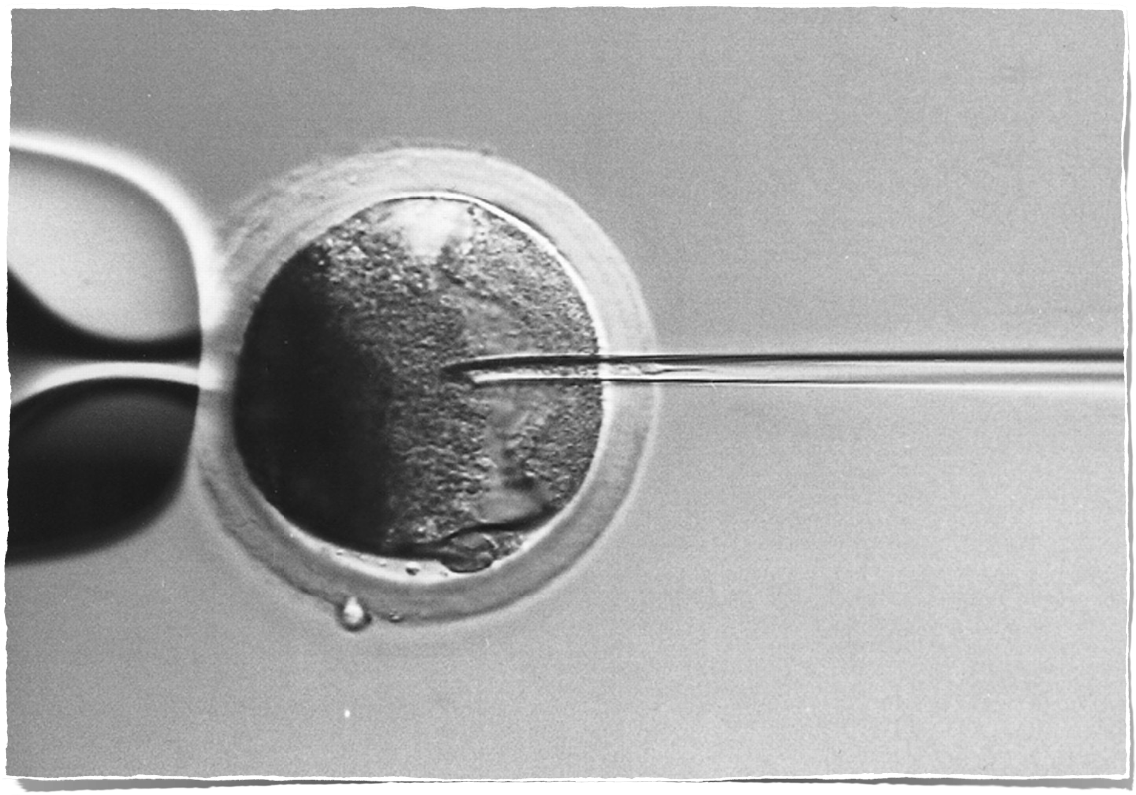
ICSI
genetically valuable
animals
genetically valuable
animals

Slide 2
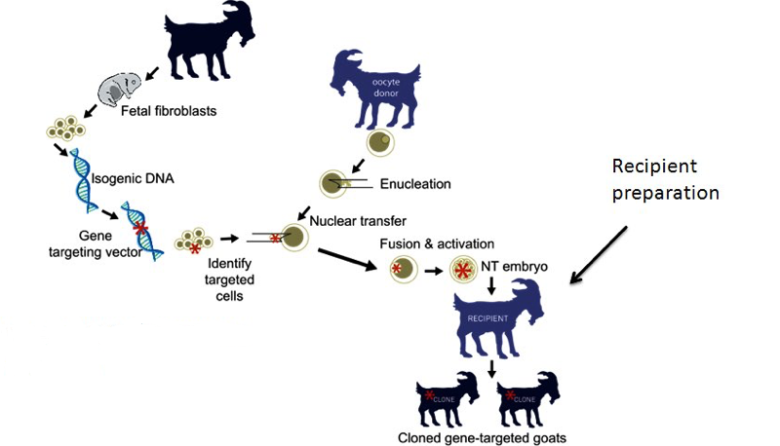
Transgenesis
Genetically Engineered (GE) Animals
The insertion of foreign DNA into a genome
- called TRANSGENE -
in which transferred to living organism
http://chem.usu.edu/leochen/htm/research/animal-cancer-model-development-molecular-imaging

Slide 3
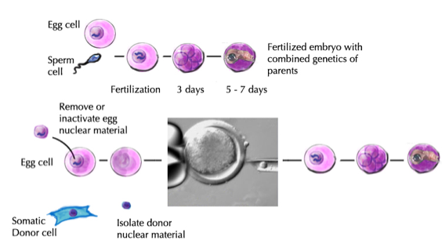
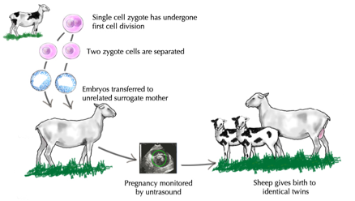
Cloning
A genetically identical copy of a cell or whole organism
Somatic Cell
Nuclear Transfer
Embryo splitting

