Slide 1
Polymer Technology
Chapter 7
Solid-State Properties

Slide 2
Solid-State Properties
Most of the commercial polymers, especially polyolefins such as polyethylene and polypropylene, are highly crystalline materials.
Single crystals of some commercial plastics like polyethylene can be synthesized under laboratory conditions, but no bulk plastics are completely crystalline.
The commerial macromolecules can be semicrystalline.
In the case of semicrystalline macromolecules, regular crystalline units are linked by unoriented random-conformation chains, constituting the amorphous regions of the plastics.
Certain plastics may have very low crystallinity characterized by poorly defined crystalline microstructure in an amorphous matrix.
An important example for a commercial polymer is poly(vinyl chloride)cwith low crystallinity.

Slide 3
Solid-State Properties The Amorphous State
Different from the semi-crystalline plastics, completely amorphous plastics such as atactic polystyrene exist as long, randomly coiled, interpenetrating chains that are capable of forming stable, flow-restricting entanglements at sufficiently high molecular weight.
In the molten state, the thermal energy is sufficiently high for long segments of each plastic chain to move.
As the the plastic in the molten state is cooled, a temperature is reached at which all long-range segmental motions cease.
The glass-transition temperature is the characteristic temperature, which varies widely with polymer structure.
At temperatures below the glass-transition temperature, the only molecular motions that can occur are short-range motions of several close chain segments and motions of substituent groups, which is known as the secondary relaxations.

Slide 4
Solid-State Properties The Amorphous State Chain Entanglements and Reptation
A good analogy for the plastic materials can be made with a bowl of spaghetti.
If the individual strands of spaghetti are long similar to the chains of the polymer, it will be very difficult to separate one strand from the others with a fork; on the other hand, if the strands are short, they will be separated easily.
The entanglement structure has significant importance in relation to visco-elastic property, melt viscosity, and mechanical properties such as stress relaxation, creep, and craze formation.

Slide 5
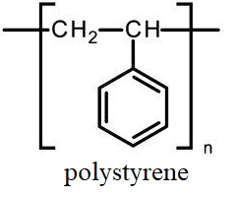
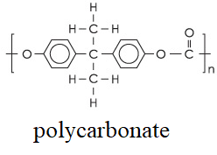
Solid-State Properties The Amorphous State Chain Entanglements and Reptation
Critical Molecular Weight: The minimum polymer chain length for the formation of stable entanglements depends on the flexibility of the specified polymer chain.
Relatively flexible polymer chains, like polystyrene, have a high critical molecular weight; at the same time, more rigid-chain polymers, like polycarbonate, have a lower critical molecular weight.
The molecular weight of most commercial polymers is significantly greater than the critical molecular weight in order to attain maximum thermal and mechanical properties.
As an example, the molecular weight of commercial polystyrene are in the range of 100000 to 400000.
The critical molecular weight for polystyrene is only 31200.

Slide 6
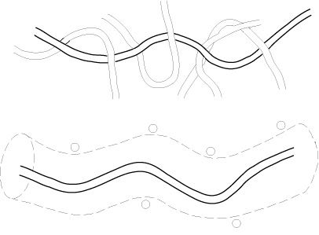
Solid-State Properties The Amorphous State Chain Entanglements and Reptation
Reptation: In the molten state, individual polymer chains can move by local Brownian motion restricted by the topological constraint of neighboring chains of the same polymer.
The motion of the polymer chains can be visualized as snakelike motion, known as reptation, of the chain within a virtual tube that is defined by the locus of its entanglements with neighboring molecules of the plastics.
The theory of snakelike motion or reptation has been largely successful in developing a qualitative and quantitative molecular theory for the dynamics and viscoelastic properties of entangled polymers
Reptation model of a polymer chain

Slide 7
Solid-State Properties The Amorphous State The Glass Transition
The temperature, which illustrates the transition from the amorphous solid state to the molten state, is called the glass-transition temperature and illustrated with Tg.
Different phenomenological models have been applied to the platics to provide an understanding of the glass transition.
One of the models marks an isoviscous state.
At the isoviscous state, as a polymer is cooled from its molten state, viscosity tremends up rapidly to a maximum value, almost 10¹² Pa-s at Tg, for all glassy materials.
The glass-transition temperature of amorphous plasticd can vary widely depending on the chemical structure of the polymer chain.
Mostly, polymers with flexible backbones and small substituent groups have low Tg and polymers with rigid backbones have high Tg.

Slide 8
Solid-State Properties The Amorphous State Secondary-Relaxation Processes
The secondary-relaxation process, which shown below the glass transition temperature, is a small-scale molecular motion, occuring in the amorphous glassy state.
The secondary-relaxation processes may involve limited motions of the main-chain or rotations, vibrations, or flips of substituent groups.
An example of a main-chain secondary relaxation is the Schatzki crankshaft rotation model, at which five contiguous bonds join in rotation around the main chain consisting of C–C bonds.
Another example for main-chain secondary relaxations is the rotation of aromatic rings in the backbone of some high-temperature polymers, like poly-sulfone and polycarbonate.
In addition to the given main-chain secondary-relaxation motions, substituent groups can also rotate at relatively low temperatures in the glassy state.

Slide 9
Solid-State Properties The Crystalline State Ordering of Polymer Chains
Certain plastics cooled from the molten state can organize into regular crystalline structures as shown in the figure below.
This type of crystalline polymers have less perfect organization than crystals of low-molecular-weight compounds or low-molecular-weight polymers crystallized from the solution of the specified plastics.
The repeating units of the crystalline polymer morphology contains crystalline lamellae, which consists of arrays of folded chains.
The thickness of a typical crystallite may vary in the range from 100 to 200 Å, which indicates that only a certain portion of the complete chain repeating units is involved in each fold.

Slide 10
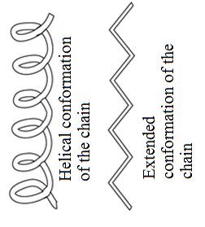
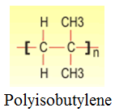
Solid-State Properties The Crystalline State Ordering of Polymer Chains
High thermal energy of the plastics favors a large number of conformations in the molten state.
As the molten form of the plastics is cooled, the lower-energy conformations are favored, and chains are free to organize into lamellar structure as stated before.
Most of the times, the lowest-energy conformation for the plastics is the extended chain conformation as shown in the figure on the right.
Examples for the plastics include polyethylene, syndiotactic vinyl polymers, poly(vinyl alcohol) and nylons.
Polymers with larger substituent groups, like polypropylene, for most isotactic polymers and polyisobutylene, the lowest-energy conformation is a helix of some preferred geometry.

Slide 11
Solid-State Properties The Crystalline State Ordering of Polymer Chains
Plastics crystallized from the molten state of the polymer or from concentrated solution of the polymer, crystallites can organize into larger spherical structures called spherulites.
Each spherulite of the crystalline includes arrays of lamellar crystallites that are typically oriented with the chain axis perpendicular to the radial direction of the spherulite.
No polymer has 100% crystalline structure
The most crystalline polymers such as high-density polyethylene have lattice defect regions among the spherulite, including unordered, amorphous material.
Therefore, semicrystalline polymers may illustrate both the glass transition temperature, corresponding to long-range segmental motions in the amorphous regions of the plastics, and a crystalline-melting temperature, at which the crystallites are destroyed within the macromolecules.

Slide 12
References
Robert O. Ebewele, «POLYMER SCIENCE AND TECHNOLOGY», CRC Press, 2000.
Fried, Joel R., «Polymer science and technology», Prentice Hall, Third edition.

