Slide 1
HATCHING
Water Temperature
Flow Rate
(For 1000 larvae, 3-4 L / min, 5-12 ppm O₂)
Light (darkness)
Salinity
Vitellus quantity
Hatching system (trough or vertical incubator)
I. period
(Fertilization-eyed egg, day 13-22)
II. period
(eyed egg - larvae, day 7-15)
III. Period
(larvae – sac fry, day 15-21)

Slide 2
HATCHING
Eggs are incubated undisturbed until the eyed stage
is reached in vertical flow incubators or hatching jars.
Vertical flow incubators: A single water source flows
(3-4 L/min) up through the eggs, spills over into the tray
below, thus becoming aerated, allowing large numbers of eggs to hatch in a minimal amount of space and water.
Time taken for hatching varies depending on water temperature, taking 100 days at 3.9°C and 21 days at 14.4°C.
Hatching jars, available commercially or constructed from a 40 L drum and PVC pipe, introduce water from the bottom and flow from the top. 50 000 eggs can be incubated inexpensively suspended in a water flow that rolls the eggs, provided that the incubator contains two-thirds of the incubator volume in eggs, and the flow rate lifts the eggs 50 percent of their static depth.
In all the above methods dead eggs are removed regularly to limit fungal infection. Fungal infections can be controlled using formalin (37 percent solution of formaldehyde) in the inflow water at 1:600 dilution for 15 minutes daily, but not within 24 hours of hatching. Upon reaching the eyed stage addling (dropping eggs 40 cm) removes weak and undeveloped eggs.

Slide 3
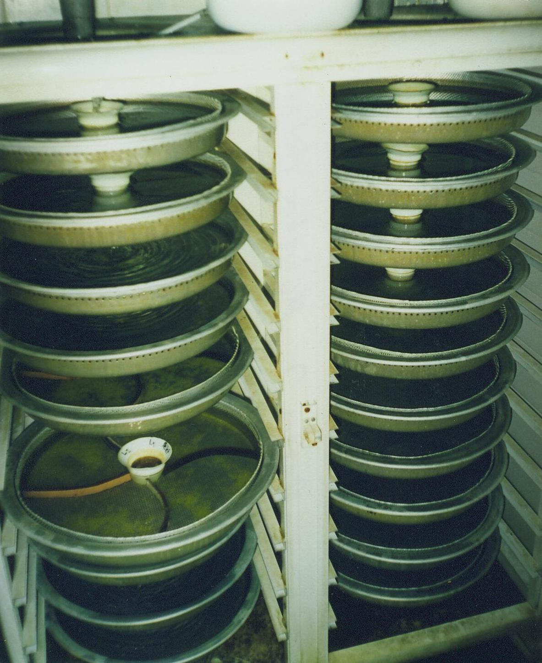
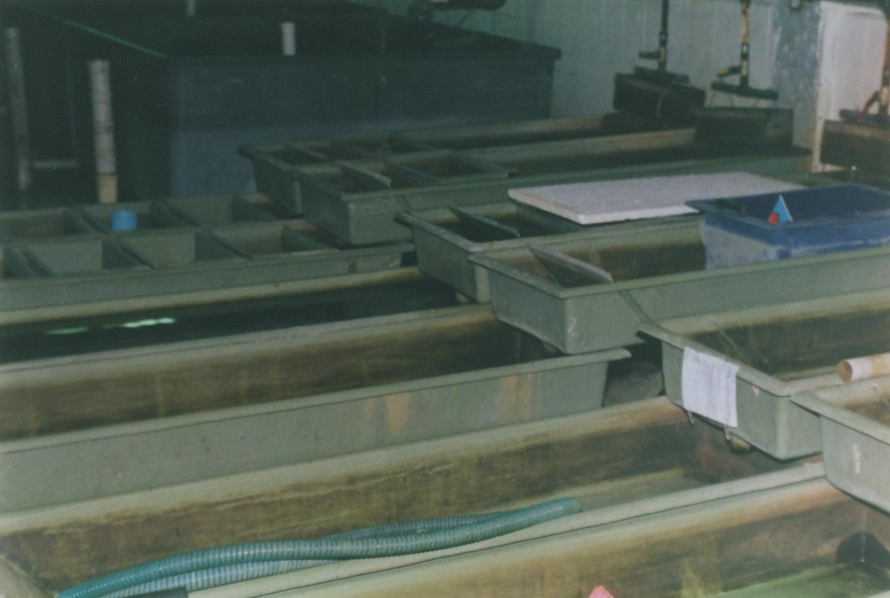
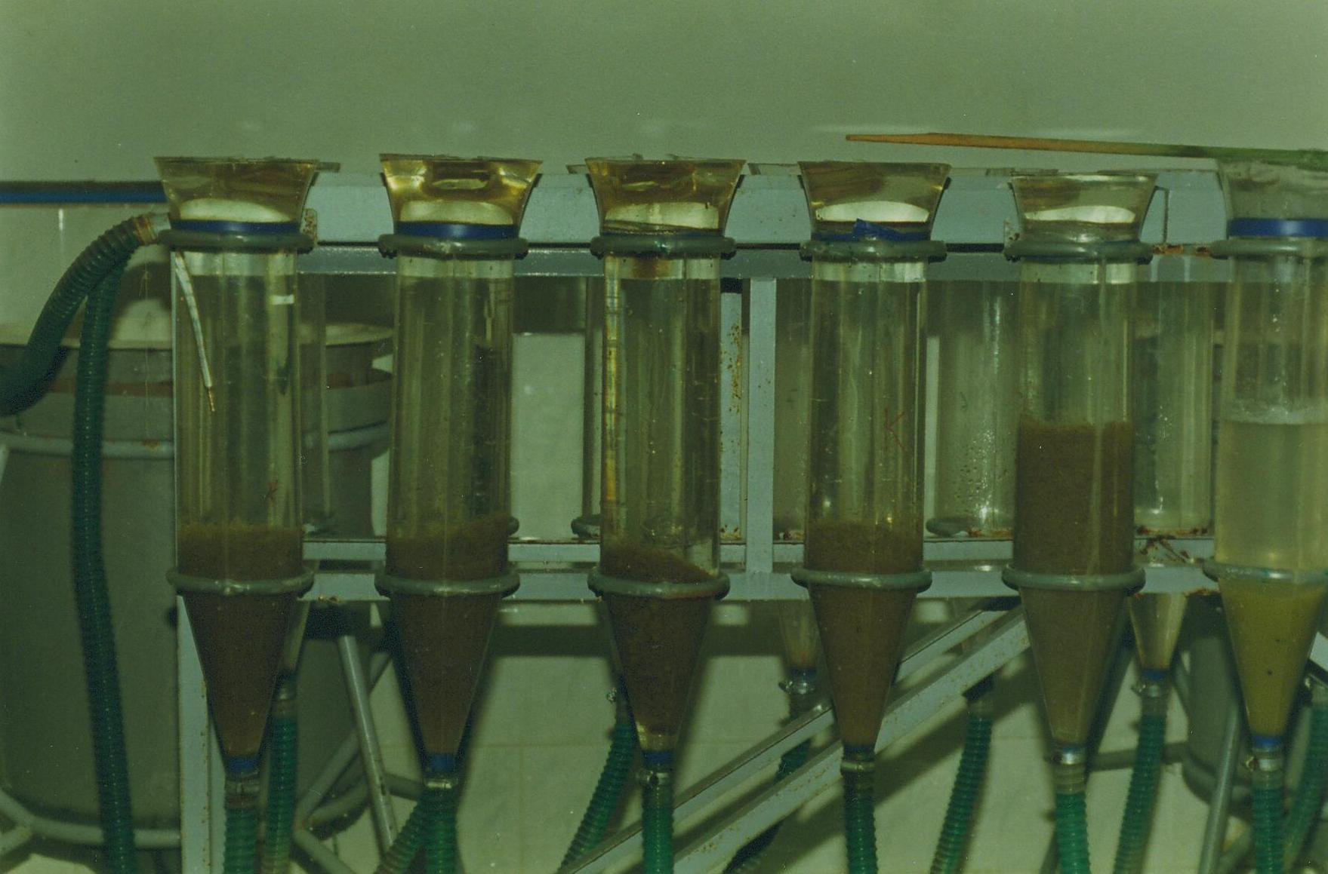
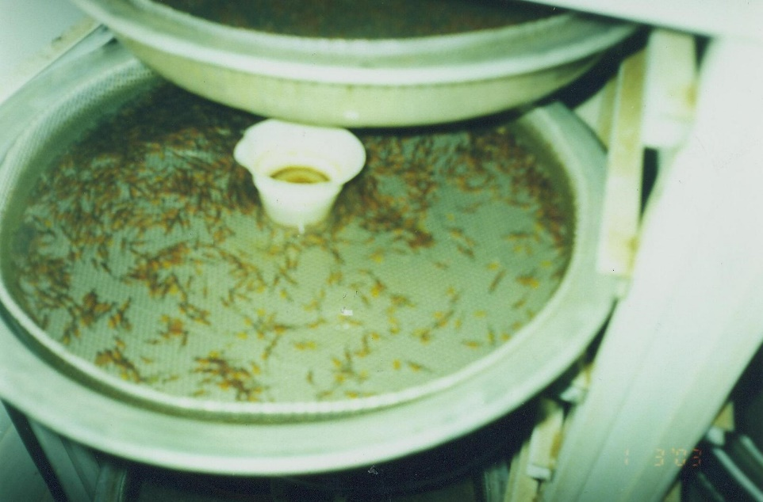

Slide 4
HATCHING
DEGREE DAYS Trout
(Water temp x day)
For trout
10ºC x 30 days = 300 degree days
For carp
20ºC x 3 days = 60 degree days
Temp. (ºC) | Wild (day) | Cultured (day)
3 | 110 | 100
6 | 75 | 61
10 | 45 | 30
12 | 37 | 26
14 | 29 | 21

Slide 5
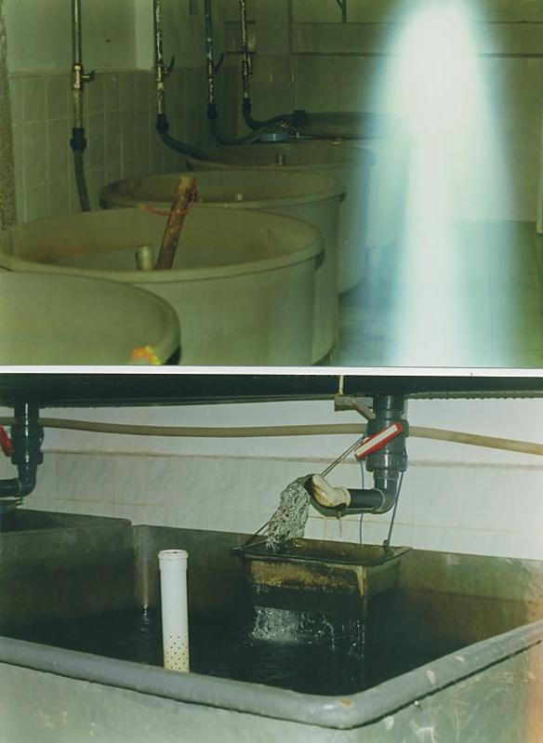
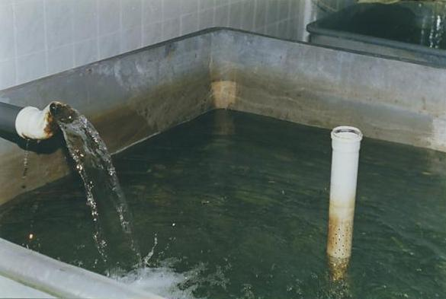

Slide 6
