Slide 1
VETERINARY FORENSIC MEDICINE
DR. EKREM ÇAĞATAY ÇOLAKOĞLU
ANKARA UNİVERSITY VETERINARY FACULTY INTERNAL MEDICINE

Slide 2
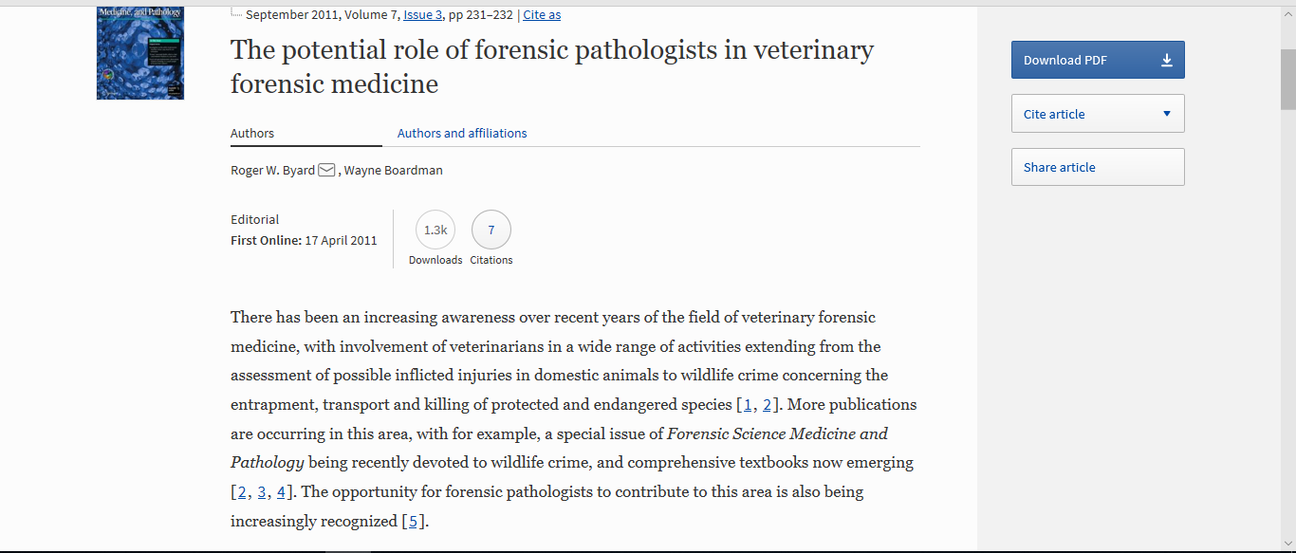

Slide 3
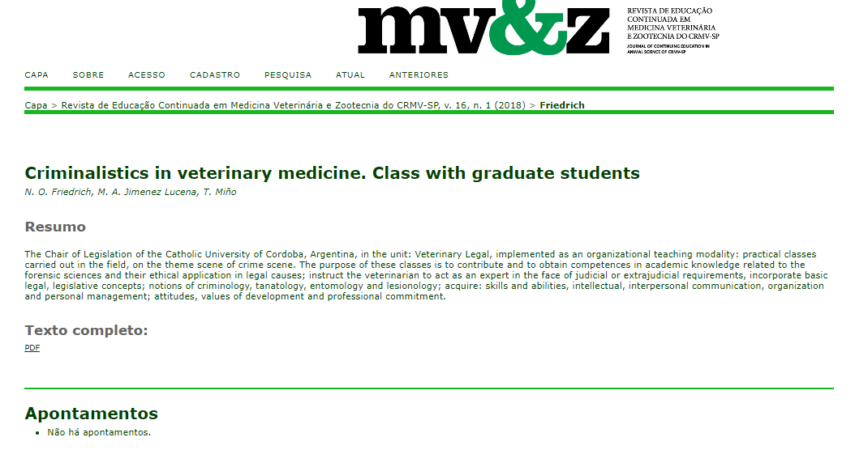

Slide 4
