Slide 1
Yayın Yap ve Yok Ol!
Altuğ Yalçıntaş
Ankara Üniversitesi
altug.yalcintas@politics.ankara.edu.tr

Slide 2
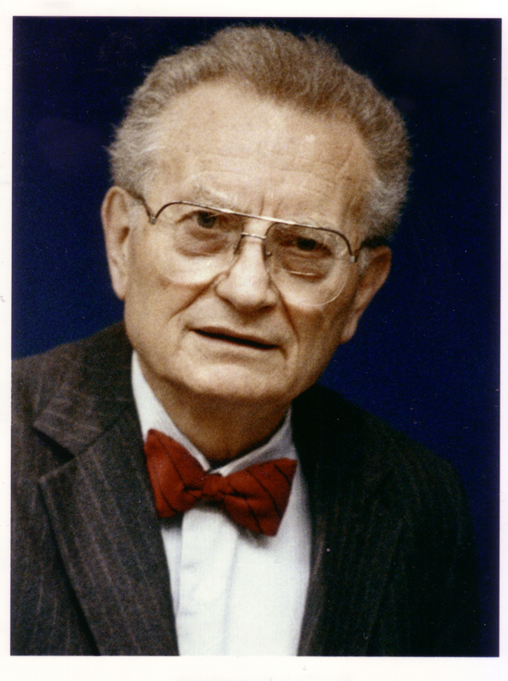
Economics as the queen of social sciences
“Economics is the queen of social sciences”*
* Paul Samuelson 1976 [1948]. Economics.
NY: MacGraw-Hill: 6
Paul Samuelson (MIT)
1970 “Nobel Prize” in Economics (The first American to win the prize)

Slide 3
Author* → Authority
* yazar, müellif, muharrir

Slide 5
A sample from the manuscripts of Karl Marx
Source: International Institute of Social History, Amsterdam

Slide 7
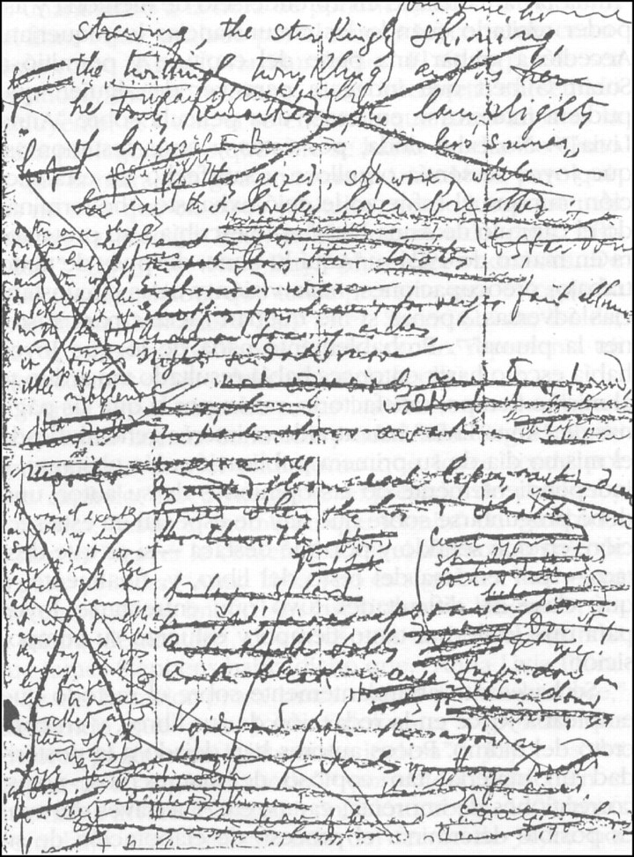
James Joyce, Finnegan Uyanması
Kaynak: http://www.openculture.com/2018/06/james-joyces-crayon-covered-manuscript-pages-ulysses-finnegans-wake.html [Erişim tarihi: Ekim 2019]

Slide 8
The Processes of Peer Reviewing

Slide 9
The Processes of Peer Reviewing

Slide 12
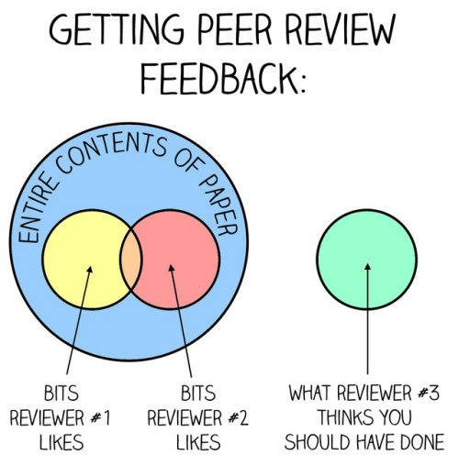
The Processes of Peer Reviewing
Source: @AsapSCIENCE (Accessed April 2017)

Slide 13
Serdar Sayan (2016) Serving as a referee for your own paper: A dream come true or…?, Review of Social Economy, 74:1, 75-82, DOI: 10.1080/00346764.2015.1067757

Slide 14
Dijital yayıncılık
Yayıncılığın marjinal maliyetlerinin sıfıra yaklaşmış olması
Dijitalleşme: PDF, EPUB, MOBI ve diğer baskı türleri
Metalaşma: makale başına 80 USD’den 2000 USD’ye varan yayın “ücret”i
Connectivism: bir makalenin yayına girdiği anda dünyanın her yerinden aynı anda erişime açık hale gelmesi
Massification (or mess-ification) ve akademik enflasyon
Abuse of scientometrics / bibliometrics: impact factors, h-index etc.

Slide 15
Scientometrics
A field of research where scholars evaluate the importance of publications, journals, institutions, and authors by calculating their citations and other indicators in the past years
Citation of an article: how many times an article has been mentioned by other authors in the past years? (e.g. scholar.google.com or WoS)
Impact factor for journals: how many times have the published articles been cited on average within a specific period?
Indices for authors (such as h-index): how many times have the publications of an author been cited in recent years?
Rankings of institutions (such as THE, QS, Shanghai etc.):

Slide 16
Citations
Source: Google Scholar [Accessed October 2018]

Slide 17
Impact factor*
* Ideas (2018)
Source: https://ideas.repec.org/top/top.journals.simple.html
[Accessed October 2018]

Slide 18
Impact factor*
* ISI Impact Factor (2010)
Source: http://www.socialcapitalgateway.org/content/ranking/ranking-economics-journals-based-impact-factor [Accessed October 2018]

Slide 22
Main producers of scientometric data
Onex Corp., Clarivate Analytics (formerly owned by Thomson Reuters): SSCI, SCI, AHCI and Journal Citation Reports
Elsevier, Scopus
ProQuest, Sociological Abstracts
American Economic Association, EconLit
Philosopher’s Information Center, Philosopher’s Index
Independent scholars (see journal: Scientometrics)

Slide 23
Birikimli Nedensellik
İntihal
Avcı durumundayken av durumuna düşmek
Retraction of articles: Khalid Zaman, Bruno Frey, Peter Nijkamp
Citation stacking: Journal of the History of Economic Thought, European Journal of the History of Economic Thought, History of Economic Ideas

Slide 24
Reasons for retractions
Research misconduct:
Plagiarism
Manufacturing data
Manipulating data
Questionable research practices:
Mismanagement of funding
Non-peer reviewed
Double / spontaneous submission
…

Slide 25
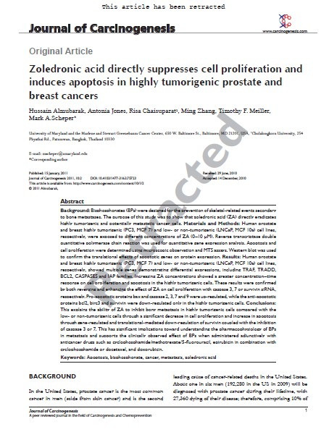
Retractions
https://retractionwatch.com/
http://retractiondatabase.org/
Over 2000 retractions (estimated)
80 retractions each year (estimated)
Yoshitaka Fujii: author of more than 180 articles

Slide 26
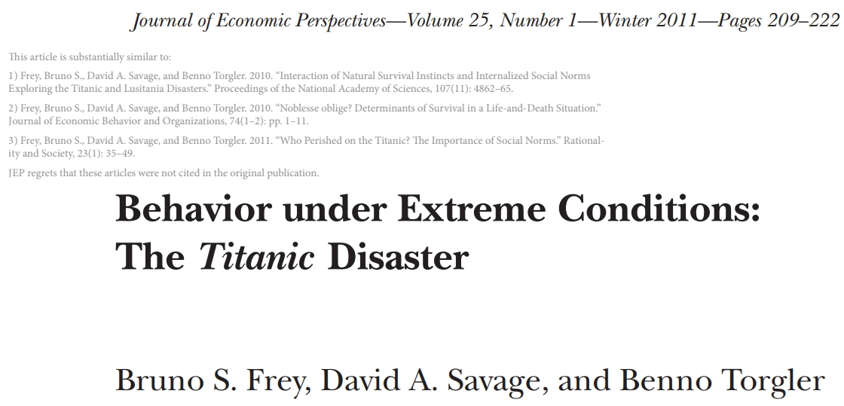

Slide 27
Evolution of costs
Internet technologies and digitalisation in intellectual economies
Diminishing total costs and marginal costs
Total costs of a publication process: costs related to editing, reviewing, printing, storing, distributing (converging zero)
Marginal cost of a publication process: cost of an addition copy of an article or a book (almost zero)
Massification: Massive amounts of publications, publishers, researchers, universities, research funds – and of course: PROFITS!

Slide 28
Massification
Diminishing costs
EXCESSIVE PROFITS

Slide 29
Yayıncılık endüstrisinde kârlar
Kaynak: Alex O. Holcombe https://theconversation.com/free-for-all-arc-funded-research-now-open-to-the-public-11497 [Accessed October 2014]

Slide 30
Kaynak:
http://shiny.retr0.me/journal_costs/?year=2014&inst=19,22,38,42,59,64,80,95,136
By Stuart Lawson and Ben Meghreblian

Slide 31
Kaynak:
http://retr0.me/2015/07/07/UK-HEI-journal-subscriptions.html
By Stuart Lawson and Ben Meghreblian (rakamlar 2014 için)

Slide 32
Kaynak: http://shiny.retr0.me/journal_costs/?year=2010&inst=19,22,38,42,59,64,80,95,136
By Stuart Lawson and Ben Meghreblian

Slide 33
Ankara Üniversitesi
http://sgdb.ankara.edu.tr/files/2018/05/AU_2017_Yili_Idari_Faaliyet_Raporu.pdf [Ekim 2018]

Slide 34
Ankara Üniversitesi "Kütüphane ve Dokümantasyon Birimi" ile Diğer Tüm Birimlerin Yıl Sonu Gerçekleşen Harcamaları
 |  | Kütüphane Harcama (TL) |  | Toplam Harcama (TL) |  | %
2018 |  | 8107307 |  | 362727729 |  | 2,23
2017 |  | 6908000 |  | 313195428 |  | 2,21
2016 |  | 5652593 |  | 295590240 |  | 1,91
2015 |  | 4375902 |  | 207844244 |  | 2,11
2014 |  | 3854106 |  | 162982761 |  | 2,36
2013 |  | 3975703 |  | 171978821 |  | 2,31
Kaynak: AÜ internet sitesinde her yıl Strateji Geliştirme Daire Başkanlığı Tarafından Hazırlanan Faaliyet Raporları
http://sgdb.ankara.edu.tr/?page_id=1255 [Erişim Tarihi: Ağustos 2019]

Slide 35
How?
More and more companies starting a journal or a publication platform
Less and less quality of academic service
Often no reviewing or editing
Mimicking the names of “real” journals
ISBN, DOAJ, impact factors are often fake
More profits that attract more companies
to the industry

Slide 36
Double check!
Publisher and/or owner of journal
Editorial board
Authors who have published so far
ISBN: International Standard Book Number
DOAJ: Directory of Open Access Journals
Read the copyright license agreement carefully
Ask your supervisor!

