Slide 1
Lecture 4 Functions
Dr. Hacer Yalım Keleş

Slide 2
Functions:

Slide 3
Definition vs. Decleration:

Slide 4
Inline Functions:

Slide 5
Static Variables:

Slide 6
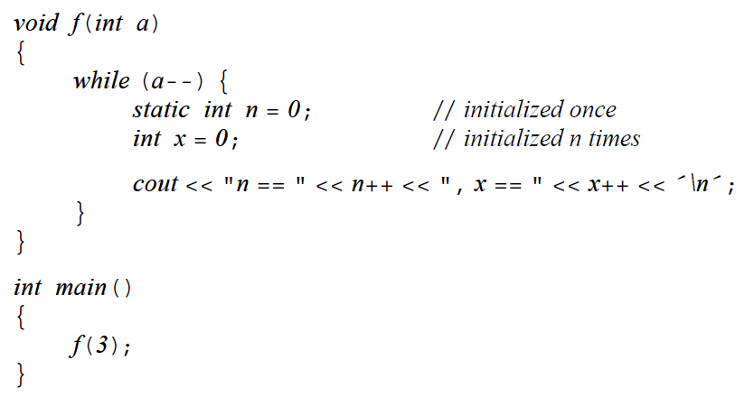

Slide 7
Argument passing:

Slide 8
Passing a reference to a literal, a constant and an argument that requires conversion:

Slide 9
Array Arguments

Slide 10
Array Size:

Slide 11
Value Return

Slide 13
Function Overloading

Slide 15
Without overloading:

Slide 17
Overloading vs. Scope

Slide 18
Best match for each argument
Ambiguous!

Slide 19
Default arguments:

Slide 20
scope..

Slide 21
Function pointers:

