Slide 1
BLM258
Chapter 3: The Relational Data Model and Relational Database Constraints

Slide 2
Outline
The Relational Data Model
Relational Data Model Constraints
Relational Database Schemas
Update Operations
Transactions
Dealing with Constraint Violations

Slide 3
The Relational Data Model Concepts
Relational model represents data as a collection of relations
A relation is a table of values
Row corresponds to a real-world entity or relationship
Row is called as tuple in relational data model
Table names and column names should interpret the meaning of the values.

Slide 4
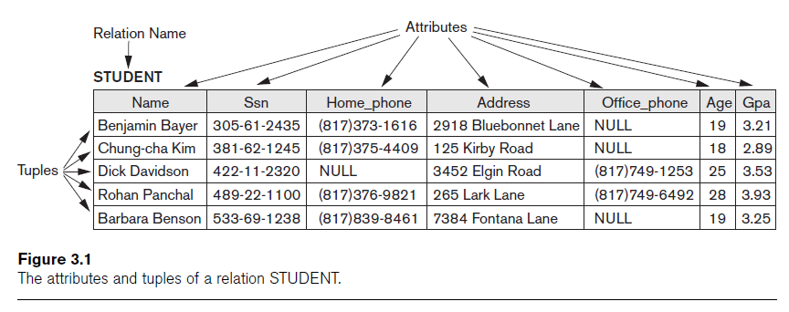
The Relational Data Model Concepts

Slide 5
Domains, Attributes, Tuples and Relations
Domain D
Set of atomic values
Atomic value means that each value is indivisible
Data type need to be specified for each domain

Slide 6
Domains, Attributes, Tuples and Relations
Relational Schema R
R(A₁, A₂, ..., A_{n})
Relation name R and a list of attributes, A₁, A₂, ..., A_{n}
Degree (or arity) of a relation is defined as the number of attributes n of its relation schema.
Relation (or relation state)
Set of n-tuples r = {t₁, t₂, ..., t_{m}}
Each n-tuple t
Ordered list of n values t =<v₁, v₂, ..., v_{n}
Each value v_{i}, 1 ≤ i ≤ n, is an element of dom(A_{i}) or is a special NULL value

Slide 7
Domains, Attributes, Tuples and Relations
Relation (or relation state) r(R)
Mathematical relation of degree n on the domains dom(A₁), dom(A₂), ..., dom(A_{n})
Subset of the Cartesian product of the domains that define R:
r(R) ⊆ (dom(A₁) × dom(A₂) × ... × dom(A_{n}))
Total number of values in domain is called as cardinality

Slide 8
Characteristics of Relations
Relations defined as a set of tuples and the order of tuples in a relation is not specified.
Tuples have no order among them.
Attributes and the values within tuples are ordered.

Slide 9
Characteristics of Relations
Each value in a tuple is atomic.
Composite and multivalued attributes not allowed
Composite attributes are represented by simple component attributes in basic relational model.
Multivalued attributes must be represented by separate relations.

Slide 10
Characteristics of Relations
NULL values
Value unknown
Value exists but is not available
Value undefined

Slide 11
Relational Model Constraints
Constraints are restrictions on the actual values in a database state.
Constraints are derived from the rules in the miniworld.
Inherent model-based constraints
Schema-based constraints
Application-based constraints

Slide 12
Domain Constraints
Numeric data types for integers and real numbers
Characters
Booleans
Strings
Date, time

Slide 13
Key Constraints
No two tuples can have the same combination of values for all their attributes
Superkey
No two distinct tuples in any state r of R can have the same value for SK
Key
Superkey of R
Removing any attribute A from K leaves a set of attributes K that is not a superkey of R any more.

Slide 14
Key Constraints
If relation schema have more than one key, all keys are called as candidate key.
One of the condidate key is selected as primary key.
Other candidate keys that are not selected are called as unique keys.

Slide 15
Entity Integrity, Referential Integrity and Foreign Keys
Entity integrity constraint: No primary key can be NULL
Referential integrity constraint: It is specified among tuples in two relations.
The attributes in foreign key should be in same domain as the primary key attributes.
Value of FK in a tuple in relation R1 should occur as a value of PK in a tuple of relation R2 or should be NULL.

Slide 16
Update Operations
Insert Operation
Can break any of the constraint
If an inser operation violates any constraints, the default behaviour is rejection.
Update Operation
If the attribute to be updated is not part of primary key or foreign key, there will be no problem.
If a primary or foreign key to be updated, similar problems as with insert may take place.

Slide 17
Update Operations
Delete Operation
It can only violate referential integrity
Three ways to deal with this issue:
Restrict
Cascade
Set null or set default

