Slide 1
COM258
Chapter 2: Database System Concepts and Architecture

Slide 2
Outline
Data Models, Schemas and Instances
Three-Schema Architecture
Data Independence
Database Languages and Interfaces

Slide 3
Database System Concepts and Architecture
Basic client/server DBMS architecture
Client module
Server module

Slide 4
Data Models, Schemas and Instances
Data abstraction is the fundemantal concept with respect to data models.
Data abstraction is defined as the suppression of details of data organization and storage
Its main goal is to highlight the essential features to improve understanding of data.

Slide 5
Data Models, Schemas and Instances
Data model may be considered as the collection of concepts that define the structure of a database.
To achieve data abstraction, data model is used.
Data model specifies the basic operations like retrievals and updates on the database.
It also allows database designer to create a set of valid operations on database objects.

Slide 6
Data Models, Schemas and Instances
Data Models Categories
High-level or conceptual data models
Many users perceive data in this manner.
Low-level or physical data models
Describes the details of data storage on computer media
Representational data models
Easily understood by end users
Similar to how data organized in computer storage

Slide 7
Data Models, Schemas and Instances
Entity
Represents a real-world object or concept
Attribute
Describes an entity
Relationship among two or more entities
Entity-Relationship model (ER model)

Slide 8
Data Models, Schemas and Instances
Relational data model is used commonly in commercial DBMSs
Object data model is a new family of higher-level implementation data model
Physical data model deals with how data is stored in disk.
Access path
Index

Slide 9
Data Models, Schemas and Instances
Define a new database:
Specify database schema
Initial state:
Populated or loaded with the initial data
Valid state:
It is the state that satisfies the structure and constraints specified in the schema
Schema evolution:
As application requirements change, modifications are applied to schema.

Slide 10
Three-Schema Architecture
Internal level:
In this level, the physical storage structure of the database is described.
Conceptual level:
This level speciifes the structure of the whole database for a community of users.
External or view level:
The part of the database for a particular user group is interested in is described.

Slide 11
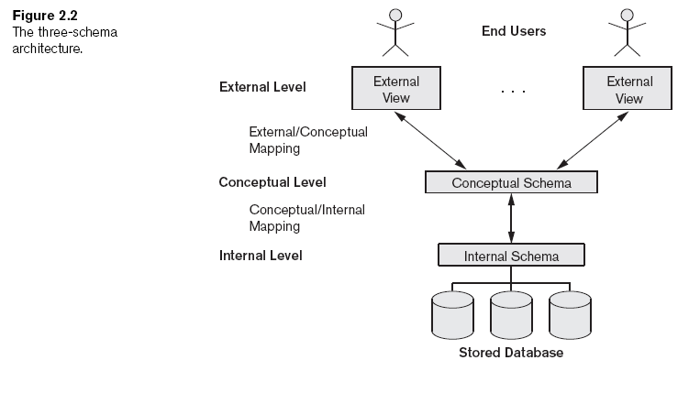
Three-Schema Architecture

Slide 12
Data Independence
It is the ability to change the schema at one level without having to change the schema at the next higher level in a database system.
There are two types of data independence:
Logical
Physical

Slide 13
DBMS Languages
Data definition language (DDL)
Storage definition language (SDL)
View definition language (VDL)
Data manipulation language (DML)

Slide 14
DBMS Languages
High-level or nonprocedural DML
Set-at-a-time or set-oriented
Low-level or procedural DML
Must be embedded in a general-purpose programming language
Record-at-a-time

Slide 15
DBMS Interfaces
Menu-based interfaces for Web clients or browsing
Forms-based interfaces
Graphical user interfaces
Natural language interfaces
Speech input and output
Interfaces for parametric users
Interfaces for the DBA

