Slide 1
The national museum of nature and science kahaku-japon
Mahdiyar Behjooyan
19100302

Slide 2
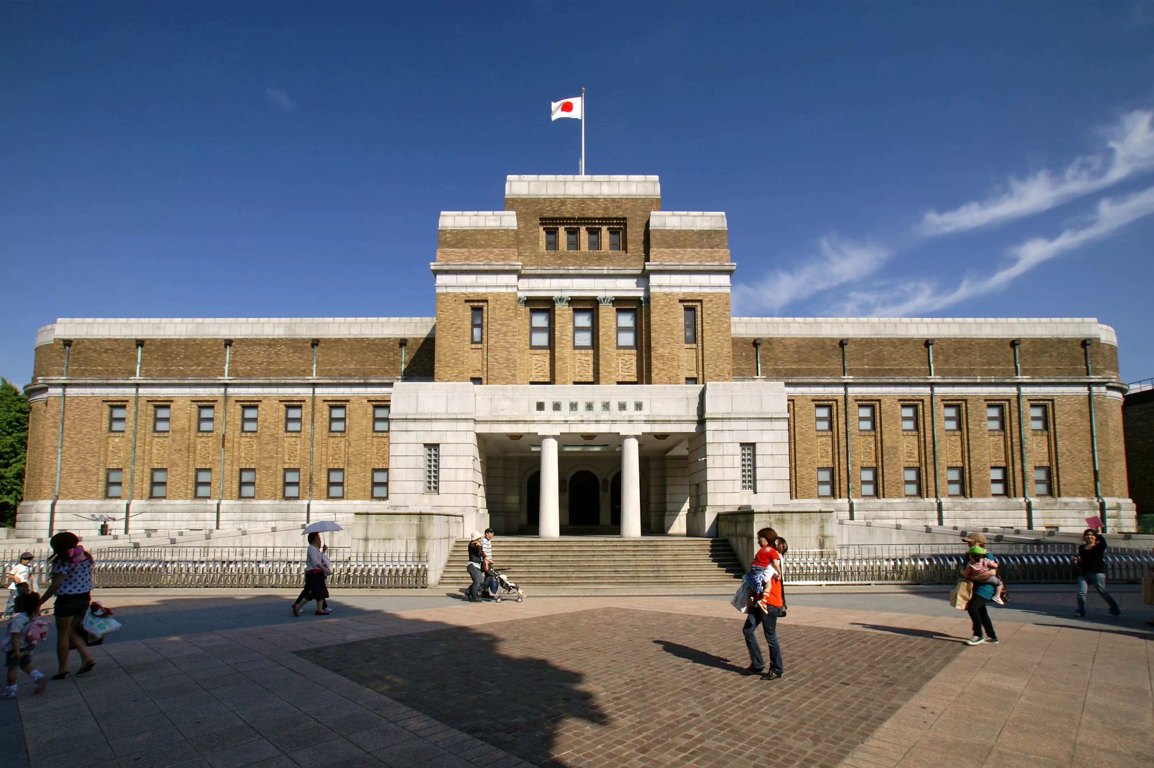
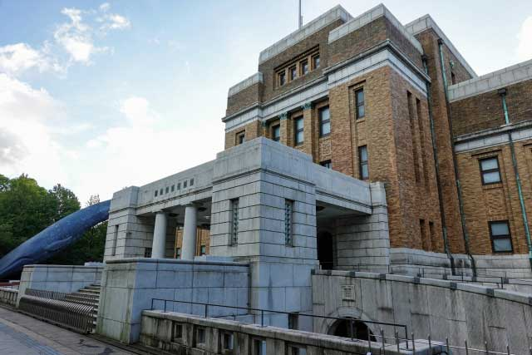
Established in 1877, the National Museum of Nature and Science (Kahaku) is one of the oldest museums in Japan. It is also the only national museum in the country that offers a comprehensive exhibition of natural history and the history of science and technology. Kahaku plays a core role among science museums in Japan and in the Asian region. It promotes three fundamental activities; conducting research studies, collecting and preserving specimens, and organizing exhibitions and educational programs. These activities are carried out mainly in three of their institution districts.

Slide 3
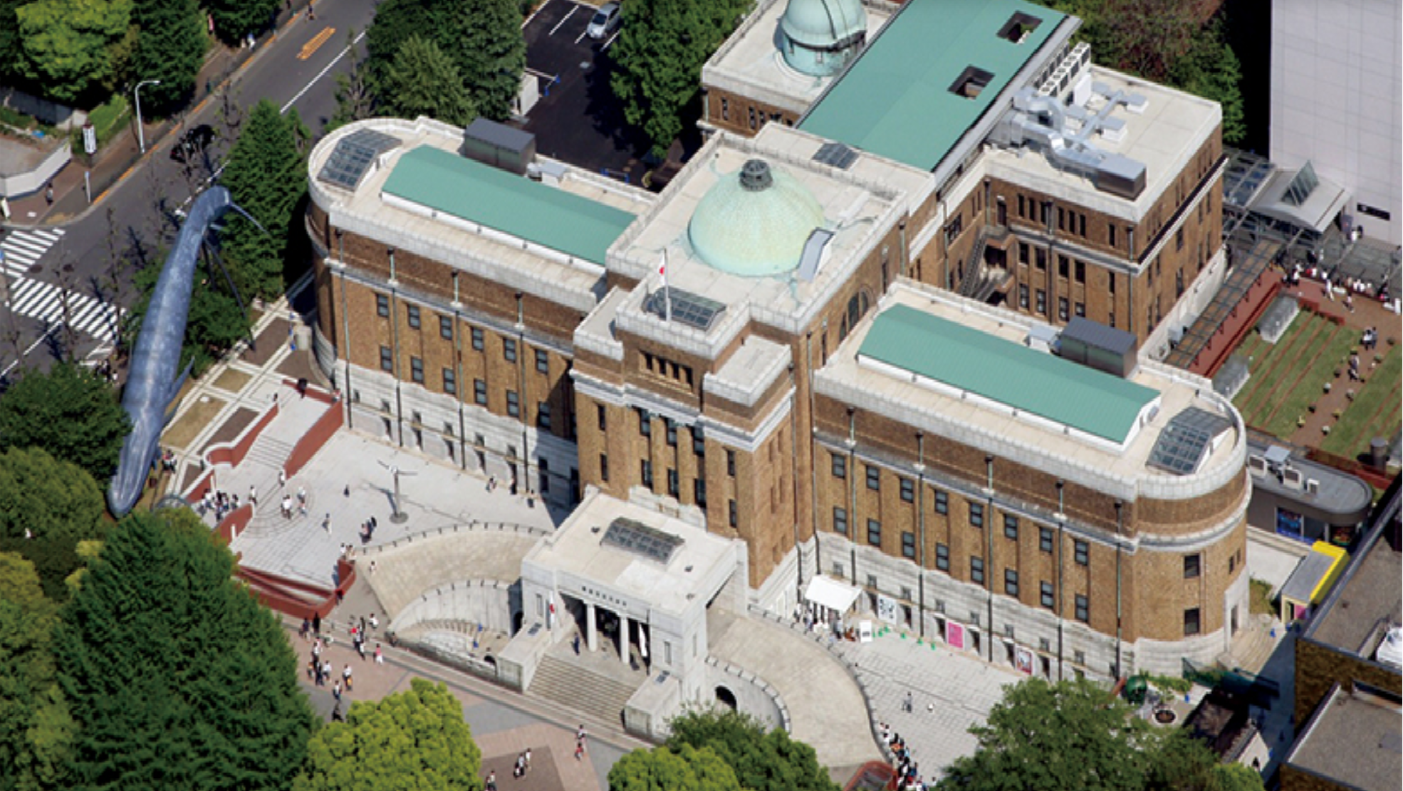
The first is Ueno district, consisting of Japan Gallery, completed inside the Ueno Park in 1931 (designated as an important cultural property), and its adjacent building, Global Gallery. The second is Tsukuba district, consisting of Tsukuba Botanical Garden and the Research and Natural History Collection Wings. The third is Shirokane district, the site of the Institute for Nature Study (designated as a natural monument and historic site).

Slide 4
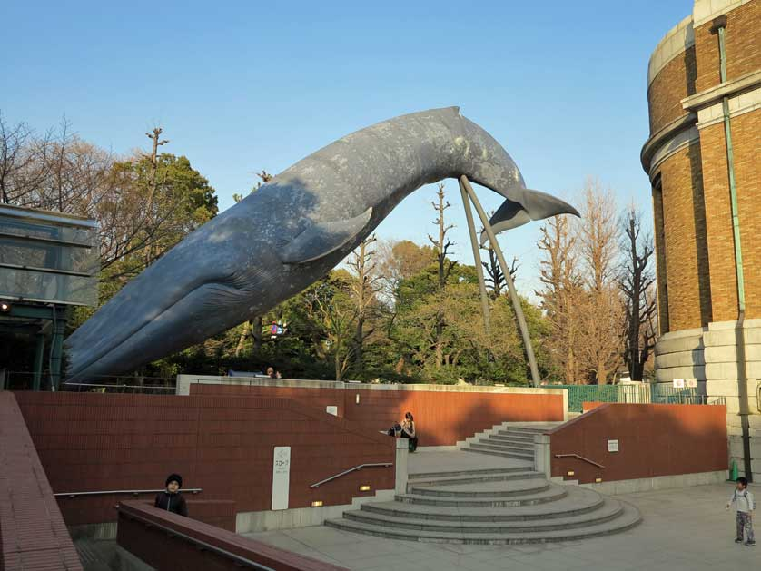
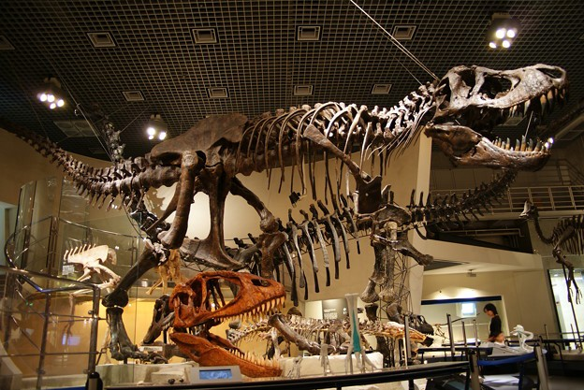
The National Museum of Nature and Science is a central and leading museum in natural history and the history of science and technology. Our competent researchers cover a wide range of specialized fields, ranging from zoology and botany through petrology, mineralogy and paleontology to anthropology and the history of science and technology. The Museum conducts research in partnership with a wide range of institutions.

Slide 5
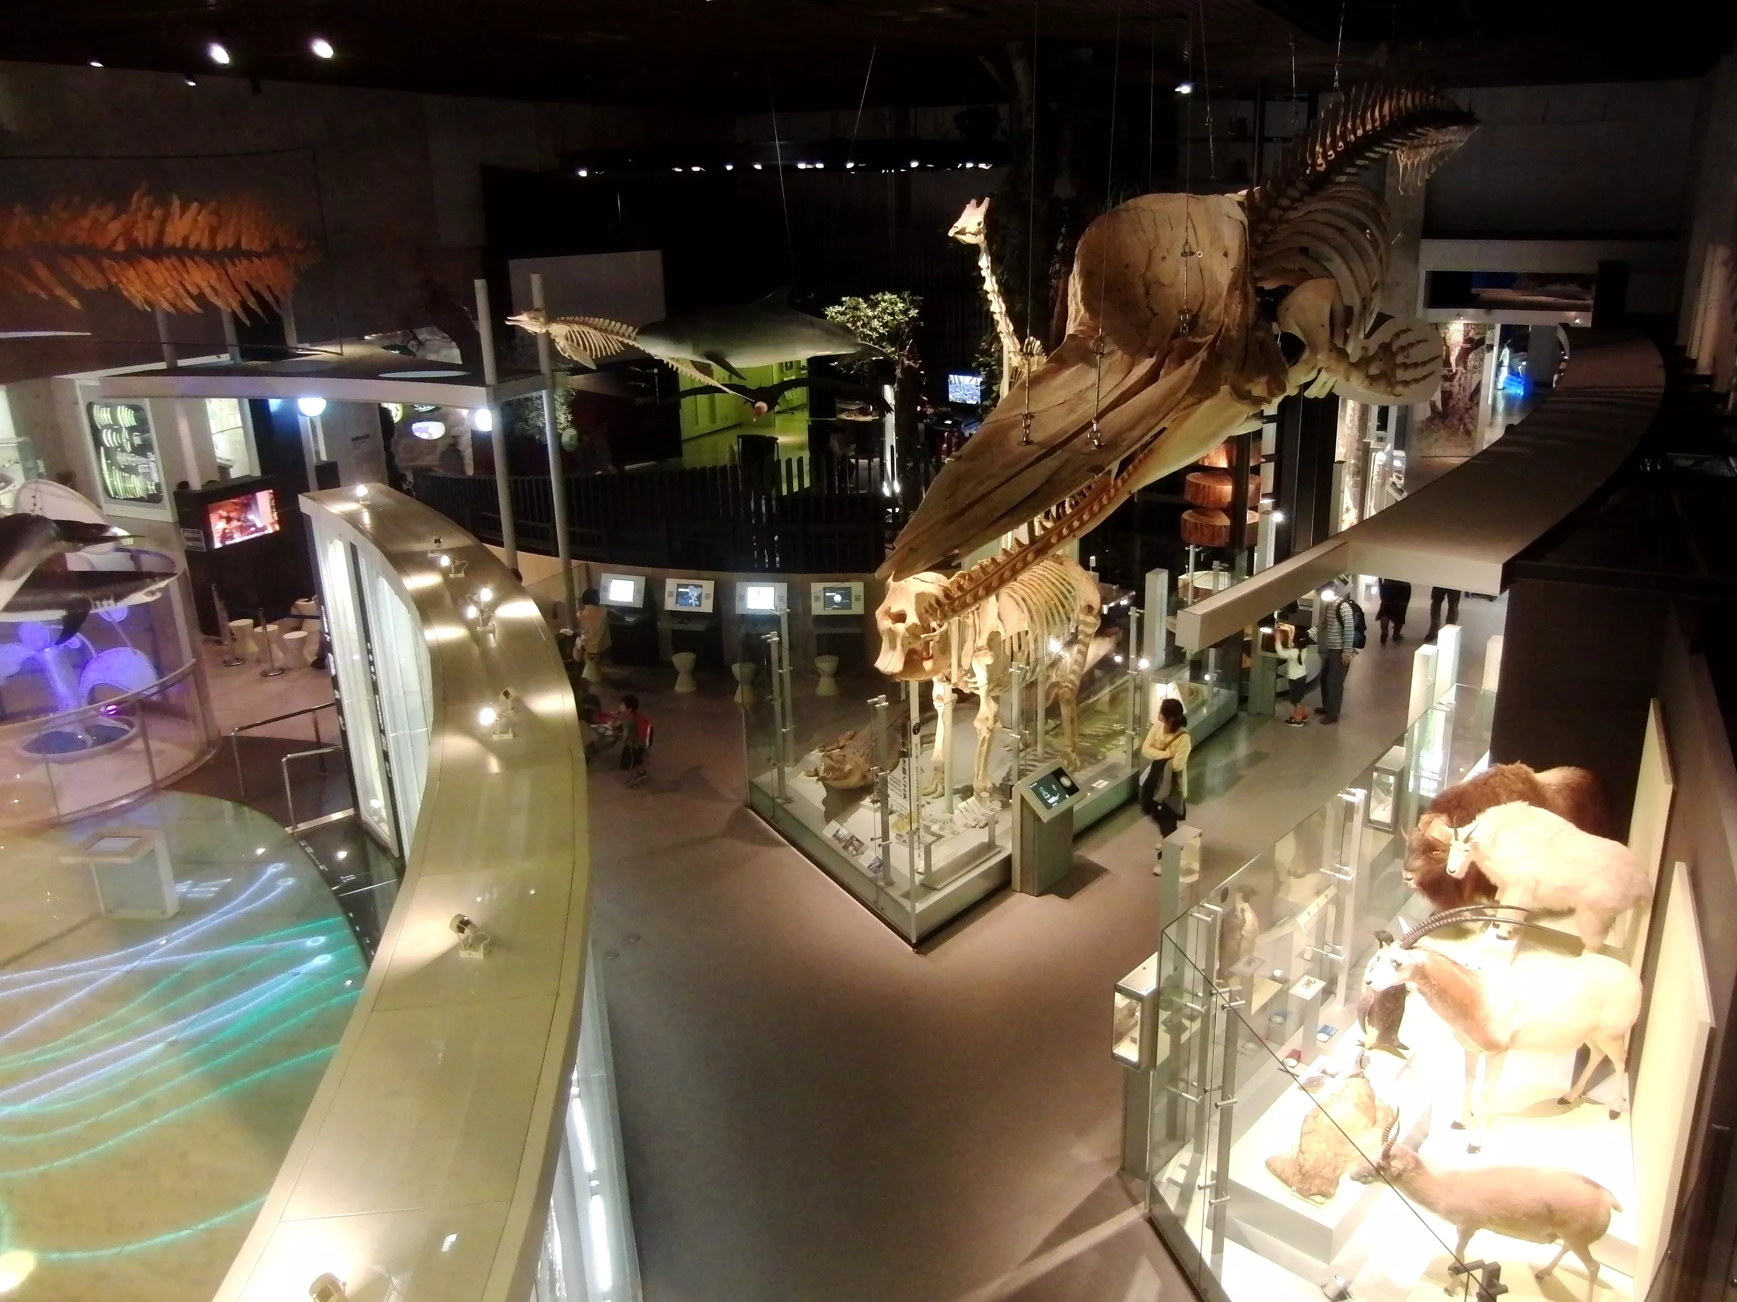
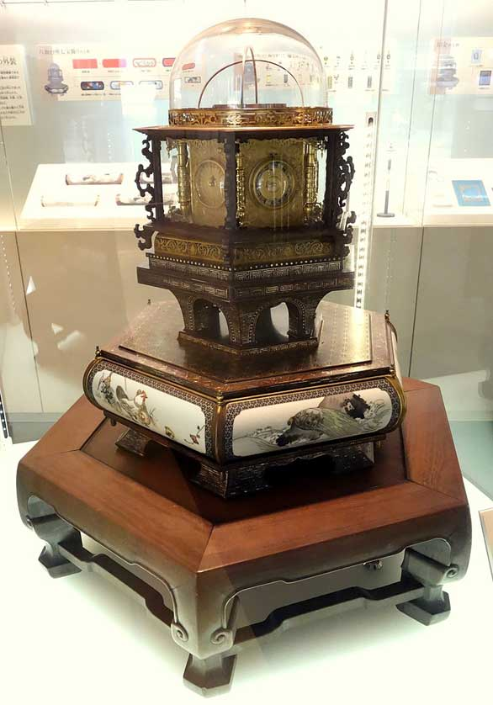
Each floor of National Museum of Nature and Science is organized around a unifying theme, informed by the Museum's rich and high-quality collection of original specimens. Each floor's exhibits work together to convey a message, in turn relating to the overarching message of the permanent exhibits, “Human Beings in Coexistence with Nature.” By presenting these themes in a clear and systematic fashion, the Museum encourages visitors to think about what we can do to protect the environment in which all living things exist and to build a future of harmonious coexistence between people and the natural world.

Slide 6
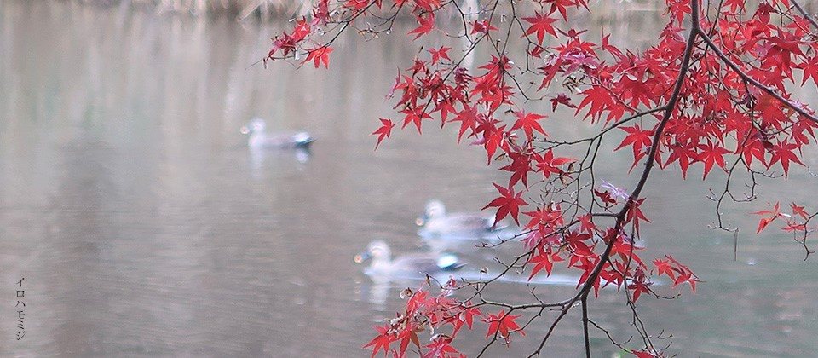
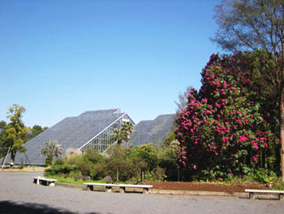
Approximately 3,000 plant species are shown in two major areas, “World Vegetation Area” and “Human and Biodiversity Area.” Visitors can get in touch with world's plant diversity in compartmented major Japanese vegetations and Tropical Rainforest and Savanna Greenhouses. Plant resources that have been utilized in various ways by the human race are displayed in the Human and Biodiversity Area including Tropical Resource Plant Greenhouse. Specimens are labeled to indicate endangered plants and plants native to Mt. Tsukuba. The Garden is ideal for plant observation, enjoyment, recreation and relaxation, and for informal study by school pupils and students.

Slide 7
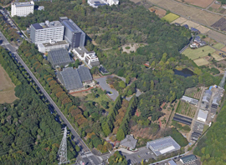
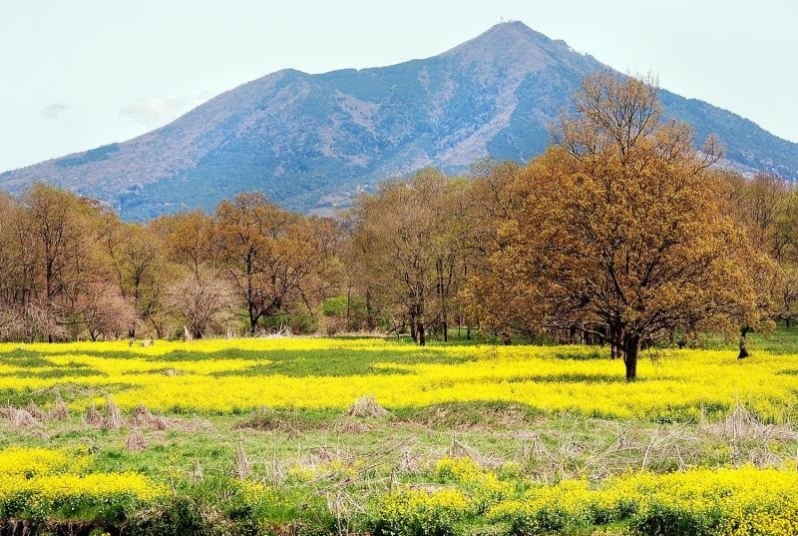
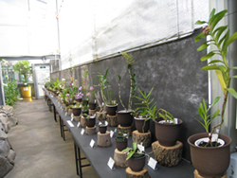
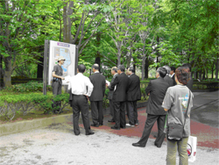
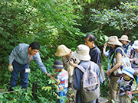
The Institute for Nature Study incorporates a broad-leaf evergreen forest, preserving the primeval environment of the local warm-temperate zone. Here students and researchers can observe plants and animals in the wild and study the workings of their ecosystems. The grounds are dotted with signs indicating the species of various plants, making the Institute an excellent resource for developing a deep understanding of nature.

Slide 8
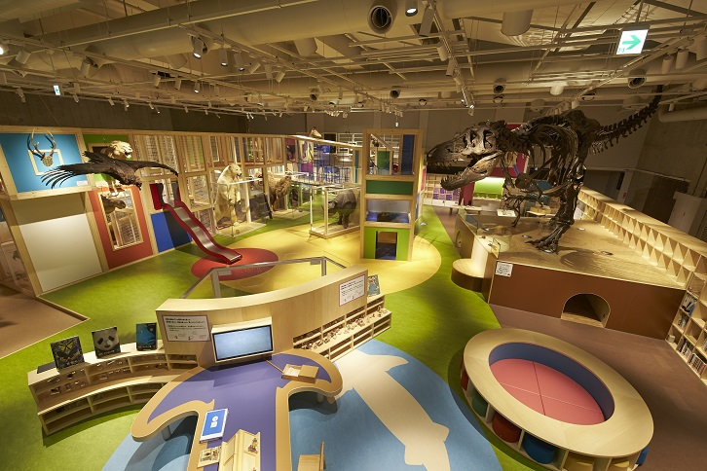
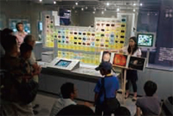
The Museum offers educational programs for children and adults. Drawing on specimens and research results, and working with partners in the business world and academia, the Museum provides high quality, professionally produced educational-support programs that are fresh, challenging and entertaining..

Slide 9
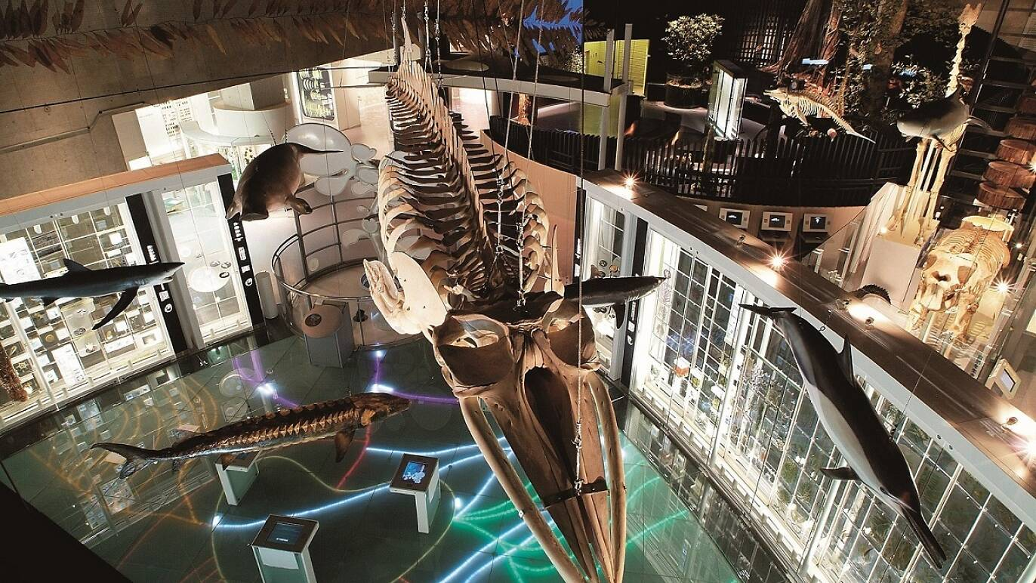
As part of its efforts to enhance peoples’ understanding and awareness of science and technology, the Museum develops and implements personnel training programs works that act as a bridge between science and technology on the one hand and society in general on the other.

