Slide 1
Factors - relevant to the barns

Slide 2
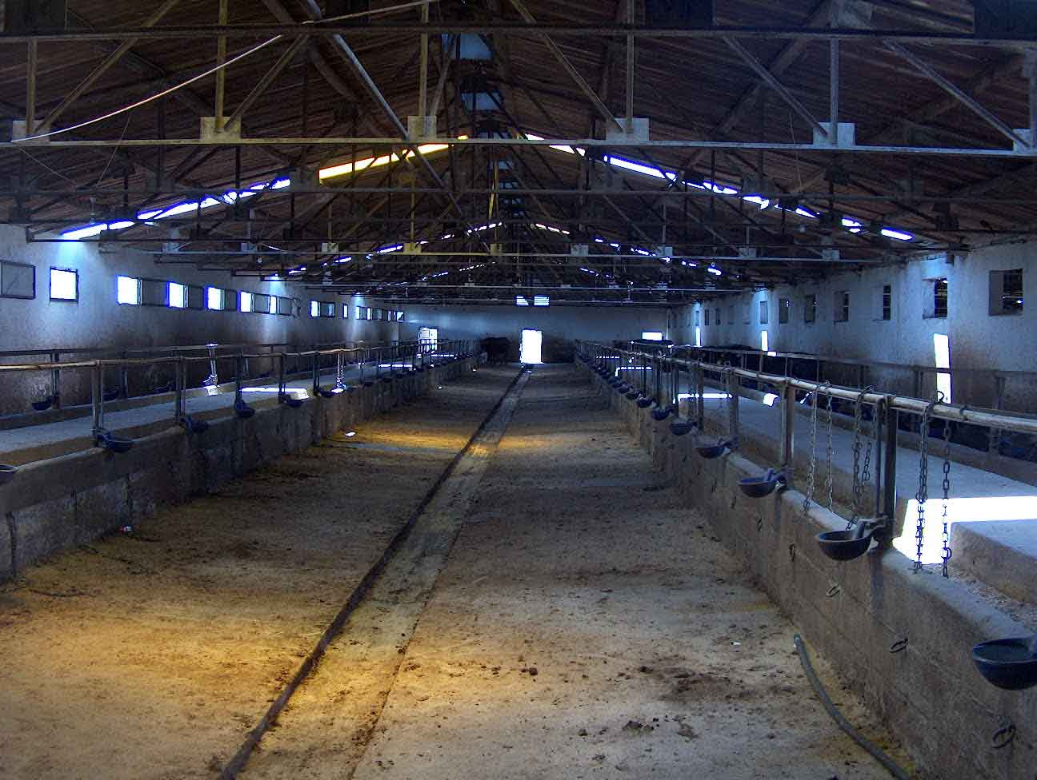

Slide 3
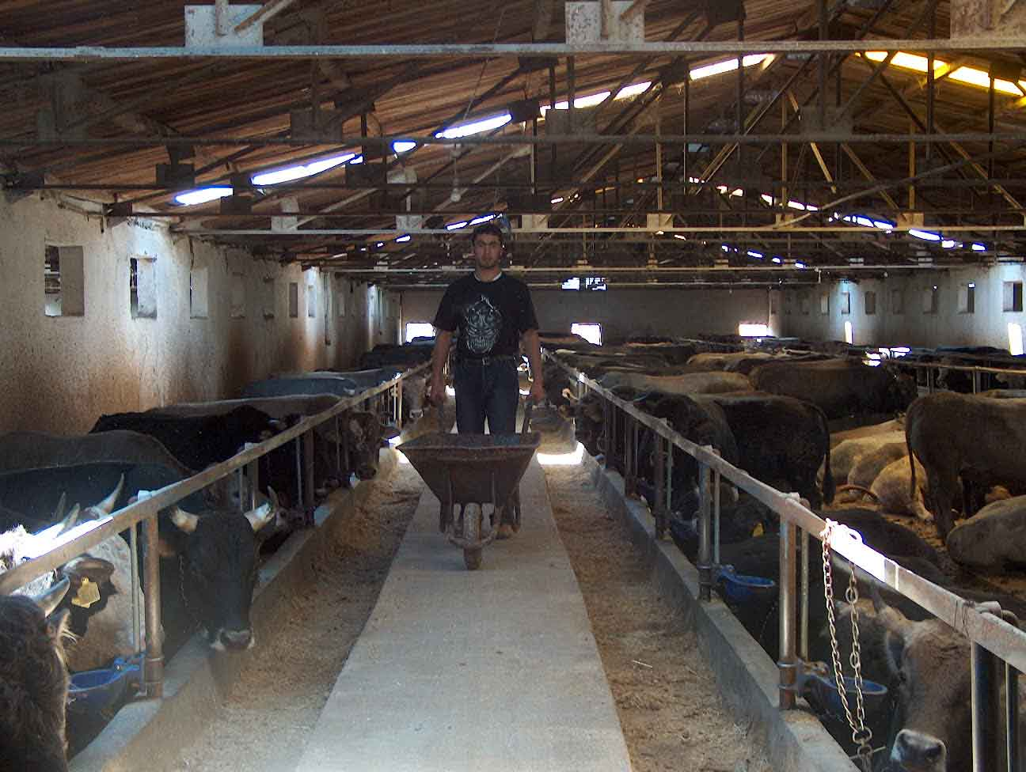

Slide 4
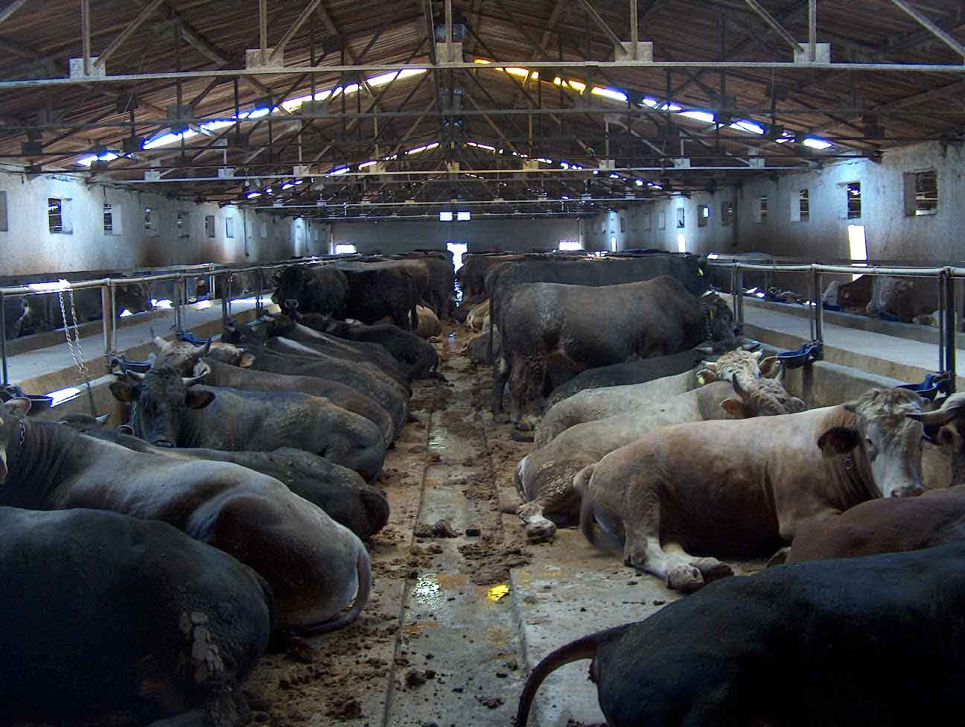

Slide 5
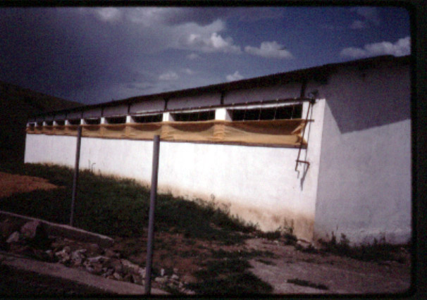

Slide 6
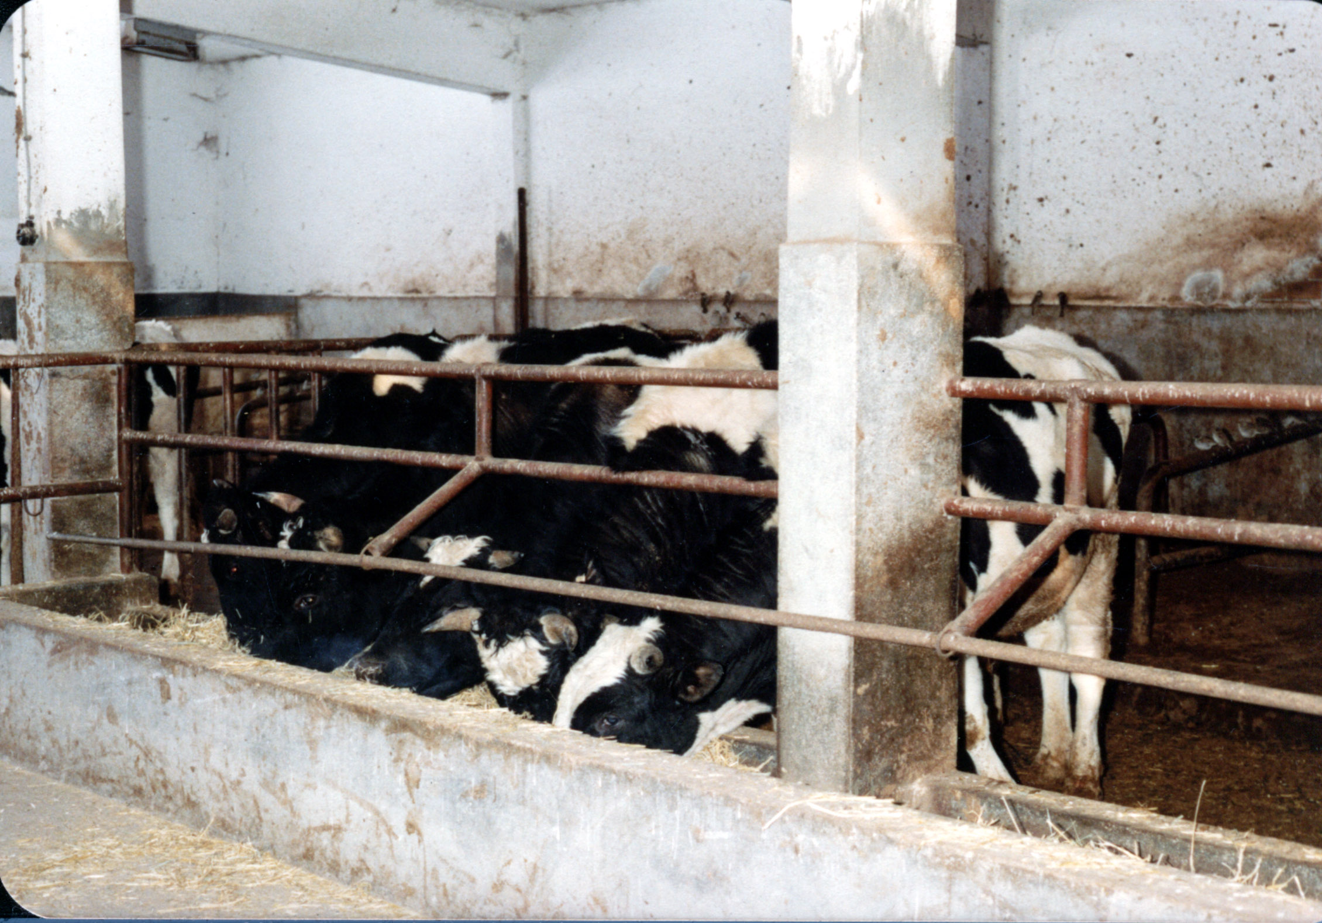

Slide 7
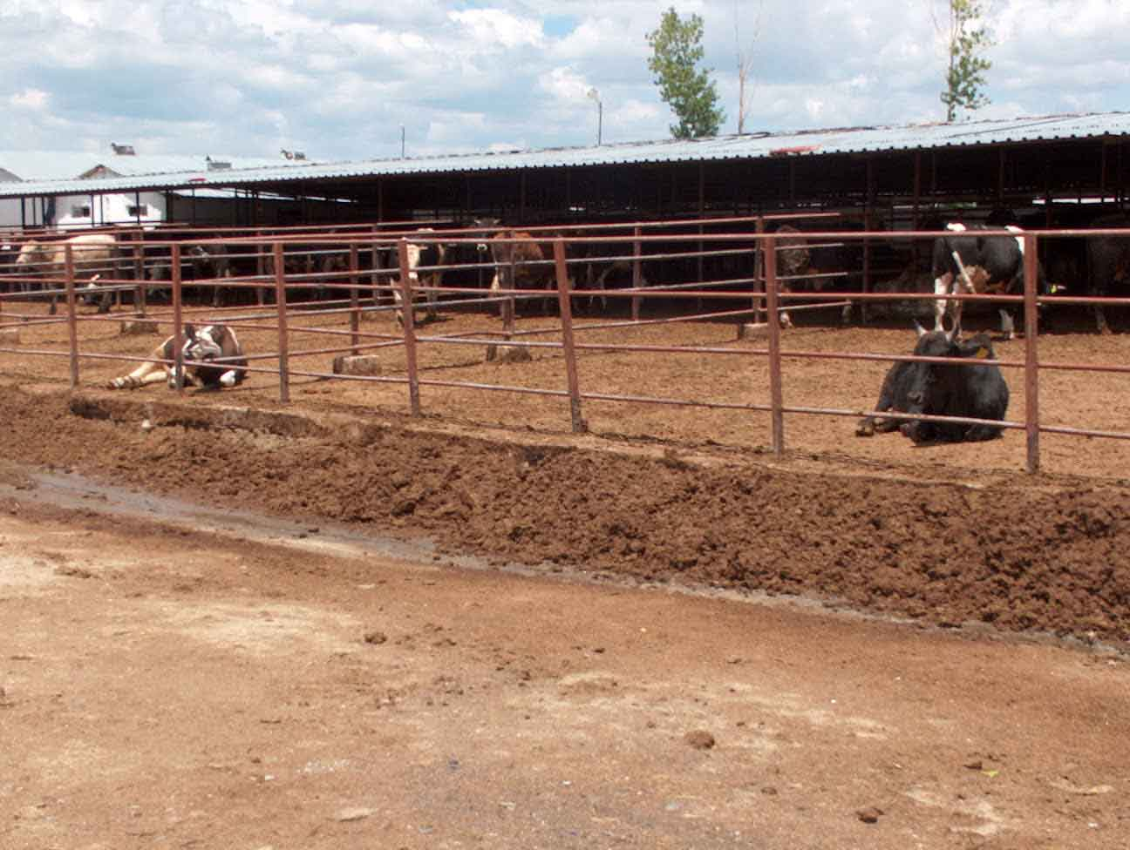

Slide 8
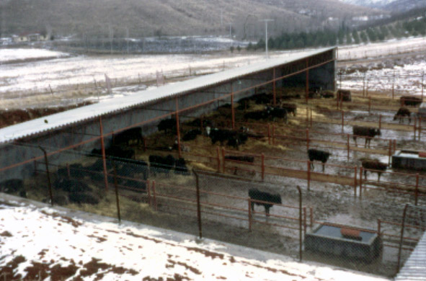

Slide 9
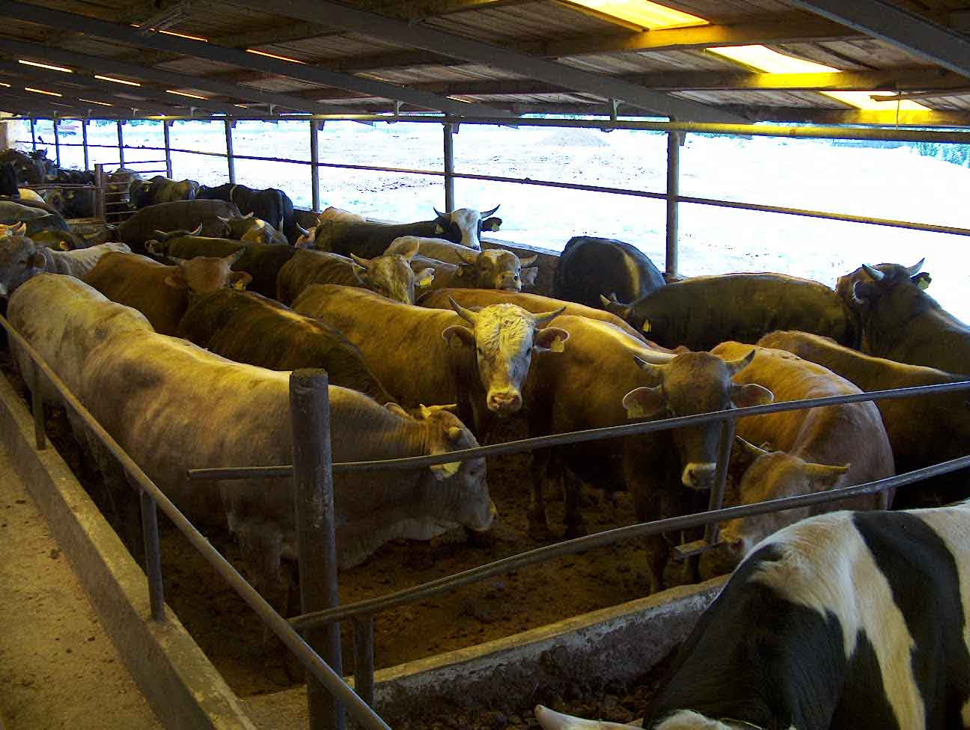

Slide 10
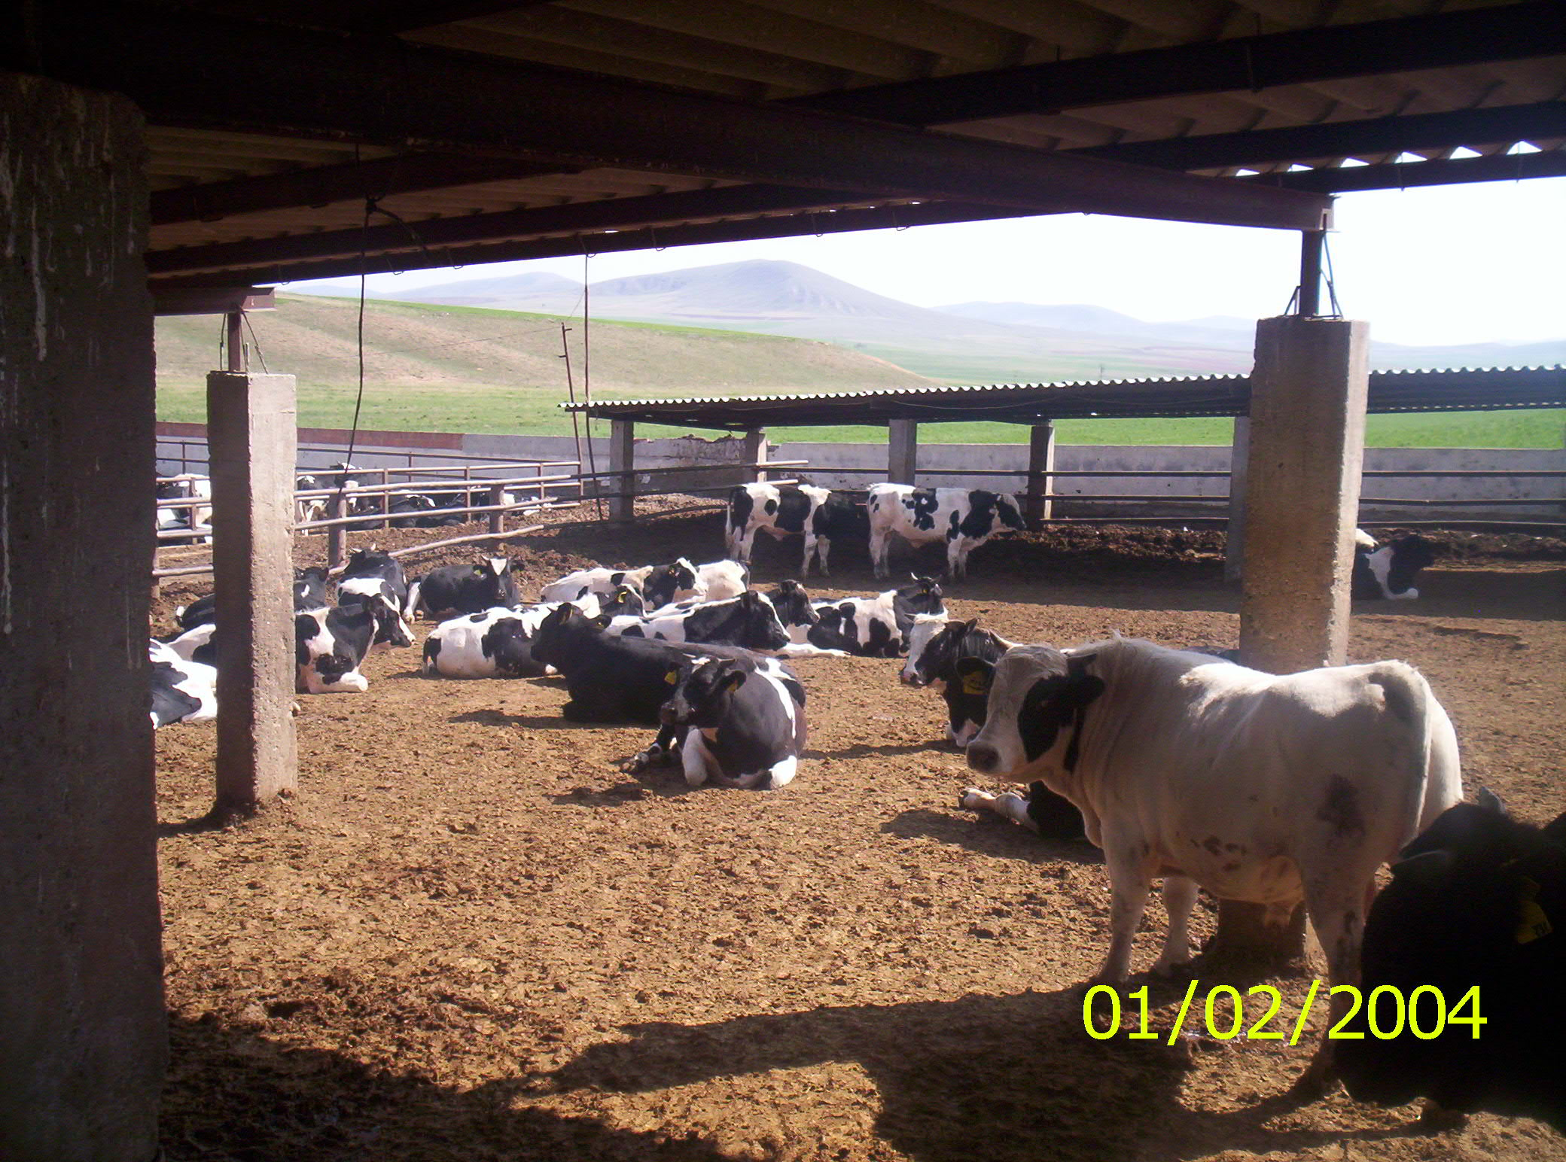

Slide 11
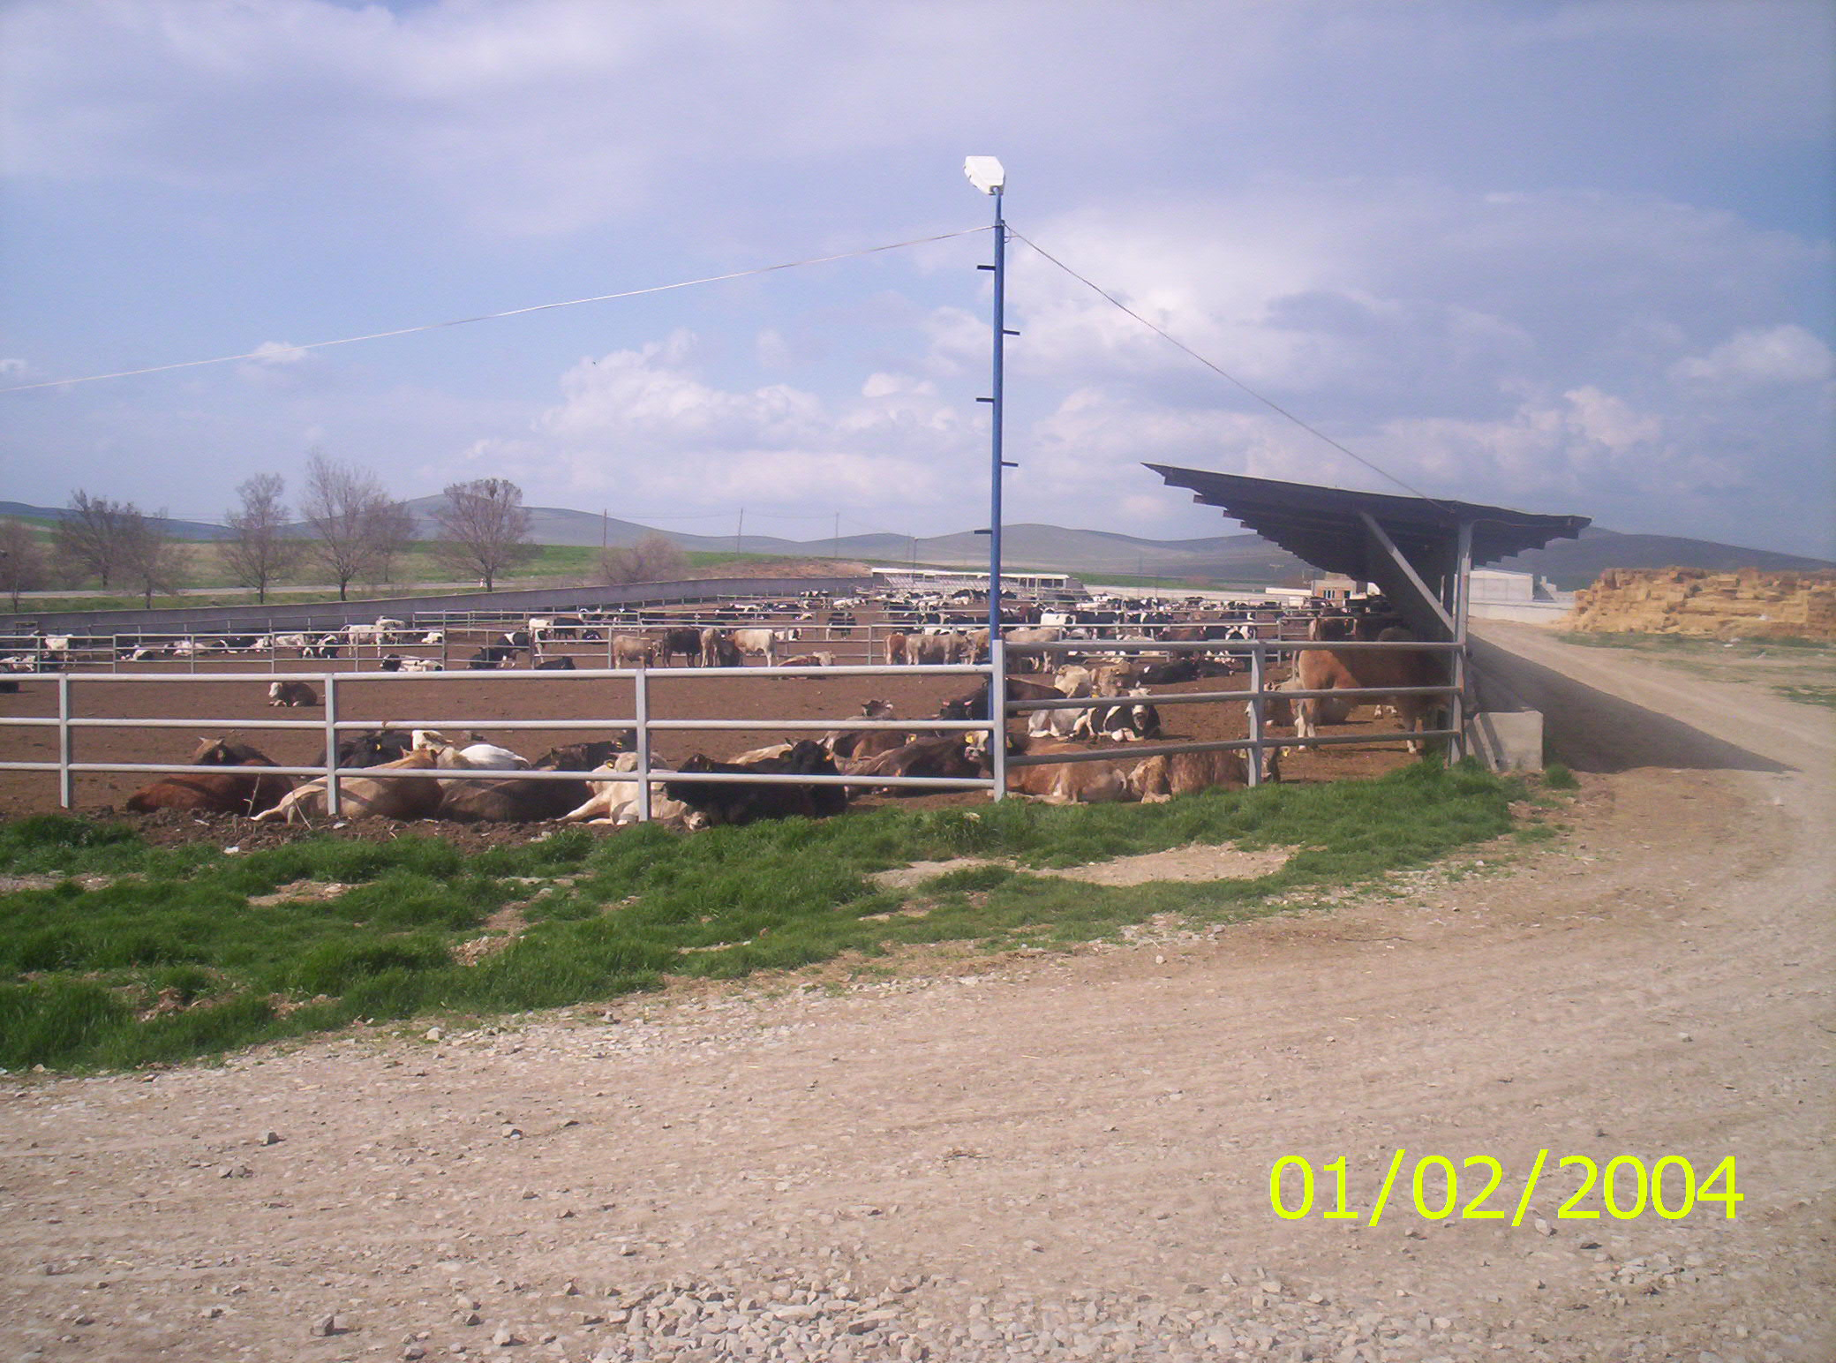

Slide 12
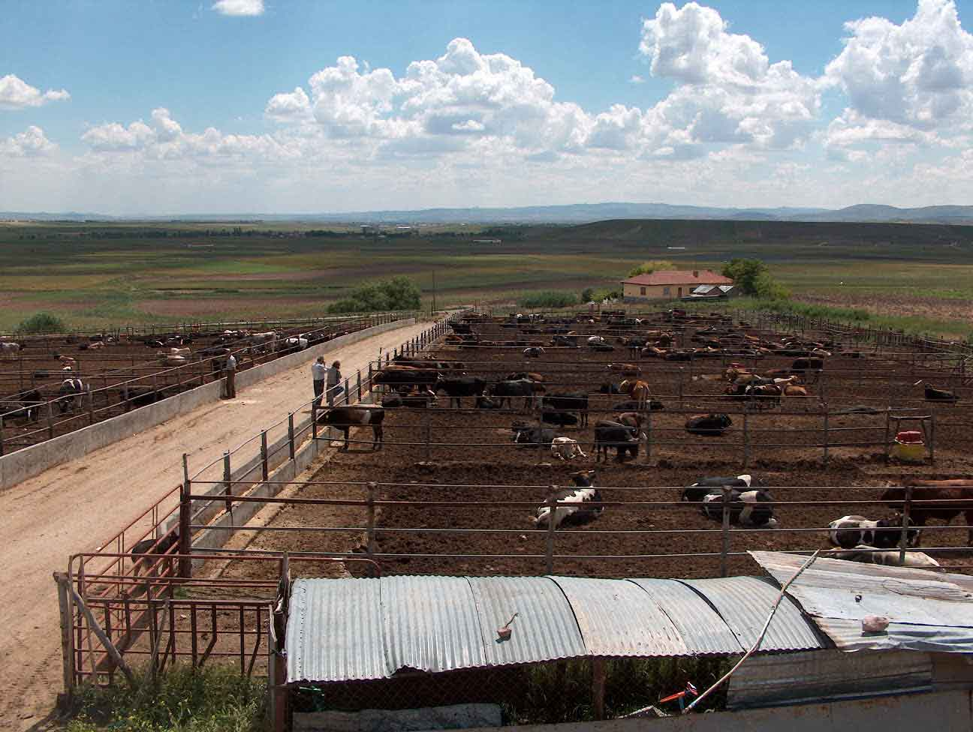

Slide 13
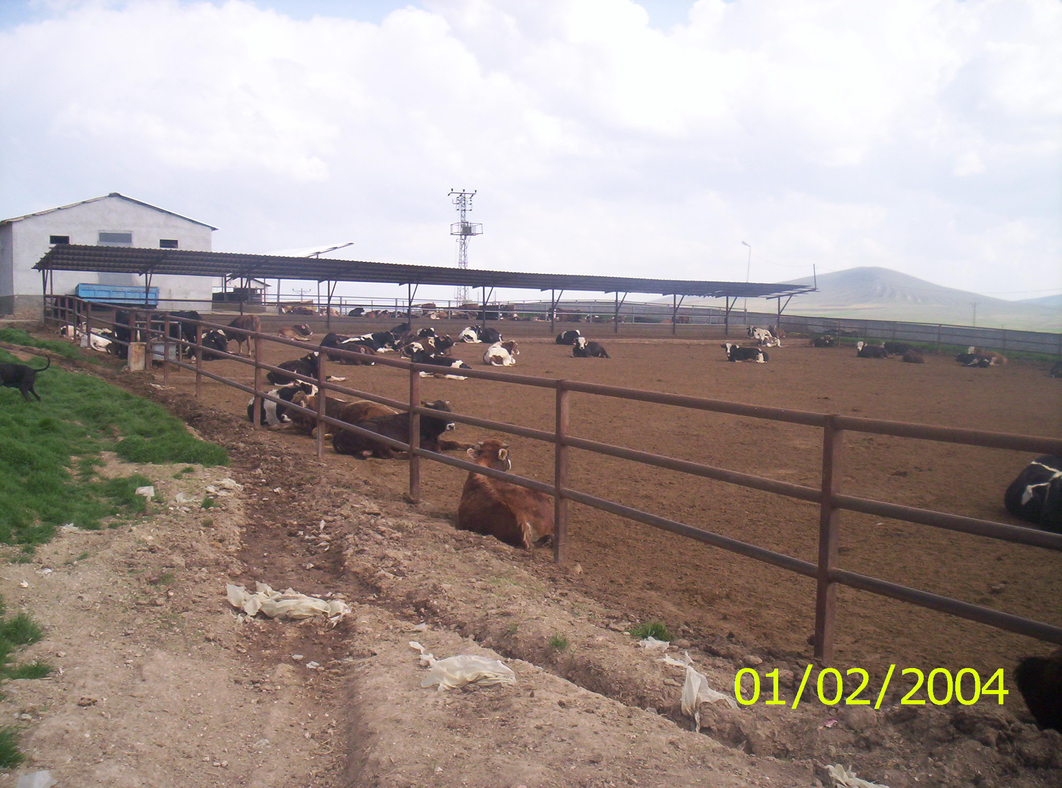

Slide 14
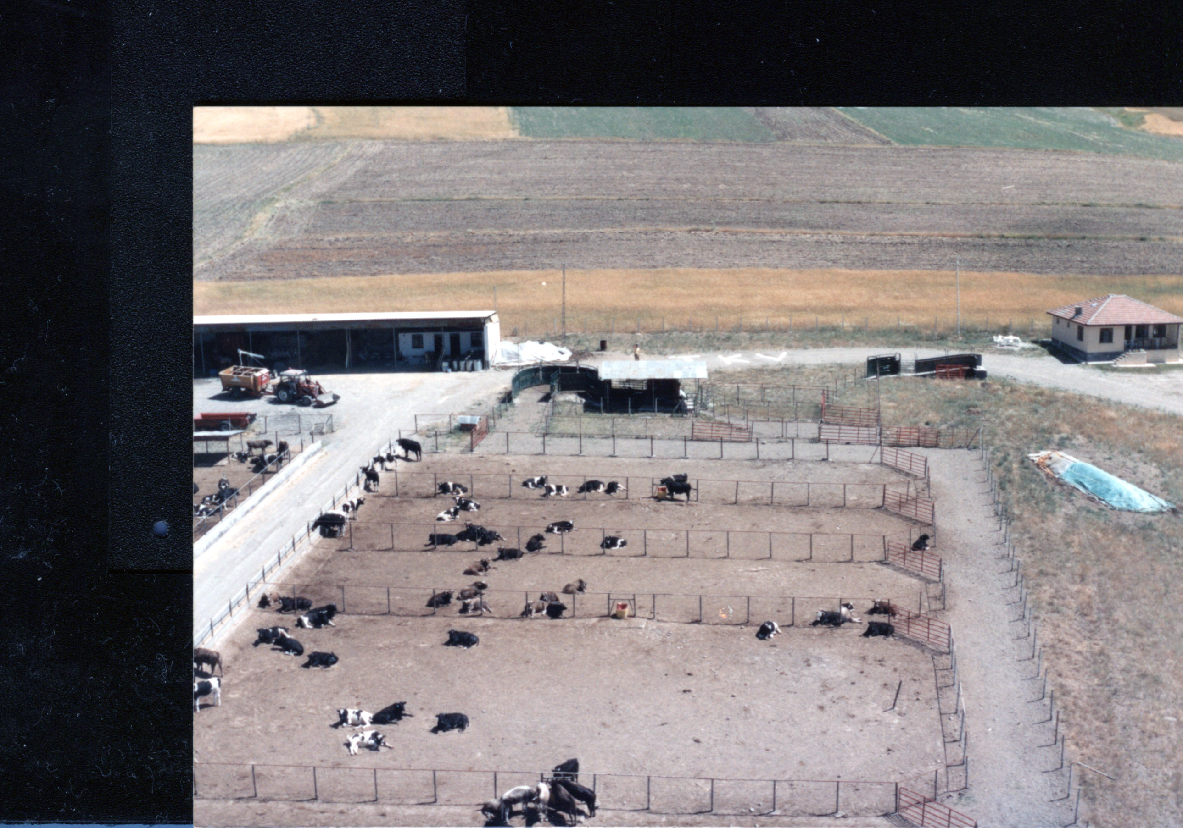

Slide 15
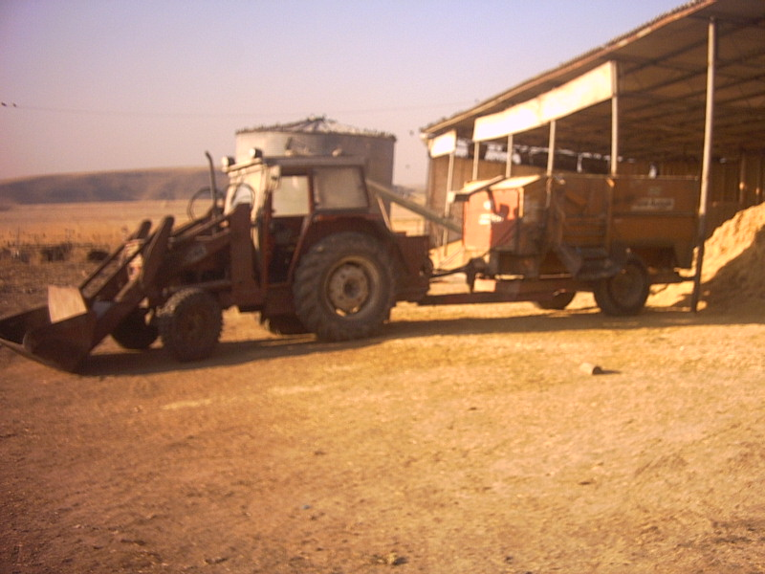

Slide 16
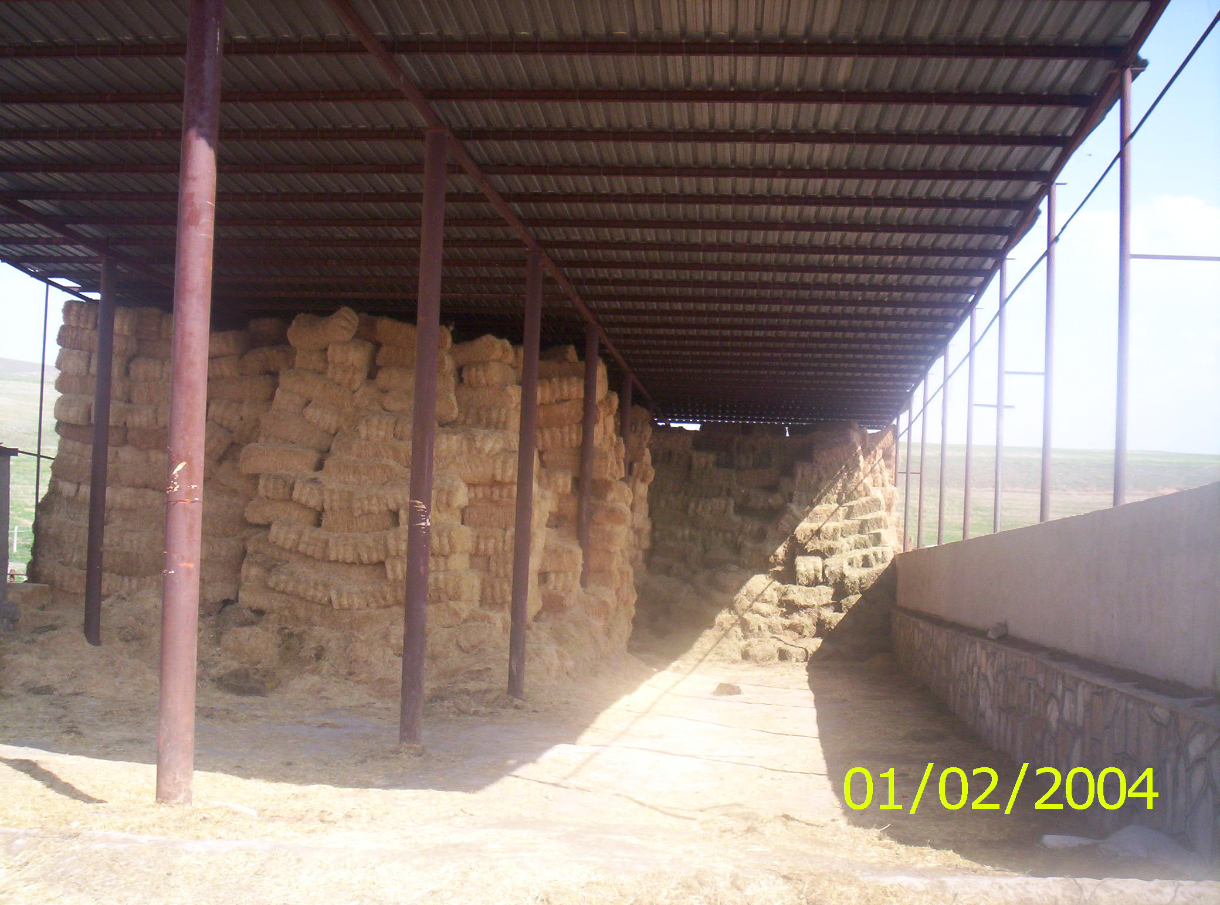

Slide 17
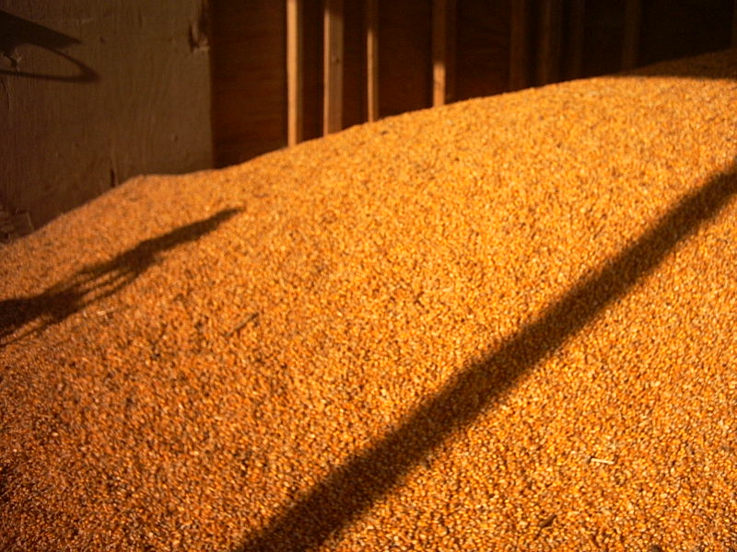

Slide 18
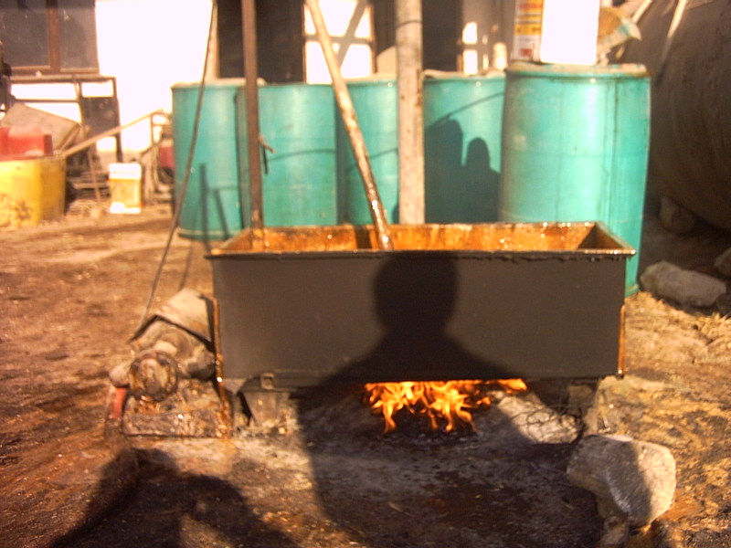

Slide 19
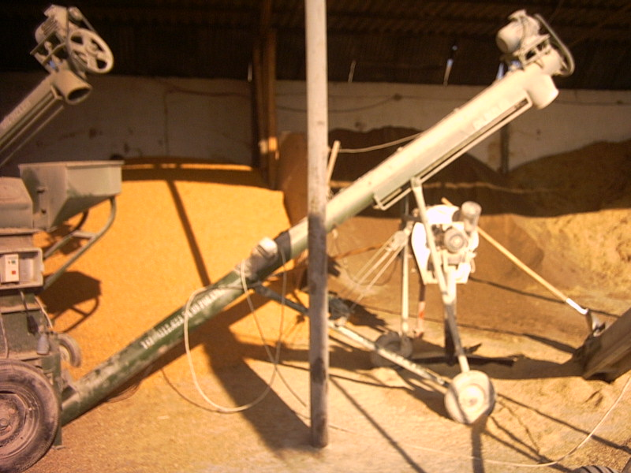

Slide 20
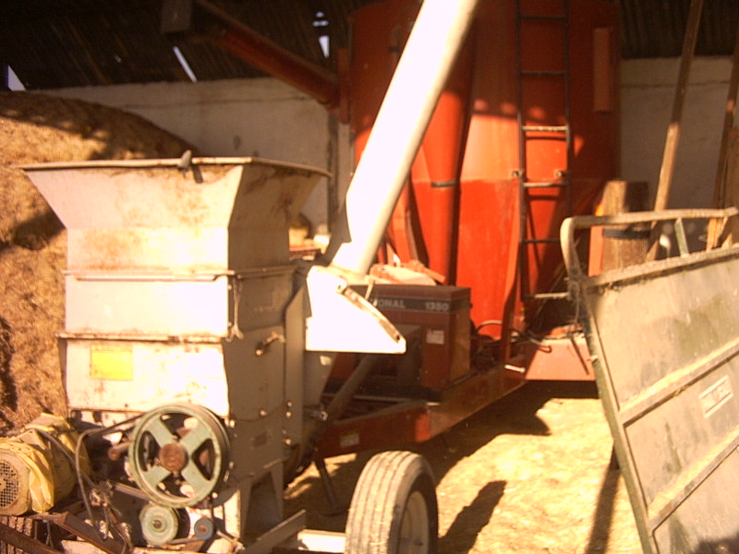

Slide 21
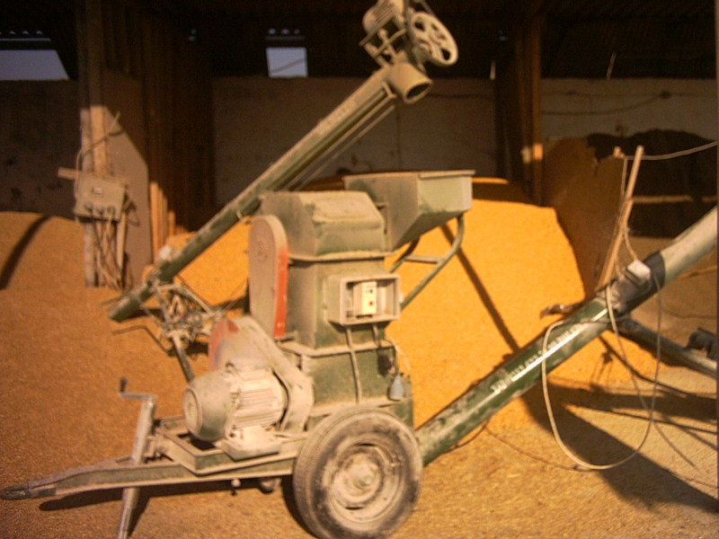

Slide 22
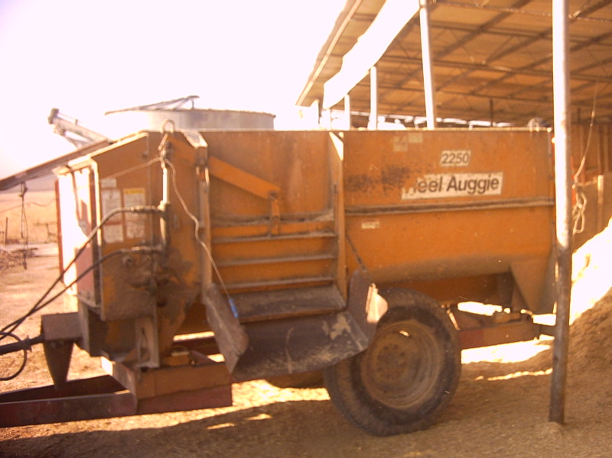

Slide 23
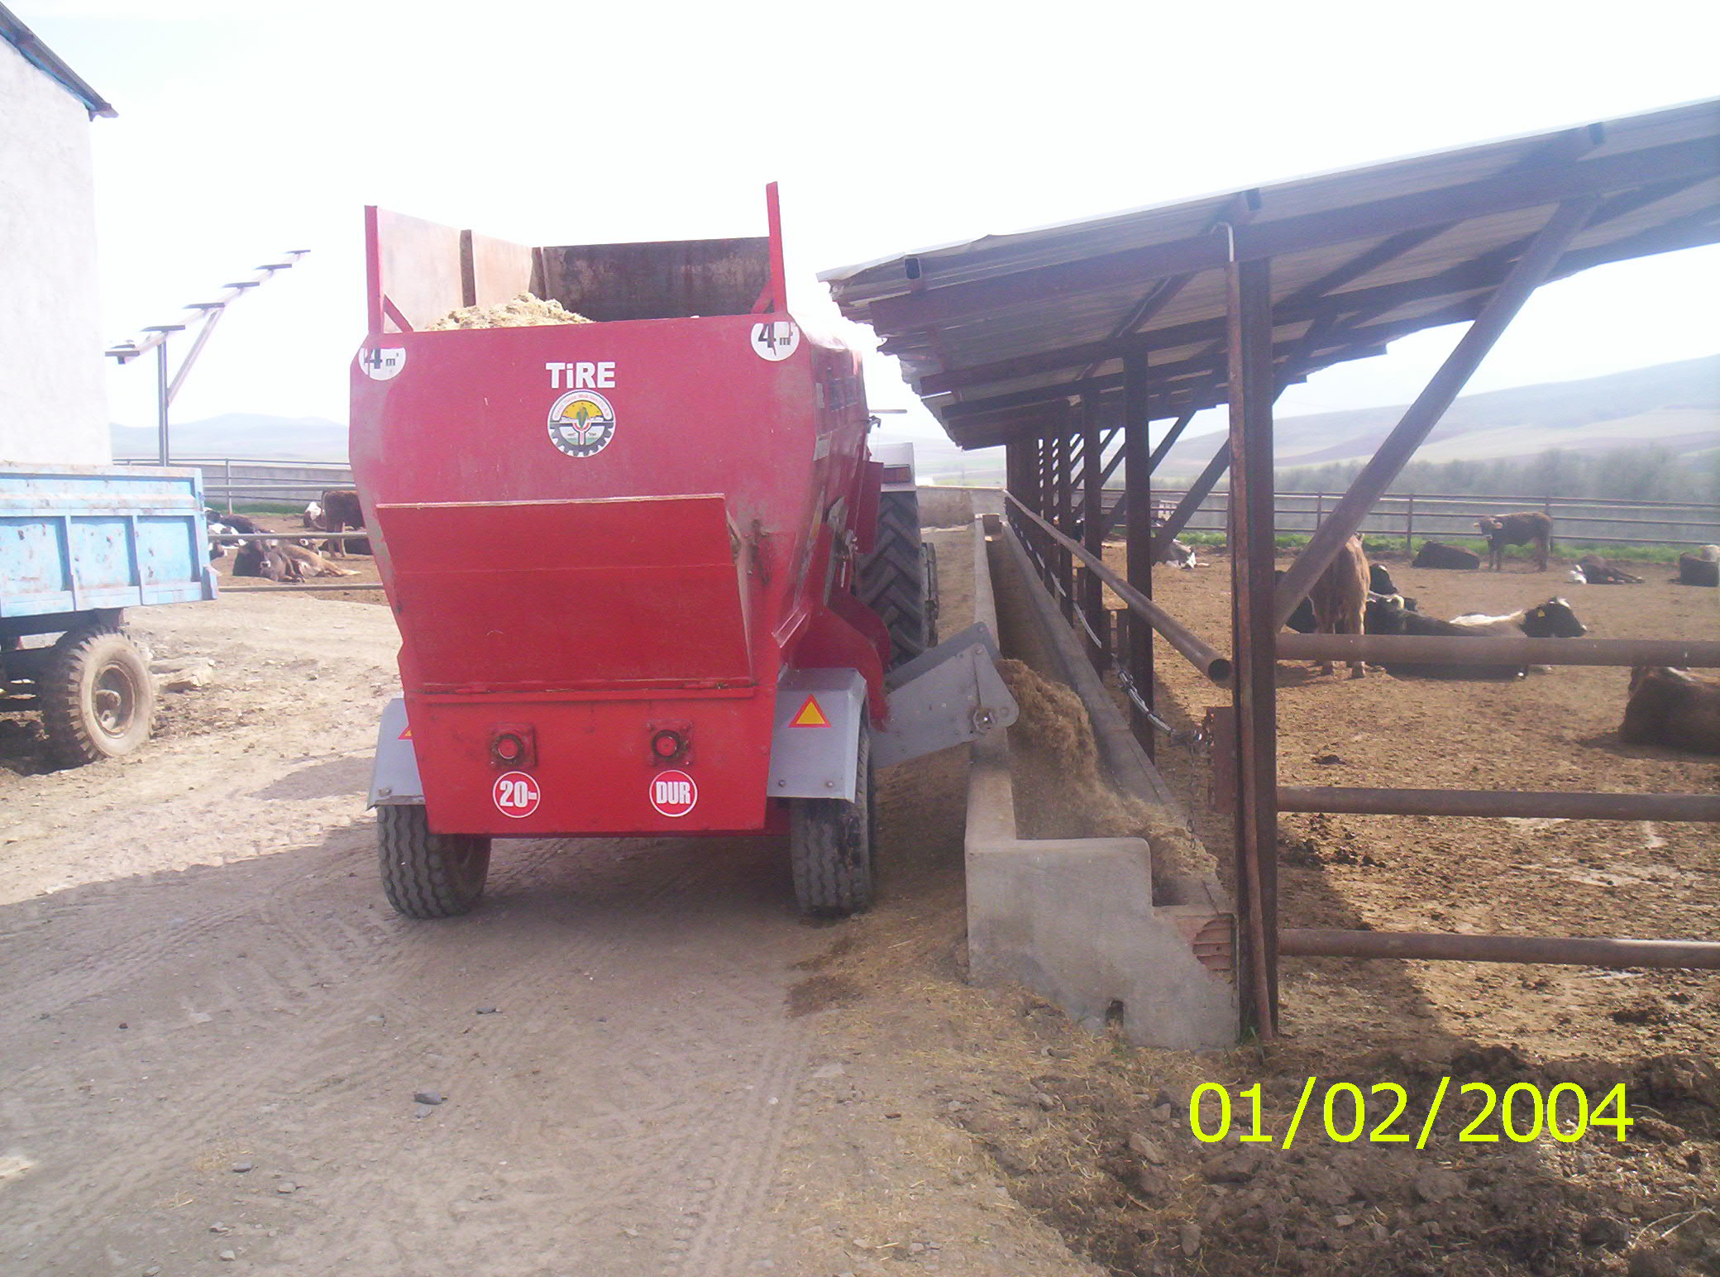

Slide 25
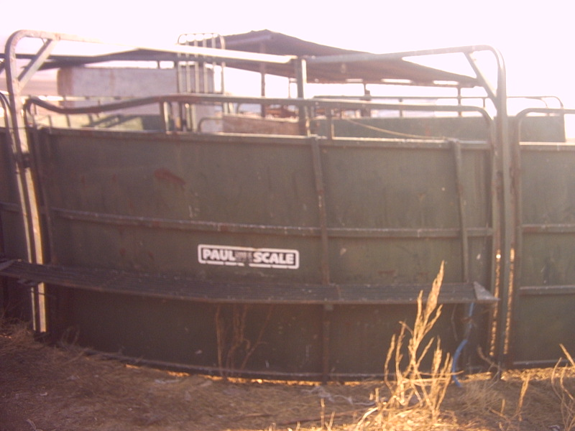

Slide 26
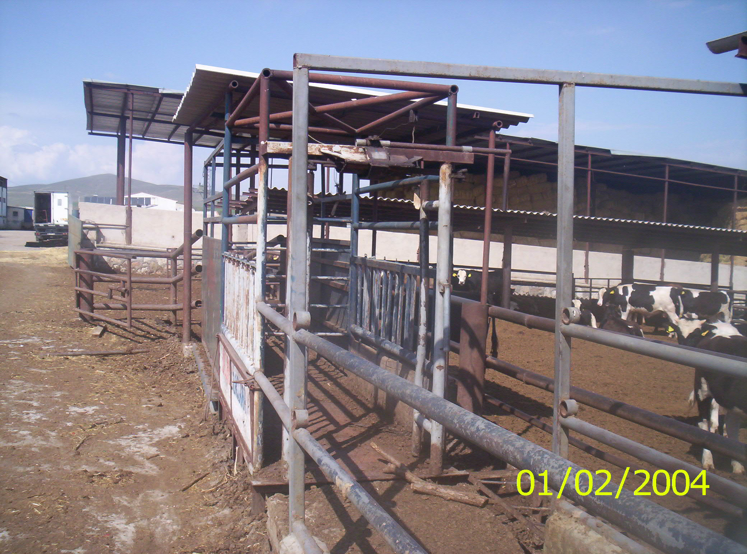

Slide 27
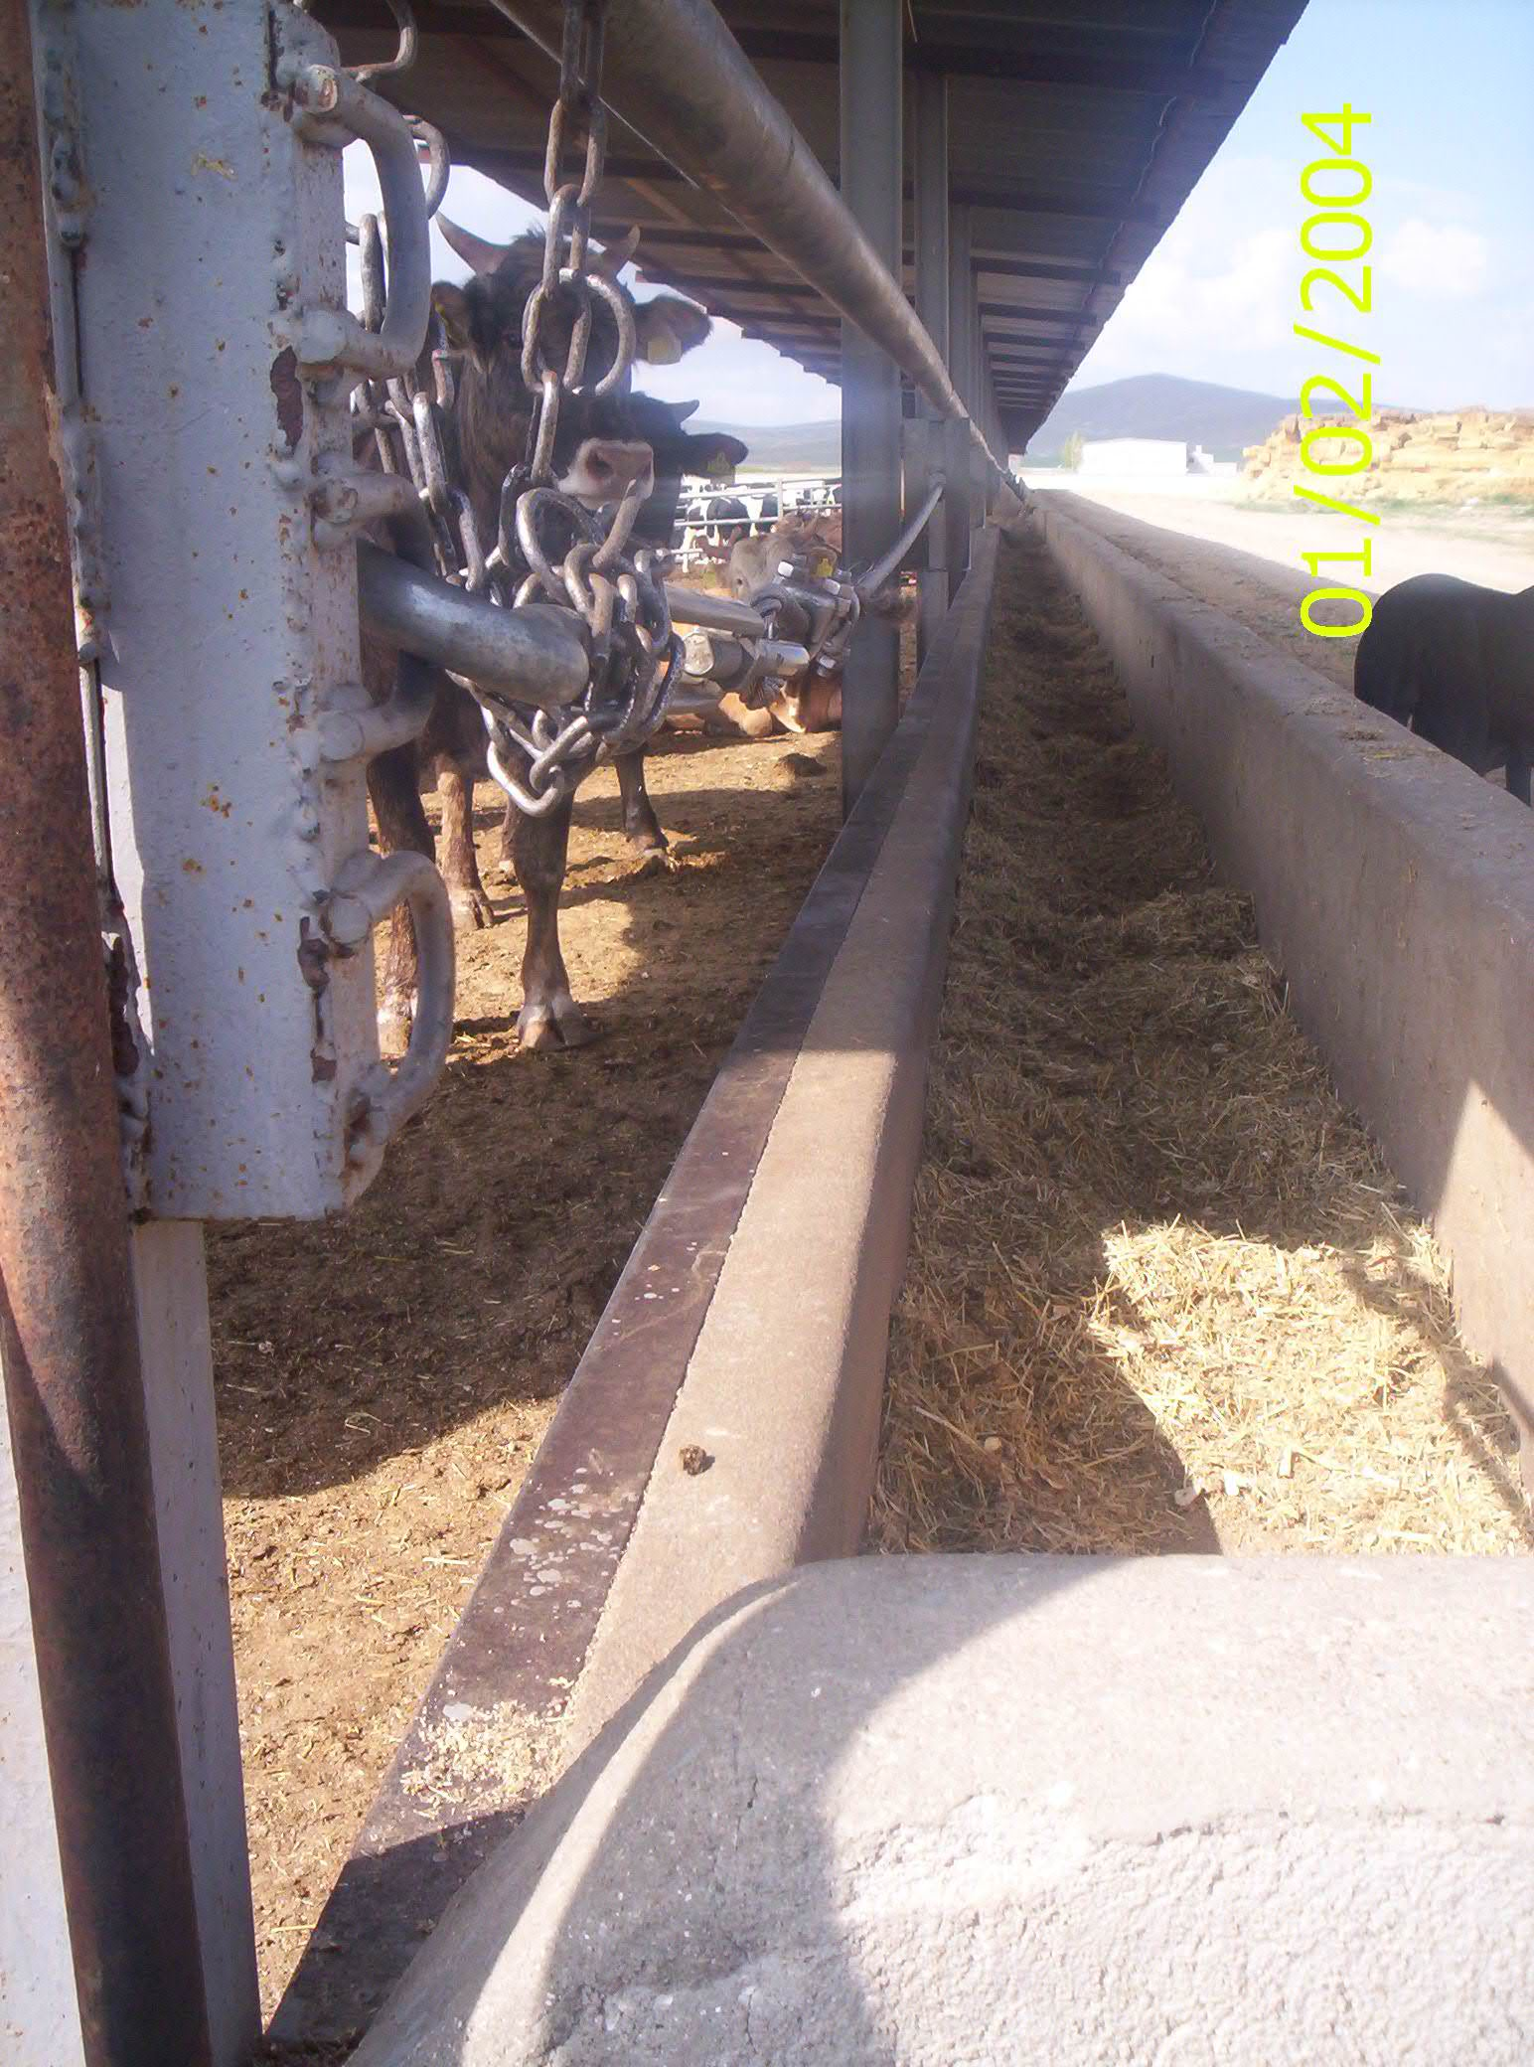

Slide 28
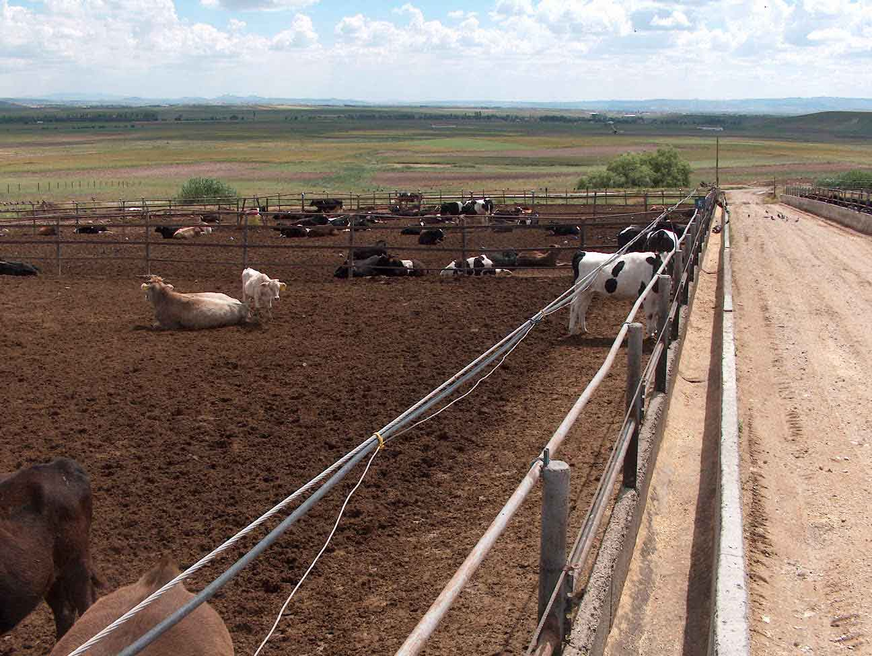

Slide 30
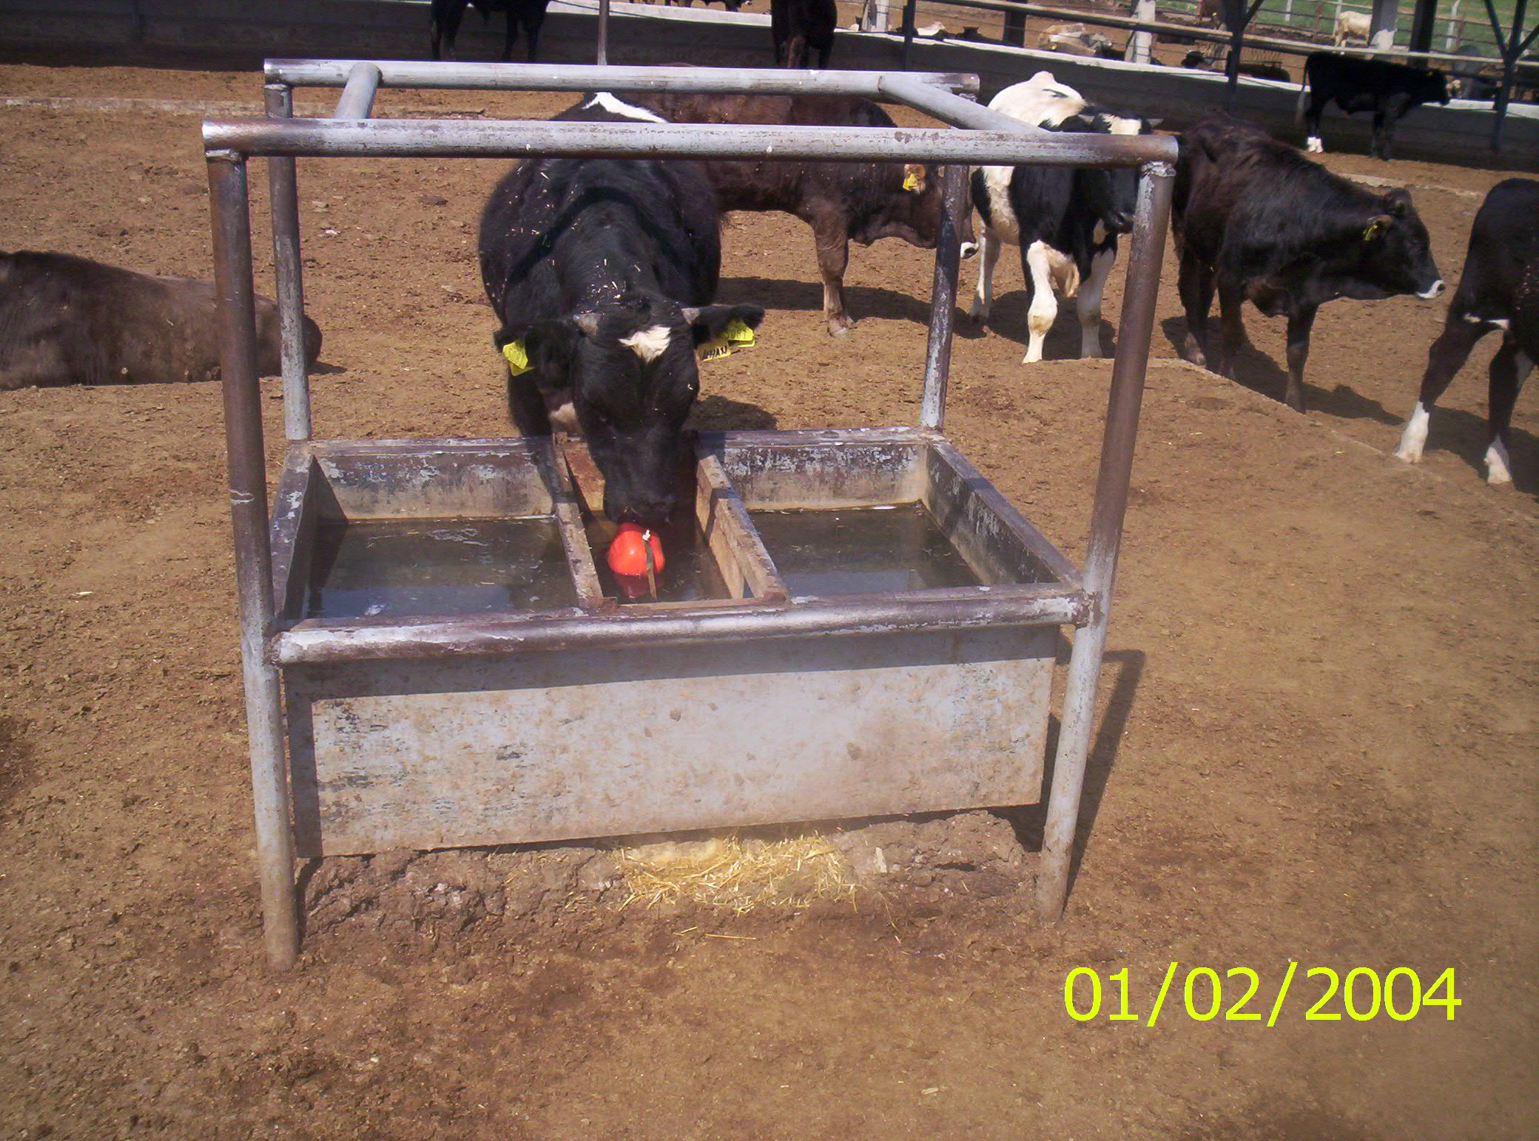

Slide 31
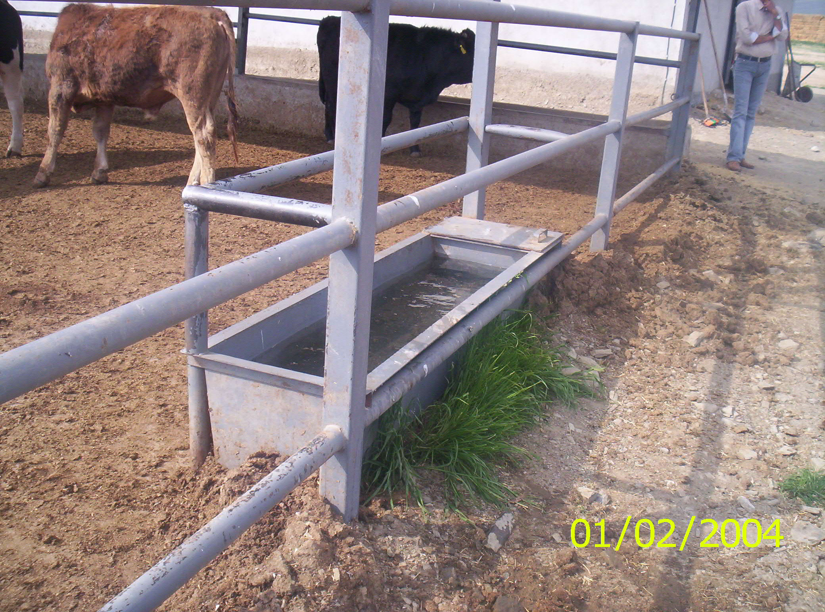

Slide 33
Factors - relevant to the diseases
Acidosis
Meteorism
Enteritis
Foot and mouth disease
Coccidiosis
Bronchopneumonia
IBR
Leptospirosis
etc...

Slide 34
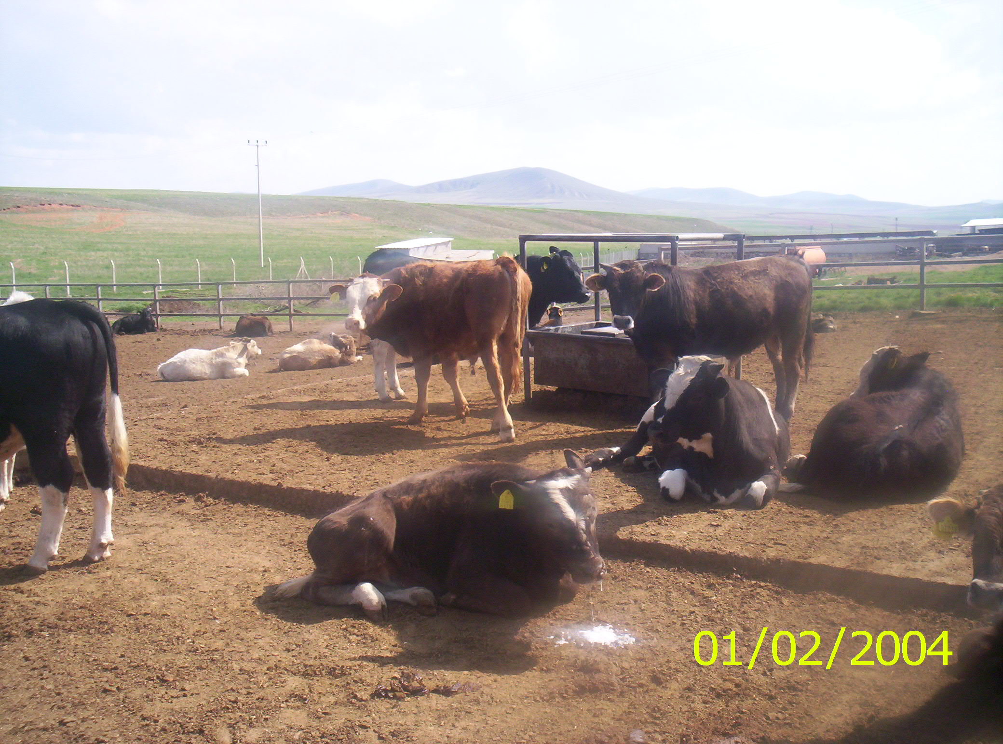
Foot and mouth disease

Slide 37
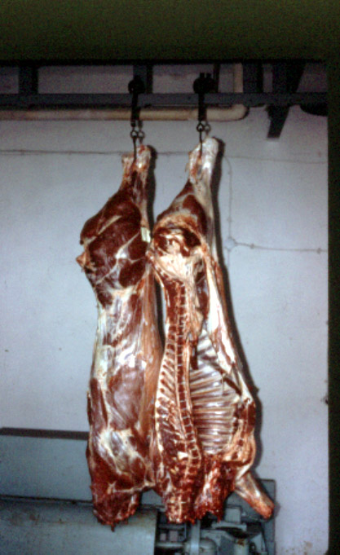
Slaughter and Carcass Traits
The carcass should be split into two sides.
The weight of the warm dressed carcass should be determined and the carcass moved to the cooler promptly. When the adopted period of chilling has elapsed, the weight of the cold dressed carcass should be determined.

Slide 38
Dressing Percentage
The weight of the dressed carcass in relation to the weight of the live slaughter animal-the dressing percentage-is a factor of obvious importance in evaluating the product from animal production experiments. However, the weight of the contents of the digestive tract and bladder-often termed the ‘’fill’’-is generally an uncontrolled variable and introduces an unknown error in the individual case. This is done by utilizing the ‘’empty-body’’ (net live) weight together with the warm or chilled dressed weight in calculating the dressing percentage.

