Slide 1
Embriyo Transferinde 5 Temel Adım
Embriyo transferi nedir?
Embriyo transferi, belirli genetik özelliklere sahip bir hayvanı daha hızlı üretmenin bir yoludur.
Donör ve alıcının yönetimi
Donörün süperovülasyonu ve alıcının östrus senkronizasyonu
Doğal çiftleşme veya suni tohumlama uygulaması
Embriyonun toplanması ve değerlendirilmesi
Embriyo transferi
http://www.google.com.tr/imgres?imgurl=http://1.bp.blogspot.com/-bnzeFlLc2pM/Ti8_mFnwLzI/AAAAAAAAADE/eP4VUJ4WFeo/s640/Fig.2.JPG&imgrefurl=http://videocirurgiavet.blogspot.com/p/videocirurgia-em-animais-de-ompanhia.html&h=349&w=584&tbnid=Wef3TYMx3JbwDM:&zoom=1&docid=hc27gDd3dK18lM&itg=1&ei=C5LtVJGKEefEygP80YDAAg&tbm=isch&client=safari&ved=0CEkQMyglMCU
http://www.vhhms.com/index.php/LAPAROSCOPIC_AI_and_ET_in_SHEEP,_GOATS_and_DEER;http://extension.missouri.edu/p/MP913
Notes:
8 ET
ET technique, allows the production of a large number of offspring from selected dams, thus optimizing selection response in breeding programs given the higher selection intensity and lower generation interval achieved. The success of ET depends on several factors affecting survival of transferred embryos including;
management of donor and recipient does,
estrus synchronization in donors and recipients and superovulation of donors,
An average of 6 to 8 transferable embryos per donor can be produced in a successful goat ET program. These results depend on some factors such as breed, age and nutrition that contribute to the high variability. The variability of the superovulatory response, the poor fertilization associated with high ovulatory responses and early regression of corpora lutea.
Superovulation
There are a number of ways to superovulate goat and sheep, each of which has its advantages and disadvantages. The major commercial products applied are equine chorionic gonadotrophin (eCG or PMSG) and FSHp (porcine pituitary gland).
FSH is administered twice daily for 3-4 days, usually in decreasing doses between 1-5 mg (example 2-2-1.5-1.5-1-1-0.5-0.5), beginning between 1 and 4 days before the end of the progestagen treatment since the half-life of pFSH is only 5 hours.
Average number of oocytes recovered is significantly higher in FSH-treated goats (9.4) than PMSG-treated goats (5.7).
Both intrinsic and extrinsic factors are responsible for the variability. Among the intrinsic factors, genetic, age, stage of the cycle at which the treatment applied are important. Environmental factors such as season, nutrition, health state, AI and type of gonadotrophin administered are known to contribute to the variability.
natural breeding or Artificial Insemination,
collection and evaluation of embryos,
transfer of embryos
What is the limitation to widely use this technique?
mostly because of the lower benefit/cost ratio achieved in this species,
the uncertainty (belirsizlik) of results as a pregnancy rate,
wide range variability of response to superovulation,
fertilization failure and premature regression of the corpus luteum,
It is need to perform embryo collection by surgical way, even though non-surgical procedures have been described.

Slide 2
Embriyo transferi nedir?
Embriyo transferi, belirli genetik özelliklere sahip bir hayvanı daha hızlı üretmenin bir yoludur.
http://www.google.com.tr/imgres?imgurl=http://1.bp.blogspot.com/-bnzeFlLc2pM/Ti8_mFnwLzI/AAAAAAAAADE/eP4VUJ4WFeo/s640/Fig.2.JPG&imgrefurl=http://videocirurgiavet.blogspot.com/p/videocirurgia-em-animais-de-ompanhia.html&h=349&w=584&tbnid=Wef3TYMx3JbwDM:&zoom=1&docid=hc27gDd3dK18lM&itg=1&ei=C5LtVJGKEefEygP80YDAAg&tbm=isch&client=safari&ved=0CEkQMyglMCU
http://www.vhhms.com/index.php/LAPAROSCOPIC_AI_and_ET_in_SHEEP,_GOATS_and_DEER;http://extension.missouri.edu/p/MP913
Notes:
8 ET
ET technique, allows the production of a large number of offspring from selected dams, thus optimizing selection response in breeding programs given the higher selection intensity and lower generation interval achieved. The success of ET depends on several factors affecting survival of transferred embryos including;
management of donor and recipient does,
estrus synchronization in donors and recipients and superovulation of donors,
An average of 6 to 8 transferable embryos per donor can be produced in a successful goat ET program. These results depend on some factors such as breed, age and nutrition that contribute to the high variability. The variability of the superovulatory response, the poor fertilization associated with high ovulatory responses and early regression of corpora lutea.
Superovulation
There are a number of ways to superovulate goat and sheep, each of which has its advantages and disadvantages. The major commercial products applied are equine chorionic gonadotrophin (eCG or PMSG) and FSHp (porcine pituitary gland).
FSH is administered twice daily for 3-4 days, usually in decreasing doses between 1-5 mg (example 2-2-1.5-1.5-1-1-0.5-0.5), beginning between 1 and 4 days before the end of the progestagen treatment since the half-life of pFSH is only 5 hours.
Average number of oocytes recovered is significantly higher in FSH-treated goats (9.4) than PMSG-treated goats (5.7).
Both intrinsic and extrinsic factors are responsible for the variability. Among the intrinsic factors, genetic, age, stage of the cycle at which the treatment applied are important. Environmental factors such as season, nutrition, health state, AI and type of gonadotrophin administered are known to contribute to the variability.
natural breeding or Artificial Insemination,
collection and evaluation of embryos,
transfer of embryos
What is the limitation to widely use this technique?
mostly because of the lower benefit/cost ratio achieved in this species,
the uncertainty (belirsizlik) of results as a pregnancy rate,
wide range variability of response to superovulation,
fertilization failure and premature regression of the corpus luteum,
It is need to perform embryo collection by surgical way, even though non-surgical procedures have been described.

Slide 3
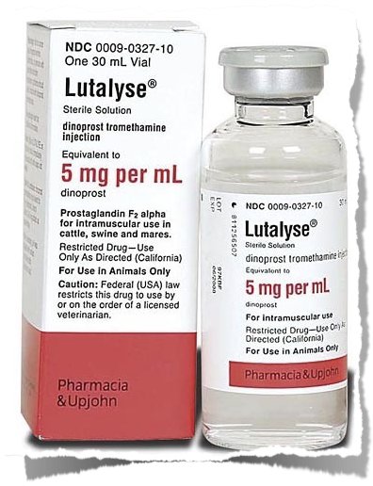
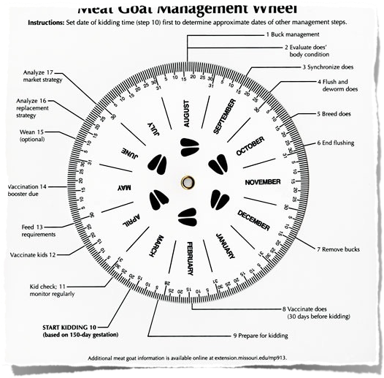
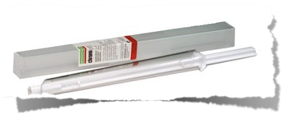
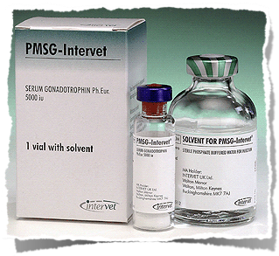
http://www.google.com.tr/imgres?imgurl=http://1.bp.blogspot.com/-bnzeFlLc2pM/Ti8_mFnwLzI/AAAAAAAAADE/eP4VUJ4WFeo/s640/Fig.2.JPG&imgrefurl=http://videocirurgiavet.blogspot.com/p/videocirurgia-em-animais-de-ompanhia.html&h=349&w=584&tbnid=Wef3TYMx3JbwDM:&zoom=1&docid=hc27gDd3dK18lM&itg=1&ei=C5LtVJGKEefEygP80YDAAg&tbm=isch&client=safari&ved=0CEkQMyglMCU
http://www.vhhms.com/index.php/LAPAROSCOPIC_AI_and_ET_in_SHEEP,_GOATS_and_DEER;http://extension.missouri.edu/p/MP913
Notes:
8 ET
ET technique, allows the production of a large number of offspring from selected dams, thus optimizing selection response in breeding programs given the higher selection intensity and lower generation interval achieved. The success of ET depends on several factors affecting survival of transferred embryos including;
management of donor and recipient does,
estrus synchronization in donors and recipients and superovulation of donors,
An average of 6 to 8 transferable embryos per donor can be produced in a successful goat ET program. These results depend on some factors such as breed, age and nutrition that contribute to the high variability. The variability of the superovulatory response, the poor fertilization associated with high ovulatory responses and early regression of corpora lutea.
Superovulation
There are a number of ways to superovulate goat and sheep, each of which has its advantages and disadvantages. The major commercial products applied are equine chorionic gonadotrophin (eCG or PMSG) and FSHp (porcine pituitary gland).
FSH is administered twice daily for 3-4 days, usually in decreasing doses between 1-5 mg (example 2-2-1.5-1.5-1-1-0.5-0.5), beginning between 1 and 4 days before the end of the progestagen treatment since the half-life of pFSH is only 5 hours.
Average number of oocytes recovered is significantly higher in FSH-treated goats (9.4) than PMSG-treated goats (5.7).
Both intrinsic and extrinsic factors are responsible for the variability. Among the intrinsic factors, genetic, age, stage of the cycle at which the treatment applied are important. Environmental factors such as season, nutrition, health state, AI and type of gonadotrophin administered are known to contribute to the variability.
natural breeding or Artificial Insemination,
collection and evaluation of embryos,
transfer of embryos
What is the limitation to widely use this technique?
mostly because of the lower benefit/cost ratio achieved in this species,
the uncertainty (belirsizlik) of results as a pregnancy rate,
wide range variability of response to superovulation,
fertilization failure and premature regression of the corpus luteum,
It is need to perform embryo collection by surgical way, even though non-surgical procedures have been described.

Slide 4
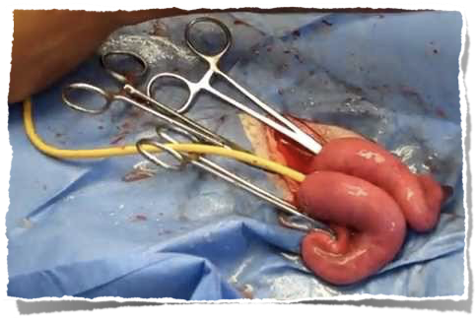
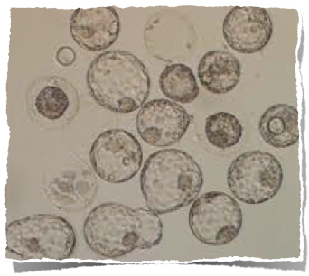
http://www.google.com.tr/imgres?imgurl=http://1.bp.blogspot.com/-bnzeFlLc2pM/Ti8_mFnwLzI/AAAAAAAAADE/eP4VUJ4WFeo/s640/Fig.2.JPG&imgrefurl=http://videocirurgiavet.blogspot.com/p/videocirurgia-em-animais-de-ompanhia.html&h=349&w=584&tbnid=Wef3TYMx3JbwDM:&zoom=1&docid=hc27gDd3dK18lM&itg=1&ei=C5LtVJGKEefEygP80YDAAg&tbm=isch&client=safari&ved=0CEkQMyglMCU
http://www.vhhms.com/index.php/LAPAROSCOPIC_AI_and_ET_in_SHEEP,_GOATS_and_DEER;http://extension.missouri.edu/p/MP913
Notes:
8 ET
ET technique, allows the production of a large number of offspring from selected dams, thus optimizing selection response in breeding programs given the higher selection intensity and lower generation interval achieved. The success of ET depends on several factors affecting survival of transferred embryos including;
management of donor and recipient does,
estrus synchronization in donors and recipients and superovulation of donors,
An average of 6 to 8 transferable embryos per donor can be produced in a successful goat ET program. These results depend on some factors such as breed, age and nutrition that contribute to the high variability. The variability of the superovulatory response, the poor fertilization associated with high ovulatory responses and early regression of corpora lutea.
Superovulation
There are a number of ways to superovulate goat and sheep, each of which has its advantages and disadvantages. The major commercial products applied are equine chorionic gonadotrophin (eCG or PMSG) and FSHp (porcine pituitary gland).
FSH is administered twice daily for 3-4 days, usually in decreasing doses between 1-5 mg (example 2-2-1.5-1.5-1-1-0.5-0.5), beginning between 1 and 4 days before the end of the progestagen treatment since the half-life of pFSH is only 5 hours.
Average number of oocytes recovered is significantly higher in FSH-treated goats (9.4) than PMSG-treated goats (5.7).
Both intrinsic and extrinsic factors are responsible for the variability. Among the intrinsic factors, genetic, age, stage of the cycle at which the treatment applied are important. Environmental factors such as season, nutrition, health state, AI and type of gonadotrophin administered are known to contribute to the variability.
natural breeding or Artificial Insemination,
collection and evaluation of embryos,
transfer of embryos
What is the limitation to widely use this technique?
mostly because of the lower benefit/cost ratio achieved in this species,
the uncertainty (belirsizlik) of results as a pregnancy rate,
wide range variability of response to superovulation,
fertilization failure and premature regression of the corpus luteum,
It is need to perform embryo collection by surgical way, even though non-surgical procedures have been described.

Slide 5
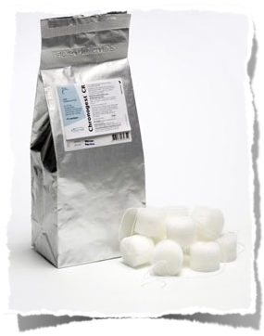
http://www.google.com.tr/imgres?imgurl=http://1.bp.blogspot.com/-bnzeFlLc2pM/Ti8_mFnwLzI/AAAAAAAAADE/eP4VUJ4WFeo/s640/Fig.2.JPG&imgrefurl=http://videocirurgiavet.blogspot.com/p/videocirurgia-em-animais-de-ompanhia.html&h=349&w=584&tbnid=Wef3TYMx3JbwDM:&zoom=1&docid=hc27gDd3dK18lM&itg=1&ei=C5LtVJGKEefEygP80YDAAg&tbm=isch&client=safari&ved=0CEkQMyglMCU
http://www.vhhms.com/index.php/LAPAROSCOPIC_AI_and_ET_in_SHEEP,_GOATS_and_DEER;http://extension.missouri.edu/p/MP913
Notes:
8 ET
ET technique, allows the production of a large number of offspring from selected dams, thus optimizing selection response in breeding programs given the higher selection intensity and lower generation interval achieved. The success of ET depends on several factors affecting survival of transferred embryos including;
management of donor and recipient does,
estrus synchronization in donors and recipients and superovulation of donors,
An average of 6 to 8 transferable embryos per donor can be produced in a successful goat ET program. These results depend on some factors such as breed, age and nutrition that contribute to the high variability. The variability of the superovulatory response, the poor fertilization associated with high ovulatory responses and early regression of corpora lutea.
Superovulation
There are a number of ways to superovulate goat and sheep, each of which has its advantages and disadvantages. The major commercial products applied are equine chorionic gonadotrophin (eCG or PMSG) and FSHp (porcine pituitary gland).
FSH is administered twice daily for 3-4 days, usually in decreasing doses between 1-5 mg (example 2-2-1.5-1.5-1-1-0.5-0.5), beginning between 1 and 4 days before the end of the progestagen treatment since the half-life of pFSH is only 5 hours.
Average number of oocytes recovered is significantly higher in FSH-treated goats (9.4) than PMSG-treated goats (5.7).
Both intrinsic and extrinsic factors are responsible for the variability. Among the intrinsic factors, genetic, age, stage of the cycle at which the treatment applied are important. Environmental factors such as season, nutrition, health state, AI and type of gonadotrophin administered are known to contribute to the variability.
natural breeding or Artificial Insemination,
collection and evaluation of embryos,
transfer of embryos
What is the limitation to widely use this technique?
mostly because of the lower benefit/cost ratio achieved in this species,
the uncertainty (belirsizlik) of results as a pregnancy rate,
wide range variability of response to superovulation,
fertilization failure and premature regression of the corpus luteum,
It is need to perform embryo collection by surgical way, even though non-surgical procedures have been described.

Slide 6
ET tekniği, seçilen bireylerden çok sayıda yavru üretilmesine izin verir.
ET'nin başarısı, transfer edilen embriyoların hayatta kalmasını etkileyen çeşitli faktörlere bağlıdır; verici ve alıcı yönetimi yapar,
Donör ve alıcılarda östrus senkronizasyonu ve donörlerin süperovulasyonu,
Başarılı bir keçi ET programında donör başına ortalama 6 ila 8 aktarılabilir embriyo üretilebilir.
Bu sonuçlar, ırk, yaş ve beslenme gibi bazı faktörlere bağlıdır.
Uygulanan başlıca ticari ürünler at koryonik gonadotropin (eCG veya PMSG) ve FSHp'dir (domuz hipofiz bezi).
http://www.google.com.tr/imgres?imgurl=http://1.bp.blogspot.com/-bnzeFlLc2pM/Ti8_mFnwLzI/AAAAAAAAADE/eP4VUJ4WFeo/s640/Fig.2.JPG&imgrefurl=http://videocirurgiavet.blogspot.com/p/videocirurgia-em-animais-de-ompanhia.html&h=349&w=584&tbnid=Wef3TYMx3JbwDM:&zoom=1&docid=hc27gDd3dK18lM&itg=1&ei=C5LtVJGKEefEygP80YDAAg&tbm=isch&client=safari&ved=0CEkQMyglMCU
http://www.vhhms.com/index.php/LAPAROSCOPIC_AI_and_ET_in_SHEEP,_GOATS_and_DEER;http://extension.missouri.edu/p/MP913
Notes:
8 ET
ET technique, allows the production of a large number of offspring from selected dams, thus optimizing selection response in breeding programs given the higher selection intensity and lower generation interval achieved. The success of ET depends on several factors affecting survival of transferred embryos including;
management of donor and recipient does,
estrus synchronization in donors and recipients and superovulation of donors,
An average of 6 to 8 transferable embryos per donor can be produced in a successful goat ET program. These results depend on some factors such as breed, age and nutrition that contribute to the high variability. The variability of the superovulatory response, the poor fertilization associated with high ovulatory responses and early regression of corpora lutea.
Superovulation
There are a number of ways to superovulate goat and sheep, each of which has its advantages and disadvantages. The major commercial products applied are equine chorionic gonadotrophin (eCG or PMSG) and FSHp (porcine pituitary gland).
FSH is administered twice daily for 3-4 days, usually in decreasing doses between 1-5 mg (example 2-2-1.5-1.5-1-1-0.5-0.5), beginning between 1 and 4 days before the end of the progestagen treatment since the half-life of pFSH is only 5 hours.
Average number of oocytes recovered is significantly higher in FSH-treated goats (9.4) than PMSG-treated goats (5.7).
Both intrinsic and extrinsic factors are responsible for the variability. Among the intrinsic factors, genetic, age, stage of the cycle at which the treatment applied are important. Environmental factors such as season, nutrition, health state, AI and type of gonadotrophin administered are known to contribute to the variability.
natural breeding or Artificial Insemination,
collection and evaluation of embryos,
transfer of embryos
What is the limitation to widely use this technique?
mostly because of the lower benefit/cost ratio achieved in this species,
the uncertainty (belirsizlik) of results as a pregnancy rate,
wide range variability of response to superovulation,
fertilization failure and premature regression of the corpus luteum,
It is need to perform embryo collection by surgical way, even though non-surgical procedures have been described.

Slide 7
Uygulanan başlıca ticari ürünler at koryonik gonadotropin (eCG veya PMSG) ve FSHp'dir (domuz hipofiz bezi).
FSH 3-4 gün boyunca günde iki kez, genellikle 1-5 mg arasındaki (örneğin 2-2-1.5-1.5-1-1-0.5-0.5) azalan dozlarda uygulanır;
Geri kazanılan ortalama oosit sayısı FSH ile tedavi edilen keçilerde PMSG ile tedavi edilen keçilere göre önemli ölçüde daha yüksektir.
Faktörler arasında, uygulanan tedavinin genetik, yaş ve siklusun evresi önemlidir.
Mevsim, beslenme, sağlık durumu, ST ve uygulanan gonadotropin türü gibi çevresel faktörlerin değişkenliğe katkıda bulunduğu bilinmektedir.
http://www.google.com.tr/imgres?imgurl=http://1.bp.blogspot.com/-bnzeFlLc2pM/Ti8_mFnwLzI/AAAAAAAAADE/eP4VUJ4WFeo/s640/Fig.2.JPG&imgrefurl=http://videocirurgiavet.blogspot.com/p/videocirurgia-em-animais-de-ompanhia.html&h=349&w=584&tbnid=Wef3TYMx3JbwDM:&zoom=1&docid=hc27gDd3dK18lM&itg=1&ei=C5LtVJGKEefEygP80YDAAg&tbm=isch&client=safari&ved=0CEkQMyglMCU
http://www.vhhms.com/index.php/LAPAROSCOPIC_AI_and_ET_in_SHEEP,_GOATS_and_DEER;http://extension.missouri.edu/p/MP913
Notes:
8 ET
ET technique, allows the production of a large number of offspring from selected dams, thus optimizing selection response in breeding programs given the higher selection intensity and lower generation interval achieved. The success of ET depends on several factors affecting survival of transferred embryos including;
management of donor and recipient does,
estrus synchronization in donors and recipients and superovulation of donors,
An average of 6 to 8 transferable embryos per donor can be produced in a successful goat ET program. These results depend on some factors such as breed, age and nutrition that contribute to the high variability. The variability of the superovulatory response, the poor fertilization associated with high ovulatory responses and early regression of corpora lutea.
Superovulation
There are a number of ways to superovulate goat and sheep, each of which has its advantages and disadvantages. The major commercial products applied are equine chorionic gonadotrophin (eCG or PMSG) and FSHp (porcine pituitary gland).
FSH is administered twice daily for 3-4 days, usually in decreasing doses between 1-5 mg (example 2-2-1.5-1.5-1-1-0.5-0.5), beginning between 1 and 4 days before the end of the progestagen treatment since the half-life of pFSH is only 5 hours.
Average number of oocytes recovered is significantly higher in FSH-treated goats (9.4) than PMSG-treated goats (5.7).
Both intrinsic and extrinsic factors are responsible for the variability. Among the intrinsic factors, genetic, age, stage of the cycle at which the treatment applied are important. Environmental factors such as season, nutrition, health state, AI and type of gonadotrophin administered are known to contribute to the variability.
natural breeding or Artificial Insemination,
collection and evaluation of embryos,
transfer of embryos
What is the limitation to widely use this technique?
mostly because of the lower benefit/cost ratio achieved in this species,
the uncertainty (belirsizlik) of results as a pregnancy rate,
wide range variability of response to superovulation,
fertilization failure and premature regression of the corpus luteum,
It is need to perform embryo collection by surgical way, even though non-surgical procedures have been described.

Slide 8
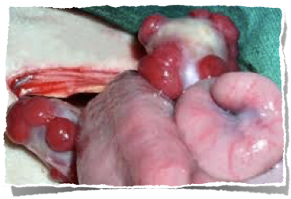
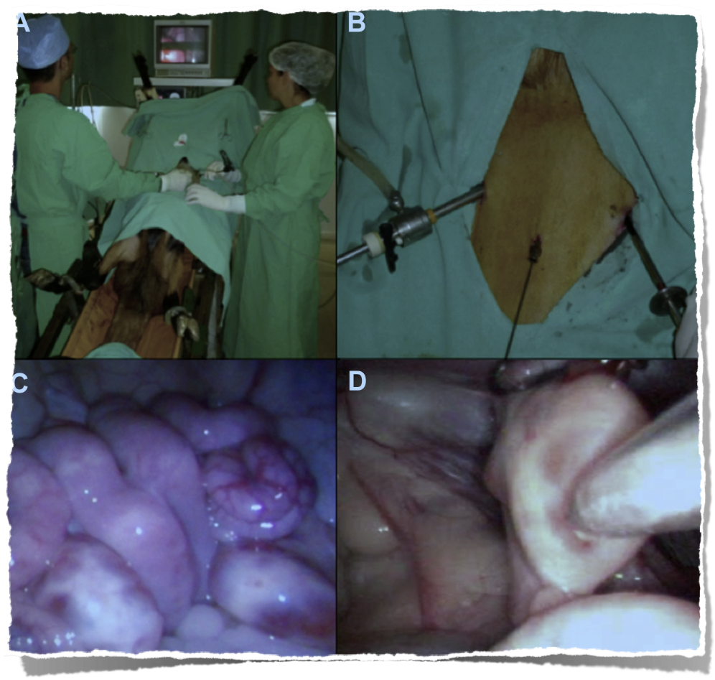
http://www.google.com.tr/imgres?imgurl=http://1.bp.blogspot.com/-bnzeFlLc2pM/Ti8_mFnwLzI/AAAAAAAAADE/eP4VUJ4WFeo/s640/Fig.2.JPG&imgrefurl=http://videocirurgiavet.blogspot.com/p/videocirurgia-em-animais-de-ompanhia.html&h=349&w=584&tbnid=Wef3TYMx3JbwDM:&zoom=1&docid=hc27gDd3dK18lM&itg=1&ei=C5LtVJGKEefEygP80YDAAg&tbm=isch&client=safari&ved=0CEkQMyglMCU
http://www.vhhms.com/index.php/LAPAROSCOPIC_AI_and_ET_in_SHEEP,_GOATS_and_DEER;http://extension.missouri.edu/p/MP913
Notes:
8 ET
ET technique, allows the production of a large number of offspring from selected dams, thus optimizing selection response in breeding programs given the higher selection intensity and lower generation interval achieved. The success of ET depends on several factors affecting survival of transferred embryos including;
management of donor and recipient does,
estrus synchronization in donors and recipients and superovulation of donors,
An average of 6 to 8 transferable embryos per donor can be produced in a successful goat ET program. These results depend on some factors such as breed, age and nutrition that contribute to the high variability. The variability of the superovulatory response, the poor fertilization associated with high ovulatory responses and early regression of corpora lutea.
Superovulation
There are a number of ways to superovulate goat and sheep, each of which has its advantages and disadvantages. The major commercial products applied are equine chorionic gonadotrophin (eCG or PMSG) and FSHp (porcine pituitary gland).
FSH is administered twice daily for 3-4 days, usually in decreasing doses between 1-5 mg (example 2-2-1.5-1.5-1-1-0.5-0.5), beginning between 1 and 4 days before the end of the progestagen treatment since the half-life of pFSH is only 5 hours.
Average number of oocytes recovered is significantly higher in FSH-treated goats (9.4) than PMSG-treated goats (5.7).
Both intrinsic and extrinsic factors are responsible for the variability. Among the intrinsic factors, genetic, age, stage of the cycle at which the treatment applied are important. Environmental factors such as season, nutrition, health state, AI and type of gonadotrophin administered are known to contribute to the variability.
natural breeding or Artificial Insemination,
collection and evaluation of embryos,
transfer of embryos
What is the limitation to widely use this technique?
mostly because of the lower benefit/cost ratio achieved in this species,
the uncertainty (belirsizlik) of results as a pregnancy rate,
wide range variability of response to superovulation,
fertilization failure and premature regression of the corpus luteum,
It is need to perform embryo collection by surgical way, even though non-surgical procedures have been described.

Slide 9
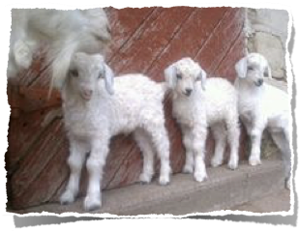
http://www.google.com.tr/imgres?imgurl=http://1.bp.blogspot.com/-bnzeFlLc2pM/Ti8_mFnwLzI/AAAAAAAAADE/eP4VUJ4WFeo/s640/Fig.2.JPG&imgrefurl=http://videocirurgiavet.blogspot.com/p/videocirurgia-em-animais-de-ompanhia.html&h=349&w=584&tbnid=Wef3TYMx3JbwDM:&zoom=1&docid=hc27gDd3dK18lM&itg=1&ei=C5LtVJGKEefEygP80YDAAg&tbm=isch&client=safari&ved=0CEkQMyglMCU
http://www.vhhms.com/index.php/LAPAROSCOPIC_AI_and_ET_in_SHEEP,_GOATS_and_DEER;http://extension.missouri.edu/p/MP913
Notes:
8 ET
ET technique, allows the production of a large number of offspring from selected dams, thus optimizing selection response in breeding programs given the higher selection intensity and lower generation interval achieved. The success of ET depends on several factors affecting survival of transferred embryos including;
management of donor and recipient does,
estrus synchronization in donors and recipients and superovulation of donors,
An average of 6 to 8 transferable embryos per donor can be produced in a successful goat ET program. These results depend on some factors such as breed, age and nutrition that contribute to the high variability. The variability of the superovulatory response, the poor fertilization associated with high ovulatory responses and early regression of corpora lutea.
Superovulation
There are a number of ways to superovulate goat and sheep, each of which has its advantages and disadvantages. The major commercial products applied are equine chorionic gonadotrophin (eCG or PMSG) and FSHp (porcine pituitary gland).
FSH is administered twice daily for 3-4 days, usually in decreasing doses between 1-5 mg (example 2-2-1.5-1.5-1-1-0.5-0.5), beginning between 1 and 4 days before the end of the progestagen treatment since the half-life of pFSH is only 5 hours.
Average number of oocytes recovered is significantly higher in FSH-treated goats (9.4) than PMSG-treated goats (5.7).
Both intrinsic and extrinsic factors are responsible for the variability. Among the intrinsic factors, genetic, age, stage of the cycle at which the treatment applied are important. Environmental factors such as season, nutrition, health state, AI and type of gonadotrophin administered are known to contribute to the variability.
natural breeding or Artificial Insemination,
collection and evaluation of embryos,
transfer of embryos
What is the limitation to widely use this technique?
mostly because of the lower benefit/cost ratio achieved in this species,
the uncertainty (belirsizlik) of results as a pregnancy rate,
wide range variability of response to superovulation,
fertilization failure and premature regression of the corpus luteum,
It is need to perform embryo collection by surgical way, even though non-surgical procedures have been described.

