Slide 1
Suni Tohumlama Nasıl Yapılır?
Taze
Soğutulmuş (kısa süreli saklama)
Dondurulmuş
Notes:
7 Artificial Insemination
Three methods of semen preservation and four techniques of insemination are used worldwide in small ruminants;
fresh, chilled (refrigerated) or frozen semen and
vaginal, cervical, intrauterine or, laparoscopic insemination techniques.
Fresh semen is the preferred method of preservation when the male is present in the herd, especially during the breeding season when semen production and quality are at their peak level. 38 ◦C and 24 hour with milk based diluents.
The use of chilled semen is a common strategy in circumstances where a particular male is shared by a group of farmers located within a relatively small area. In such cases, the semen is stored at (mines) ∼4◦C and can be used for up to 24 h from collection.
Finally, semen is frozen for long-term preservation allowing it to be marketed over a wide area, used throughout the year, and conserving the genetic material in case the animal dies. Vaginal insemination is successful for fresh semen.
Intracervical insemination is used for refrigerated and frozen semen. However, in order to achieve high pregnancy rates (>70%) with frozen semen, intrauterine deposition of semen is required. While in many does it is possible to by-pass the cervix and deposit the semen intrauterine, in certain categories of animals (e.g. doelings, breeds like Nigerian dwarf) and individuals this will only be possible using a laparoscopic technique, making the procedure more technically challenging.
The trans-cervical method of insemination involves grasping the cervix and retracting it into the vagina with a pair of forceps to allow an inseminating instrument to be introduced into the cervical canal. The University of Guelph (Canada) has developed an instrument with a special bent tip that allows passage through the cervix.
Laparoscopic insemination involves the penetration of the abdominal cavity and deposition of semen directly into the uterus of a ewe in estrus. In addition, gas is inserted into the abdominal cavity through a second abdominal penetration to assist insemination. Main aims of laparoscopic insemination are breeding stud rams and improving the genetic merit of progeny. The adequate anaesthesia, pre- and post-operative analgesia must be provided. Laparoscopic insemination must not be conducted routinely on the same ewe.
Factors effecting success are;
These techniques that we use are having differences as species, breedings, and the number of parturition for each animal. Overall AI fertility rates with frozen–thawed semen vary from 40% to 65%, and seem to be highly affected by factors such as season, farm, reproductive status of female, and site of semen deposition related to anatomical structure, convenient time for AI, response to synchronisation of doe.
Flushing
Convenient time
Monitoring
Response to synch.
Anatomical structure
Non-Stress

Slide 2
Suni Tohumlama Nasıl Yapılır?
Vajinal
Servikal
Transservikal
Laparoskopik
Notes:
7 Artificial Insemination
Three methods of semen preservation and four techniques of insemination are used worldwide in small ruminants;
fresh, chilled (refrigerated) or frozen semen and
vaginal, cervical, intrauterine or, laparoscopic insemination techniques.
Fresh semen is the preferred method of preservation when the male is present in the herd, especially during the breeding season when semen production and quality are at their peak level. 38 ◦C and 24 hour with milk based diluents.
The use of chilled semen is a common strategy in circumstances where a particular male is shared by a group of farmers located within a relatively small area. In such cases, the semen is stored at (mines) ∼4◦C and can be used for up to 24 h from collection.
Finally, semen is frozen for long-term preservation allowing it to be marketed over a wide area, used throughout the year, and conserving the genetic material in case the animal dies. Vaginal insemination is successful for fresh semen.
Intracervical insemination is used for refrigerated and frozen semen. However, in order to achieve high pregnancy rates (>70%) with frozen semen, intrauterine deposition of semen is required. While in many does it is possible to by-pass the cervix and deposit the semen intrauterine, in certain categories of animals (e.g. doelings, breeds like Nigerian dwarf) and individuals this will only be possible using a laparoscopic technique, making the procedure more technically challenging.
The trans-cervical method of insemination involves grasping the cervix and retracting it into the vagina with a pair of forceps to allow an inseminating instrument to be introduced into the cervical canal. The University of Guelph (Canada) has developed an instrument with a special bent tip that allows passage through the cervix.
Laparoscopic insemination involves the penetration of the abdominal cavity and deposition of semen directly into the uterus of a ewe in estrus. In addition, gas is inserted into the abdominal cavity through a second abdominal penetration to assist insemination. Main aims of laparoscopic insemination are breeding stud rams and improving the genetic merit of progeny. The adequate anaesthesia, pre- and post-operative analgesia must be provided. Laparoscopic insemination must not be conducted routinely on the same ewe.
Factors effecting success are;
These techniques that we use are having differences as species, breedings, and the number of parturition for each animal. Overall AI fertility rates with frozen–thawed semen vary from 40% to 65%, and seem to be highly affected by factors such as season, farm, reproductive status of female, and site of semen deposition related to anatomical structure, convenient time for AI, response to synchronisation of doe.
Flushing
Convenient time
Monitoring
Response to synch.
Anatomical structure
Non-Stress

Slide 3
Suni Tohumlama Nasıl Yapılır?
Flushing
Uygun zaman
Görüntüleme
Senkronizasyon
Anatomik yapı
Stressiz
Notes:
7 Artificial Insemination
Three methods of semen preservation and four techniques of insemination are used worldwide in small ruminants;
fresh, chilled (refrigerated) or frozen semen and
vaginal, cervical, intrauterine or, laparoscopic insemination techniques.
Fresh semen is the preferred method of preservation when the male is present in the herd, especially during the breeding season when semen production and quality are at their peak level. 38 ◦C and 24 hour with milk based diluents.
The use of chilled semen is a common strategy in circumstances where a particular male is shared by a group of farmers located within a relatively small area. In such cases, the semen is stored at (mines) ∼4◦C and can be used for up to 24 h from collection.
Finally, semen is frozen for long-term preservation allowing it to be marketed over a wide area, used throughout the year, and conserving the genetic material in case the animal dies. Vaginal insemination is successful for fresh semen.
Intracervical insemination is used for refrigerated and frozen semen. However, in order to achieve high pregnancy rates (>70%) with frozen semen, intrauterine deposition of semen is required. While in many does it is possible to by-pass the cervix and deposit the semen intrauterine, in certain categories of animals (e.g. doelings, breeds like Nigerian dwarf) and individuals this will only be possible using a laparoscopic technique, making the procedure more technically challenging.
The trans-cervical method of insemination involves grasping the cervix and retracting it into the vagina with a pair of forceps to allow an inseminating instrument to be introduced into the cervical canal. The University of Guelph (Canada) has developed an instrument with a special bent tip that allows passage through the cervix.
Laparoscopic insemination involves the penetration of the abdominal cavity and deposition of semen directly into the uterus of a ewe in estrus. In addition, gas is inserted into the abdominal cavity through a second abdominal penetration to assist insemination. Main aims of laparoscopic insemination are breeding stud rams and improving the genetic merit of progeny. The adequate anaesthesia, pre- and post-operative analgesia must be provided. Laparoscopic insemination must not be conducted routinely on the same ewe.
Factors effecting success are;
These techniques that we use are having differences as species, breedings, and the number of parturition for each animal. Overall AI fertility rates with frozen–thawed semen vary from 40% to 65%, and seem to be highly affected by factors such as season, farm, reproductive status of female, and site of semen deposition related to anatomical structure, convenient time for AI, response to synchronisation of doe.
Flushing
Convenient time
Monitoring
Response to synch.
Anatomical structure
Non-Stress

Slide 4
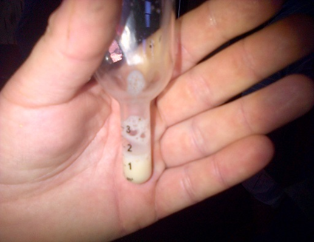
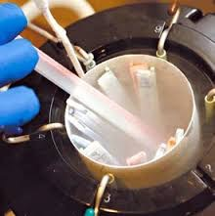
Suni Tohumlama Nasıl Yapılır?
Notes:
7 Artificial Insemination
Three methods of semen preservation and four techniques of insemination are used worldwide in small ruminants;
fresh, chilled (refrigerated) or frozen semen and
vaginal, cervical, intrauterine or, laparoscopic insemination techniques.
Fresh semen is the preferred method of preservation when the male is present in the herd, especially during the breeding season when semen production and quality are at their peak level. 38 ◦C and 24 hour with milk based diluents.
The use of chilled semen is a common strategy in circumstances where a particular male is shared by a group of farmers located within a relatively small area. In such cases, the semen is stored at (mines) ∼4◦C and can be used for up to 24 h from collection.
Finally, semen is frozen for long-term preservation allowing it to be marketed over a wide area, used throughout the year, and conserving the genetic material in case the animal dies. Vaginal insemination is successful for fresh semen.
Intracervical insemination is used for refrigerated and frozen semen. However, in order to achieve high pregnancy rates (>70%) with frozen semen, intrauterine deposition of semen is required. While in many does it is possible to by-pass the cervix and deposit the semen intrauterine, in certain categories of animals (e.g. doelings, breeds like Nigerian dwarf) and individuals this will only be possible using a laparoscopic technique, making the procedure more technically challenging.
The trans-cervical method of insemination involves grasping the cervix and retracting it into the vagina with a pair of forceps to allow an inseminating instrument to be introduced into the cervical canal. The University of Guelph (Canada) has developed an instrument with a special bent tip that allows passage through the cervix.
Laparoscopic insemination involves the penetration of the abdominal cavity and deposition of semen directly into the uterus of a ewe in estrus. In addition, gas is inserted into the abdominal cavity through a second abdominal penetration to assist insemination. Main aims of laparoscopic insemination are breeding stud rams and improving the genetic merit of progeny. The adequate anaesthesia, pre- and post-operative analgesia must be provided. Laparoscopic insemination must not be conducted routinely on the same ewe.
Factors effecting success are;
These techniques that we use are having differences as species, breedings, and the number of parturition for each animal. Overall AI fertility rates with frozen–thawed semen vary from 40% to 65%, and seem to be highly affected by factors such as season, farm, reproductive status of female, and site of semen deposition related to anatomical structure, convenient time for AI, response to synchronisation of doe.
Flushing
Convenient time
Monitoring
Response to synch.
Anatomical structure
Non-Stress

Slide 5
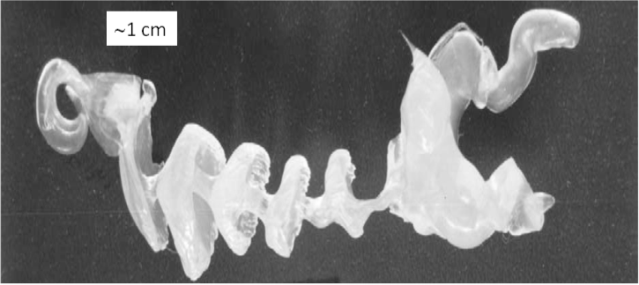
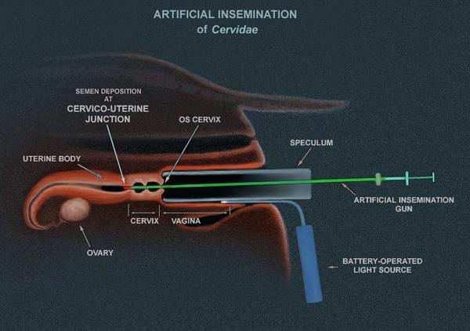
Notes:
7 Artificial Insemination
Three methods of semen preservation and four techniques of insemination are used worldwide in small ruminants;
fresh, chilled (refrigerated) or frozen semen and
vaginal, cervical, intrauterine or, laparoscopic insemination techniques.
Fresh semen is the preferred method of preservation when the male is present in the herd, especially during the breeding season when semen production and quality are at their peak level. 38 ◦C and 24 hour with milk based diluents.
The use of chilled semen is a common strategy in circumstances where a particular male is shared by a group of farmers located within a relatively small area. In such cases, the semen is stored at (mines) ∼4◦C and can be used for up to 24 h from collection.
Finally, semen is frozen for long-term preservation allowing it to be marketed over a wide area, used throughout the year, and conserving the genetic material in case the animal dies. Vaginal insemination is successful for fresh semen.
Intracervical insemination is used for refrigerated and frozen semen. However, in order to achieve high pregnancy rates (>70%) with frozen semen, intrauterine deposition of semen is required. While in many does it is possible to by-pass the cervix and deposit the semen intrauterine, in certain categories of animals (e.g. doelings, breeds like Nigerian dwarf) and individuals this will only be possible using a laparoscopic technique, making the procedure more technically challenging.
The trans-cervical method of insemination involves grasping the cervix and retracting it into the vagina with a pair of forceps to allow an inseminating instrument to be introduced into the cervical canal. The University of Guelph (Canada) has developed an instrument with a special bent tip that allows passage through the cervix.
Laparoscopic insemination involves the penetration of the abdominal cavity and deposition of semen directly into the uterus of a ewe in estrus. In addition, gas is inserted into the abdominal cavity through a second abdominal penetration to assist insemination. Main aims of laparoscopic insemination are breeding stud rams and improving the genetic merit of progeny. The adequate anaesthesia, pre- and post-operative analgesia must be provided. Laparoscopic insemination must not be conducted routinely on the same ewe.
Factors effecting success are;
These techniques that we use are having differences as species, breedings, and the number of parturition for each animal. Overall AI fertility rates with frozen–thawed semen vary from 40% to 65%, and seem to be highly affected by factors such as season, farm, reproductive status of female, and site of semen deposition related to anatomical structure, convenient time for AI, response to synchronisation of doe.
Flushing
Convenient time
Monitoring
Response to synch.
Anatomical structure
Non-Stress

Slide 6
Dünya çapında, küçükbaş hayvanlarda üç sperma koruma yöntemi ve dört tohumlama tekniği kullanılmaktadır;
Taze, soğutulmuş (soğutulmuş) veya dondurulmuş sperma ve vajinal, servikal, intrauterin veya laparoskopik döllenme teknikleri.
Taze sperma, özellikle sperma üretimi ve kalitesinin zirvede olduğu üreme mevsiminde tercih edilen koruma yöntemidir. Süt bazlı sulandırıcılar ile 38◦C ve 24 saat.
Soğutulmuş sperma kullanımı, belirli bir erkeğin nispeten küçük bir alanda bulunan bir grup çiftçi tarafından paylaşıldığı durumlarda yaygın bir stratejidir. Bu gibi durumlarda, sperma ∼4◦C'de saklanır ve alınmasından itibaren 24 saate kadar kullanılabilir.
Son olarak, sperma uzun süreli koruma için dondurulur ve geniş bir alanda pazarlanması mümkündür, yıl boyunca kullanılır ve hayvanın ölmesi durumunda genetik materyali korunur.
Vajinal tohumlama taze sperma için başarılıdır.
Notes:
7 Artificial Insemination
Three methods of semen preservation and four techniques of insemination are used worldwide in small ruminants;
fresh, chilled (refrigerated) or frozen semen and
vaginal, cervical, intrauterine or, laparoscopic insemination techniques.
Fresh semen is the preferred method of preservation when the male is present in the herd, especially during the breeding season when semen production and quality are at their peak level. 38 ◦C and 24 hour with milk based diluents.
The use of chilled semen is a common strategy in circumstances where a particular male is shared by a group of farmers located within a relatively small area. In such cases, the semen is stored at (mines) ∼4◦C and can be used for up to 24 h from collection.
Finally, semen is frozen for long-term preservation allowing it to be marketed over a wide area, used throughout the year, and conserving the genetic material in case the animal dies. Vaginal insemination is successful for fresh semen.
Intracervical insemination is used for refrigerated and frozen semen. However, in order to achieve high pregnancy rates (>70%) with frozen semen, intrauterine deposition of semen is required. While in many does it is possible to by-pass the cervix and deposit the semen intrauterine, in certain categories of animals (e.g. doelings, breeds like Nigerian dwarf) and individuals this will only be possible using a laparoscopic technique, making the procedure more technically challenging.
The trans-cervical method of insemination involves grasping the cervix and retracting it into the vagina with a pair of forceps to allow an inseminating instrument to be introduced into the cervical canal. The University of Guelph (Canada) has developed an instrument with a special bent tip that allows passage through the cervix.
Laparoscopic insemination involves the penetration of the abdominal cavity and deposition of semen directly into the uterus of a ewe in estrus. In addition, gas is inserted into the abdominal cavity through a second abdominal penetration to assist insemination. Main aims of laparoscopic insemination are breeding stud rams and improving the genetic merit of progeny. The adequate anaesthesia, pre- and post-operative analgesia must be provided. Laparoscopic insemination must not be conducted routinely on the same ewe.
Factors effecting success are;
These techniques that we use are having differences as species, breedings, and the number of parturition for each animal. Overall AI fertility rates with frozen–thawed semen vary from 40% to 65%, and seem to be highly affected by factors such as season, farm, reproductive status of female, and site of semen deposition related to anatomical structure, convenient time for AI, response to synchronisation of doe.
Flushing
Convenient time
Monitoring
Response to synch.
Anatomical structure
Non-Stress

Slide 7
İntraservikal tohumlama, soğutulmuş ve dondurulmuş sperma için kullanılır. Bununla birlikte, dondurulmuş sperma ile yüksek gebelik oranları (>% 70) elde etmek için intrauterin tohumlama gereklidir. Birçoğunda serviks by-pass ve intrauterin, belirli hayvan kategorilerinde (örneğin, doelings, Nijeryalı cüce gibi ırklar) ve bireylerde biriktirmek mümkün olsa da, bu sadece prosedürü daha teknik hale getiren laparoskopik bir teknik kullanılarak mümkün olacaktır. zorlayıcı.
Trans-servikal tohumlama yöntemi, serviksin kavranmasını ve bir tohumlama aletinin servikal kanala sokulmasını sağlamak için bir çift forseps ile vajinaya geri çekilmesini içerir. Guelph Üniversitesi (Kanada), serviks içinden geçişe izin veren özel bükülmüş ucu olan bir alet geliştirdi.
Laparoskopik döllenme, karın boşluğunun nüfuz etmesini ve semenin östrustaki bir dişi koyun rahmine birikmesini içerir. Ek olarak, döllenmeye yardımcı olmak için ikinci bir karın penetrasyonu yoluyla karın boşluğuna gaz sokulur. Laparoskopik döllenmenin temel amaçları damızlık koçanı yetiştirmek ve dölün genetik değerini arttırmaktır. Yeterli anestezi, ameliyat öncesi ve sonrası analjezi sağlanmalıdır. Laparoskopik tohumlama aynı dişi üzerinde rutin olarak yapılmamalıdır.
Notes:
7 Artificial Insemination
Three methods of semen preservation and four techniques of insemination are used worldwide in small ruminants;
fresh, chilled (refrigerated) or frozen semen and
vaginal, cervical, intrauterine or, laparoscopic insemination techniques.
Fresh semen is the preferred method of preservation when the male is present in the herd, especially during the breeding season when semen production and quality are at their peak level. 38 ◦C and 24 hour with milk based diluents.
The use of chilled semen is a common strategy in circumstances where a particular male is shared by a group of farmers located within a relatively small area. In such cases, the semen is stored at (mines) ∼4◦C and can be used for up to 24 h from collection.
Finally, semen is frozen for long-term preservation allowing it to be marketed over a wide area, used throughout the year, and conserving the genetic material in case the animal dies. Vaginal insemination is successful for fresh semen.
Intracervical insemination is used for refrigerated and frozen semen. However, in order to achieve high pregnancy rates (>70%) with frozen semen, intrauterine deposition of semen is required. While in many does it is possible to by-pass the cervix and deposit the semen intrauterine, in certain categories of animals (e.g. doelings, breeds like Nigerian dwarf) and individuals this will only be possible using a laparoscopic technique, making the procedure more technically challenging.
The trans-cervical method of insemination involves grasping the cervix and retracting it into the vagina with a pair of forceps to allow an inseminating instrument to be introduced into the cervical canal. The University of Guelph (Canada) has developed an instrument with a special bent tip that allows passage through the cervix.
Laparoscopic insemination involves the penetration of the abdominal cavity and deposition of semen directly into the uterus of a ewe in estrus. In addition, gas is inserted into the abdominal cavity through a second abdominal penetration to assist insemination. Main aims of laparoscopic insemination are breeding stud rams and improving the genetic merit of progeny. The adequate anaesthesia, pre- and post-operative analgesia must be provided. Laparoscopic insemination must not be conducted routinely on the same ewe.
Factors effecting success are;
These techniques that we use are having differences as species, breedings, and the number of parturition for each animal. Overall AI fertility rates with frozen–thawed semen vary from 40% to 65%, and seem to be highly affected by factors such as season, farm, reproductive status of female, and site of semen deposition related to anatomical structure, convenient time for AI, response to synchronisation of doe.
Flushing
Convenient time
Monitoring
Response to synch.
Anatomical structure
Non-Stress

Slide 8
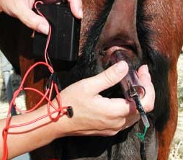
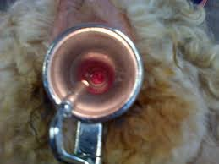
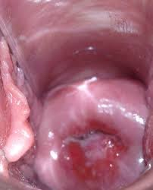
Notes:
7 Artificial Insemination
Three methods of semen preservation and four techniques of insemination are used worldwide in small ruminants;
fresh, chilled (refrigerated) or frozen semen and
vaginal, cervical, intrauterine or, laparoscopic insemination techniques.
Fresh semen is the preferred method of preservation when the male is present in the herd, especially during the breeding season when semen production and quality are at their peak level. 38 ◦C and 24 hour with milk based diluents.
The use of chilled semen is a common strategy in circumstances where a particular male is shared by a group of farmers located within a relatively small area. In such cases, the semen is stored at (mines) ∼4◦C and can be used for up to 24 h from collection.
Finally, semen is frozen for long-term preservation allowing it to be marketed over a wide area, used throughout the year, and conserving the genetic material in case the animal dies. Vaginal insemination is successful for fresh semen.
Intracervical insemination is used for refrigerated and frozen semen. However, in order to achieve high pregnancy rates (>70%) with frozen semen, intrauterine deposition of semen is required. While in many does it is possible to by-pass the cervix and deposit the semen intrauterine, in certain categories of animals (e.g. doelings, breeds like Nigerian dwarf) and individuals this will only be possible using a laparoscopic technique, making the procedure more technically challenging.
The trans-cervical method of insemination involves grasping the cervix and retracting it into the vagina with a pair of forceps to allow an inseminating instrument to be introduced into the cervical canal. The University of Guelph (Canada) has developed an instrument with a special bent tip that allows passage through the cervix.
Laparoscopic insemination involves the penetration of the abdominal cavity and deposition of semen directly into the uterus of a ewe in estrus. In addition, gas is inserted into the abdominal cavity through a second abdominal penetration to assist insemination. Main aims of laparoscopic insemination are breeding stud rams and improving the genetic merit of progeny. The adequate anaesthesia, pre- and post-operative analgesia must be provided. Laparoscopic insemination must not be conducted routinely on the same ewe.
Factors effecting success are;
These techniques that we use are having differences as species, breedings, and the number of parturition for each animal. Overall AI fertility rates with frozen–thawed semen vary from 40% to 65%, and seem to be highly affected by factors such as season, farm, reproductive status of female, and site of semen deposition related to anatomical structure, convenient time for AI, response to synchronisation of doe.
Flushing
Convenient time
Monitoring
Response to synch.
Anatomical structure
Non-Stress

Slide 9
Dünya çapında, küçükbaş hayvanlarda üç sperma koruma yöntemi ve dört tohumlama tekniği kullanılmaktadır;
Taze, soğutulmuş (soğutulmuş) veya dondurulmuş sperma ve vajinal, servikal, intrauterin veya laparoskopik döllenme teknikleri.
Taze sperma, özellikle sperma üretimi ve kalitesinin zirvede olduğu üreme mevsiminde tercih edilen koruma yöntemidir. Süt bazlı sulandırıcılar ile 38◦C ve 24 saat.
Soğutulmuş sperma kullanımı, belirli bir erkeğin nispeten küçük bir alanda bulunan bir grup çiftçi tarafından paylaşıldığı durumlarda yaygın bir stratejidir. Bu gibi durumlarda, sperma ∼4◦C'de saklanır ve alınmasından itibaren 24 saate kadar kullanılabilir.
Son olarak, sperma uzun süreli koruma için dondurulur ve geniş bir alanda pazarlanmasına izin verir, yıl boyunca kullanılır ve hayvanın ölmesi durumunda genetik materyali korur. Vajinal tohumlama taze sperma için başarılıdır.
İntraservikal tohumlama buzdolabında ve dondurulmuş meni için kullanılır. Bununla birlikte, dondurulmuş meni ile yüksek gebelik oranları (>% 70) elde etmek için, meni intrauterin birikimi gereklidir. Birçoğunda serviks by-pass ve meni intrauterin, belirli hayvan kategorilerinde (örneğin, doelings, Nijeryalı cüce gibi ırklar) ve bireylerde biriktirmek mümkün olsa da, bu sadece prosedürü daha teknik hale getiren laparoskopik bir teknik kullanılarak mümkün olacaktır. zorlayıcı.
Trans-servikal tohumlama yöntemi, serviksin kavranmasını ve bir tohumlama aletinin servikal kanala sokulmasını sağlamak için bir çift forseps ile vajinaya geri çekilmesini içerir. Guelph Üniversitesi (Kanada), serviks içinden geçişe izin veren özel bükülmüş ucu olan bir alet geliştirdi.
Laparoskopik döllenme, karın boşluğunun nüfuz etmesini ve semenin östrustaki bir dişi koyun rahmine birikmesini içerir. Ek olarak, döllenmeye yardımcı olmak için ikinci bir karın penetrasyonu yoluyla karın boşluğuna gaz sokulur. Laparoskopik döllenmenin temel amaçları damızlık koçanı yetiştirmek ve dölün genetik değerini arttırmaktır. Yeterli anestezi, ameliyat öncesi ve sonrası analjezi sağlanmalıdır. Laparoskopik tohumlama aynı dişi üzerinde rutin olarak yapılmamalıdır.
Başarıyı etkileyen faktörler;
Kullandığımız bu teknikler, türler, cinsler ve her hayvan için doğum sayısı olarak farklılık göstermektedir. Donmuş çözdürülmüş meni ile genel AI doğurganlık oranları% 40 ila% 65 arasında değişmektedir ve mevsim, çiftlik, dişinin üreme durumu ve anatomik yapıya bağlı semen birikme yeri, AI için uygun zaman gibi faktörlerden çok etkilenmiş gibi görünmektedir. , doe senkronizasyonuna yanıt.
Flushing
Uygun zaman
İzleme
Senkronizasyona yanıt.
Anatomik yapı
Sigara Stres
Notes:
7 Artificial Insemination
Three methods of semen preservation and four techniques of insemination are used worldwide in small ruminants;
fresh, chilled (refrigerated) or frozen semen and
vaginal, cervical, intrauterine or, laparoscopic insemination techniques.
Fresh semen is the preferred method of preservation when the male is present in the herd, especially during the breeding season when semen production and quality are at their peak level. 38 ◦C and 24 hour with milk based diluents.
The use of chilled semen is a common strategy in circumstances where a particular male is shared by a group of farmers located within a relatively small area. In such cases, the semen is stored at (mines) ∼4◦C and can be used for up to 24 h from collection.
Finally, semen is frozen for long-term preservation allowing it to be marketed over a wide area, used throughout the year, and conserving the genetic material in case the animal dies. Vaginal insemination is successful for fresh semen.
Intracervical insemination is used for refrigerated and frozen semen. However, in order to achieve high pregnancy rates (>70%) with frozen semen, intrauterine deposition of semen is required. While in many does it is possible to by-pass the cervix and deposit the semen intrauterine, in certain categories of animals (e.g. doelings, breeds like Nigerian dwarf) and individuals this will only be possible using a laparoscopic technique, making the procedure more technically challenging.
The trans-cervical method of insemination involves grasping the cervix and retracting it into the vagina with a pair of forceps to allow an inseminating instrument to be introduced into the cervical canal. The University of Guelph (Canada) has developed an instrument with a special bent tip that allows passage through the cervix.
Laparoscopic insemination involves the penetration of the abdominal cavity and deposition of semen directly into the uterus of a ewe in estrus. In addition, gas is inserted into the abdominal cavity through a second abdominal penetration to assist insemination. Main aims of laparoscopic insemination are breeding stud rams and improving the genetic merit of progeny. The adequate anaesthesia, pre- and post-operative analgesia must be provided. Laparoscopic insemination must not be conducted routinely on the same ewe.
Factors effecting success are;
These techniques that we use are having differences as species, breedings, and the number of parturition for each animal. Overall AI fertility rates with frozen–thawed semen vary from 40% to 65%, and seem to be highly affected by factors such as season, farm, reproductive status of female, and site of semen deposition related to anatomical structure, convenient time for AI, response to synchronisation of doe.
Flushing
Convenient time
Monitoring
Response to synch.
Anatomical structure
Non-Stress

Slide 10
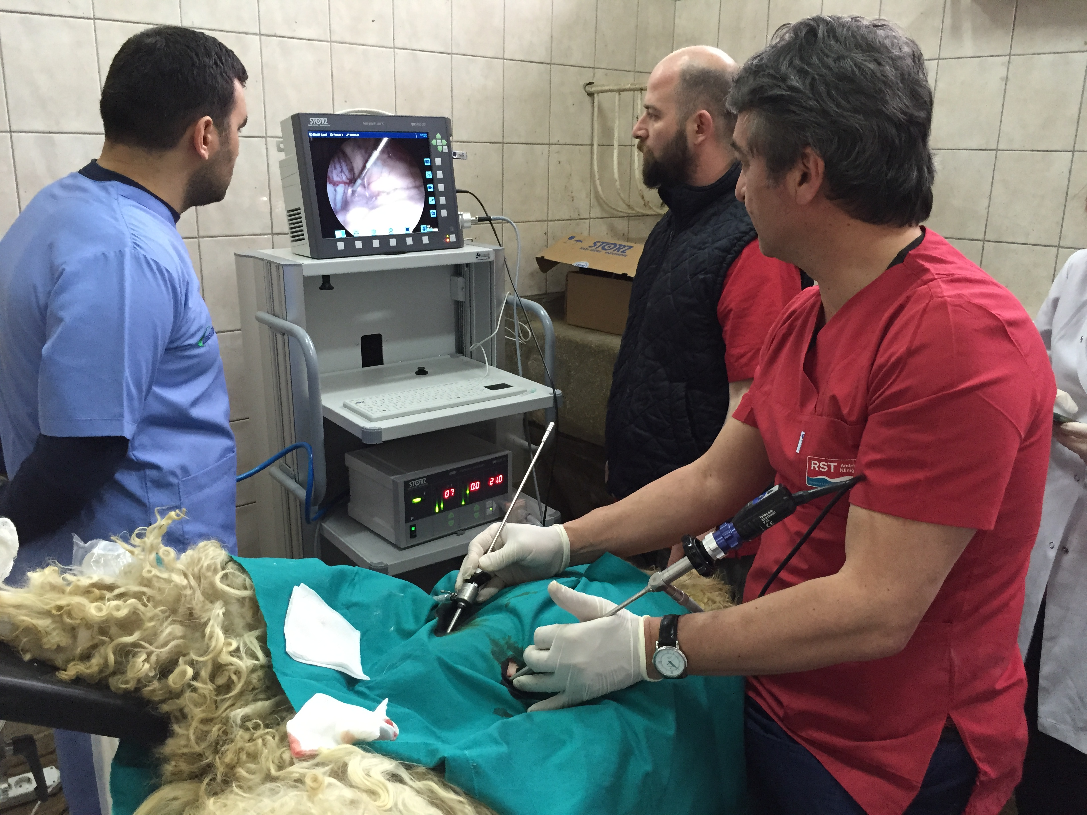
Notes:
7 Artificial Insemination
Three methods of semen preservation and four techniques of insemination are used worldwide in small ruminants;
fresh, chilled (refrigerated) or frozen semen and
vaginal, cervical, intrauterine or, laparoscopic insemination techniques.
Fresh semen is the preferred method of preservation when the male is present in the herd, especially during the breeding season when semen production and quality are at their peak level. 38 ◦C and 24 hour with milk based diluents.
The use of chilled semen is a common strategy in circumstances where a particular male is shared by a group of farmers located within a relatively small area. In such cases, the semen is stored at (mines) ∼4◦C and can be used for up to 24 h from collection.
Finally, semen is frozen for long-term preservation allowing it to be marketed over a wide area, used throughout the year, and conserving the genetic material in case the animal dies. Vaginal insemination is successful for fresh semen.
Intracervical insemination is used for refrigerated and frozen semen. However, in order to achieve high pregnancy rates (>70%) with frozen semen, intrauterine deposition of semen is required. While in many does it is possible to by-pass the cervix and deposit the semen intrauterine, in certain categories of animals (e.g. doelings, breeds like Nigerian dwarf) and individuals this will only be possible using a laparoscopic technique, making the procedure more technically challenging.
The trans-cervical method of insemination involves grasping the cervix and retracting it into the vagina with a pair of forceps to allow an inseminating instrument to be introduced into the cervical canal. The University of Guelph (Canada) has developed an instrument with a special bent tip that allows passage through the cervix.
Laparoscopic insemination involves the penetration of the abdominal cavity and deposition of semen directly into the uterus of a ewe in estrus. In addition, gas is inserted into the abdominal cavity through a second abdominal penetration to assist insemination. Main aims of laparoscopic insemination are breeding stud rams and improving the genetic merit of progeny. The adequate anaesthesia, pre- and post-operative analgesia must be provided. Laparoscopic insemination must not be conducted routinely on the same ewe.
Factors effecting success are;
These techniques that we use are having differences as species, breedings, and the number of parturition for each animal. Overall AI fertility rates with frozen–thawed semen vary from 40% to 65%, and seem to be highly affected by factors such as season, farm, reproductive status of female, and site of semen deposition related to anatomical structure, convenient time for AI, response to synchronisation of doe.
Flushing
Convenient time
Monitoring
Response to synch.
Anatomical structure
Non-Stress

