Slide 1
CHAPTER 9

Slide 2
Raw Material Supply (Inventory Control/STOCK)
Purchasing is called procurement. Stocking from the business point of view is the storage of material factors in a specific place to meet some economic functions today or in the future.
When the supply function in enterprises is mentioned, generally only material supply (raw material supply) is understood in the literature.
The classification of procurement can be done as follows:
1. According to the subject (goods, services, rights)
2. According to the repetition of the activity (continuous, periodic, one time)
3. According to principle (in case of need, stocking, adjusted by need)
4. According to the form (active, passive).

Slide 3
Markets are divided into two:
1.Supply market
a) Capital supply market
b) Labor supply market
c) Goods and services market
2. Version Market
*There are a number of phases of the supply of goods. These stages can be examined under the following headings.
1. Market survey
2. Determination of supply quantity
3. Supply of the price
4. Purchasing
5. Transportation of raw material to the enterprises
6. Warehousing
7. Supply financing

Slide 4
Supply of Raw Materials
There is the possibility to stock material factors in enterprises. Stocking; can be likened to the event that arrival, waiting and leaving of the water in a pool.
In livestock enterprises, the raw material is first shipped to the enterprise, stocked and shipped from stock to production in accordance with its purpose for a certain period of time.
The supply of the raw material to the enterprises is made in two ways;
a) In one batch
b) In parcel
Each method has both advantages and disadvantages.

Slide 5
Advantages of raw material supply in one batch; ♦ Significant discount on raw material price ♦ A sample of raw material quality is provided,
♦ Order costs are minimized. Disadvantages; ♦ Warehousing costs increase. ♦ There is the risk of irrational use of money by linking the limited revolving fund facilities to the raw material that can be used in a longer term.
♦ Significant deficiencies may arise in revolving fund financing.

Slide 6
Advantages of raw material supply in parcel: ♦ The stocking costs of the enterprise are further reduced.
♦ The revolving fund facilities that are limited in the enterprise are used rationally in the supply system in parcel. ♦ As the number of lots in supply increases, the stocking costs of the enterprise can be further minimized. Disadvantages; ♦ Order costs in the business increase. ♦ The expected uniformity in the quality of the raw material supplied cannot be achieved
♦ The possibility of discounting is reduced according to the purchase price.

Slide 7
To summarize; It is necessary to supply the raw material required by the enterprise at the appropriate time, in the appropriate quantity, in the appropriate quality, at an affordable price and from the appropriate source.
These five criteria are actually called «OPTIMAL STOCK» in the enterprise.

Slide 8
Stock Types in Business It is possible to examine and examine the stock types that can be applied in animal husbandry enterprises under five headings as in all enterprises. These;
♦ Notice stock ♦ Safety stock (Asset stock)
♦ Optimal stock ♦ Average stock
♦ Maximum stock The first two of these five stocks (notice and safety stocks) determine the minimum stock level in the enterprise.

Slide 9
a) Notice Stock As the name implies, the notice stock is the stock that informs the entity to re-supply raw materials when the amount of stock in a business drops to a certain level.
The formula that allows calculation of notice stock in the enterprise is given below. If OA / OB = CD / CB , CD = OA x CB / OB OA: The amount of stock required for a given period OB: Time to use stock in the enterprise CB: The stock renewal period of the enterprise CD: Indicates the level of stock to be reported (noticed).

Slide 10
Example: The monthly feed requirement of a livestock farm is 120 tons. The time needed for the company to renew its stock is five days. Find this enterprise’s notice stock level?
CD = OA * CB / OB
It means that when the stock feed level drops to ? tonnes, notify the buyer. This amount is the amount of notice stock.

Slide 11
b) Safety (Asset) Stock: Operation must not touch the safety stock unless it is absolutely necessary. If it is used in production, it is the amount of safety stock that must be renewed first. The level of stock formed by the notice and safety stocks together is the minimum stock for the enterprise. Minimum Stock = Notice Stock + Safety Stock

Slide 12
c) Determination of Optimum Stock and Optimum Order Quantity:
Optimum stock means the most suitable stock for an enterprises. The most appropriate stock amount in enterprises “Optimum Stock” determination can be done in many ways.
1. Calculation with table 2. Calculation with graphic
3. Algebraic calculation 4. Calculation with computer

Slide 13
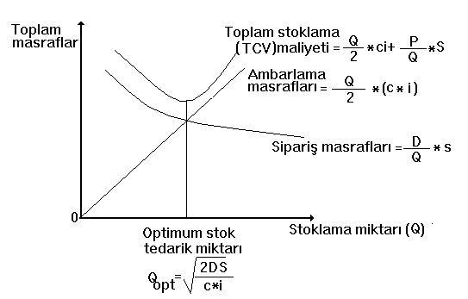

Slide 14
Optimum stock is the amount of stock determined by the vertical drawn from the A point to the Q axis, which passes through the point where the order costs curve cuts the stocking costs line and the total stocking cost (TCV) is minimum. It also gives the optimum amount for the enterprise. Let's try to calculate the amount of economic order in a livestock enterprise according to the parameters and symbols in the model.

Slide 15
Example: In a large-scale livestock business, the total annual feed requirement is 2000 tons / year. The price of the feed is 500 TL / ton. The cost of having the unit raw material in stock is 8% of the unit price. The cost of each order is 400 TL. What is the optimum stock quantity for this enterprise?
D=2000 ton/year c: 500 TL/ton S=400 TL i:%8
The enterprise must purchase the annual feed requirement in ? batches.

Slide 16
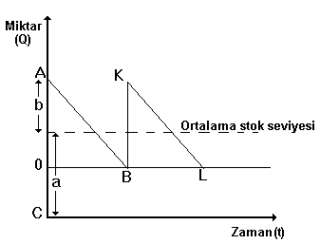
d.Average Stock: Half of the amount of inventory used by the entity in a given period. To formulate ; a + b / 2 or; AC / 2 or
e. Maximum Stock: It can be defined as the stock that is added to the optimum stock amount and that should be kept in the enterprise as a maximum level.
Maximum Stock: Optimum Stock +Q

