Slide 1



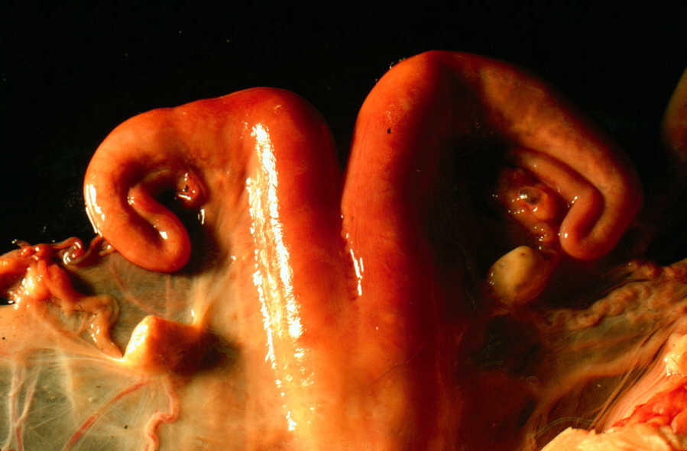
Reproductive Physiology
Female Anatomy
Assoc. Prof. Dr. Halit KANCA
Department of Obstetrics and Gynecology
Faculty of Veterinary Medicine, University of Ankara

Slide 2
Reproductive Physiology
Female Anatomy
Learning Objectives:
To be able to describe the female reproductive system in domestic animals.
Structure
Function

Slide 3
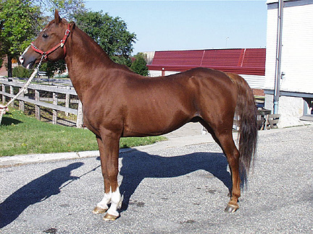
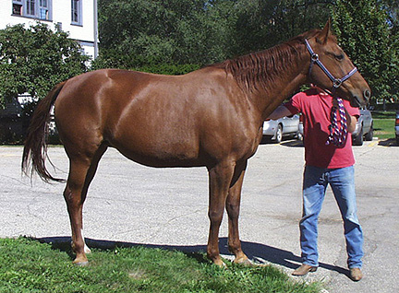
Reproductive Physiology
Female Anatomy
Equine - Horse
Male
Stallion
Female
Mare

Slide 4
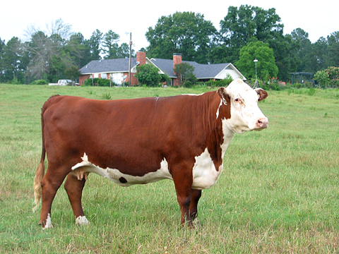
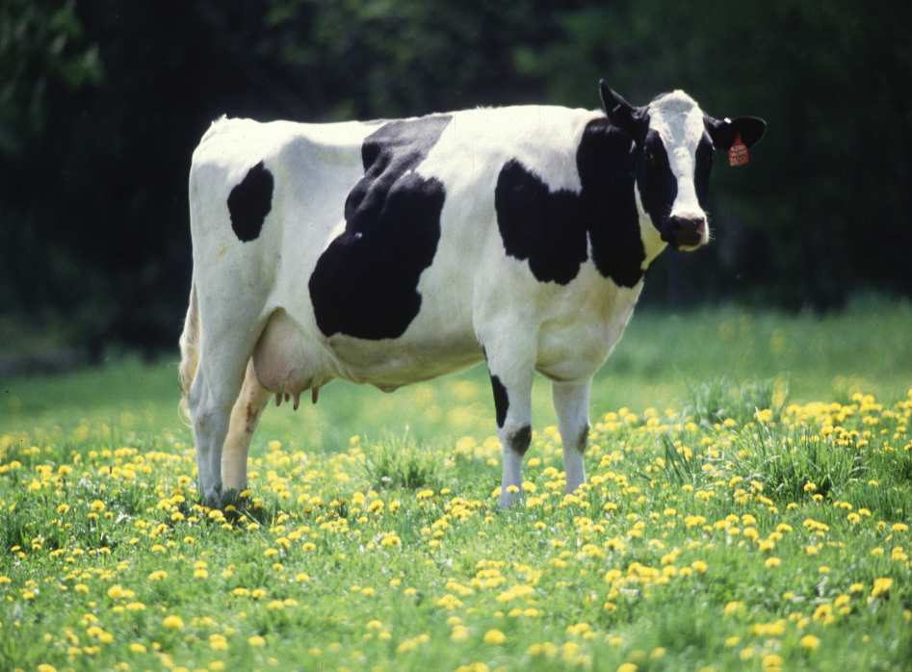
Reproductive Physiology
Female Anatomy
Bovine - Cattle
Male
Bull
Female
Cow

Slide 5
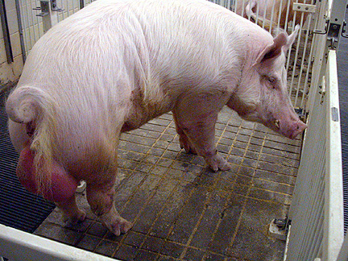
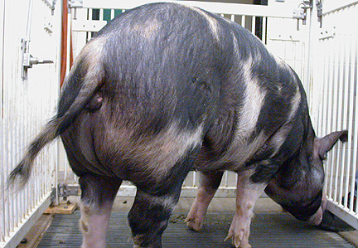
Reproductive Physiology
Female Anatomy
Porcine - Swine
Male
Boar
Female
Sow

Slide 6
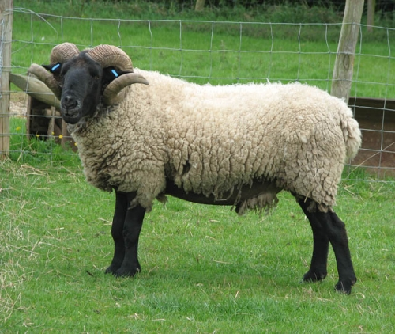
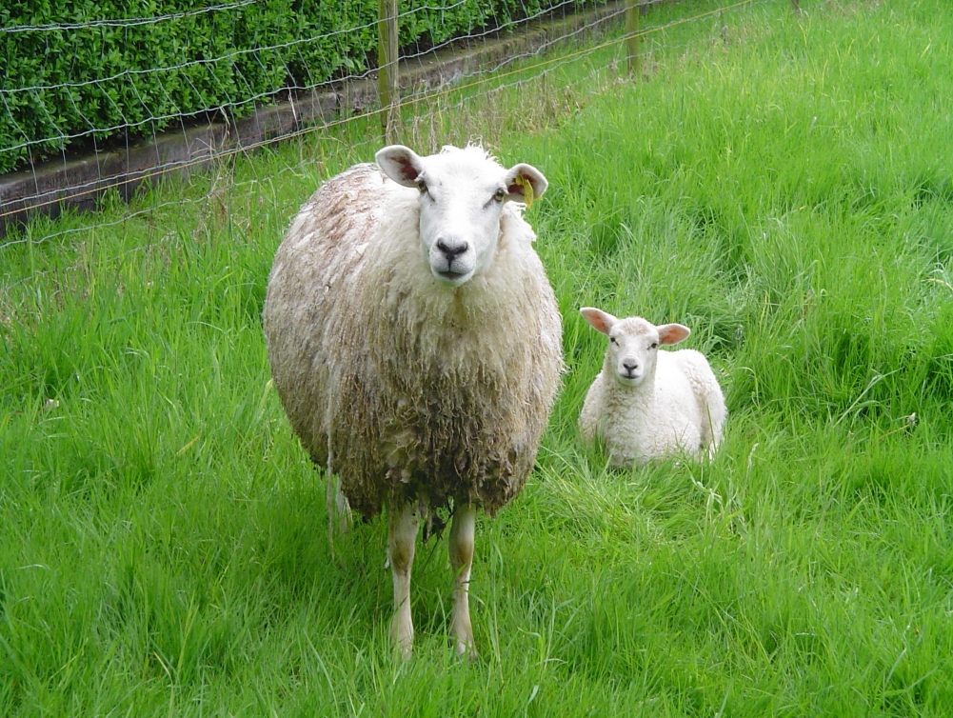
Reproductive Physiology
Female Anatomy
Ovine - Sheep
Male
Ram
Female
Ewe

Slide 7
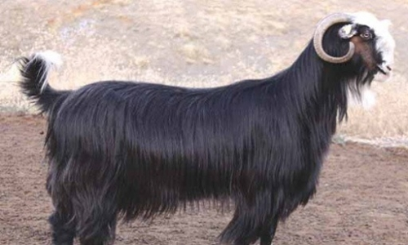
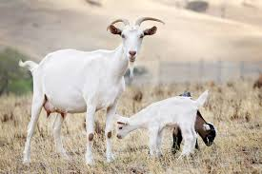
Reproductive Physiology
Female Anatomy
Caprine - Goat
Male
Buck
Female
Doe

Slide 8
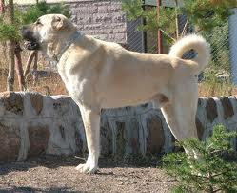
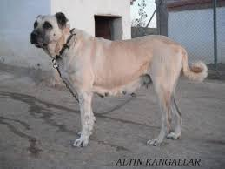
Reproductive Physiology
Female Anatomy
Canine - Dog
Male
Dog
Female
Bitch

Slide 9
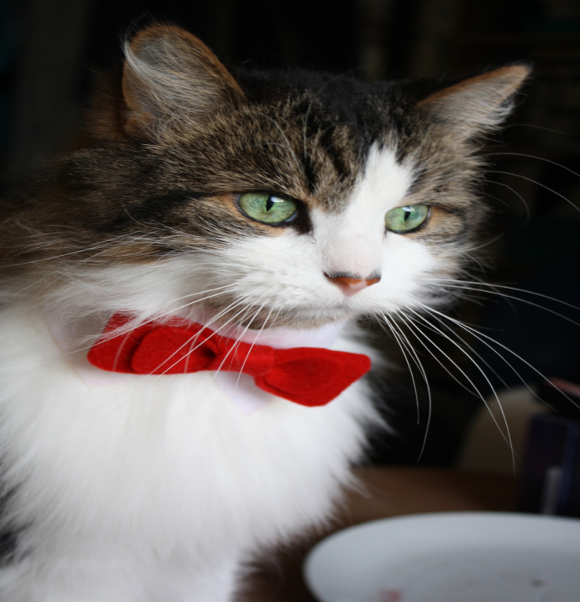
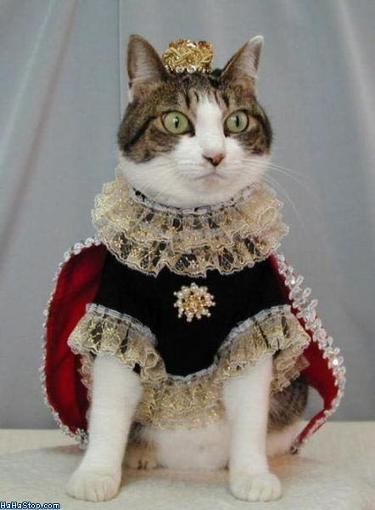
Reproductive Physiology
Female Anatomy
Feline - Cat
Male
Tomcat
Female
Queen

Slide 10
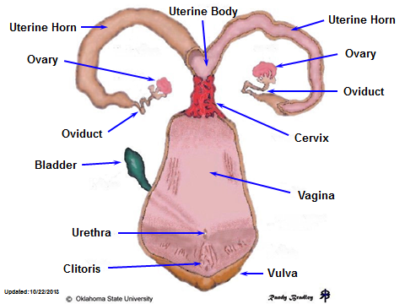
Reproductive Physiology
Female Anatomy

Slide 11
Reproductive Physiology
Female Anatomy
The compact ovary contains thousands of ovarian follicles, of which a few at a time rapidly go through several stages of maturation before ovulation.
The ova is transported to the uterus via the oviduct where, if fertilized, it implants, forms a placenta, develops, and is delivered via the vagina

Slide 12
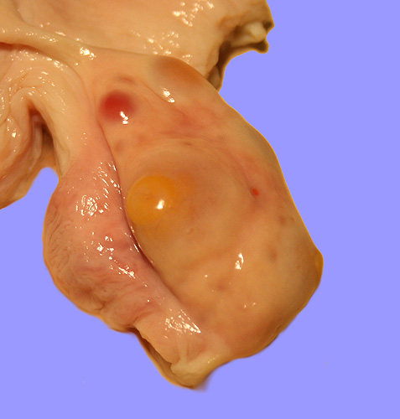
Reproductive Physiology
Female Anatomy
Ovaries
Functions
  Hormonal
  Estrogen
  Progesterone
  Female gamete
  Oocyte

Slide 13
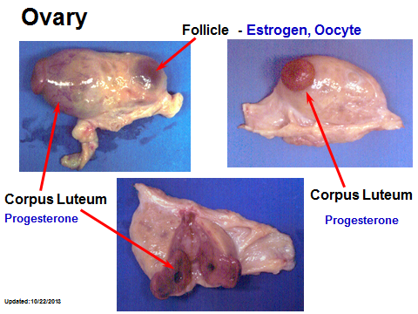
Reproductive Physiology
Female Anatomy
Ovaries
Endocrine Function

Slide 14
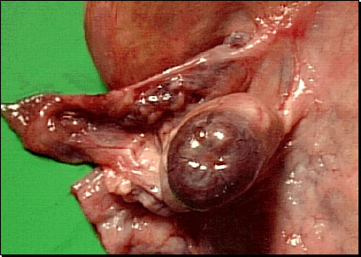
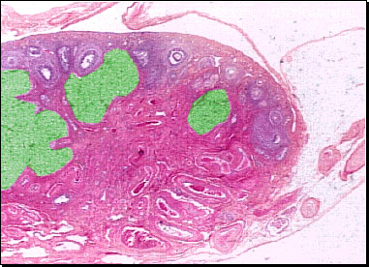
Reproductive Physiology
Female Anatomy
Ovaries
Endocrine Function
The corpus luteum forms from the cells of the theca interna and the granulosa cells under the influence of the pituitary luteinizing hormone.
Blood vessels and connective tissue grow into the luteal cells to form an endocrine gland which secretes progestins.
Hormones from the corpus luteum will support fetal development during pregnancy.
Afterwards it will become a scar (corpus albicans).

Slide 15
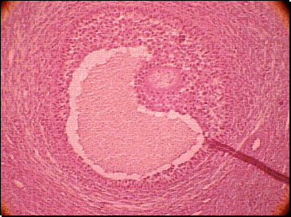
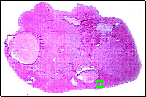
Reproductive Physiology
Female Anatomy
Ovaries
Endocrine Function
The corpus luteum forms from the cells of the theca interna and the granulosa cells under the influence of the pituitary luteinizing hormone.
Blood vessels and connective tissue grow into the luteal cells to form an endocrine gland which secretes progestins.
Hormones from the corpus luteum will support fetal development during pregnancy.
Afterwards it will become a scar (corpus albicans).

Slide 16
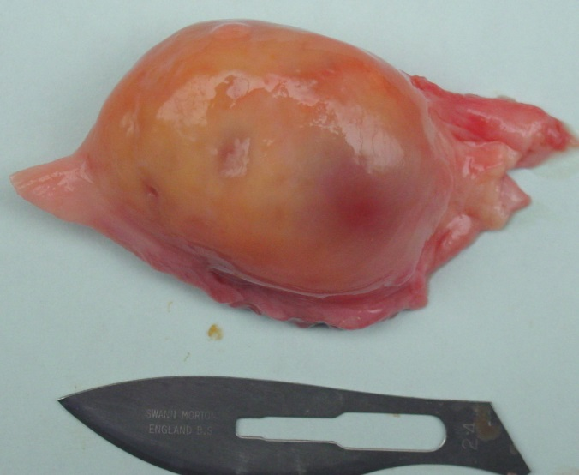
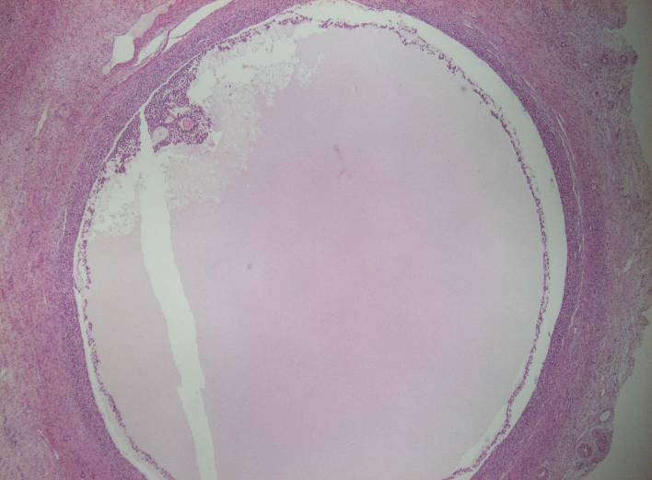
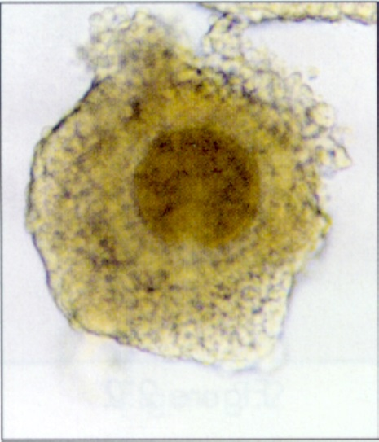
Reproductive Physiology
Female Anatomy
Ovaries
Gametogenesis
The preovulatory follicle and his oocyte

Slide 17
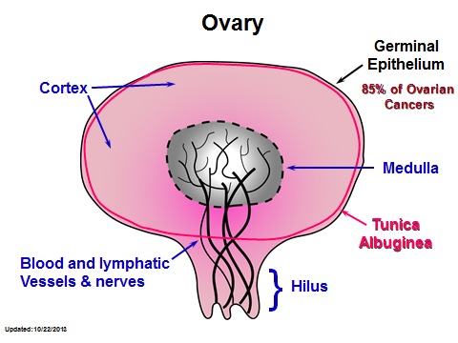
Reproductive Physiology
Female Anatomy

Slide 18
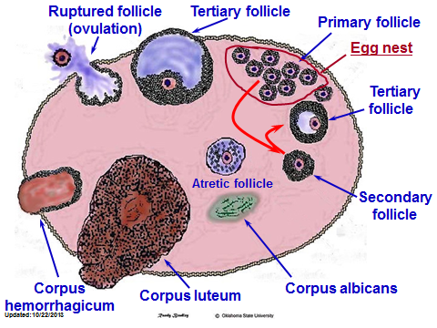
Reproductive Physiology
Female Anatomy

Slide 19
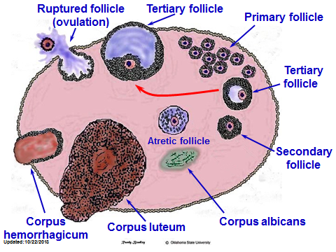
Reproductive Physiology
Female Anatomy

Slide 20

Reproductive Physiology
Female Anatomy

Slide 21
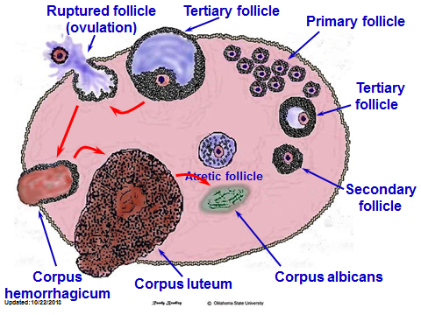
Reproductive Physiology
Female Anatomy

Slide 22
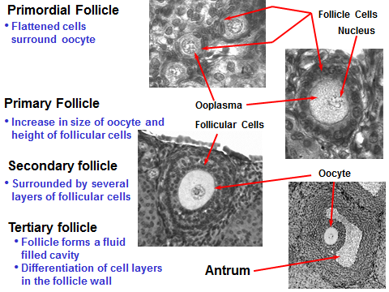
Reproductive Physiology
Female Anatomy

Slide 23
The primary follicle develops from the primordial follicle and is characterized by several layers of follicular cells surrounding the oocyte. The follicular cells become more cuboidal and secretory in appearance and are referred to as granulosa cells. At this time, a clear layer of extracellular material, called the zona pellucida, can be seen around the oocyte.
Primordial follicle. In most mammals the oogonia have formed primordial follicles at the time of birth. It is generally believed that all of the primordial follicles that are going to develop are present at the birth of the animal. The primordial follicle is a single egg or oocyte surrounded by a single layer of flattened cells called the follicular cells. Many of the follicles will not develop and will undergo a gradual breakdown or atrophy: this process is called atresia and the follicles are said to be atretic.

Slide 24
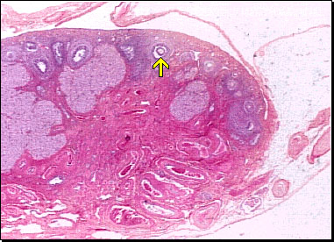
Secondary Follicle
SECONDARY FOLLICLES develop from primary follicles and are characterized by the formation of an antrum.
  The antrum is a fluid-filled space which begins as a number of small spaces between the granulosa cells.
  As the several spaces unite into a single fluid-filled chamber, the oocyte remains on a mound of granulosa cells, the cumulus oophorus, to one side of the follicle.
  A layer of granulosa cells remains surrounding the oocyte.
  The cells secrete the female sex steroids.

Slide 25
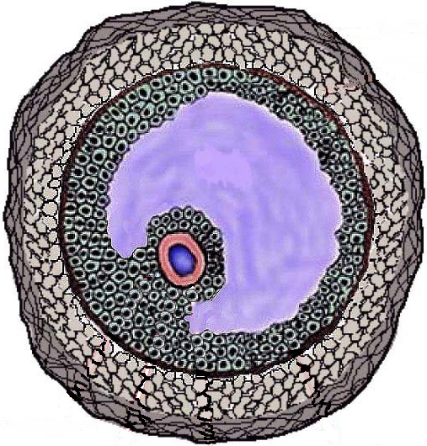
Tertiary Follicle
Theca Externa
Antrum
(Follicular Fluid)
Theca Interna
Basement
Membrane
Granulosa
Oocyte
Cumulus Oophorus

Slide 26
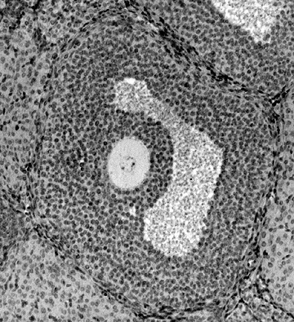
Tertiary Follicle
Theca Interna
Granulosa
Oocyte
Cumulus
Oophorus
Antrum

Slide 27
Reproductive Physiology
Female Anatomy
Produce 1 ova per cycle in cow
Produces 12-20 ova per cycle in sow
Produces 1-3 ova per cycle in ewe

Slide 28
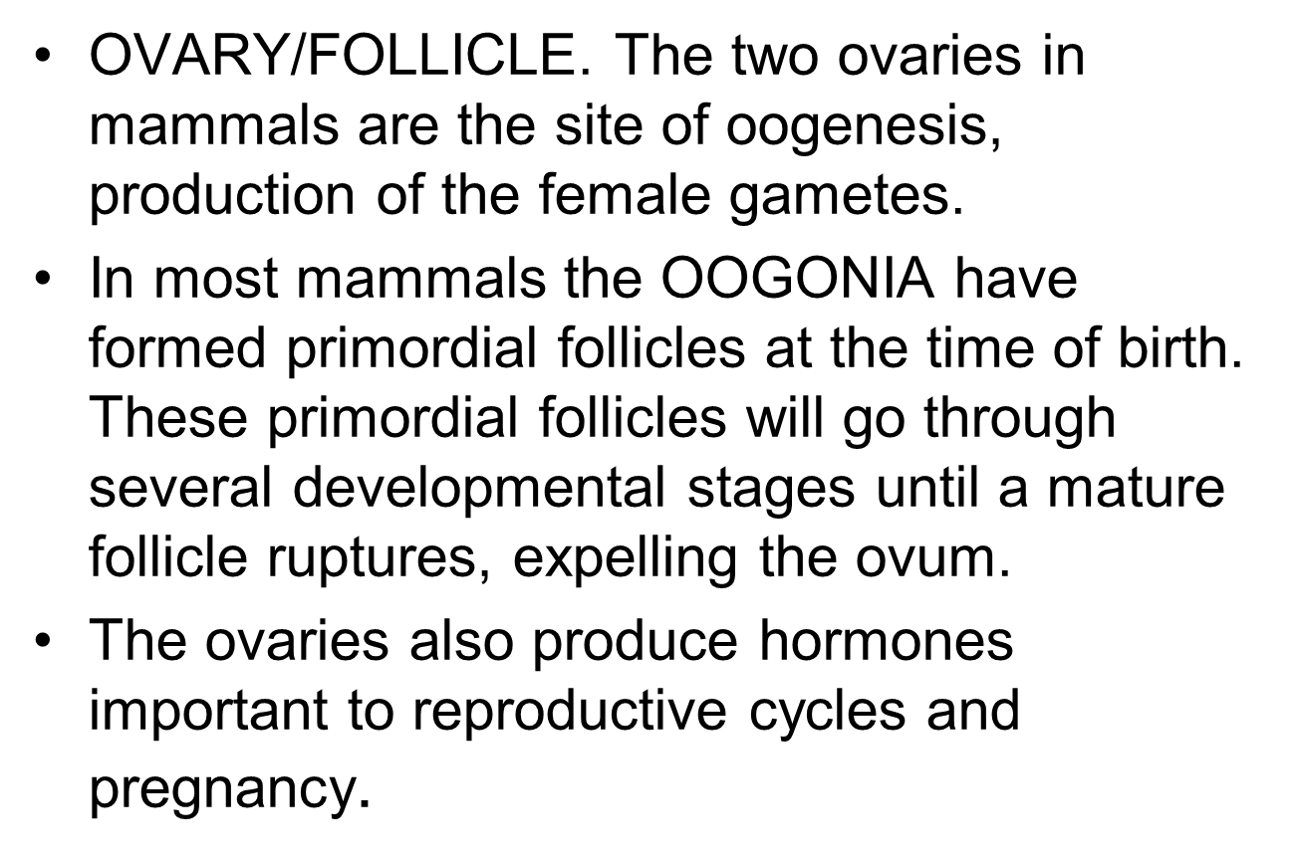
Reproductive Physiology
Female Anatomy

Slide 29
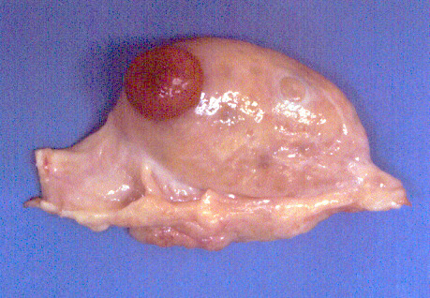
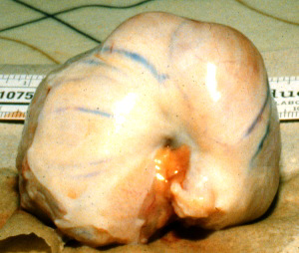
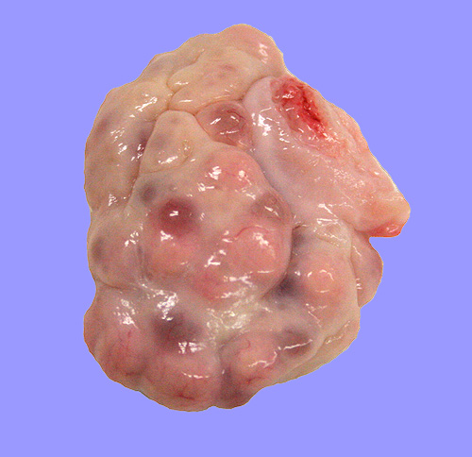
Ovarian Differences
Cow
Mare
Sow

Slide 30

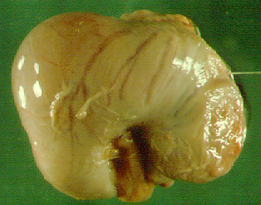
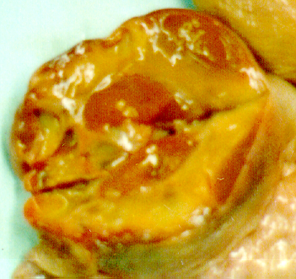
Cow
Sow
Cow, Sow, Ewe, Human
Cortex on outside
Ovulation can occur on any point of the ovary
Mare
Preovulatory
Tertiary
Follicle
Blood vessels
and connective
tissue in medulla
Inversion of the cortex and medulla.
Ovulation occurs at the Ovulation Fossa
Internal
CL
Mare

Slide 31
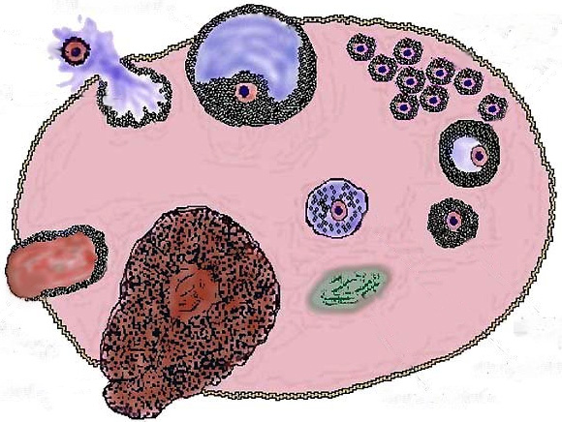
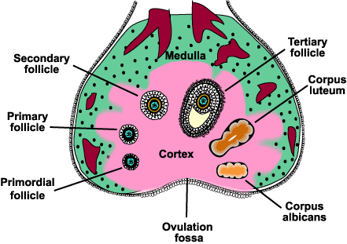
Mare
Cow

Slide 32
Secondary Sex Organ: A Series of Tubes to Convey the Oocyte/Embryo/Fetus to the Outside
Serosa
Submucosa
Lumen
Longitudinal smooth
muscle layer
Circular smooth
muscle layer
Mucosa
Muscularis

Slide 33
Reproductive Physiology
Female Anatomy
The entire duct system is lined by epithelia with regional specializations.
There are a variety of species differences in the shape of the uterus, and the type of placentation that supports the embryo.
In contrast to the male, the urinary tract uses separate ducts until reaching the vestibule of the vagina.

Slide 34
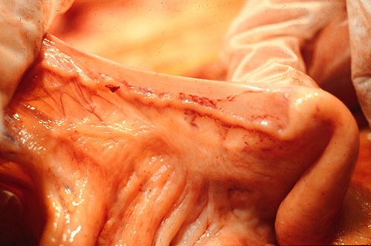
Functions of Oviduct
Gamete Transport
  Sperm
  Oocyte
Supports early embryo development
Transport of embryo to uterus

Slide 35
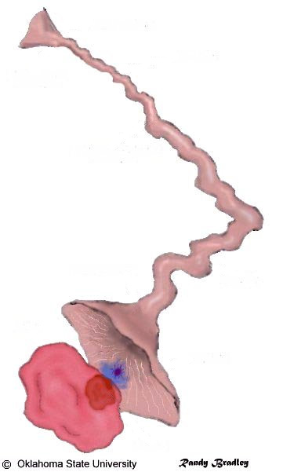
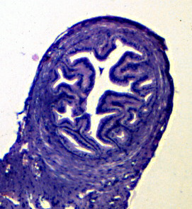
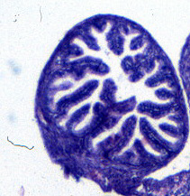
Uterine Horn
Isthmus
Utero-Tubal Junction
Oviduct
Ampullary-Isthmic
Junction
Ampulla
Infundibulum
(20 - 30 cm²)
Ostium
Cumulus Oophorus
and Oocyte
Fimbria
Ovary
Follicle

Slide 36
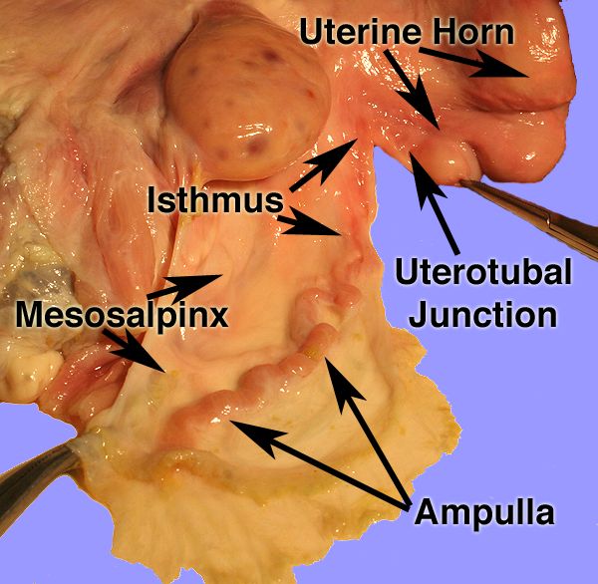
Oviduct

Slide 37
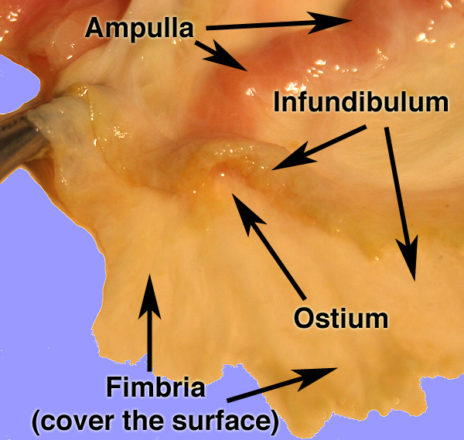
Oviduct

Slide 38
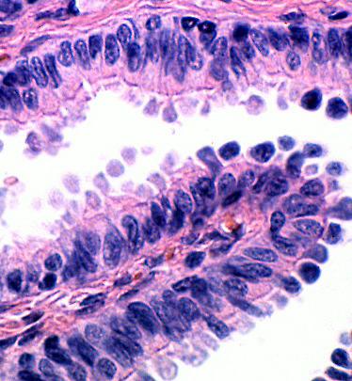
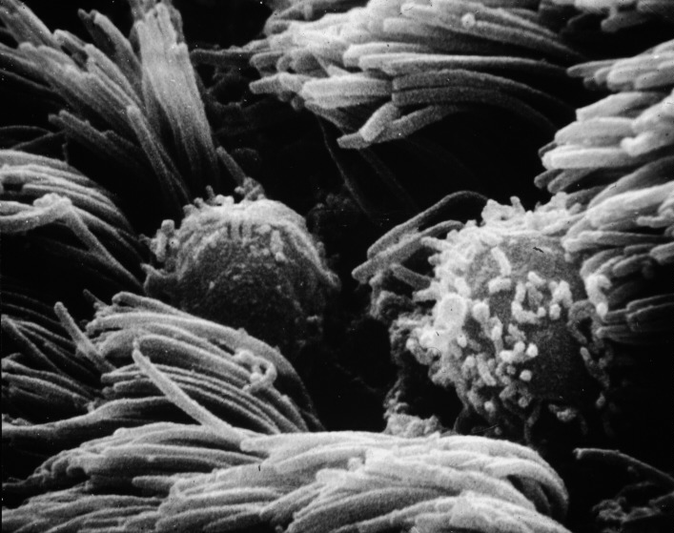
Oviduct Histology
Mucosa
Ciliated Columnar
Nonciliated Columnar

Slide 39
Functions of the Uterus
Muscle contractions
  Transport sperm
  Expel fetus and placenta
Absorption and phagocytosis
Partially prepares sperm for fertilization
  capacitation
Provides environment for embryo and fetal growth
Hormone production
  Prostaglandin F2α production

Slide 40
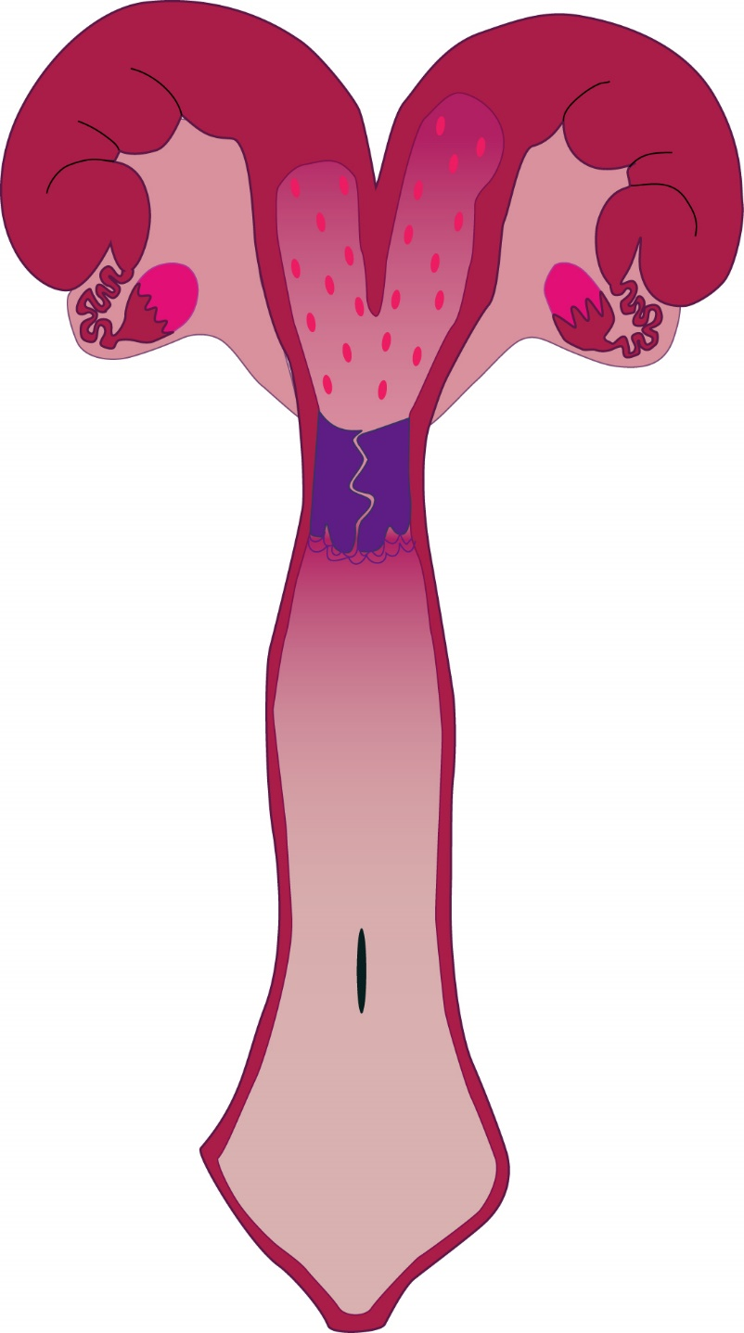
Uterus (bovine)
horn
Bicornuate
  poorly to moderately developed uterine horns
  uterine body
  one cervix
body
cervix

Slide 41

Uterus

Slide 42


Uterine Histology
Endometrium
Endometrial
Glands
Perimetrium
Myometrium

Slide 43

Uterine Histology
Mucosa
Endometrial
Gland
Endometrium
Submucosa
Myometrium
Perimetrium

Slide 44


Uterus
The uterus, with layers called endometrium,
myometrium and perimetrium, respectively.

Slide 45
Functions of the Cervix
Transport of sperm
Barrier to sperm (species dependent)
Reservoir for sperm
Blocking bacterial invasion during pregnancy
Birth canal

Slide 46

Cervix
CERVIX. The cervix acts as the valve of the reproductive tract.
It separates the vagina from the uterus and is usually closed
except during estrus and parturition.

Slide 47

COW
Uterine Body
Cervix is composed of thick connective tissue
Internal Cervical Os
Mucus is secreted near the time of breeding and ovulation.
Cervix
Cow has 4-5
annular rings
External Cervical Os
Vagina

Slide 48



Slide 49

External Cervical Os

Slide 50



Uterine and Cervical Differences
Cow
Mare
Sow

Slide 51


Duplex
Oposum
Rabbit, Mouse
2 Uterine Horns
2 Cervixes
2 Vaginas
1 Vagina

Slide 52

Bicornuate
Cow
Sow
Ewe
Smaller uterine horns
Large uterine horns
1 Vagina
1 Cervix
1 Uterine Body
2 Uterine Horns

Slide 53

Bicornuate
Mare
Large uterine body
Smaller uterine horns
1 Vagina
1 Cervix
1 Uterine Body
2 Uterine Horns

Slide 54

Bicornuate
Dog
Cat
1 Vagina
1 Cervix
1 Uterine Body
2 Uterine Horns
Small uterine body
Long uterine horns

Slide 55

Simplex
Woman
Large uterine body
No uterine horns
1 Vagina
1 Cervix
1 Uterine Body

Slide 56
Functions of the Vagina
Copulatory organ
Glands secrete lubrication
Birth canal
Glands secrete pheromones

Slide 57

Vagina
Anterior Vagina
Posterior Vagina (Vestibule)
Cervix
Fornix
Vulva-Vaginal Sphincter
Stratified
Squamous
Epithelium
Columnar
Epithelium
Urethra
Mucosa
Submucosa
Submucosa

Slide 58


Posterior Vaginal Histology
Stratified Squamous
Epithelium
Mucosa
Submucosa

Slide 59
Function of External Genitalia
Labia
  Closes entrance to vagina
Clitoris
  Female sensory organ

Slide 60


External Genitalia of the Cow
Anus
Vulva
Labia
Clitoris
Labia

