Slide 1
transesterification
Another definition is that the glycerides present in the lipids react with an alcohol in the presence of a catalyst to form ester and glycerol.
The catalyst used in the reaction increases the speed and efficiency of the reaction.
Because the transesterification reaction is a reversible reaction, excess alcohol present in the medium can convert the reaction in favor of the forward direction.

Slide 2
The alcohols used for this purpose are generally primary and secondary monohydric aliphatic alcohols having between 1 and 8 carbon atoms.
The alcohol is methanol, ethanol, propanol, butanol and amyl alcohol.
The most commonly used alcohols are methyl alcohol and ethyl alcohol. The most preferred alcohol in commercial applications is methyl alcohol because it is cheap.

Slide 3
In addition to these catalysts, microbial lipases can also be used as catalysts.
Lipases (EC 3.1.1.3) are known as enzymes which catalyze the hydrolysis, alcoholysis, esterification and transesterification reactions of carboxylic acids.
These enzymes are the best and stable biological catalysts that can be used to perform esterification and transesterification reactions involved in biodiesel production.

Slide 4
Conventional transesterification
In-situ (direct) transesterification

Slide 5
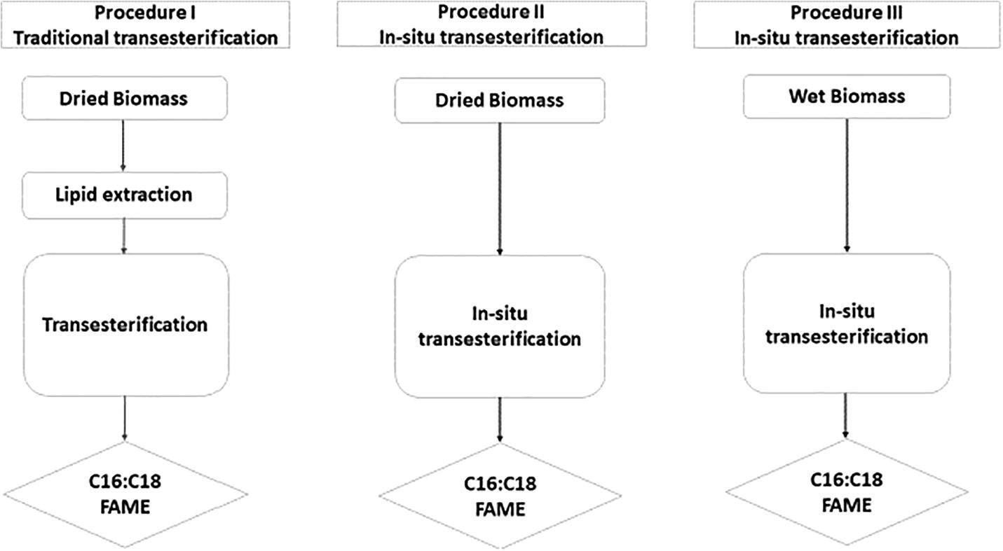
Comparison of conventional and in-situ transesterification

Slide 6
The parameters affecting Transesterification Reaction?
Lipid used as raw material
Ratio of alcohol to lipids
Catalyst type and concentration
Reaction temperature
Agitation speed

Slide 7
The catalysts for transesterification rxn
basic
Chemical catalysts
Enzymes
acidic
lipase

Slide 8
Catalysis with alkali
NaOH, KOH, carbonates and
Alkoxides (sodium methoxide, sodium ethoxide, sodium propoxide, sodium butoxide)
4000 times faster
Commercial (effective and less corrosive)

Slide 9
Catalysis with acid
H2SO4, HCl, organic sulfonic acids
Contains excessive amounts of free fatty acids and water
glycerides
Obtaining high methyl ester but slow

Slide 10
Disadvantages of catalysis with chemicals;
Energy requirement
Difficult to seperate glycerol
The need to remove the catalyst from the product
Treatment of alkaline wastewater
Free fatty acids and water inhibits the reaction

Slide 11
Catalysis with lipase
Lipase (triacylglycerolacylhydrolase; EC 3.1.1.3)
Intracellular and extracellular
Glycerol hydrolysis, alcoholysis, acidolysis
Transesterification, esterification

Slide 12
Advantages of lipase usage
Immobilization
Thermal stability
Easy separation of the product
Long-term activation
Disadvantages of lipase use
Expensive

Slide 13
Transesterification catalyzed by supercritical method
The transesterification reaction can be carried out with heterogeneous catalysts under normal conditions, or without catalyst with supercritical methanol.
The transesterification reaction can be carried out by this method under high temperature and pressure (250 ° C and 10 MPa) and at a ratio of methanol to alcohol of 42: 1.
Under these conditions, the methanol-triacylglycerol mixture forms a homogeneous phase and no catalyst is required to complete the reaction.
In addition to these advantages, the high cost, the use of excess methanol and the difficult separation of glycerol are the main disadvantages of this method.

Slide 14
Agitation speed;
In the transesterification reaction, mixing is very important. Because the oils do not mix in sodium hydroxide and methanol solution.
As soon as the two phases are mixed, the reaction starts and there is no need to mix after this step.
In some studies where animal oils were used as raw materials in the transesterification reaction, the reaction could not be observed without mixing.

