Slide 1
Instrumentation

Slide 2
Asepsis: the complete absence of any bacteria, viruses, fungi, mold
or parasites capable of causing infection
Disinfection: the application of a chemical agent to destroy or
inhibit the growth of microorganisms on the surface of an
instrument or surgical device
Sanitization: cleansing an object or area free from any dirt or dust,
thereby reducing the number of microorganisms present on
contaminated surfaces to levels presumed safe by public health
Standards
Sterilization: to free an object or instrument of all living
microorganisms

Slide 3
Basic oral surgery instruments

Slide 4
Scalpel handles and blades
Scalpel handles used in oral surgery: (A) No. 3; (B) No. 5; (C) No. B3; (D) No. 7. (A, C and D courtesy of Swann-Morton Limited, Owlerton
Green, Sheffield, UK; B courtesy of Hu-Friedy Mfg. Inc., Chicago, IL.)

Slide 5
Scalpel blades used in oral surgery: (A) # 15; (B) # 15c; (C) # 11; (D) # 10. (Courtesy of Swann-Morton Limited, Owlerton Green, Sheffield, UK.)

Slide 6
A no. 5 scalpel held in the (A) pen grip and (B) modified pen grip.

Slide 7
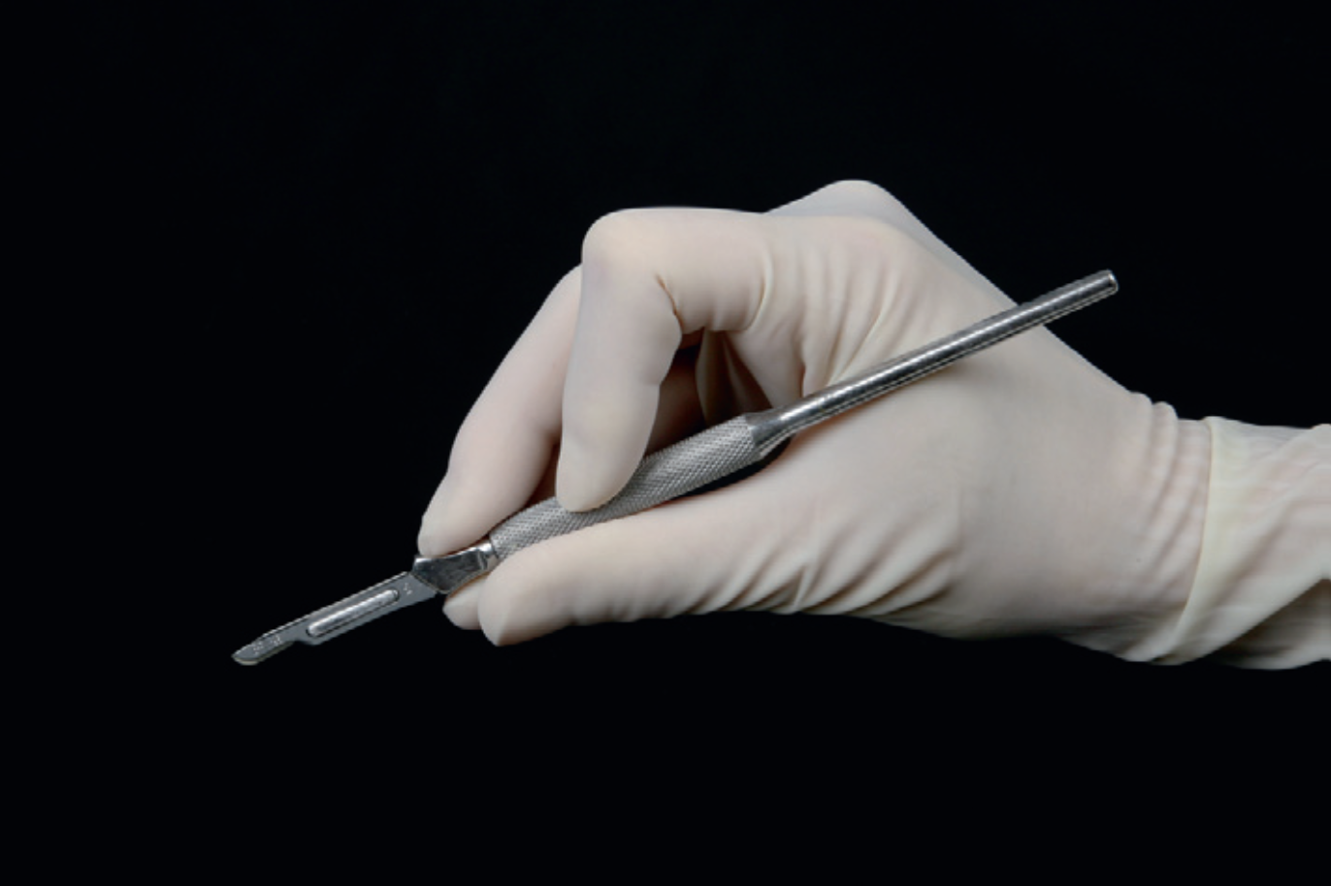

Slide 8
Scissors
Scissors incise tissues by a shearing action between the two blades and therefore cause more tissue trauma than scalpel blades.
To minimize the crushing of tissues, only sharp scissors should be used.
Scissors used for soft tissue surgery should not be used for cutting sutures

Slide 9
Scissors
Metzenbaum scissors are used for blunt as well as sharp dissection in undermining soft tissue, and for cutting.

Slide 10


Slide 11
The Goldman–Fox scissors and the double curved LaGrange scissors are variations on the iris scissors that can be used for the same purpose.

Slide 12
Suture scissors

Slide 13
Tissue forceps
Tissue forceps are hinged instruments that can either be locking or non-locking.

Slide 14
The delicate Adson 1X2 tissue forceps is used most commonly in oral surgery for gentle tissue handling, e.g., when stabilizing mucogingival flaps during suturing.

Slide 15
The ‘1X2’ refers to the one small sharp point on the one end that fits between the two sharp points on the other end.
It causes less tissue trauma compared with the plain Adson forceps and the Adson–Brown forceps, which has multiple teeth.
An Adson forceps is only 120 mm long. If longer forceps are needed, e.g., to reach the caudal part of the oral cavity, a Gerald 1X2 tissue forceps, which measures 170–180 mm, can be used.

Slide 16
Gerald 1X2 tissue forceps

Slide 17
The Allis tissue forceps is an example of a locking tissue forceps with a middle hinge. It can only be used on firm tissue that is to be excised, e.g., a large mass of gingival enlargement.
It should never be placed on friable tumors, wound edges or mucogingival flaps because it is very traumatic as a result of the crushing action.

Slide 18
Periosteal elevators
Periosteal elevators (also occasionally referred to as ‘periosteals’) are
used to elevate mucoperiosteal flaps
Many periosteal elevators are double-ended. One end is slightly curved and rounded, while the other end typically is pointed or
square.

Slide 19
The Molt periosteal elevator # 9 , which is popular both in human and veterinary oral surgery
The pointed end of the Molt periosteal elevator is used in a prying motion to elevate the dental papilla between two teeth.

Slide 20
In animals with thin or friable gingiva, it is safer to insert the instrument under a small increment of tissue, after which
it is gently rotated over 45–90 degrees, lifting the tissue up and sideways.
This minimizes the risk of slipping and tearing the gingiva,
which can easily occur if the push stroke technique is used. The instrument is held in a pen grip or modified pen grip

Slide 21
24G periosteal elevator
is a delicate instrument and its rounded end allows mucoperiosteal flaps to be elevated atraumatically, even in very small animals with friable gingiva.

Slide 22
Mead # 3 periosteal elevator.
is a sturdy, double-ended periosteal elevator most suitable for thick attached gingiva and hard palatal mucosa.

Slide 23
A # 24G periosteal elevator held in the pen grip and modified pen grip

Slide 24
Retractors
Once a mucoperiosteal flap is elevated and bone is exposed, the flap is reflected or retracted using a periosteal elevator, in order to protect it during osseous surgery or sectioning of a tooth.

Slide 25
Seldin retractor
Cawood–Minnesota retractor

Slide 26
Senn retractor

Slide 27
A 89-mm (left) and a 140-mm (right) pediatric Gelpi perineal retractor.

Slide 28
Needle holders
Halsey needle holder

Slide 29
DeBakey needle holder

Slide 30
Castroviejo needle holder

Slide 31
Olson-Hegar needle holder

