Slide 1
Gingivitis
Periodontitis
Dr. Murat ÇALIŞKAN

Slide 2
GINGIVITIS
Gingivitis refers to any inflammation of the gingiva; however, the term is usually used to refer to plaque bacterial-induced gingivitis.

Slide 3
ETIOLOGY AND PATHOGENESIS
Plaque bacteria, a susceptible host, and the host’s inflammatory response are all factors in the initiation and development of gingivitis.
Bacterial plaque accumulates on the tooth surface and directly, as well as indirectly, stimulates a host inflammatory response.
Bacterial plaque forms a biofilm that adheres tenaciously to the tooth surface providing protection against antimicrobial agents.

Slide 4
The level of the epithelial attachment of the gingiva to the tooth surface is not altered in gingivitis. This means that there is no attachment loss, no periodontal pocket formation, and gingivitis is completely reversible with removal of subgingival plaque.

Slide 5
CLINICAL FEATURES
Normal gingival tissues have thin and sharp margins, which are coral pink in color (unless normal pigmentation is different)
Normal gingiva, with thin, sharp margins.

Slide 6
In gingivitis, plaque and calculus may be visible adjacent to the gingival tissues. The initial inflammation of the gingiva results in erythema and rounding of the gingival margins

Slide 7
As inflammation increases, the gingiva bleeds more readily and the erythema may extend to the entire attached gingiva. The owners may report gingival bleeding by the animal during tooth brushing, when eating hard foods, chewing on hard objects, or playing with toys. Halitosis is often a clinical feature of gingivitis.
The depth of the gingival sulcus remains within normal limits, which is generally considered to be less than 3 mm in the dog and less than 0.5 mm in the cat4

Slide 8
Gingival bleeding in advanced gingivitis
Marginal gingivitis, rounded edges

Slide 9
Normal gingiva over incisor, gingivitis (rounding of margins) in interdental papilla.
Mild plaque, calculus, mild gingivitis.
Marginal gingivitis, calculus

Slide 10
MANAGEMENT
The approach to managing gingivitis includes treatment and prevention. Marginal gingivitis, with only supragingival plaque, can often be resolved with daily tooth brushing.
If daily tooth brushing does not resolve the gingivitis, there is probably subgingival plaque or calculus that needs to be removed with professional cleaning.
Physical removal of supragingival and subgingival plaque and calculus will result in resolution of the gingivitis.

Slide 11
Scaling of the teeth to remove plaque and calculus is done with mechanical and/or hand scalers.
Daily tooth brushing is the gold standard for plaque prevention. It is usually only necessary to brush the buccal and labial tooth surfaces
Chlorhexidine is an excellent antimicrobial for decreasing plaque, and may be added to the home care regimen for certain patients
Chewing on any hard object, that is either unbendable or that cannot be dented with a fingernail, may cause a tooth to fracture.

Slide 12
PERİODONTİTİS
Periodontitis is present when plaque bacterial induced inflammation has affected the gingiva (gingivitis) as well as other tissues of the periodontium.
The periodontium is made up of the tissues that surround and support the tooth including the gingiva, cementum of the tooth, periodontal ligament, and the alveolar and supporting bone

Slide 13
ETIOLOGY AND PATHOGENESIS
Periodontitis is an infectious disease caused by plaque bacteria and the resulting inflammatory response in a susceptible individual.

Slide 14
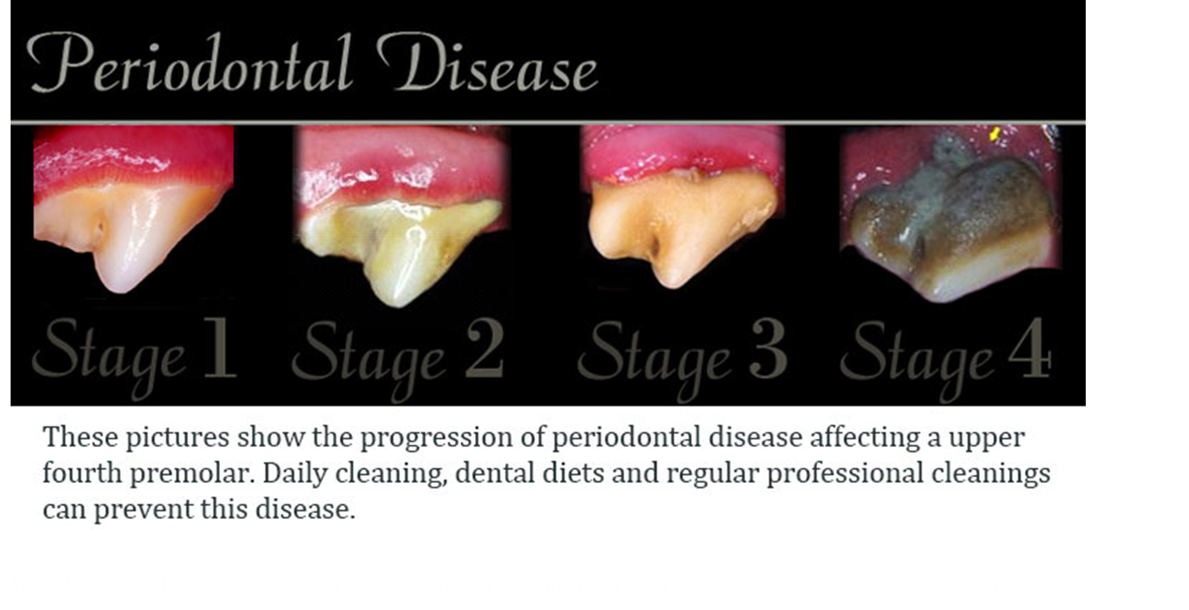

Slide 15
Dental radiograph of a pathological fracture
secondary to severe periodontal disease in a small
breed dog. (Courtesy of Dr. Brook Niemiec.)
Intraoral dental radiograph of right upper
fourth premolar in dog with periodontal abscess
from chronic periodontitis.

Slide 16
Dental picture of the case, removing
exudates from the alveolus during periodontal
abscess debridement.
Periodontal probes, two of many varieties.
(Courtesy of Dr. Brook Niemiec.)

Slide 17
Periodontal probe in a deep pocket on the
mandibular incisors of dog. Note the fairly
normal appearing gingiva. This lesion would not
have been identified without the probe.
(Courtesy of Dr. Brook Niemiec.)
Significant periodontal pocket on the buccal aspect of the right maxillary fourth premolar in a dog. (Courtesy of Dr. Brook Niemiec.)

Slide 18
Significant periodontal pocket on the palatal
aspect of the left maxillary second premolar in a
dog.
Dental radiograph of the case in revealed severe bony loss surrounding the roots of the left maxillary first and second premolars (teeth were extracted

Slide 23
http://avdc.org/AFD/five-stages-of-pet-periodontal-disease/

Slide 24
MANAGEMENT
Scaling and root planing (SRP) for mechanical debridement is the most important procedure in treating periodontitis
Periodontal pockets which are 3–6 mm in depth may show enhanced periodontal attachment gains if a local antibiotic is applied
Teeth which have pockets greater than 5–6 mm or furcation levels II or III requiremore advanced therapy for resolution of theinfection

Slide 25
The choice of antibiotic is based on the spectrum of antimicrobial activity and the anaerobic natüre of the periodontal pathogens.
Therefore amoxicillin-clavulanic acid, clindamycin, and metronidazole are frequently used because of their anaerobic spectrum of activity.
Nutritional support may be beneficial. Protein and other nutrients are important for maintaining healthy host epithelial defense and immune barriers.

