Slide 1
Evrim, Kurumlar ve İktisat Kuramı: Memetics
Altug Yalcintas
Ankara University
altug.yalcintas@politics.ankara.edu.tr

Slide 2
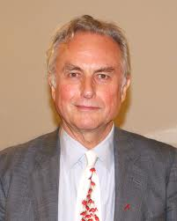
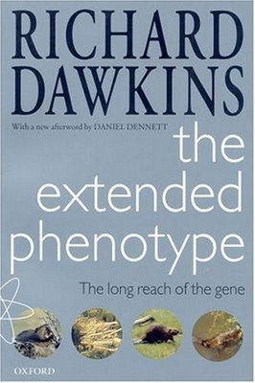
Richard Dawkins
An Oxford zoologist
A public figure
Famous for the following books:
The Selfish Gene (1976), The Extended Phenotype (1982), The Blind Watchmaker (1986), The God Delusion (2006)

Slide 3
Richard Dawkins
Famous for his views on:
Gene selection
Replicators
Memetics (idea selection)
Gradualism
Complexity
An outspoken atheist, a critic of creationism and intelligent design

Slide 4
Richard Dawkins
My subjective impression:
A very careful evidence seeker
A great writer of popular science
A euro-centric, arrogant Oxford fellow
A secret rationalist (selfishness rules) and positivist (only Darwinism) on how science works
Unneccasarily harsh on his attack on religion
An opponent of Gould and Eldredge
(Almost) No place in nature for chance
(Almost) No place in nature for stasis

Slide 5
The Selfish Gene (1976)
Questions:
Why are people kind to each other?
How could cooperation have emerged?
How should we explain altruistic behaviour
Altruism: the practice of concern for the welfare of others
Bees sticks other animals to protect their colony
(and they die soon after)
Giving up food for others
Parenthood
Suicide bombers

Slide 6
The Selfish Gene (1976)
Explanations:
species are imperfect therefore they cooperate
species benefit from cooperation
Altruism is a traditional feature of human societies

Slide 7
The Selfish Gene (1976)
Dawkins’ explanation: Our behaviour is mainly determined by our genome.
Altruism or altruistic behaviour is prevalent
because “genes for altruism” are selected
although this is often not good for the organism
thus: “selfish gene”
Be careful: genes are selfish, not organisms (humans)

Slide 8
The Selfish Gene (1976)
Gene:
The simplest unit of information that replicates itself
Unknown to Darwin
First introduced by Gregor Mendel in 1860s
Not much attention was paid until Cambridge scholars Watson and Crick discovered DNA in 1950s

Slide 9
The Selfish Gene (1976)
How does gene selection work?
Genes are numberless
Genes are able to replicate themselves
Replication is not perfect. It is error-prone.
Some genes remain silent for long periods
Struggle for survival of the fittest gene
Survival means replication of a gene through generations

Slide 10
The Selfish Gene (1976)

Slide 11
The Blind Watchmaker (1986)
Q1: Can a monkey write a sentence from Shakespeare, given sufficient time? (Experiment this in class)
R1: No, it cannot! Selection is not based on chance only. Selection is cumulative.

Slide 12
The Blind Watchmaker (1986)
Q2: But if we could show that nature worked in complex ways, would this mean that arts existed in nature (in the absence of humans)? *
R2: Yes, it would. But one needs to define what art is.
* This Q is a paraphrased form of Q1. It does not exist in Dawkins’ works and and does not belong to Dawkins himself.

Slide 13
The Blind Watchmaker (1986)
1. In the presence of a designer (such as William Shakespeare)

Slide 14
The Blind Watchmaker (1986)
Cumulative selection: multiple stages, algorythm
P
T
U
E
C
Y
C
E
n number of generations
C
T
K
E
C
A
K
E

Slide 15
The Blind Watchmaker (1986)
How about a sentence like this?
“Kkdl j lslj jlljjlslj”
…
“Frdkdkd, Romxxsr, jdjdtrymen, ırnd me”
…
“Friends, Romans, countrymen, lend me
your ears; I come to bury Caesar, not to
praise him”

Slide 16
The Blind Watchmaker (1986)
(2) In the absence of a designer:
Simple rules → complex structures

Slide 17
The Blind Watchmaker (1986)
An experiment: read a sentence in Turkish and let student to repeat after you and then write it down on a piece of paper. Read the results aloud.
One Turkish, one German, and one Dutch sentence

Slide 18
The Blind Watchmaker (1986)
Imagine: you find a watch in the middle of a forest. Would you think this watch is left out in the forest by a (human) being, or would you think it has emerged out of natural selection?
How about an animal mimicking a dead leaf?
How about a snowflake?
…

Slide 19
The Blind Watchmaker (1986)
We’ll do three models / software:
The Blind Watchmaker Software
Polya Urn Process
A Model of Residential Segregation

Slide 20
The Blind Watchmaker (1986)
The Blind Watchmaker Software
Indeteministic outcomes (blindness)
Prediction is not possible
A simulation is available here: http://watchmakersuite.sourceforge.net/

Slide 21
The Blind Watchmaker (1986)
Polya Urn Process
A different outcome after every trial
No laws at all!
A simulation is available here: http://success-equation.com/urn.html

Slide 22
The Blind Watchmaker (1986)
A Model of Residential Segregation
The model works through an algorithm. Such as:
I continue living in where I currently live if my neighbours are X [X: muslim, high income, conservative]
I move to another house if one of my neighbours are Y [Y: homosexual, single, smoker, drunkard]
A simulation is available here: http://www.avanderw.co.za/schellings-segregation-simulation

Slide 23
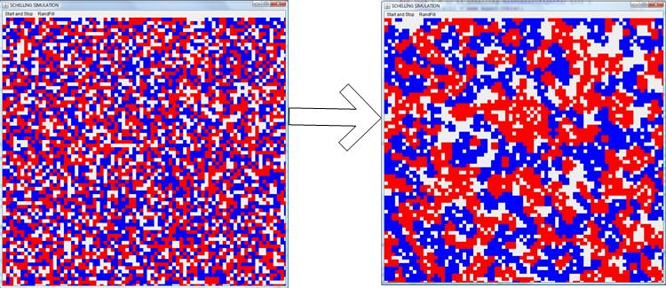
The Blind Watchmaker (1986)
A Model of Residential Segregation

Slide 24
The Blind Watchmaker (1986)
A Model of Residential Segregation

Slide 25
The Blind Watchmaker (1986)
So what?
(1) Evolution is not by chance alone but rather via cumulative selection
Watchmaker is mother nature in which genes strive for reproducing themselves.
Watchmaker is blind because there is no purpose for genes to reproduce themselves.

Slide 26
The Blind Watchmaker (1986)
So what?
(2) Different forms of art exists in nature (in pre-human and non-human communities)
“Art is nature (society)”
Discuss Spinoza’s claim that “God is nature”. Any similarities, differences?

Slide 27
The Blind Watchmaker (1986)
Complexity: contingency + algorhytm (such as a positive feedback mechn.)
Algorhytm: a simple software (Chp.3)
Hierarchy of components
Complexity lies in deeper and lower levels of selection
No need to explain the most complex structures. We need to decide on the level of explanation (or seleciton)

Slide 28
The Selfish Gene (1976)
That’s not all, folks!
Meme (memetics) and cultural evolution
Gene (genotype or biosphere) → meme (memotype or infosphere)
Meme selection
Selfish meme
We are all meme machines!
Memes as viruses.
Gestures, words, ideas, designs are all memes.
Meme for faith, meme for free speech, meme for solidarity
Talking, writing, hearing, reading are mechanisms that replicate memes.
Meme nest: our mind as software processing memes

Slide 29
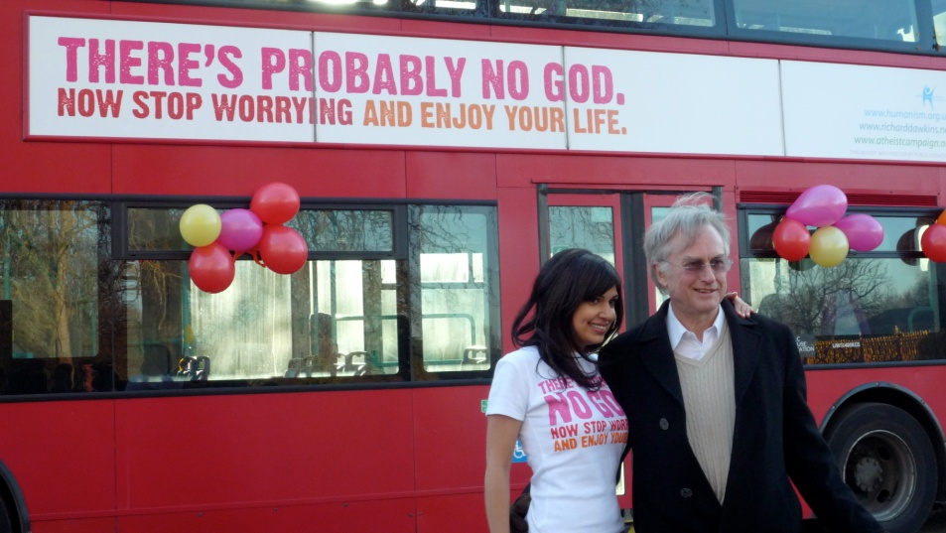
The God Delusion (2006)
Claim: evidence for faith is absent.
Main attack: extremism, fundamentalism, and tradition
However: only Judaism, Christianity, and Islam (no other forms of extemism, fundamentalism, and tradition)
Flying teapot and spagetti monster
His cure: reason (therefore: rationalism). A good design in the absence of a designer is possible.

