Slide 1
Evrim, Kurumlar ve İktisat Kuramı: Neden Coğrafya? (1)
Altug Yalcintas
Ankara University
altug.yalcintas@politics.ankara.edu.tr

Slide 2
Why Geography?
Some of the issues to be discussed today and in the following weeks:
Guns, Germs, and Steel (1997) by Jared Diamond
Segregation models and economic Clusters
Eventually, what is
“economic geography”?
“social geography”?
“moral geography”?
“political geography”?

Slide 3
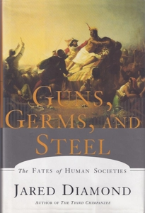
Why Geography?
Guns, Germs, and Steel: The Fates of Human Societies (1997) by Jared Diamond
Jared Diamond, professor of biology at UCLA
Winners of
(1) «Pulitzer Prize» (1998) and
(2) «Aventis Prize for Best Science Book» (1998)
Filmed by National Geographic Society (2005)
Translated into many languages, including Turkish
May be out of stock as TUBITAK is not really willing
to publish these book no more!

Slide 4
Why Geography?
Guns, Germs, and Steel: The Fates of Human Societies (1997) by Jared Diamond
Central theme (in economic terms):
Income and wealth distribution among human societes over ages
Key explanatory argument:
Geographical (advantages and disadvantages)

Slide 5
Why Geography?
The central question [sic.]:
«Why you White men have so much Cargo and we New Guineans have so little?»
In other words,
«Why are some countries so rich while others are poor?»
More specifically,
«How can we explain the disproportionate wealth possessed by the US and Europe?»
Questions discussed in courses on «ECONOMIC GROWTH», «DEVELOPMENT ECONOMICS»,
and «ECONOMİC HISTORY»

Slide 6
Why Geography?
What do we do in these courses?
ECONOMIC GROWTH: GDP growth rates, national income accounting, rate of unemployment, rates of wages and profits, business cycles, income inequality etc.
A course in third year economics curriculum (Fall)
DEVELOPMENT ECONOMICS: improving the potential of the general public, literacy rates, health and education conditions, judiciary system, minority issues, ethnic conflicts etc.
A course in third year economics curriculum (Spring)
ECONOMIC HISTORY: study of economies in the past, overseas expansion, industrial revolution, emergence of capitalism, technological evolution
A course in second year economics curriculum (Fall)

Slide 7
Why Geography?
Source: https://www.mapsofworld.com/continents/ December 2017

Slide 8
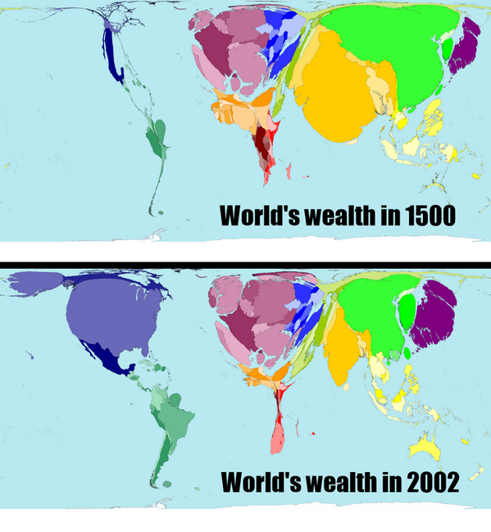
Why Geography?
Wealth distribution amongst
societies over 500 years.
Again, the same question:
How did we get here?

Slide 9
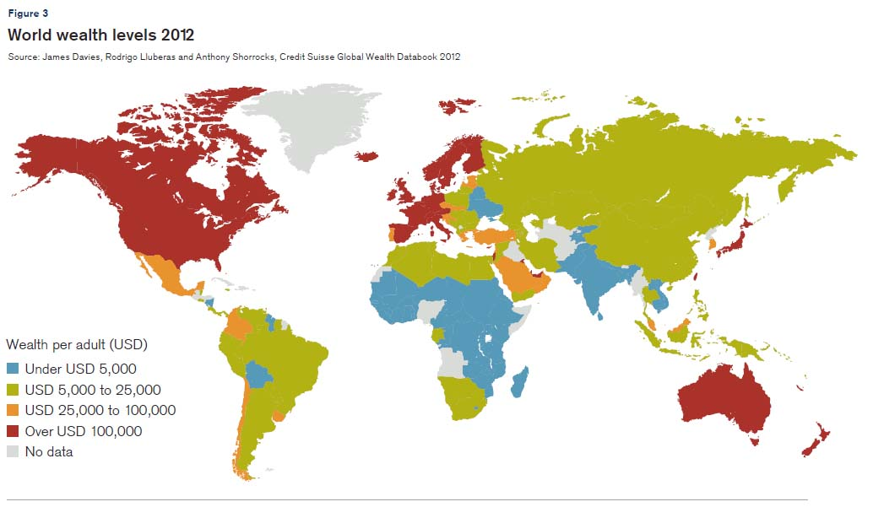
Why Geography?
Wealth distribution amongst
societies in 2012.
Again the same question:
How did we get here?

Slide 10
Why Geography?
Possible explanation (1): Superiority of the «European Race» in terms of intellectual capacity, technological abilities, morality, and genetics.
There is no such thing as «European Race»
Definition of «race» is problematical.
Possible explanation (2): Cold Climate stimulates creativity.
The Middle Eastern and the Meditteranean societies were (and are still) creative before the Western Europeans
New Guineans are as smart and hardworking as the Europeans

Slide 11
Why Geography?
Diamond’s response has to do with the HISTORY of the European and New Guinean societies
[ Remember the argument that «History Matters!» ]
History of environmental advantages and disadvantages
In other words: GEOGRAPHY.
Plus: POSITIVE FEEDBACK LOOPS.

Slide 12
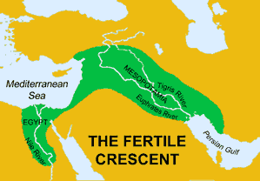
Why Geography?
13,000 years ago, in the Fertile Crescent:
Farming → domestication of plants
and animals
Transition from hunting and gathering
societies to sedentary societies
Neolithic Revolution, causing a radical
shift in human behaviour: putting down
roots to specific geographies, controling
the nature

Slide 13
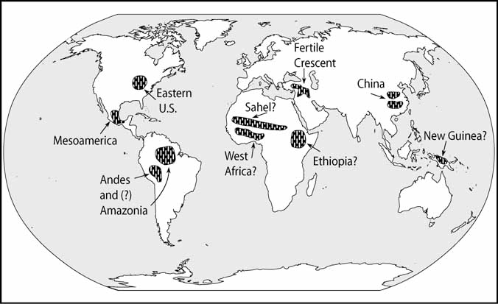
Why Geography?
In the meantime,
Spontaneous and simultaneous
agricultural activity in several
parts of the globe
So what was the advantage that
the societies in the Fertile Crescent
possessed?

Slide 14
Why Geography?
The positive feedback loop
Domestication of animals
Increasing efficiency in farming
More wheat and barley as food for people and animals
Fertilizing soil
Positive feedback in the Middle East 13,000 years ago:
Also:
Types of agricultural products
in the ME: More nutrituous and protein
Types of animals in the ME:
Horses, cows, sheep etc.
Invention of plough

Slide 15
Why Geography?
Whereas elsewhere around globe:
Domestication of high protein products
and powerful animals was not
spontaneous and simultaneous!
Thus: no positive feedback loops!

Slide 16
Why Geography?
SURPLUS ECONOMY or CAPITAL ACCUMULATION in the ME:
Geography
Institutions
Economic growth
Social and cultural development

Slide 17
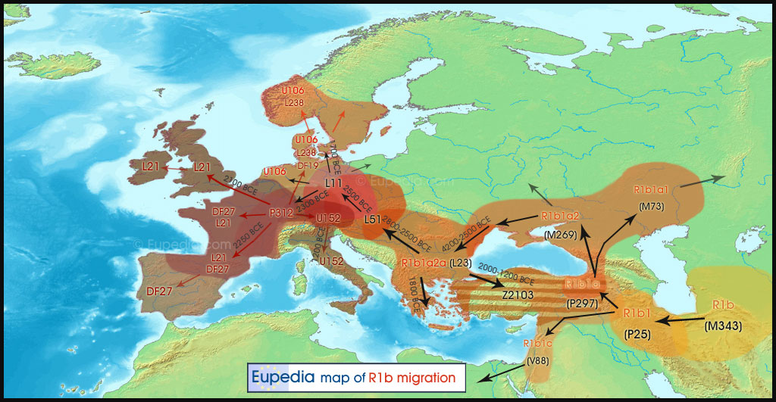
Why Geography?
Diffusion of Farming:
About 10,000 years ago,
After dramatic changes in the climate
People started to migrate
Mostly following the East – West axis
Source: Eupedia.com

Slide 18
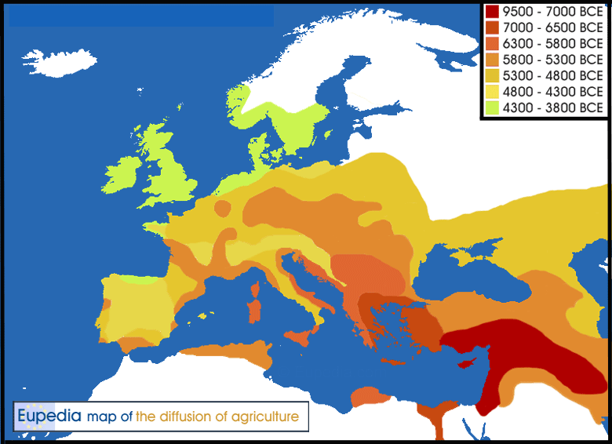
Why Geography?
Diffusion of Farming:
Migrating in East-West axis (latitude) means:
Similar climate, similar environmental
conditions (plants and animals)
Continuation of farming activity

Slide 19
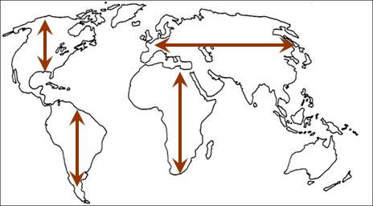
Why Geography?
Diffusion of Farming:
Euro-Asian societies possessed
a geographical luck (i.e. contingency!)
Agricultural development spread
more rapidly in Europe, North Africa,
and Asia Minor (Turkey).

Slide 20
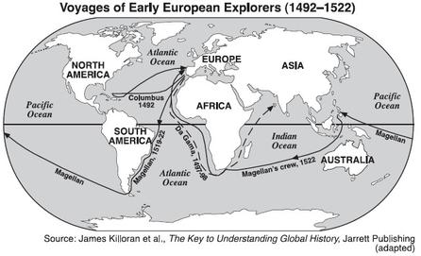
Why Geography?
Around the 1500s
European Overseas Expansion
The White Men conquered:
Americas
Africa
And the Far East

Slide 21
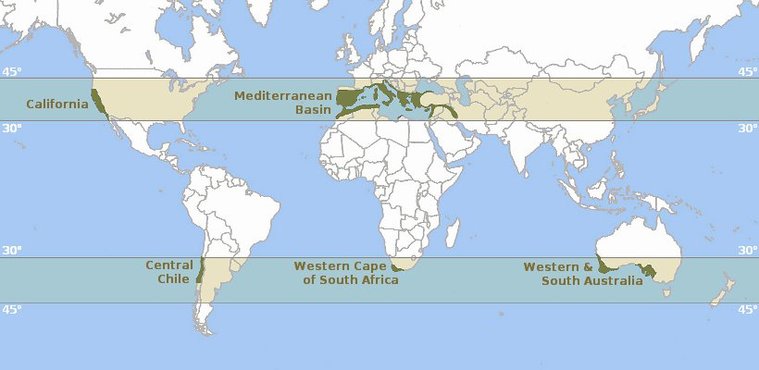
Why Geography?
Around the 1500s
European Overseas Expansion
The White Men conquered:
Americas
Africa
And the Far East

Slide 22
Why Geography?
Diamond argues:
The White Men possessed the
advantage of guns, germs, and
steel
The White Men more easily
established in the Mediterranean
Ecosystems

Slide 23
Why Geography?
Diamond argues:
Guns: armory and rifle
Germs: maleria and other diseases
Steel: From swords to rail roads
As a result: 95% of the Native
Americans and Africans were killed,
murdered, or enslaved.

Slide 24
Why Geography?
Bob Marley «Buffalo Soldier»
«… Stolen from Africa,
Going to America
Fighting on arrival
Fighting for survival …»

Slide 25
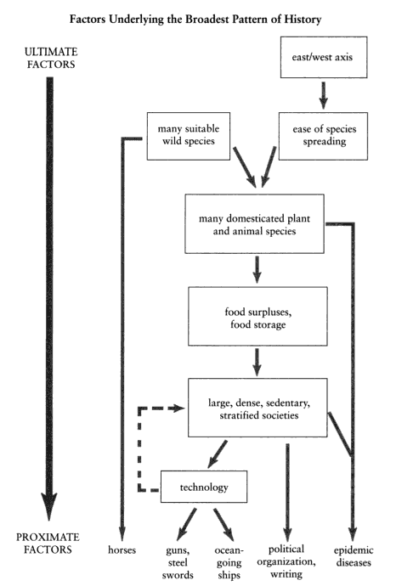
Why Geography?
In brief:
A head start + a geographical luck
Positive feedbacks
Economic, institutional, and
social development

