Slide 1
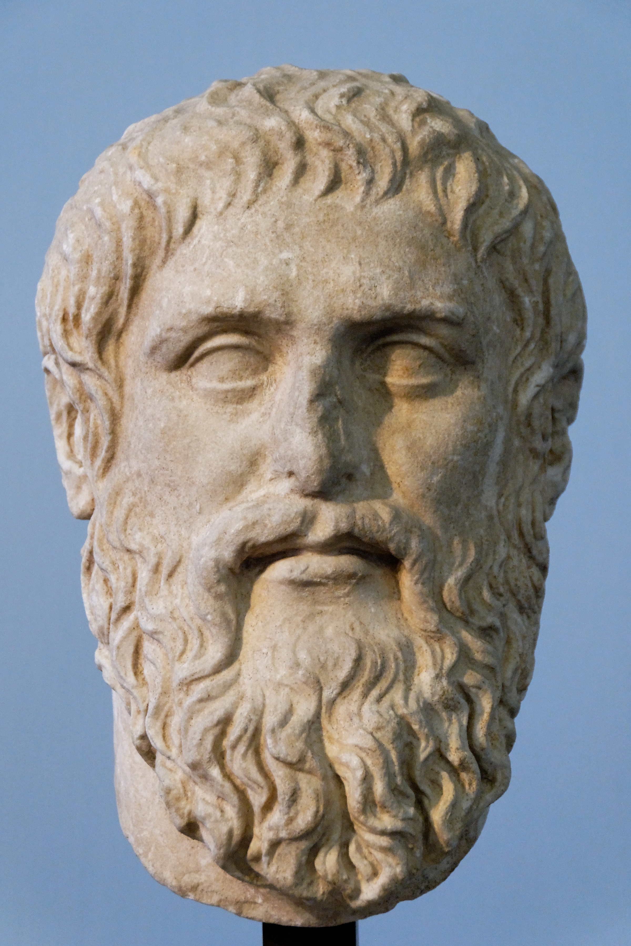
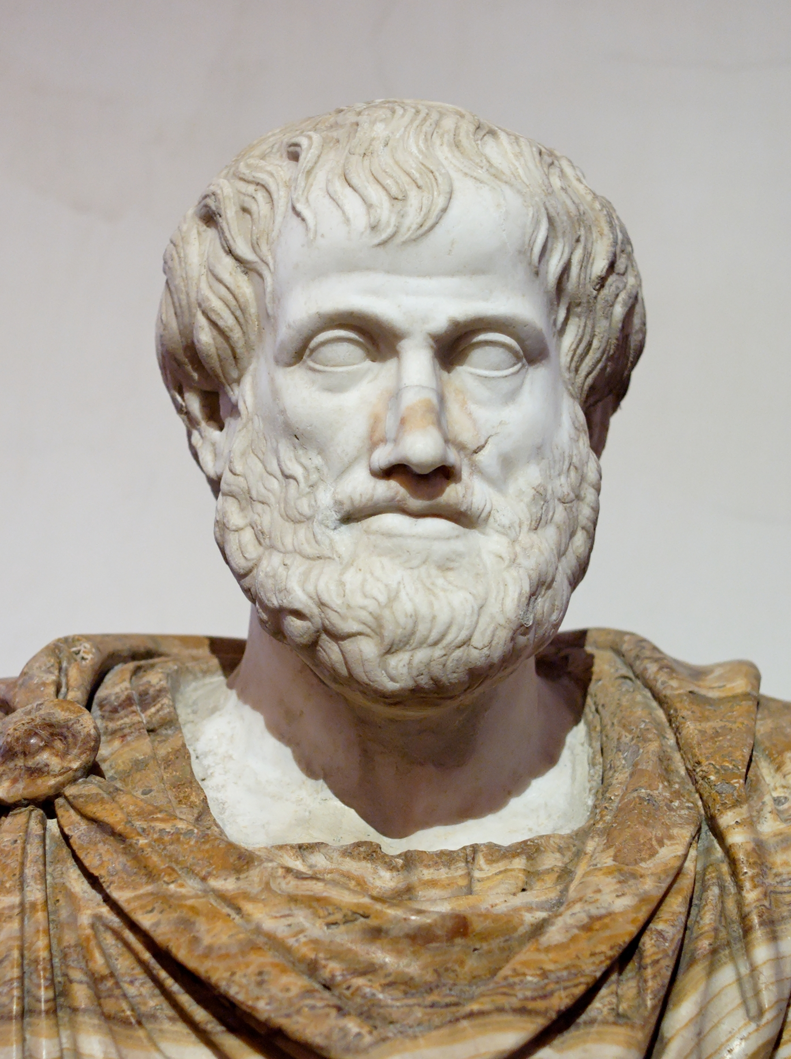
Plato & Aristotle

Slide 2
Plato (428/7-348/7)
Greek philosopher.
Founder of the Platonist school of thought and the Academy.
The Academy was the first institution of higher learning in the Western world.
Plato and Aristotle is the pivotal figure in the history of Ancient Greek and Western Philosophy.

Slide 3
A Strong Claim!
Professor Whitehead’s famous remark: “the safest general characterization of the European philosophical tradition is that it consists in a series of footnotes to Plato”.

Slide 4
There are two claims that domination of Plato’s philosophy and neo-platonism was suppressed scientific progress.
It was-by that extremist school of Neoplatonism which Western philosophy for several centuries, and stifled all progress in science-until, in fact, Aristotle was rediscovered and interest in nature revived.

Slide 5
But Alexandre Koyré thought that Galileo’s science was Plato’s victory.
The Dialogue and the Discourses tell us the history of the discovery, or better still, of the rediscovery of the language spoken by Nature. They explain to us the manner of questioning her, i.e., the theory of that scientific experimentation in which the formulation of postulates and the deduction of their implications precedes and guides the recourse to observation. This too, at least for Galileo, is a proof "by fact." The new science is for him an experimental proof of Platonism. (Koyré)

Slide 6
Physics is separated from mathematics and made into a department of theology with Platonism.
Until the 15th century Platonists and Neo-Platonists put forward only one aspect of Plato and it may have prevented scientific progress.

Slide 7
The Circular Dogma
I guess it is believed that God create the universe with compass and ruler.
Plato also believed that:
Plato came to certain general conclusions regarding the shape and motions of the universe. These conclusions, of paramount importance for everything which follows, were that the shape of the world must be a perfect sphere, and that all motion must be in perfect circles at uniform speed. (Koestler)

Slide 8
Therefore;
The task of mathematicians was to design a system of which explain circular order.
This dogma became the dominant paradigm until 17th century.
Kepler (1571-1630), offering elliptical orbit instead of circle, broke the taboos.

Slide 9
Let no one ignorant of geometry enter here.
To get the knowledge in Plato’s view is reasoning.
So that, he downplayed the importance of observation.

Slide 10
Platonic Solid

Slide 11
Reference: Arthus Koestler, The Sleepwalkers

