Slide 1
SOLUTION OF THE LEAST – SQUARES EXAMPLE IN PYTHON

Slide 2
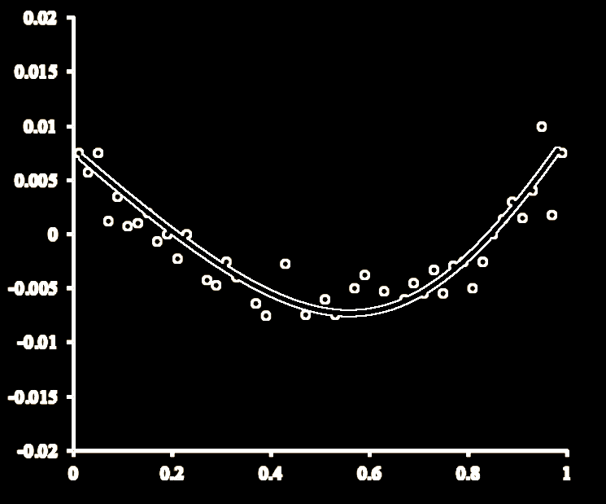
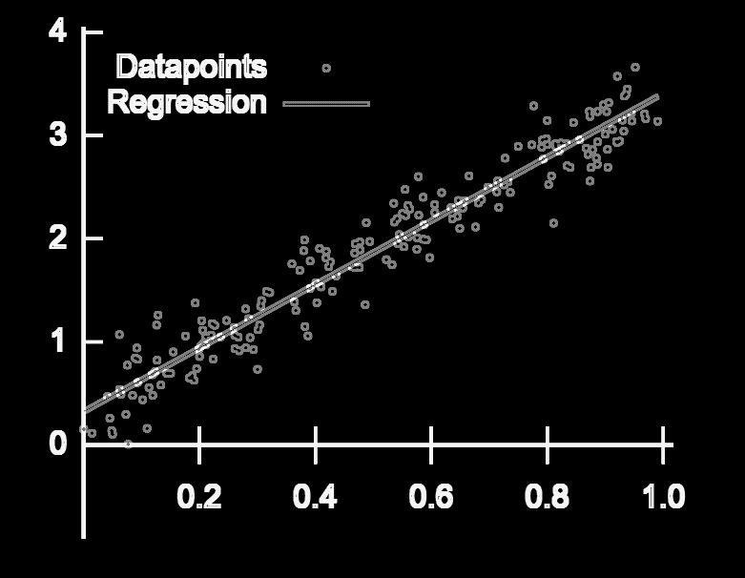

Slide 3
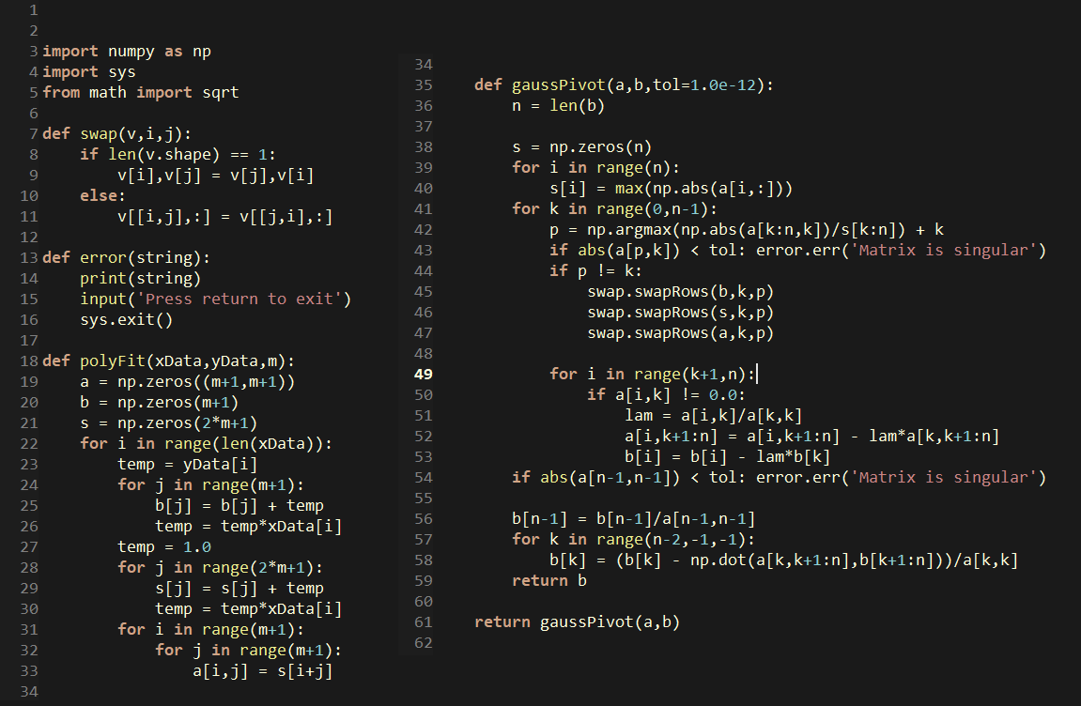

Slide 6
