Slide 1
SOLUTION OF THE BISECTION METHOD EXAMPLE IN PYTHON

Slide 2
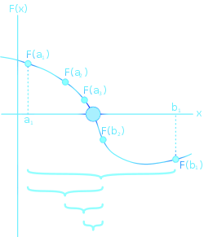

Slide 4
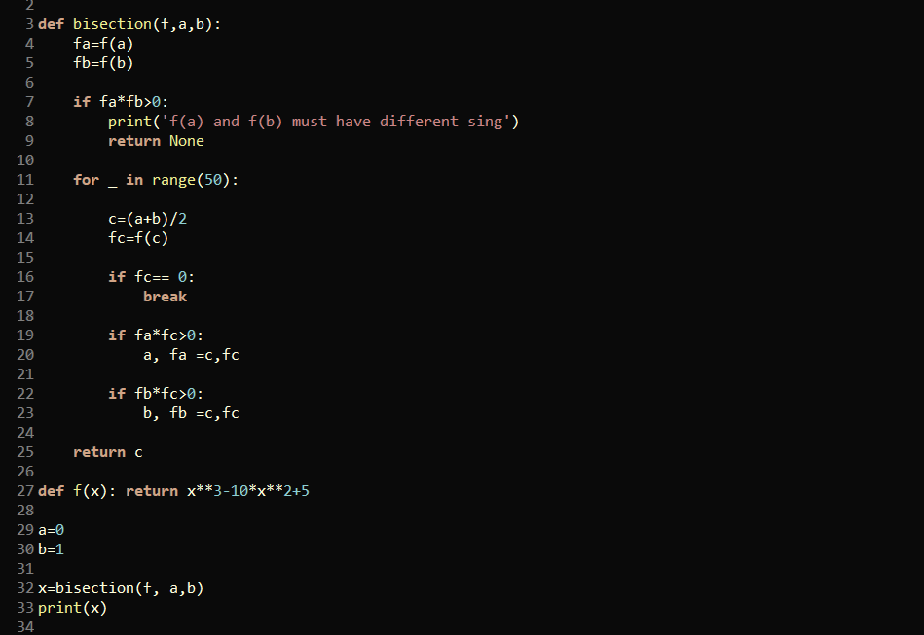

Slide 6
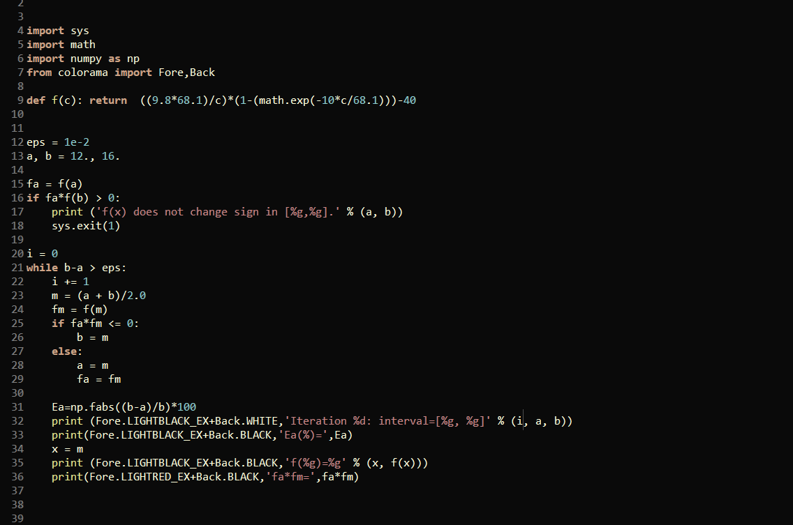

Slide 7
