Slide 1
SOLUTIONS OF THE NEWTON-RAPHSON METHOD
EXAMPLE IN PYTHON

Slide 2
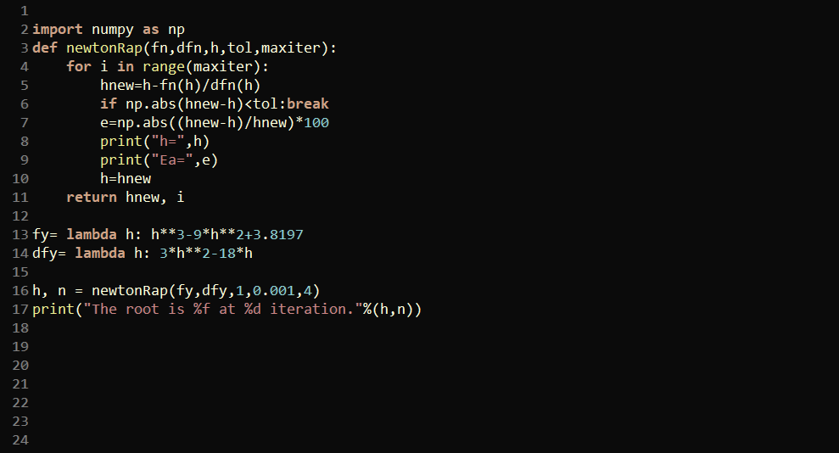

Slide 4
