Slide 1
SPECTROPHOTOMETRY

Slide 2
SPECTROPHOTOMETRY
Spectrophotometry is a discipline that investigate the transmittans/absorbance properties of a material as a function of wavelength.
This method is based on the absorption of light energy. Light is an electromagnetic radiation and is characterized by its frequency (v) or its wavelength (λ).
The light energy; E = h.v or E = h.c/ λ
  h (Planck constant) = 6,62*10⁻²⁷ erg.sec
  c = 3*10¹⁰ cm/sec

Slide 3
SPECTROPHOTOMETRY
Light can be absorbed by atoms, ions and molecules. The absorbed energy causes to pass the electrons from lower energy orbitals (ground state) to the higher energy orbitals (excited state). In order to absorb an energy, it must be equal to the difference between the two energy levels.
excited state
ground state

Slide 4
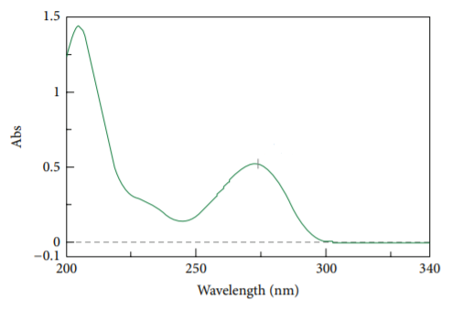
SPECTROPHOTOMETRY
Absorption of light in a specific wavelength in any spectral region is indicator of the presence of a structure with energy absorptive capacity. The absorption spectrum occurs by recording the amount of absorption as a function of wavelength.
In the UV and visible spectrum, the absorbance is plotted against the wavelength and a maximum (λ_{max} ) is observed at the wavelength which is the absorption is the highest.
International Journal of Analytical Chemistry Volume 2015, Article ID 170239

Slide 5


SPECTROPHOTOMETRY
Transmittance (Permeability) :
Permeability %
Absorbance
Absorption is measured by spectrophotometer. This measurement is the measurement of the difference between the intensity of light (I₀) transmitted to the atom, ion or molecule and the intensity (I) of the passing light.

Slide 6
SPECTROPHOTOMETRY
Lambert - Beer's Law
It explains the connection between the absorbance and concentration/length.
A = k . l . C
If the concentration is given in mol / L (M), the coefficient k is denoted by ε. (Molar absorbtivity)
ε depends on the nature and wavelength of the material.
A = ε . l . C
absorbance
length
molar concentration
molar absorbtivity

Slide 7
SPECTROPHOTOMETRY
Lambert - Beer's Law
Lambert - Beer's law is valid only under certain conditions:
No parasitic events such as refraction, reflection and diffusion should occur.
The used light should be monochromatic (single wavelength light).
The properties of the substance analyzed should not change during the study.

Slide 8
SPECTROPHOTOMETRY
Device Information in UV / Visible Spectrophotometer
Light source
Monochromator
Cuvette
Detector
Recorder
Region | Light source | Cuvette
UV | Hydrogen lamp | Quartz
Visible | Tungsten lamp | Glass or quartz

Slide 9
SPECTROPHOTOMETRY
APPLICATION AREAS OF SPECTROPHOTOMETRY
Qualitative analysis
Quantitative analysis
Determination of equilibrium constant
Determination of molecular weight
Kinetic studies
Photometric titration

Slide 10
SPECTROPHOTOMETRY
Qualitative Analysis
Chromophore group is a isolated group which have electrons and absorb light.
Continuous spectrum is a graph obtained by plotting the absorbance versus wavelength.

Slide 11
SPECTROPHOTOMETRY
Quantitative Analysis.
Based on Lambert-Beer’s Law.
Unknown concentration can be found by using the values determined at a certain wavelength.

Slide 12
SPECTROPHOTOMETRY
Calibration graph in quantitative analysis
A series of known concentrations is prepared and then their absorbance is determined.
Absorbance values are plotted against concentration and a line is drawn on a graph.
The unknown concentration is found by following equation y = mx + n.

Slide 13
SPECTROPHOTOMETRY
Spectrophotometric caffeine determination
Firstly, 5 mg of pure caffeine is weighed and dissolved in 50 mL of water. The concentration of the obtained solution is 100 μg / mL. Then this solution diluted to 4.0, 8.0, 12, 16 and 20 µg/mL (Each solution will be 10 mL and dilution calculations will be made by the students). In the spectrophotometer, 400-200 nm is chosen as the wavelength range. The absorbance at 272 nm, where the highest absorbance is observed in the spectra of standard solutions, will be measured and noted. From this data, linear regression equation will be obtained and then this equation will be used for the identification of samples whose concentration is unknown.
The absorbance value of the caffeine-containing sample with unknown concentration is measured using the same instrument parameters and the concentration of the sample is calculated by using the linear regression equation.

Slide 14
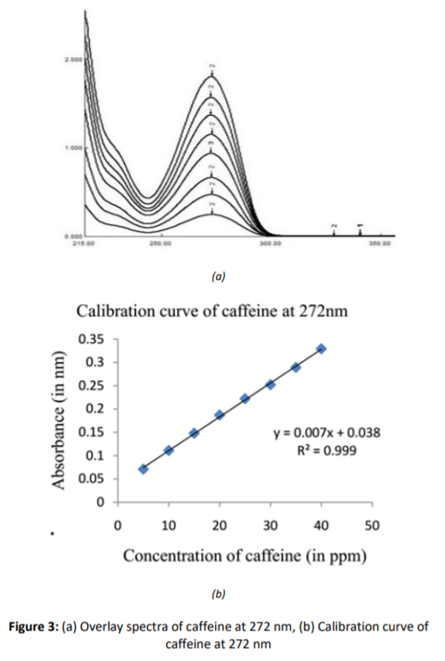
SPECTROPHOTOMETRY
Journal of Ayurvedic and Herbal Medicine 2017; 3(4): 200-204

Slide 15
Reference
Onur, Feyyaz; Analitik Kimya II, Ankara Üniversitesi Eczacılık Fakültesi Yayın No:101, s:135-149; Ankara 2011.
F. James Holler, Stanley R. Crouch; Fundamentals of Analytical Chemistry, 9th edition.

