Slide 1
COMMON AGRICULTURAL POLICY (CAP)
CHAPTER 5-PART 2
Res. Assist. PhD. Arzu Gökdai

Slide 2
KEEPING CONSUMERS CONFIDENT ABOUT FOOD SAFETY
This is about increasing concern about food hygiene and safety and animal welfare. CAP and other EU policies, such as consumer protection, have been considerably strengthened since the 1990s.
Food safety starts on the farm. EU rules apply from ‘farm to fork’, whether the food is produced in the EU or is imported from elsewhere in the world.

Slide 3
FOOD SAFETY
Europe’s consumers want food that is safe and wholesome. The concern of the EU is to make sure that the food consumers eat is of the same high standard for all its citizens.
There was a major overhaul in response to food safety scares, for example over BSE and dioxin-contaminated feed. The purpose was to make sure that EU food safety laws were as comprehensive as possible and that consumers have as much information as possible about potential risks and what is being done to minimise them.

Slide 4
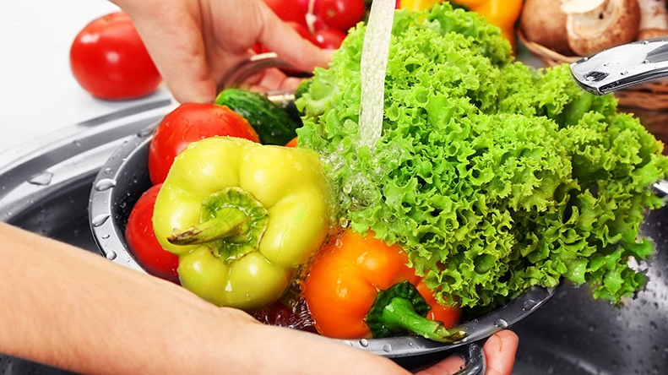
FOOD SAFETY
There are four important elements to the EU’s food safety strategy:
Rules on the safety of food and animal feed;
Independent and publicly available scientific advice;
Action to enforce the rules and control the processes;
Recognition of the consumer’s right to make choices based on complete information about where food has come from and what it contains.

Slide 5
ANIMAL HEALTH AND WELFARE
If food is to be safe, the animals it comes from must be healthy. The need to keep animals healthy through good veterinary practice and to prevent outbreaks of contagious animal diseases, such as foot-and-mouth disease, swine fever, or bird flu is an EU priority.
If an outbreak does occur, it is carefully monitored and steps are taken to prevent it spreading. All animals and animal products must meet strict health requirements before they can be imported into or traded within the EU.

Slide 6
ASSISTANCE FOR RURAL COMMUNITIES
Given that nearly 60 % of the population of the 27 Member States of the EU live in rural areas covering 90 % of the territory, rural development is a vitally important policy area.
A SPECIFIC FUND FOR RURAL DEVELOPMENT
European strategic guidelines for rural development were set out in February 2006.
Rural Development policy was strengthened to help rural areas respond to economic, social and environmental issues of the 21st century.
The new legal framework and the European Agricultural Fund for Rural Development stress the necessity to stimulate growth and to create employment in these areas to improve sustainable development in accordance with the Lisbon strategy and the Council of Gothenburg.

Slide 7
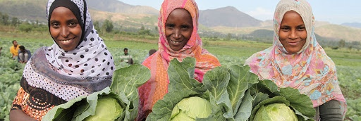
RURAL DEVELOPMENT
Rural Development policy for the period 2007–2013 will be based on 3 themes,
improving agricultural competitiveness;
improving the environment and supporting land management
improving the quality of life and diversifying the economy in rural areas

Slide 8
RURAL DEVELOPMENT
Assistance is provided for farmers for such actions;
Training in new farming techniques and rural crafts;
Assisting young farmers to set up on farms;
Assisting older farmers to retire;
Modernising farm buildings and machines;
Assisting farmers to meet demanding EU standards, e. g. environmental, animal welfare and public health;
Helping establish food processing facilities on the farm so that farmers can earn more income from farm products by adding value to them;
Improving product quality and marketing of quality products;
Encouragement of tourism;
Protection and conservation of rural heritage;

Slide 9
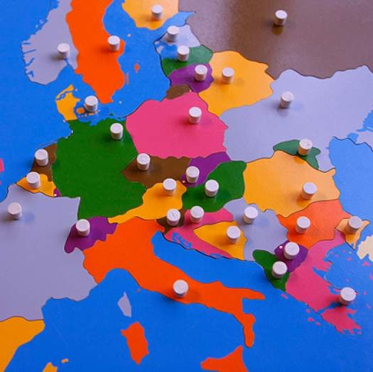
NEW MEMBER STATES,NEW CHALLENGES
Enlargement of the EU to include 10 new Member States (Cyprus, the Czech Republic, Estonia, Hungary, Latvia, Lithuania, Malta, Poland, Slovakia and Slovenia) from 1st May 2004, and Bulgaria and Romania on 1st January 2007, was a historic milestone in the remaking of Europe after centuries of destructive divisions

Slide 10
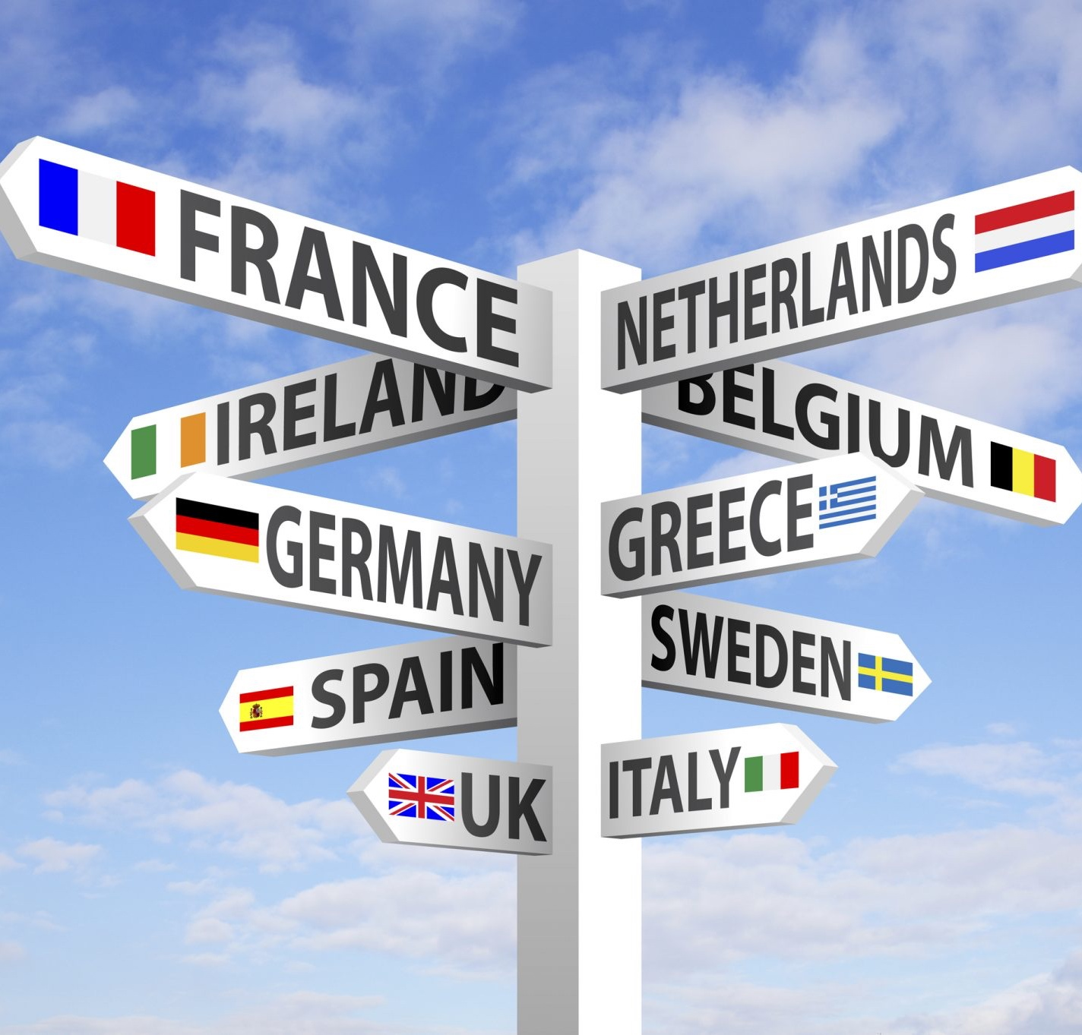
NEW MEMBER STATES,NEW CHALLENGES
Numerically, enlargement’s impact on EU agriculture is dramatic.
A further 7 million farmers have been added to the EU’s existing farming population of 6 million of the farmer 15 Member States. The new 12 Member States add about 55 million hectares of agricultural land to the 130 million hectares in the old EU of 15, an increase of 40 %, although production in the EU of 27 will only expand by about 10–20 % for most products.
as well as from the expansion of the internal EU market from 380 to nearly 500 million people.

Slide 11
NEW CHALLENGES
This was a challenge that the EU has already begun to take up, by creating new rural development measures designed to address the specific situation of the new Member States.
It is important to point out that the obligations of EU membership applied immediately to farmers in the new Member States. A key example is food safety, which is such an important issue for EU consumers that no drop in standards at community level could be considered!

Slide 12
THE EU – A MAJOR WORLD TRADER IN AGRICULTURAL GOODS
The EU is a major player in global agricultural trade as the biggest importer and second largest exporter of foodstuffs.
The EU is clear that the growing trade between all countries, whether developed or less so, must be conducted under multilateral trade rules for the benefit of all countries, in particular developing countries.
The EU is the only big trading group, among the wealthier nations, which is not only granting preferential access to its markets for imports from developing countries, but is in practice actually importing considerable quantities from those countries.

Slide 13
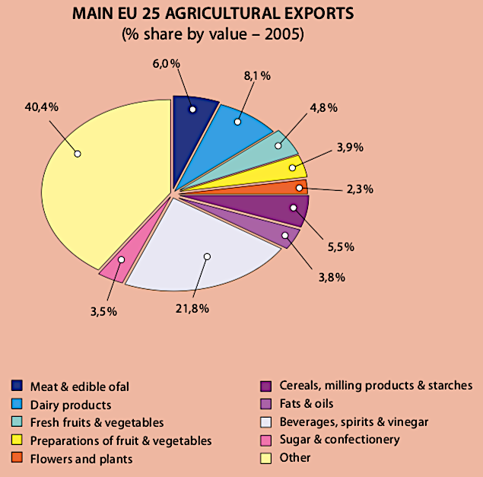
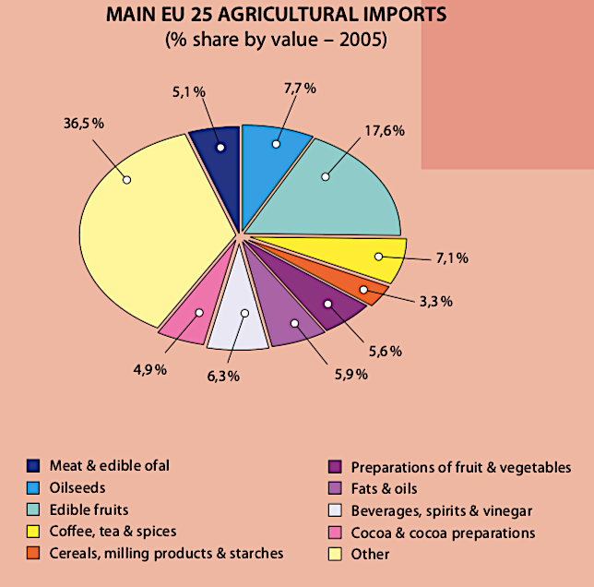
TRADE WITH DEVELOPING COUNTRIES
The EU‘s record of importing agricultural products from developing and least developed countries is already impressive and is greater than the USA, Japan, Canada, Australia, and New Zealand together.

Slide 14
HOW MUCH THE CAP COSTS
During the first years of the EU’s existence the CAP represented a significant proportion of budget expenditure, over two-thirds on occasions. The CAP costs about EUR 55 billion per year. This represents 40 % of the total EU budget, less than 0,5 % of GDP in the EU.
Unlike for other sectors, such as education, defence, transport health care or social security, whose cost is borne by national governments, the Member States have agreed that decisions about the EU‘s agricultural policy be taken at community level, and that an appropriate budget be put in place to do this.
On average each citizen contributes around 2 euros a week to finance the CAP. This is hardly a high price to pay for a healthy supply of food and a living countryside.

Slide 15
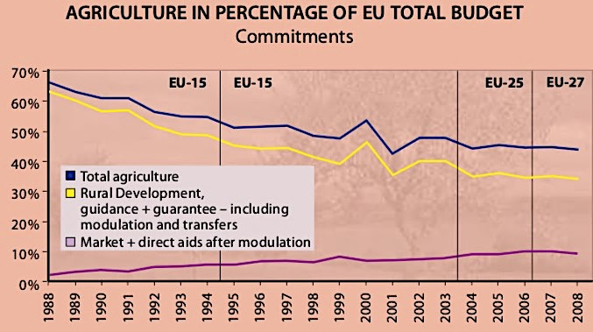
BUDGETARY CONTROL
The proportion of the budget used for market support (cereals, sugar, beef and milk) and for export subsidies has decreased, whilst that for direct aid to producers and for rural development has increased.

Slide 16
PROMOTING SUSTAINABLE AGRICULTURE IN A GLOBAL ENVIRONMENT
The EU’s role in agriculture has always been to help in;
Ensuring a stable supply of affordable and safe food for its population;
Providing a reasonable standard of living for EU farmers, while allowing the agriculture sector to modernise and develop;
Enabling that farming could continue in all regions of the EU.

Slide 17
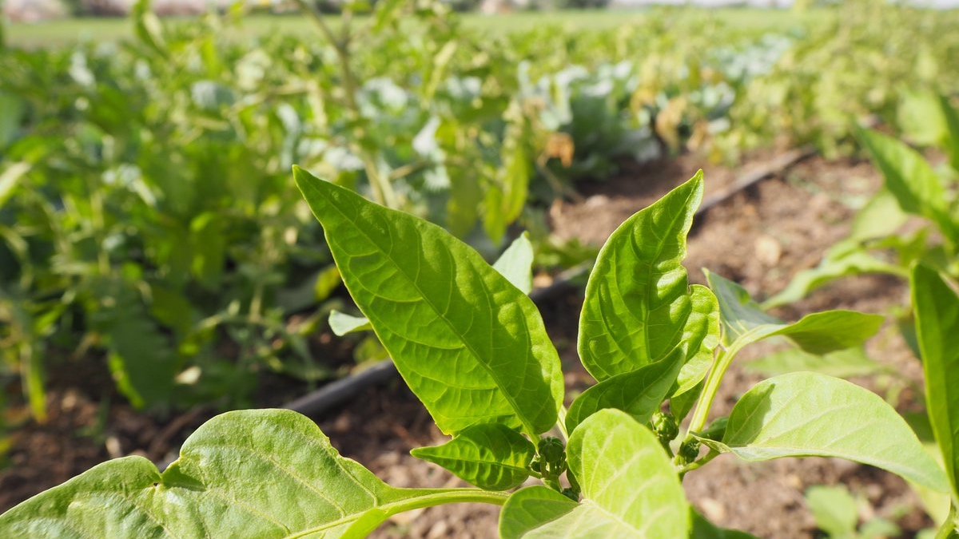
SUSTAINABLE AGRICULTURE
As the CAP has developed, in line with the requirements of EU citizens, the following factors take on a greater importance:
Improving the quality of Europe’s food;
Guaranteeing food safety;
Looking after the well-being of rural society;
Ensuring that the environment is protected for future generations;
Providing better animal health and welfare conditions;
Doing all this at minimal cost to the EU budget (which is funded mainly by taxpayers, i. e. ordinary citizens).

Slide 18
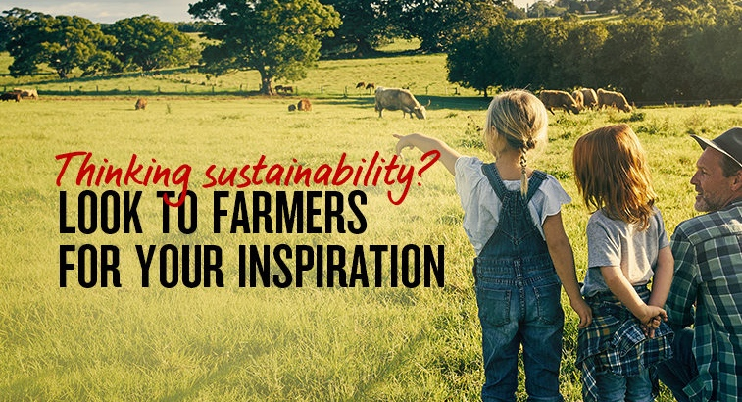
FUTURE OF CAP
During the coming years the CAP will change further in order to continue to:
Be a living policy which reflects the needs and expectations of European society;
Promote a sustainable agriculture offering safe, quality products while protecting the environment and animal welfare;
Support the multifunctional role of farmers as suppliers of public goods to society;
Promote the growth and creation of jobs in rural areas;
Reinforce a competitive and innovative agricultural sector that can respond to the challenges of the world market;
Be managed by simple and transparent rules.

Slide 19
Any Questions?!?

