Slide 1
COMMON MARKET ORGANIZATION (CMO)
CHAPTER 7
Res. Assist. PhD. Arzu Gökdai

Slide 2
Introduction to CMO
What is CMO?
The shortest and legal 'correct' answer is;
Very different group of measures implemented in different agricultural sectors in the EU
CAP’s 1st column measures, excluding direct payments
CMO measures are the result of a very long-term change of CAP (the first CAP measures taken in the 1960s were related to CMO)
Does CMO measures have a future? ...

Slide 3
Introduction to CMO
Why do we need to regulate the markets?
Most of the reasons are for states to intervene in the economy:
Elimination of market insufficiency (price fluctuation)
Redistribution of revenues (from industry to agriculture)
Non-economic objectives (standardization, phytosanitary, health, food safety)
Interventions can be monetary or not
The main reason for the intervention in the EU and in most developed countries is the redistribution of income.
The problem of income in agriculture!

Slide 4
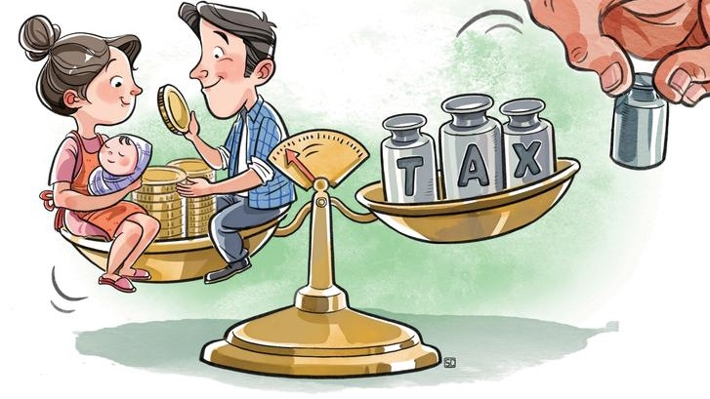
Income problem in agriculture
The old-fashioned approach is a combination of:
Market-oriented price support:
Minimum prices, production quotas, export subsidies, import / export tariffs, ...
Structural policy measures: helping farmers to quit farming
Price support without a structural policy is not a sound policy in the long run (old CMO policy!)
Farm income versus self-sufficiency in agriculture → both ways!
Structural adjustment policy is seen as the only solution!

Slide 5
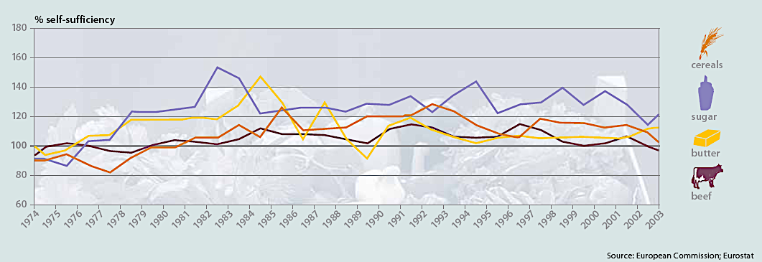
CMO was effective in getting things done right, but were they chosen correctly?

Slide 6
Many dairy farms produced butter and skim milk powder for public stocks

Slide 7
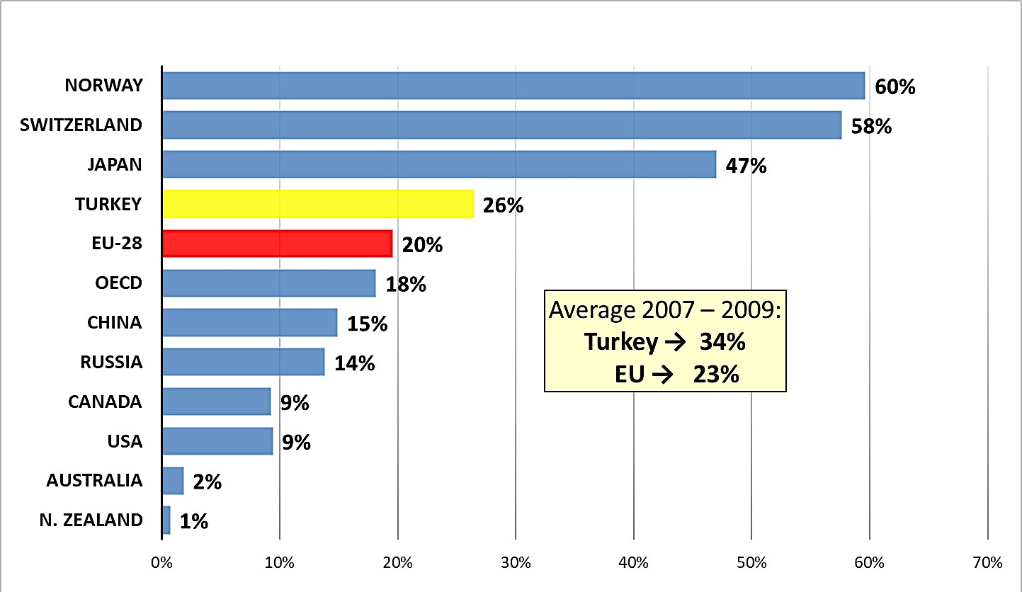
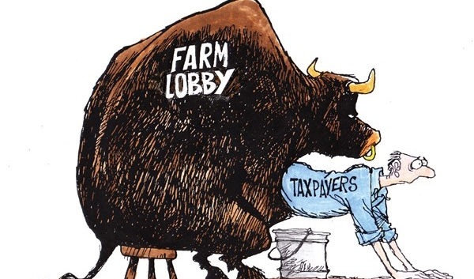
Producer Subsidies Estimates, 2014 - 2016 average (as a percentage of total farm income)

Slide 8
CMO in terms of CAP policy
Through certain policy tools, CMO helps the functioning of markets and ultimately contribute to competitiveness in the agri-food sector;
Unlike direct payments and rural development, not all CMO measures are linked to providing financial support to the beneficiary (farmers are not the only beneficiary of the measure in direct payments);
Beneficiaries are sometimes the only 'liable persons' for some rules;
The Payment Authority is the implementing body for many measures

Slide 9
Legal Framework
Single CMO Regulation = Regulation (EU) of 17 December 2013 numbered 1308/2013 of the European Parliament and Council, which constitute a common market order for agricultural product markets.
Adopted as part of the CMO reform package
Proposed by the European Commission in October 2011
In force since January 1, 2014

Slide 10
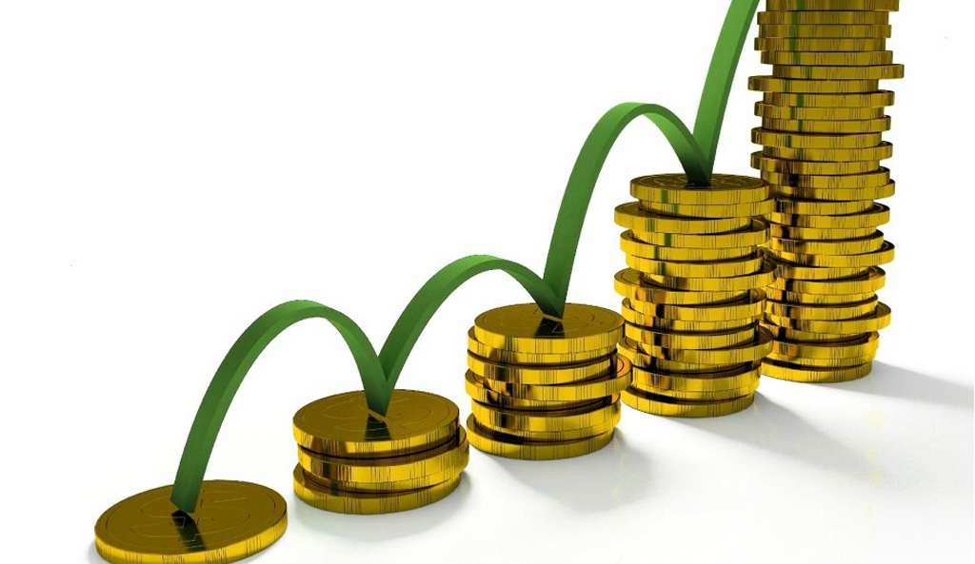
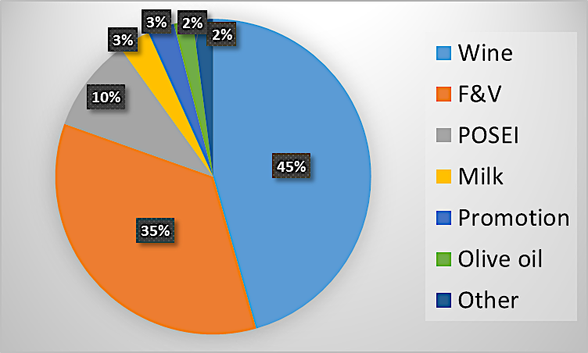
CMO expenditure structure: 2.67 billion euros for 2015

Slide 11
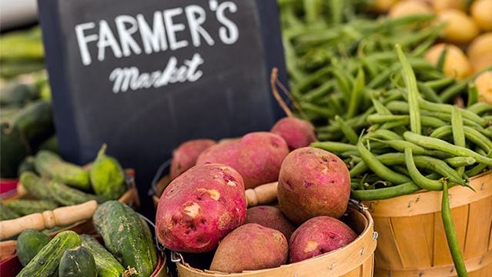
New intervention logic for CMO: challenges, objectives and tools
The key issues regarding the future of the CMO are related to:
The fluctuation of agricultural prices and
Instability of agricultural markets
The role of farmers in the food supply chain
In general, the current safety net system is not sufficient in times of severe market crisis, for this appropriate measures need to be developed.
Crisis reserve mechanism also needs to be improved
Some Member States think that the establishment of effective market stability measures is the rationale for the establishment of a separate third pillar of the CAP.

Slide 12
Difficulties faced by farmers in the EU after the 2013 Reform
The introduction of Russia's ban on imports in August 2014 showed how vulnerable the agricultural sector was to the instability in the market.
Market crisis in EU-focused negotiations by EU agriculture ministers in 2014, 2015 and 2016
Support for producers facing market stability and market crisis cannot be provided by other policy measures.
Therefore, despite its relatively low share in the agricultural budget, CMO will continue to be an important part of the CAP!

Slide 13
Market measures

Slide 14
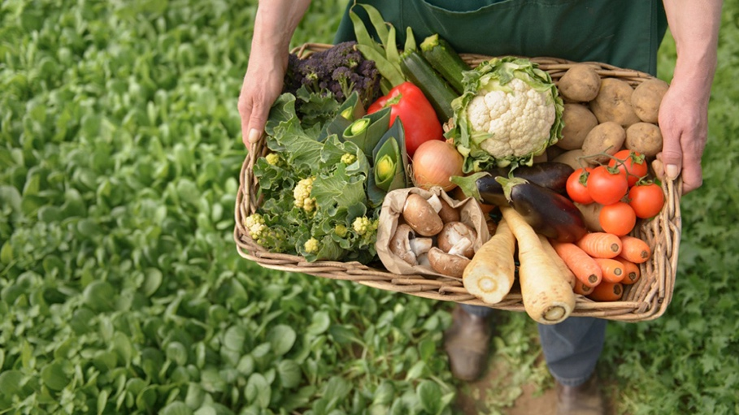
Agricultural Markets Task Force
The growing integration of the European agri-food sector in global markets has created important trading opportunities, but it has also caused greater exposure to market imperfections and increased price volatility. To try to counteract these negative effects the European Commission set up an expert group called the agriculture markets task force.
The task force discussed a number of issues with a view to strengthen the position of farmers in the agricultural food chain.

Slide 15
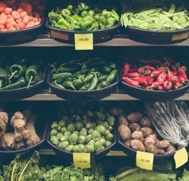
AMTF * Recommendations
Reducing unfair commercial practices.!
Increasing market transparency to help farmers negotiate their contracts
Written contracts should be offered to farmers
Producer collaboration → reducing complexity
Increasing the rate of farmers using risk management tools
Facilitating farmers' access to finance
* Tarım Piyasaları Görev Ekibi (Agricultural Markets Task Force)

Slide 16
Participation in EU and CMO
Extremely troublesome in terms of capacity building and institutional structuring
The possibility of obtaining an exception (derogation) in the harmonization of the CMO acquis is extremely limited
CMO AND EU

Slide 17
Any Questions?!?

