Slide 1
Sub-Departamento de Língua Portuguesa | Faculdade de Línguas, História e Geografia |
UNIVERSIDADE DE ANKARA
ISP 420 – Portekiz Kültürü | Cultura Portuguesa

Slide 2
Summary
Ditadura.
25 de Abril.
Cultural Features
The 2 main ‘world visions’ and traits of Portuguese culture: An historical conflict until 1980s
Portuguese Culture through its Literature
Orpheu and Pessoa: Modernism

Slide 3
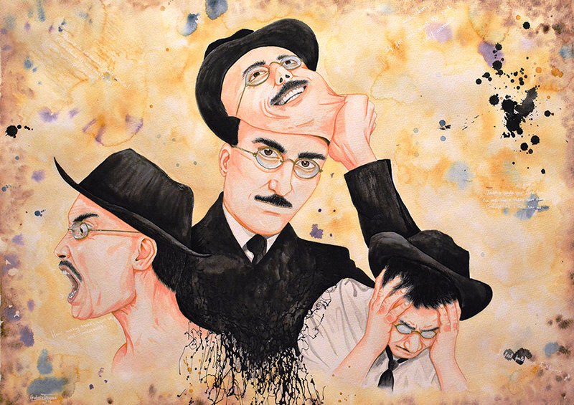
Fernando Pessoa and “Heterónimos”
“The process of transforming the self into art is, for Pessoa, a painful one, as revealed by the anguished existential undertones to many of the orthonymous poems, wherein the ‘pain of (over) thinking’ (‘dor de pensar’) is pervasive.”(p.147)
Alberto Caeiro and the simple existence with the natural world;
Álvaro de Campos: the great cosmopolitan and lover of cities
– the true modernist poet;
Ricardo Reis: the classicist in the face of inevitable mortality.

Slide 4
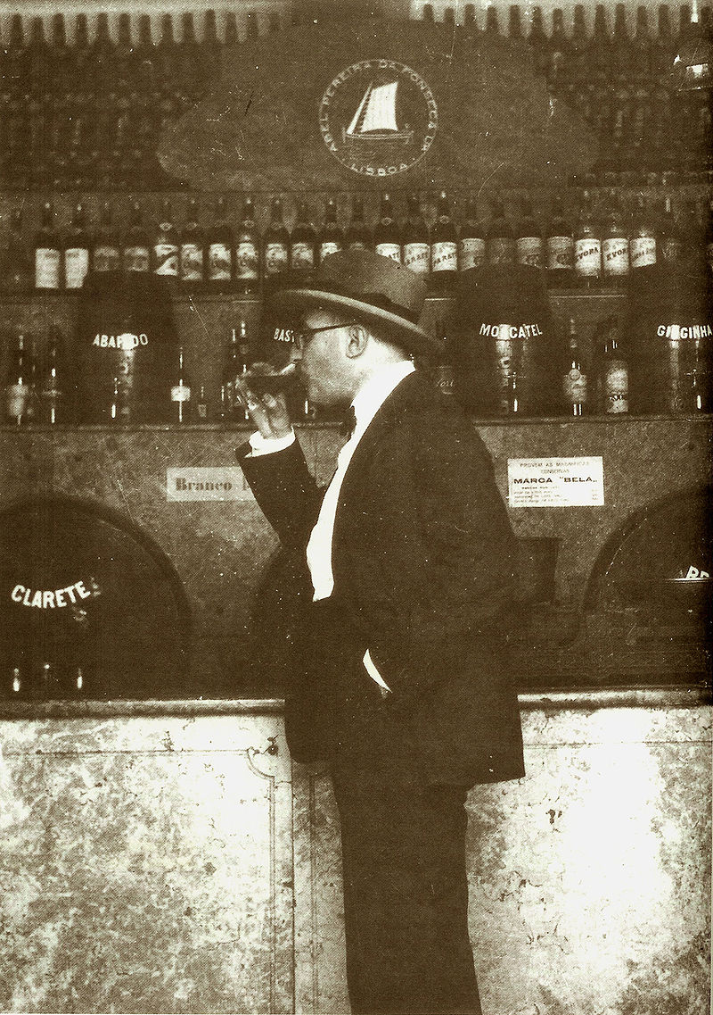
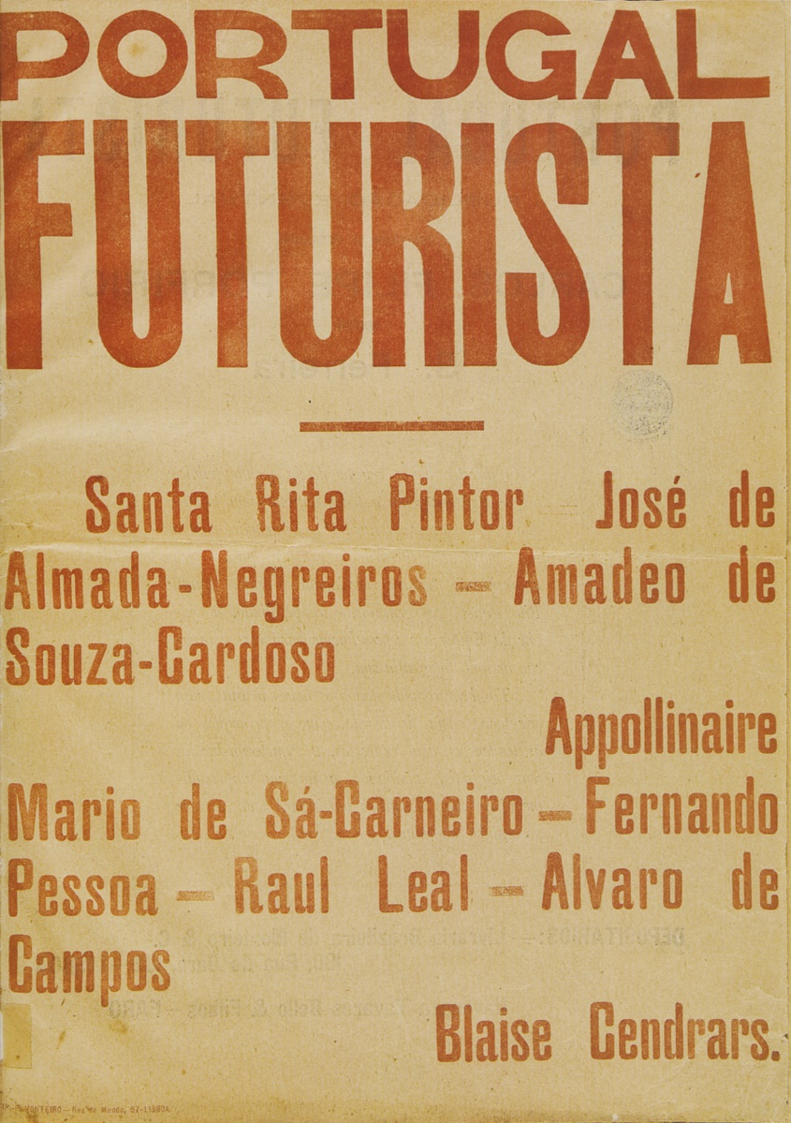
Álvaro de Campos and “Tabacaria”
“What is within me is, mainly, tiredness”

Slide 5
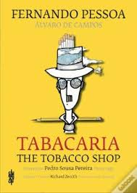
Álvaro de Campos and “Tabacaria”
“I'm nothing. I'll always be nothing. I can't want to be something. But I have in me all the dreams of the world.
(…)
(The Tobacco Shop Owner has come to the door.) As if by divine instinct, Esteves turns around and sees me. He waves hello, I shout back "Hello, Esteves!" and the universe falls back into place without ideals or hopes, and the Owner of the Tobacco Shop smiles.”

Slide 6
Álvaro de Campos and “Tabacaria”
“Eat your chocolates, little girl, Eat your chocolates! Believe me, there's no metaphysics on earth like chocolates,
And all religions put together teach no more than the candy shop. Eat, little girl, eat! If only I could eat chocolates with the same truth as you! (…)”

Slide 7
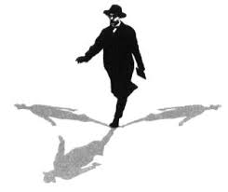
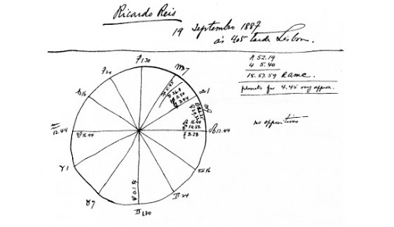
Pessoa and Modernism: ORPHEU

Slide 8
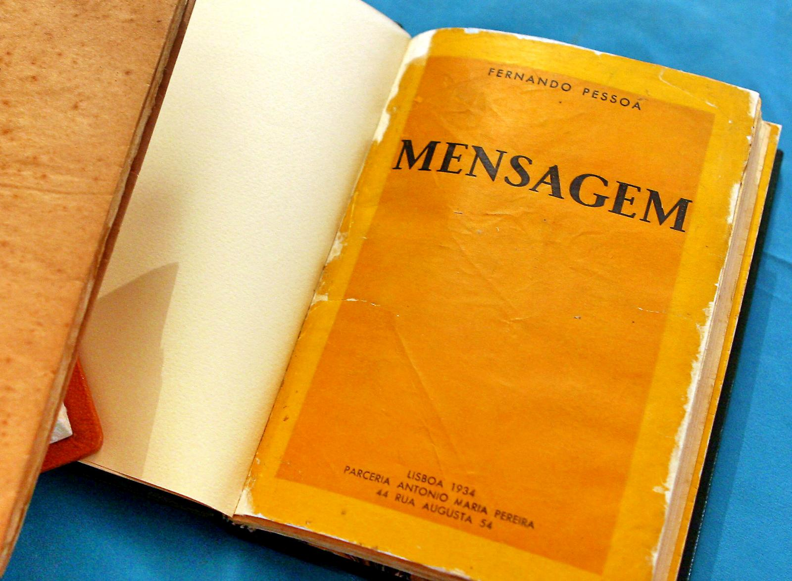
Pessoa – Modernismo – the New State
Mensagem – Message (1934) the only book-length collection to be published in Pessoa’s lifetime was the poetic culmination of his patriotism.
It gained Pessoa wider public acclaim and, not least, a useful cash reward, by winning first prize in its category in a national literary competition.
Mensagem, he had opportunely announced the imminent appearance of a ‘Supra Camões’ who would restore Portuguese culture to its former glory and it was certainly promoted as such in the days of the Estado Novo.

Slide 9
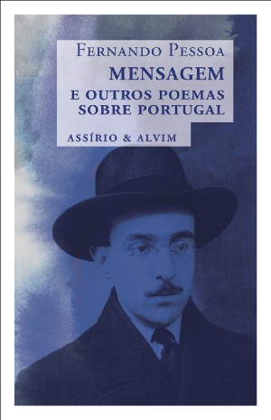
Pessoa – Modernismo – the New State
Este senhor Salazar
É feito de sal e azar
Se um dia chove
A água dissolve
O sal,
E sob céu
Fica só o azar, é natural.
Oh, c’os diabos!
Parece que já choveu…
29-3-1935

