Slide 1
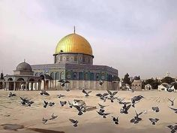
AL-QUDS

Slide 2
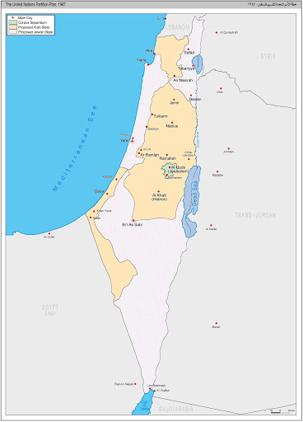
GENERAL INFORMATIONS
COUNTRY: PALESTİNA POPULATION:931.756 RELIGION:ISLAM, CHRISTIANITY, JUDAISM, ETHNİCITY:MUSLIM ARAB, JEWISH, CHRISTIAN THE NAME OF HISTORY:JARUSELAM IN HEBREW, YERUSHALAYIM , IN ARABIC al-QUDS OR BAYT al-MAQDIS.

Slide 3
Given its history, Jerusalem is a very religious city. At 64%, the majority of the population is Jewish, although there are of course different levels of adherence to the Jewish faith. The Muslim faith is the second most practiced religion in Jerusalem, representing 34% of the population. 2% of the population identifies as Christian.

Slide 4
SIGNIFICANT DATES FOR AL-QUDS
636
Al-Quds was conqured by Umar in 636.
1516
The Ottomans entered Jerusalem on 28 December 1516, under the leadership of Sinan Pasha, in the Egyptian Expedition of Yavuz Sultan Selim.
1917
On 09 December 1917, the City of Jerusalem fell into the hands of the British and became the British mandate and became the capital of Palestine.
Al-Quds was conqured by Saladin Ayyubi ,so he is known the conqueror of Al-Quds.
1187
1099
The crusader army invaded Al-Quds.

Slide 5
AT THE TİME OF UMAR
The Siege of Al-Quds was part of a military conflict which took place in the year 636 between the Bayzantine Empire and the Rashidun cliphate. It began when the Rashidun army, under the command of Abu Ubaidah, besieged Jerusalem in November 636. After six months, the Patriarch Sophronius agreed to surrender, on condition that he submit only to the Caliph. In April 636, Caliph Umar traveled to Jerusalem in person to receive the submission of the city. The Patriarch thus surrendered to him.
The Muslim conquest of the city solidified Arab control over Palestine, which would not again be threatened until the First Crusade in the late 11th century.

Slide 6
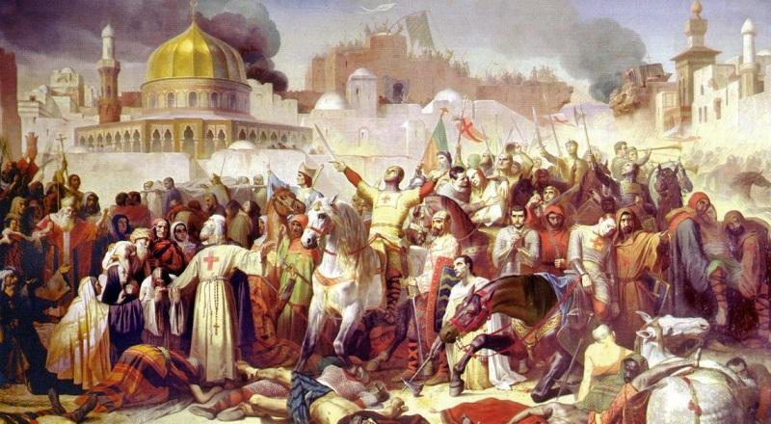
THE FIRST CRUSADES(1099)
The Middle Ages are times when wars become frequent for Jerusalem. After the indigenous Christians were expelled from the city, Christians made their first crusade and massacred many of the Muslims and Jews in the city. Later, the Kingdom of Jerusalem was established by the Crusaders. Christian communities were placed in the area to prevent Muslims and Jews from returning to the city.

Slide 7
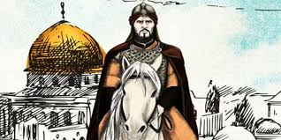
SALADIN AYYUBI TOOK BACK
Saladin Ayyubi finished the end of the Jerusalem Kingdom in 1187. he took Jerusalem back, allowed the Muslims and Jewish to return to the city. Although he struggled for the development of Al-Quds, the interest in the region decreased due to the wars in the region. During this period, many wars took place between the Mamluks and the Crusaders for Al-Quds. In addition, he is known the conqueror of Al-Quds.

Slide 8
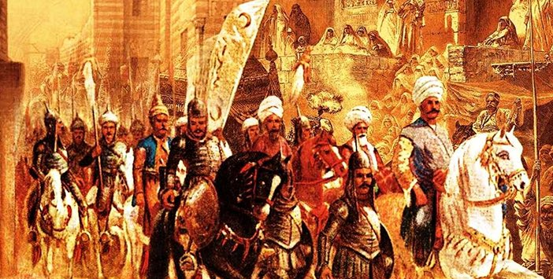
OTTOMAN EMPİRE IN Al-QUDS
Ottoman Empire entered Al-Quds on 28 December 1516, under the leadership of Sinan Pasha, in the Egyptian Expedition of Yavuz Sultan Selim. He visited Al-Quds on 31 December , 1516 and changed the city's name to Al-Quds-Sharif. The Ottoman empire managed to Al-Quds for 400 years. Al-Quds has always been important for the Ottoman Empire. Kanuni Sultan Suleyman, Sultan 4. Murad, Sultan Abdulmecid, Sultan Abdulaziz and second Abdulhamid Khan contributed to Al-Quds in many services.

Slide 9
1917:After the British invaded Al-Quds on Dec. 9, 1917 which till then had been under the control of the Ottoman Empire for 400 years , they turned a blind eye to Jewish settlements in the region. The Jewish population in the historich Palestinian territory in 1917 is said to be around 60.000. It ballooned to 800.000 in 1948, when Israel declared its independence. 1948: Isreal declared it independence on May 14, 1948 whereas Arab countries including Egypt, Jordan , Lebanon and Syria waged a war against Isreal on May 15, 1948. Isreal, which won the war , began to implement its plan for judaizing the city by invading West Al-Quds. 1967: Isreal invaded East Al-Quds and the West Bank during the six-day war. 1980: Isreal declared the entire Al-Quds as its capital in July 3, 1980. 2017: In Dec. 6, 2017 , U.S. President Donald Trump unilaterally recognized Al-Quds as ‘ Isreal’s capital.’ 2018: The U.S. Relocated its embassy to Al-Quds on May 14, 2018. 2019: 521 homes which belong palestinians were destroyed by Israel in 2019. 2020: Agreement of the century was announced by Donald Trump.

Slide 10
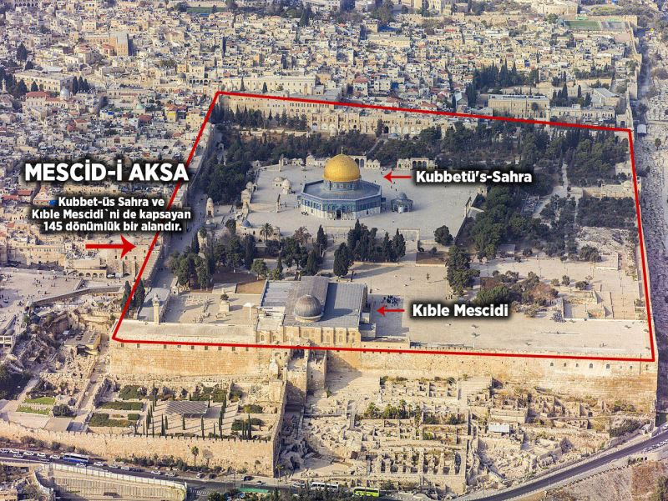
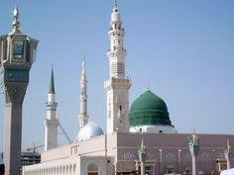
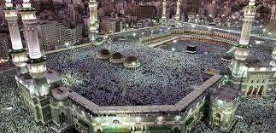
THREE BIG MASJIDS OF ISLAM

Slide 12
HANUKKAH FESTIVAL

Slide 13
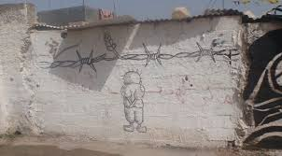
HANZALA

Slide 14
REFERENCES
https://www.aa.com.tr/en/middle-east/israel-slowly-encroaching-all-of-jerusalem/1270991 https://mirasimiz.org.tr/sayfa/Kudus-Tarihi/24 http://worldpopulationreview.com/world-cities/jerusalem-population/ https://www.sozcu.com.tr/2020/gundem/kudusun-tarihi-ve-onemi-kudus-neden-onemli-5594160/ https://www.slideshare.net/recephilmi/kudse-hazr-msn https://igoogledisrael.com/the-10-essential-things-to-see-and-do-in-jerusalem/ https://www.tarihiolaylar.com/tarihi-olaylar/hacli-seferleri-76 http://www.cografya.gen.tr/siyasi/devletler/israil.htm https://www.britannica.com/place/Jerusalem https://islamansiklopedisi.org.tr/kudus https://theculturetrip.com/middle-east/israel/articles/top-10-places-in-jerusalem-for-architecture-lovers/ https://tr.pinterest.com/pin/425660602266310221/?d=t&mt=login https://dictionary.cambridge.org/tr/okunu%C5%9F/ingilizce/christianity https://en.wikipedia.org/wiki/List_of_places_in_Jerusalem www.planetware.com www.tripadvisor.com.tr www.traveltips.usatoday.com www.en.wikipedia.org www.sozcu.com.tr www.cnnturk.com www.history.com www.islamicity.org historic cities of the islamic world book ömer faruk harman some twitter pages ESRA KOCA - 18070257

