Slide 1
Kûfe

Slide 2
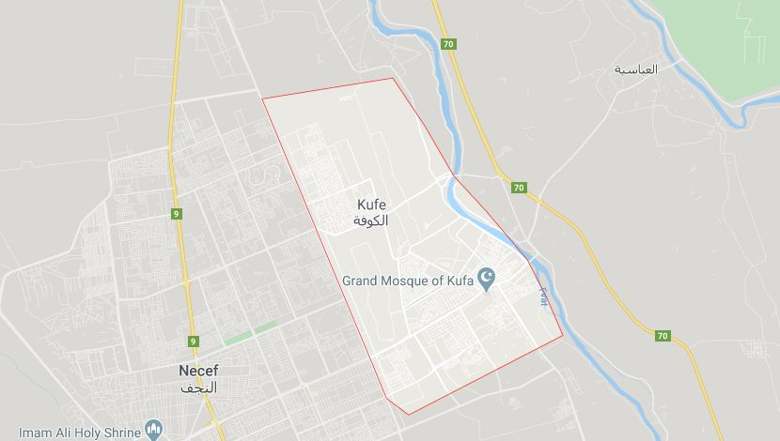
➤ locatıon and populatıon
• Kûfe is a place of a city in Iraq called Necef
• The population in 2003 is
calculated as 110.000
( no other data found )

Slide 3
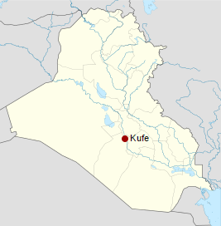
➤ locatıon and populatıon
• Kûfe is south to the Babylon
ruins
• Its distance between Bagdat
is about 170 km
•Its location is called as Haddülezrâ (Sûrestân)

Slide 4
➤ formatıon of the name
• It is said that the name ‘‘Kûfe’’ formed from
↳ Syriac or Persian
↳ the Arabic word ‘‘sand dune’’
↳ a hill called ‘‘Kûfan’’

Slide 5
➤ establishment
• Established by the command of Umar b. Hattab (r.a.)
by Sa’d b. Ebi Vakkas in the year 17 / 637
• First established as a garrison town and served as a base for the conquests of el-Cezîre, Tüster, Râmhürmüz, Nihâvend, Hemedan, Cürcân, Azerbaijcan and İsfahan

Slide 6
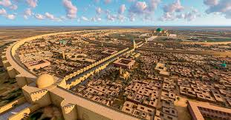
➤ Physical structure ↳ Centre
• Mosque:
At the centre of the city.
This is the classic islamic city
planning
The name of the mosque is
Kûfe ( Cuma ) Mosque and its architect is Rozbih b. Bozorgmehr. He is an İranian

Slide 7
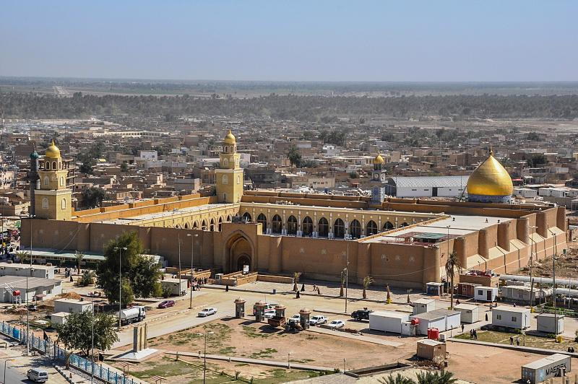
➤ Physical structure ↳ Centre

Slide 8
➤ Physical structure ↳ Centre
• Dar’ul Imare:
Builded by the command of Umar b. Hattab (r.a.) by Sa’d b. Ebi Vakkas (r.a.) just next to the mosque for managing the economics of the city and as a mansion for the governers

Slide 9
➤ Physical structure ↳ Centre
• Market Place:
Its name was Kûnase and was also next to the mosque. It not only served for trading or shopping but also as cultural activities like music or poetry competitions.
Whoever got a place, until the end of the day it was his

Slide 10
➤ Physical structure ↳ Centre
• Square:
Its name were ‘‘sahn’’ or ‘‘rahbe’’ . Probably used as military ceremony or a gathering point for soldiers. It was forbidden to use it as a place of residences

Slide 11
➤ demographic structure
• South Arabs • Chinese
• North Arabs • Byzantium
• East Arabs • Nejranian
• Iranian • Jews
• Syrian • Hiranian

Slide 12
➤ Economic structure ↳ agriculture and farming
• Olive Production • Flower Production • Fishery • Cotton Production • Beekeeping • Sesame Production
• Sugar Cane Production

Slide 13
➤ Economic structure ↳ Industry
• Ship and Boat Production • Carpentry
• Smithery • Lime Production
• Weawing • Leatherwork
• Seramic Industry • Pottery

Slide 14
➤ Economic structure ↳ Trade
Although Kûfe was established as a garrison, it turned into a developed city in economics for several reasons :
• In Ali ( r.a.) ‘s caliphate it became the capital of the Islamic State
• The close location to Hîre ( 5 km )

Slide 15
➤ Economic structure ↳ Trade
• The most important place in Kûfe for trading was the place called Kinâse
The situation among Kûfe and the nearby cities was :
• Exportation of the olive oil and importation of some animal products ( Hulvân )
• Exportation of different products to Medina

Slide 16
➤ Economic structure ↳ Trade
• The most important city with whom Kûfe traded was Basra
• The products from the Far East like coconut, spices, Indian Juniper and silk first arrived at Basra then to Kûfe

Slide 17
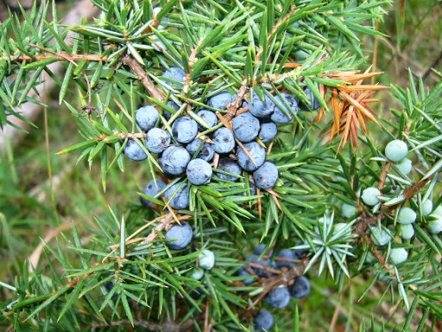
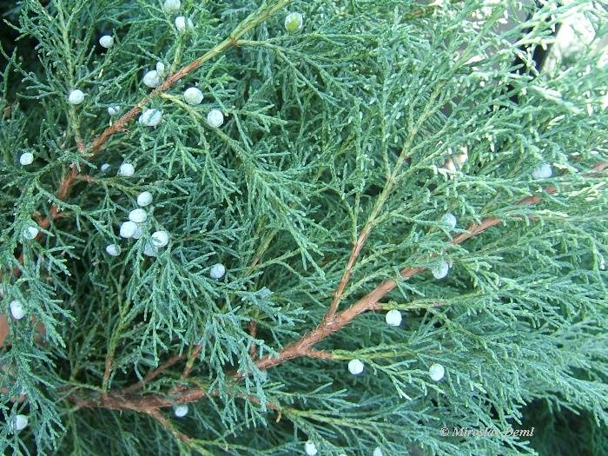
Juniper

