Slide 1
SAMARKAND

Slide 2
Samarkand is known as Maracanda on Greek dates, K'ang and Hsi-wan-chin in Chinese vekānâmas.
The name Samarkand consists of Semer which means “city” in Soğdca and the word “kant” which means “settlement”.
What is the meaning of Samarkand

Slide 3
Samarkand is one of the rare cities that are not affected by the severe summer heat and drought thanks to the Zerefşân river and the canals fed from this river. According to the advice of Islamic geographers, it is one of the most beautiful cities with its streams, lush vegetation and clean air, suitable for a healthy life.

Slide 4
Samarkand was first established in a high position overlooking the valley on the southern shore of the river Zerefşân, and its ruins, which have survived to the present day, are called Efrâsiyâb.
Old name of Samarkand

Slide 5
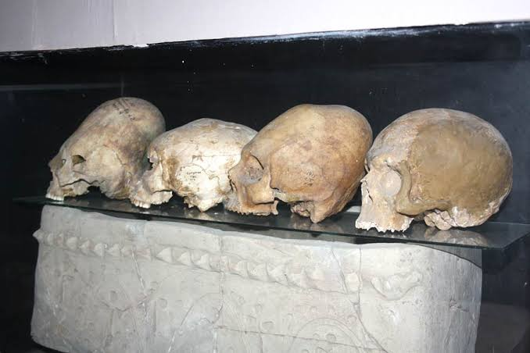
A view from the Afrasiyab museum

Slide 6
He founded the city before 535 BC as an advanced outpost by the Persian Ruler, Great Cyrus.
The legendary Turkish ruler Efrâsiyâb (Alp Er Tunga), named after the remains of Samarkand, dominated the region where the city was founded approximately two centuries before this date.
Who is Efrasiyab

Slide 7
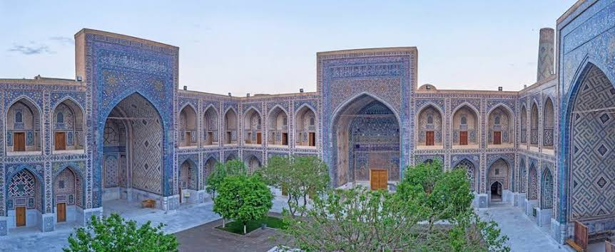
Madrasa of uluğbey

Slide 8
Alexander the Great, who took Samarkand from the Persians in 329 BC, destroyed the city due to the uprisings against him. However, he thought that Samarkand would be a good fortification for the attacks coming from outside, and surrounded it with a large wall.

Slide 9
The fact that it is located in a perfect geography, which is the intersection point of very important trade routes coming from Iran, the Silk Road, Turkish countries, Spice road, Merv and Buhara, has made Samarkand an important cultural and commercial center.
The İmportance of Samarkand

Slide 10
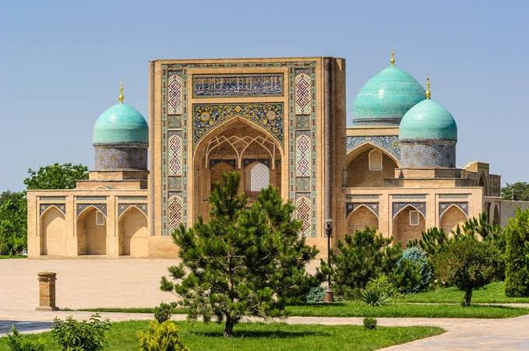
Bibi Hanım Mosque

Slide 11
Göktürk state, who seized Samarkand in 562, assigned the Samarkand, who are good merchants and know the surrounding countries, at the embassy committees. After the fall of the West Göktürk State in 659, the city came under the domination of the Chinese.

Slide 12
Governor of the Umayyads, Khorasan Said b. Osman organized an expedition on Samarkand in 676. Peace was made in return for Tarhûn, the King of Samarkand, to accept taxes and give hostages to Muslims (Belâzürî, p. 579). Among those who fell martyrs during the siege, It is rumored that the Prophet's uncle, Abbas's son, Kusem, was also present. As a matter of fact, there is a grave in Samarkand that is believed to belong to Kusem.
SEMERKANT'S MEETING WITH ISLAM

Slide 13
As a result of the work of the delegations commissioned by Omer b. Abdülazîz, many people in Samarkand and its surroundings entered Islam. 30 thousand troops formed from Sogdi soldiers at the time of Kuteybe gained an important place in the Islamic army.

Slide 14
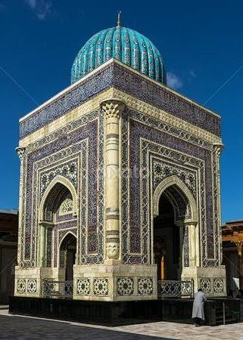
Imam Bukhari Monument Complex

Slide 15
In the time of Samanoğulları, the capital was moved to Bukhara.
It can be seen that the governors of Samarkand entered into a struggle of domination against Bukhara until the collapse of the Samanids at that time.
In the period of Sâmânîs, Samarkand became one of the most important centers of the Islamic world in terms of science, culture and economy.
Samarkand in the period of Samanoğulları

Slide 16
During the Sâmânîs, many great academicians were trained in Samarkand.
Necmeddin en-Nesefî, Abdullah b. Abdurrahman ed-Dârimî, İbn Hibbân, Ebü'l-Leys es-Semerkandî and Imam Mâtürîdî are the leading ones.
PROPERTIES OF THE SAMANOĞULLARI PERIOD

Slide 17
Eastern Iranian Sogdians made up the majority of the population in Samarkand. In terms of population, Turks were the second and Arabs followed. Religions such as Buddhism, Zoroastrianism, Manichaeism and Christianity were common before the conquest of Muslims. And also during the conquest of the city of Kuteybe ibn Muslim, the majority of the people were Zoroastrians. There were considerable Jews and Christians in Samarkand and its surroundings. IX. In the 15th century there was a Archbishop of Nestri in Samarkand.
RELIGION AND DEMOGRAPHIC STRUCTURE OF SAMARKAND

Slide 18
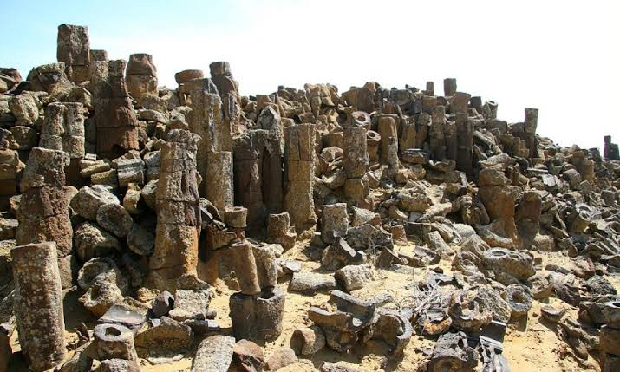
Hz. Davut Cave

Slide 19
Samarkand XIII, which was ruled by the Seljuk Sultan Melikshah in 1074 and 1089. It came under the sovereignty of Hârizmşahlar at the beginning of the century. Hârizmşah Alaeddin Muhammed ibni Tekiş, who made Samarkand the capital of his state, could not hold before Mongolian Ruler Genghis Khan. Cengiz Han, walking on Samarkand after Bukhara, destroyed the city in March 1220. While all those who resisted were massacred, a significant part of the people were exiled from the city. For over a century, Samarkand could not erase the traces of this destruction.
Mongolian invasion

Slide 20
XIV. The reconstruction and the second bright period of Samarkand, which had a troubled period due to the struggle of the Mongol inns until the last quarter of the century, started with Emir Timur, who took over Mâverâünnehir in 1369, made Samarkand as the capital and gathered scholars and artisans from various regions.
The historical buildings that survive today are mostly works of Emir Timur and his grandchildren.
CAPITAL OF TIMUR: SAMARKAND

Slide 21
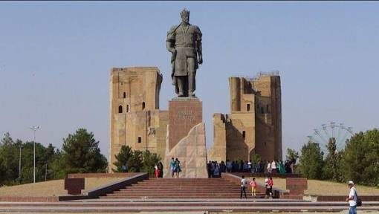
Statue of timur

Slide 22
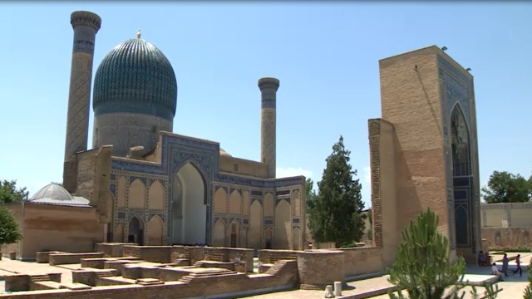
Gur Emir Tomb

Slide 23
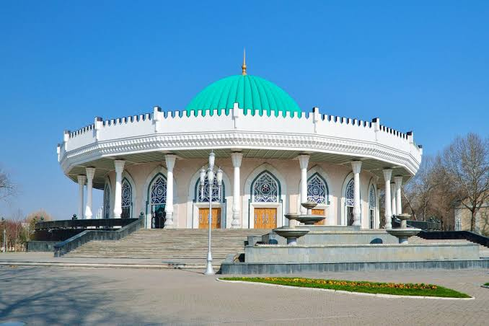
Amir TimurMuseum

Slide 25
Famous observatory with the palace named Çihilsütun built by Uluğ Bey, is among the most important works of this period.
Uluğ Bey Observatory is a 3 storey observatory.
Famous astronomers of the time in the this observatory, Ali Kuşçu, Bursalı Kadızade Rumi, Gıyaseddin Cemşid worked.

Slide 26
Captured by the Uzbek ruler Şeybânî Han in 1500, Samarkand remained under the administration of the Uzbek inns until 1868.
The Uzbeks, who ruled the country from Bukhara, attached importance to the development of their capitals. This is why Samarkand was neglected and remained in the shadow of Bukhara.
ŞEYBANİLER

Slide 27
Russians advancing on the lands of Mavaraunnehir captured Samarkand on 14 May 1868 and included it in the Turkistan general administrative region.
Today, Samarkand is the center of twelve administrations of the Republic of Uzbekistan, which declared its independence on September 1, 1991, and its economy is largely based on the surrounding agriculture, and the industry has developed. It is also famous for its carpet and ceramic.
Today

Slide 29
Resources
https://islamansiklopedisi.org.tr/semerkant
https://www.islamveihsan.com/semerkant-tarihi.html
https://www.bbc.com/turkce/haberler/2016/01/160113_vert_tra_semerkant
https://en.m.wikipedia.org/wiki/Samarkand
https://kulturveyasam.com/9-madde-ile-kadim-zamanlarin-sehri-semerkant/

