Slide 1
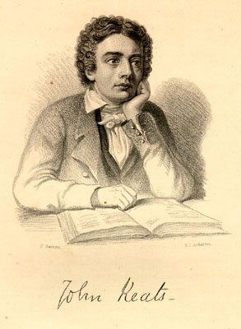

Slide 2
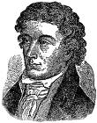
John Keats was born on 31 October 1795, the first of Frances Jennings and Thomas Keats's five children, one of whom died in infancy.
Keats was baptised at St Botolph-without-Bishopsgate and sent to a local dame school as an infant.After,he was sent to board at the Clark school in Enfield, close to his grandparents' house.
When Keats was nineteen, in 1815, Keats registered as a medical student at Guy’s Hospital.Though he continued his work and training at Guy's, Keats was devoting increasing time to the study of literature.
In May 1816, Leigh Hunt, greatly admired by Keats, agreed to publish the sonnet O Solitude in his magazine The Examiner ,a leading liberal magazine of the day.

Slide 3
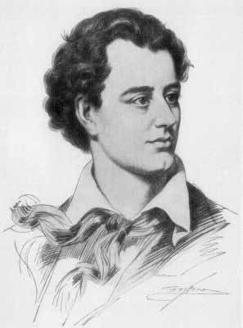
John Keats was the latest born of the great Romantic poets.
Along with Byron and Shelley , he was one of the key figures in the second generation of the movement, despite publishing his work over only a four-year period.during his short life, his work was not well received by critics, but his posthumous influence on poets such as Alfred Tennyson and Wilfred Owen was significant.
The poetry of Keats was characterised by sensual imagery, most notably in the series of odes which remain among the most popular poems in English literature.
The letters of Keats are among the most celebrated by any English poet

Slide 4
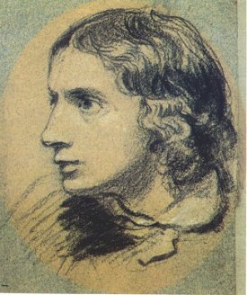
He couldn't develope himself in his early ages and he was an usual poet.
But he suddenly become a great poet in 1819,at the age of 23.
He wrote most beutiful poems in a year.
Keats belived that he should write a long poem to examine himself
In April 1817, shortly after giving Abbey his first book, Keats embarked on a four-month tour
through Carisbrooke, Canterbury, Hastings, etc He also wrote the first books of "Endymion “
which is more than four thousands stanzas in 1818.
Endymion is a long narrative poem in four books of about one thousand lines each, written mostly in heroic couplets.
It is named after its hero, Endymion, a figure taken from Greek myth

Slide 5
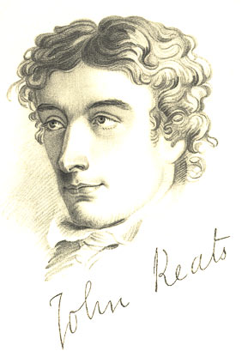
His other poems :
The Eve of St Agnes
Lamia
Isabella
La Bella Dame Sans Merci
Last Sonnet
On First Looking Into Chapman's Homer
When I Have Fears That I May Cease to Be
His sones:
"Sleep and Poetry "
"I stood Tiptoe upon a Little Hill"

Slide 6
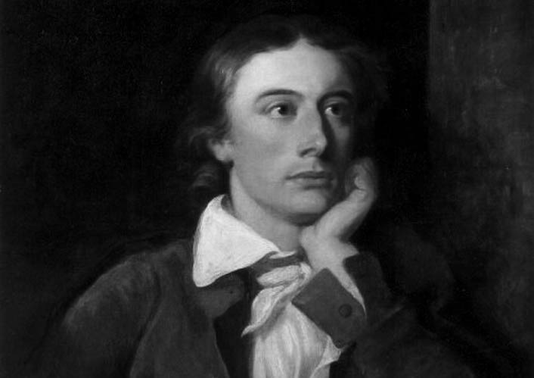
Keats originated by Greek Mythology and wrote "Ode" .This means "song" in Greek.
"Ode on Indolence"
"Ode on Psyche"
"Ode on Autumn"
"Ode to Meloncholy"
"Ode to a Grecian Urn"

Slide 7
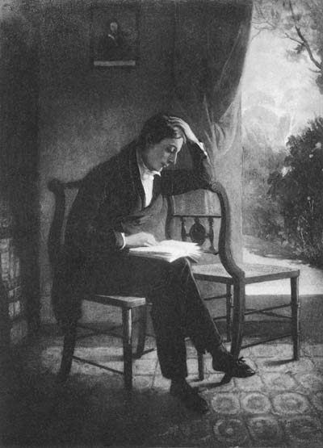
John Keats :
is said " painter-poet"
interested with Middle Ages ,especially Greek
did not like "the didactic poems" and said "We hate poetry that has a palpable design upon us."
wanted to a revolution on theatre literature but he couldn’t do .

Slide 8
Thou still unravish'd bride of quietness, Thou foster-child of silence and slow time, Sylvan historian, who canst thus express A flowery tale more sweetly than our rhyme: What leaf-fring'd legend haunt about thy shape Of deities or mortals, or of both, In Tempe or the dales of Arcady? What men or gods are these? What maidens loth? What mad pursuit? What struggle to escape? What pipes and timbrels? What wild ecstasy?
Heard melodies are sweet, but those unheard Are sweeter: therefore, ye soft pipes, play on; Not to the sensual ear, but, more endear'd,

Slide 9
Pipe to the spirit ditties of no tone: Fair youth, beneath the trees, thou canst not leave Thy song, nor ever can those trees be bare; Bold lover, never, never canst thou kiss,
Though winning near the goal - yet, do not grieve; She cannot fade, though thou hast not thy bliss, For ever wilt thou love, and she be fair!
Ah, happy, happy boughs! that cannot shed Your leaves, nor ever bid the spring adieu; And, happy melodist, unwearied, For ever piping songs for ever new; More happy love! more happy, happy love! For ever warm and still to be enjoy'd,

Slide 10
Though winning near the goal - yet, do not grieve; She cannot fade, though thou hast not thy bliss, For ever wilt thou love, and she be fair!
Ah, happy, happy boughs! that cannot shed Your leaves, nor ever bid the spring adieu; And, happy melodist, unwearied, For ever piping songs for ever new; More happy love! more happy, happy love! For ever warm and still to be enjoy'd, For ever panting, and for ever young; All breathing human passion far above, That leaves a heart high-sorrowful and cloy'd, A burning forehead, and a parching tongue.

Slide 11
Who are these coming to the sacrifice? To what green altar, O mysterious priest, Lead'st thou that heifer lowing at the skies, And all her silken flanks with garlands drest? What little town by river or sea shore, Or mountain-built with peaceful citadel, Is emptied of this folk, this pious morn?

Slide 12
was Written in 1819, the third of the five 'great odes' of 1819,
which are generally believed to have been written in the following order - Psyche, Nightingale, Grecian Urn, Melancholy, and Autumn. Of the five, Grecian Urn and Melancholy are merely dated '1819'.
is a relic of ancient Greek civilization, an urn painted with two scenes from Greek life. The first scene depicts musicians and lovers in a setting of rustic beauty
This ode contains the most discussed two lines in all of Keats's poetry - '"Beauty is truth, truth beauty," - that is all/Ye know on earth, and all ye need to know.'
"Ode on a Grecian Ode" is based on a series of paradoxes and opposites:
the discrepancy between the urn with its frozen images and the dynamic life portrayed on the urn,
the human and changeable versus the immortal and permanent,
participation versus observation,
life versus art.

Slide 13
The word "ode" itself is of Greek origin, meaning "sung
is divided into five stanzas of ten lines each, the ode contains a narrator's discourse on a series of designs on a Grecian urn.
The poem focuses on two scenes: one in which a lover eternally pursues a beloved without fulfillment, and another of villagers about to perform a sacrifice.
Critics have focused on other aspects of the poem, including the role of the narrator, the inspirational qualities of real-world objects, and the paradoxical relationship between the poem's world and reality.
has a rhyme scheme beginning with a Shakespearian quatrain (ABAB) and ending with a Miltonic sestet (CDECDE

Slide 14
Keats's odes seek to find a "classical balance" between two extremes, and in the structure of "Ode on a Grecian Urn", these extremes are the symmetrical structure of classical literature and the asymmetry of Romantic poetry . The use of the ABAB structure in the beginning lines of each stanza represents a clear example of structure found in classical literature, and the remaining six lines appear to break free of the traditional poetic styles of Greek and Roman odes.
"Ode on a Grecian Urn", which emphasizes words containing the letters "p", "b", and "v", uses syzygy ,the repetition of a consonantal sound.
The poem incorporates a complex reliance on assonance ,which is found in very few English poems. Within "Ode on a Grecian Urn", an example of this pattern can be found in line 13 ("Not to the sensual ear, but, more endear'd") where the "e" of "sensual" connects with the "e" of "endear'd" and the "ea" of "ear" connects with the "ea" of "endear'd".
A more complex form is found in line 11 ("Heard melodies are sweet, but those unheard") with the "ea" of "Heard" connecting to the "ea" of "unheard", the "o" of "melodies" connecting to the "o" of "those" and the "u" of "but" connecting to the "u" of "unheard".

Slide 15
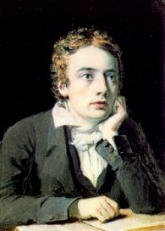
John Keats ideas:
" A think of beauty is a joy for ever."
"I f I should die, said I to myself , I have left no immortal work behind me ...But I have loved the principle of beauty in all things and If I had had time ,
I would have made myself remembered."

Slide 16
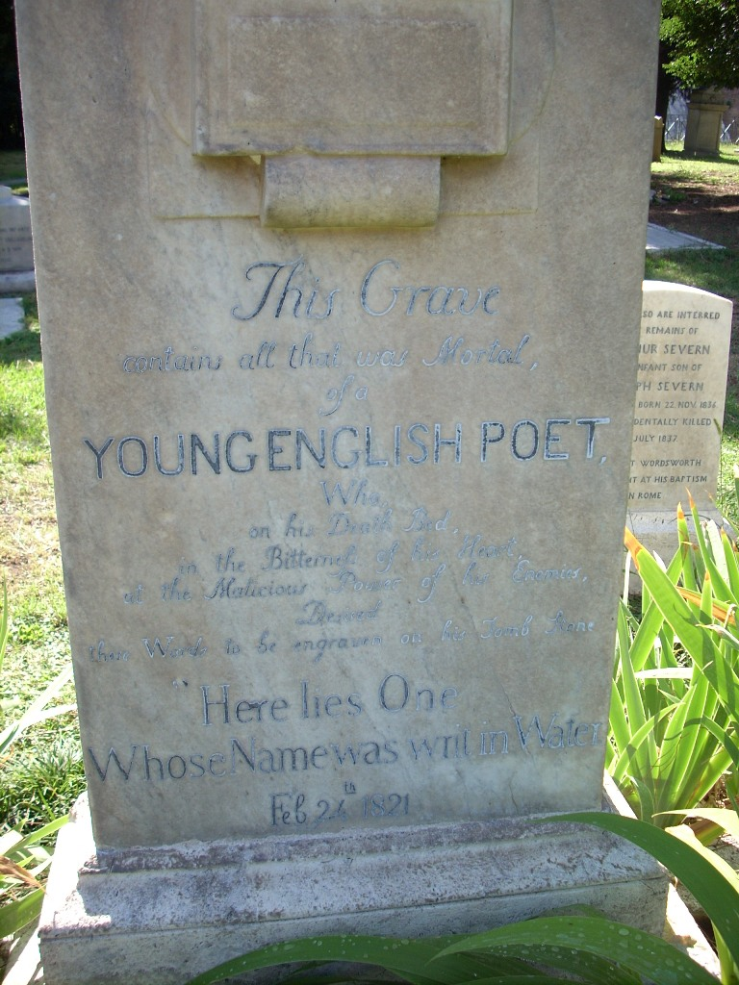
John keats was phthisis and he knew he would die.
When Keats died, at the age of 25 on 23 February 1821 and was buried in the Protestant Cemetery, Rome. His last request was to be buried under a tombstone, without his name, and bearing only the legend:
"Here lies one whose name was writ in water."

Slide 17
He wrote a lot of eternal poems but if he had lived ,he would have been the greatest poet of his generation .

Slide 18
