Slide 1
ANTIFUNGAL DRUGS
Prof.Dr.A.Tanju ÖZÇELİKAY

Slide 2
Human fungal infections have increased dramatically in incidence and severity in recent years, owing mainly to :
increasing use of broad-spectrum antimicrobial therapy
AIDS disease
treatment of patients with solid organ and bone marrow transplantation (Immunosupressan drugs)
cancer treatment

Slide 3
The antifungal drugs presently available fall into the following categories:
Systemic drugs (oral or parenteral) for systemic infections,
oral systemic drugs for mucocutaneous infections (occur in mucous membranes), and dermatophytic infections (occur in foot, skin, hair)
topical drugs for mucocutaneous infections and dermatophytic infections .

Slide 4
SYSTEMIC ANTIFUNGAL DRUGS FOR SYSTEMIC INFECTIONS
AMPHOTERICIN B
Mechanism of action:
Amphotericin B binds to ergosterol in the plasma membranes of sensitive fungal cells.
it disrupts membrane function, resulting in cell death.

Slide 5
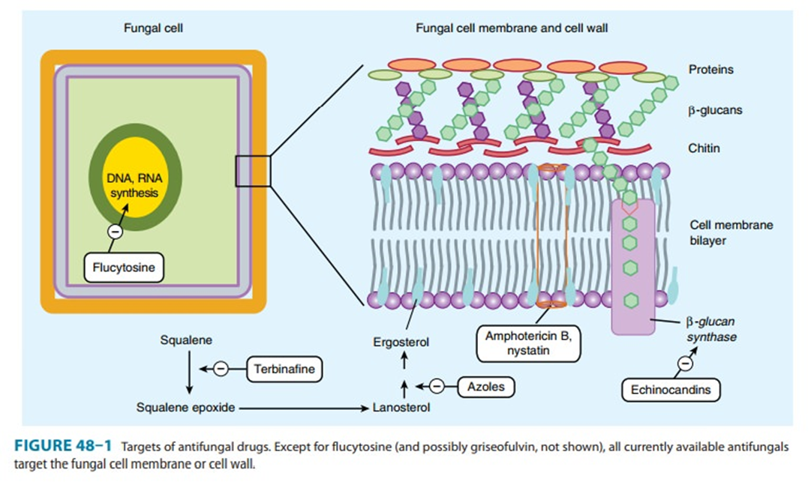

Slide 6
Pharmacokinetics:
Amphotericin B is administered by slow, intravenous (IV) infusion.
Amphotericin B is insoluble in water and must be coformulated with either sodium deoxycholate (conventional) or a variety of artificial lipids to form liposomes.
The liposomal preparations have the primary advantage of reduced renal and infusion toxicity.
However, due to high cost, liposomal preparations are reserved mainly for patients who cannot tolerate conventional amphotericin B.

Slide 7
Adverse effects:
Toxic effects related to infusion
Fever and chills: Premedication with a corticosteroid or an antipyretic helps to prevent this problem.
Rigors, nausea, headache
Hypotension
Chronic toxic effects
Renal impairment: To minimize nephrotoxicity, sodium loading with infusions of normal saline and the lipid-based amphotericin B products can be used.
when conventional amphotericin B causes renal dysfunction, the total daily dose is decreased by 50%.
Anemia

Slide 8
Adverse effects:
Drug Interactions :
Nephrotoxic drugs (aminoglycosides, cyclosporine, NSAIDs)
Flucytosine

Slide 9
FLUCYTOSINE
Flucytosine is a water-soluble pyrimidine analog related to the chemotherapeutic agent 5-fluorouracil (5-FU).
Its spectrum of action is much narrower than that of amphotericin B.
It is often used in combination with amphotericin B for the treatment of systemic mycoses.

Slide 10
Mechanism of action:
It is subsequently converted to a series of compounds, including 5-fluorouracil and 5-fluorodeoxyuridine 5′-monophosphate, which disrupt nucleic acid and protein synthesis.
Human cells are unable to convert the parent drug to its active metabolites, resulting in selective toxicity.

Slide 11
Adverse effects:
5-FC causes reversible neutropenia, thrombocytopenia, and dose-related bone marrow depression.
Reversible hepatic dysfunction with elevation of serum transaminases and alkaline phosphatase may occur.
Gastrointestinal disturbances (nausea, vomiting, and diarrhea) are common, and severe enterocolitis may also occur.

Slide 12
AZOLES
Azoles are synthetic compounds that can be classified as either imidazoles or triazoles according to the number of nitrogen atoms in the five-membered azole ring.

Slide 13
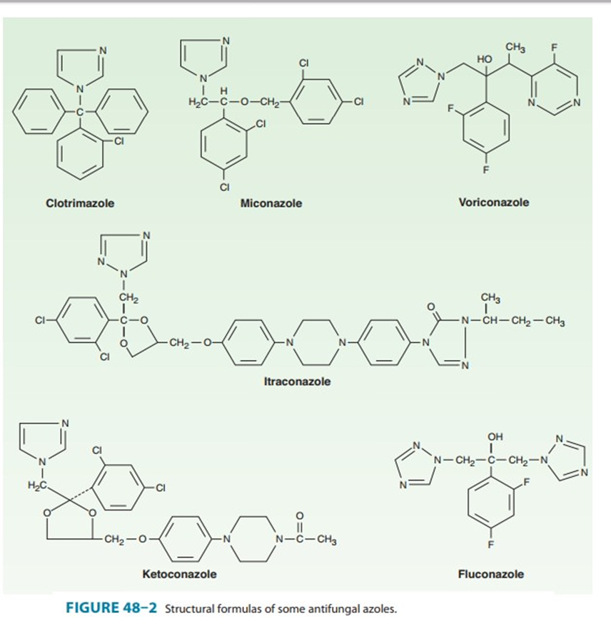
AZOLES
The imidazoles consist of ketoconazole,
miconazole, and clotrimazole which are now used only in topical therapy.
The triazoles include
itraconazole, fluconazole,
voriconazole,
and posaconazole.
In general, imidazoles are given topically for cutaneous infections, whereas triazoles are given systemically for the treatment or prophylaxis of cutaneous and systemic fungal infections.

Slide 14
Mechanism of action:
Azole drugs inhibit ergosterol synthesis by inhibition of fungal cytochrome P450 enzymes thereby blocking the demethylation of lanosterol to ergosterol.
The inhibition of ergosterol biosynthesis disrupts membrane structure and function, which, in turn, inhibits fungal cell growth.
The selective toxicity of azole drugs results from their greater affinity for fungal than for human cytochrome P450 enzymes.

Slide 16
Adverse effects and drug interactions
The most common adverse reaction is relatively minor gastrointestinal upset.
All azoles have been reported to cause abnormalities in liver enzymes and very rarely, clinical hepatitis.
All azoles inhibit the hepatic CYP450 3A4 isoenzyme to varying degrees.

Slide 17
Drugs that affect the gastric pH (for example, proton pump inhibitors) may decrease the absorption of azols and should be avoided if possible.
Imidazoles exhibit a lesser degree of selectivity than the triazoles, accounting for their higher incidence of drug interactions and adverse effects.
Azoles are considered teratogenic, and they should be avoided in pregnancy unless the potential benefit outweighs the risk to the fetus.

Slide 18
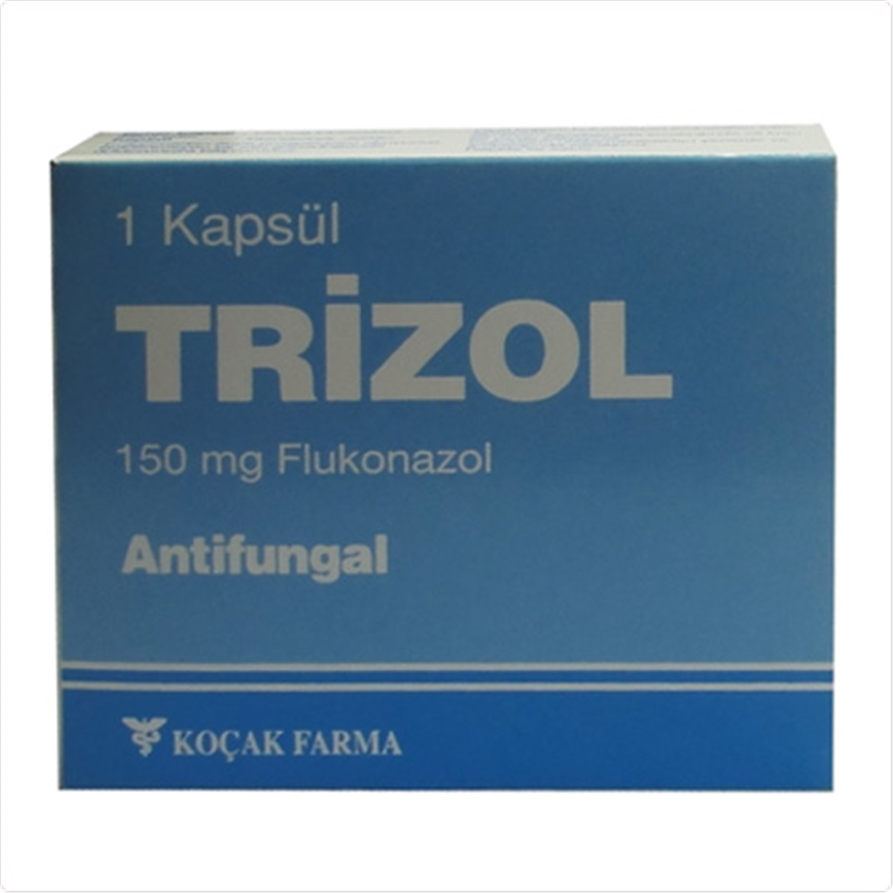
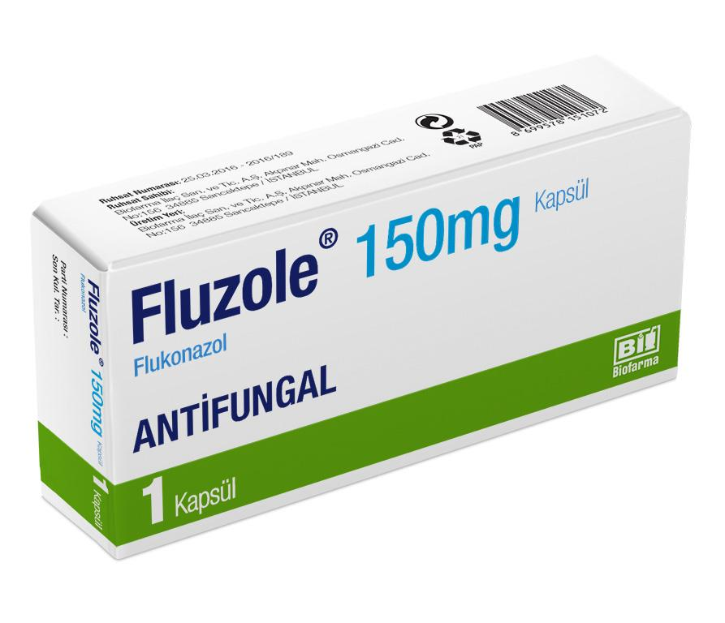
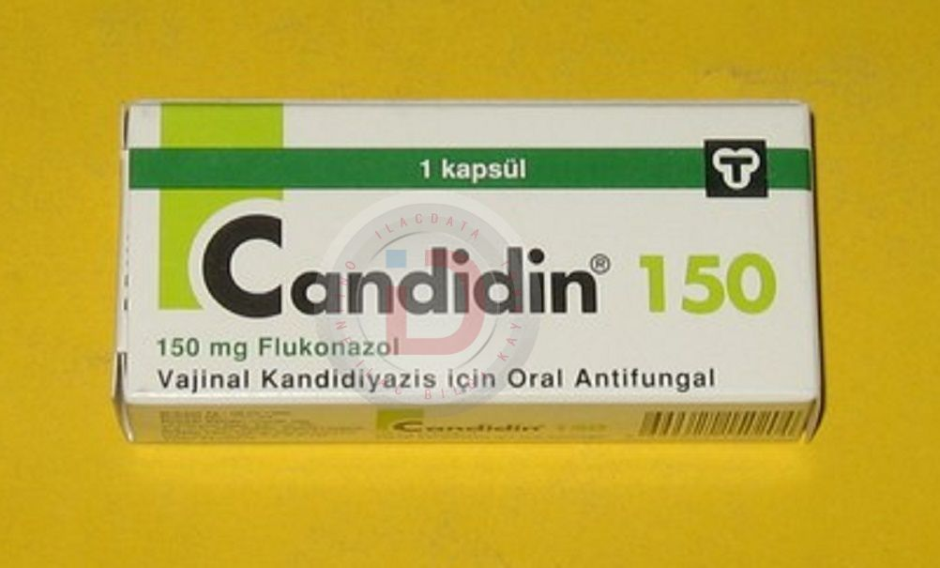
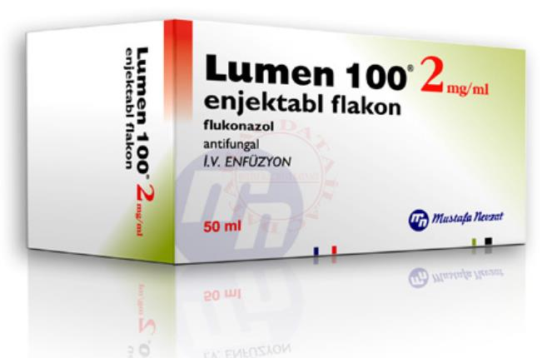

Slide 19
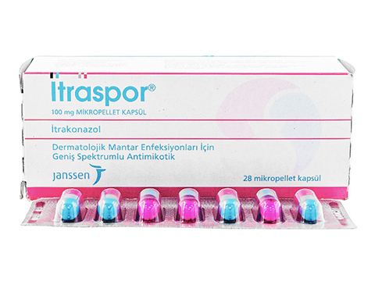
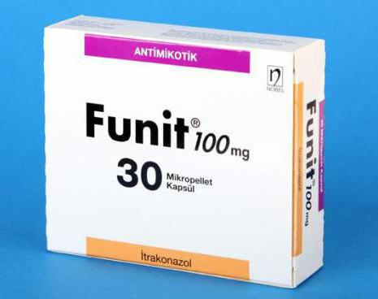

Slide 20
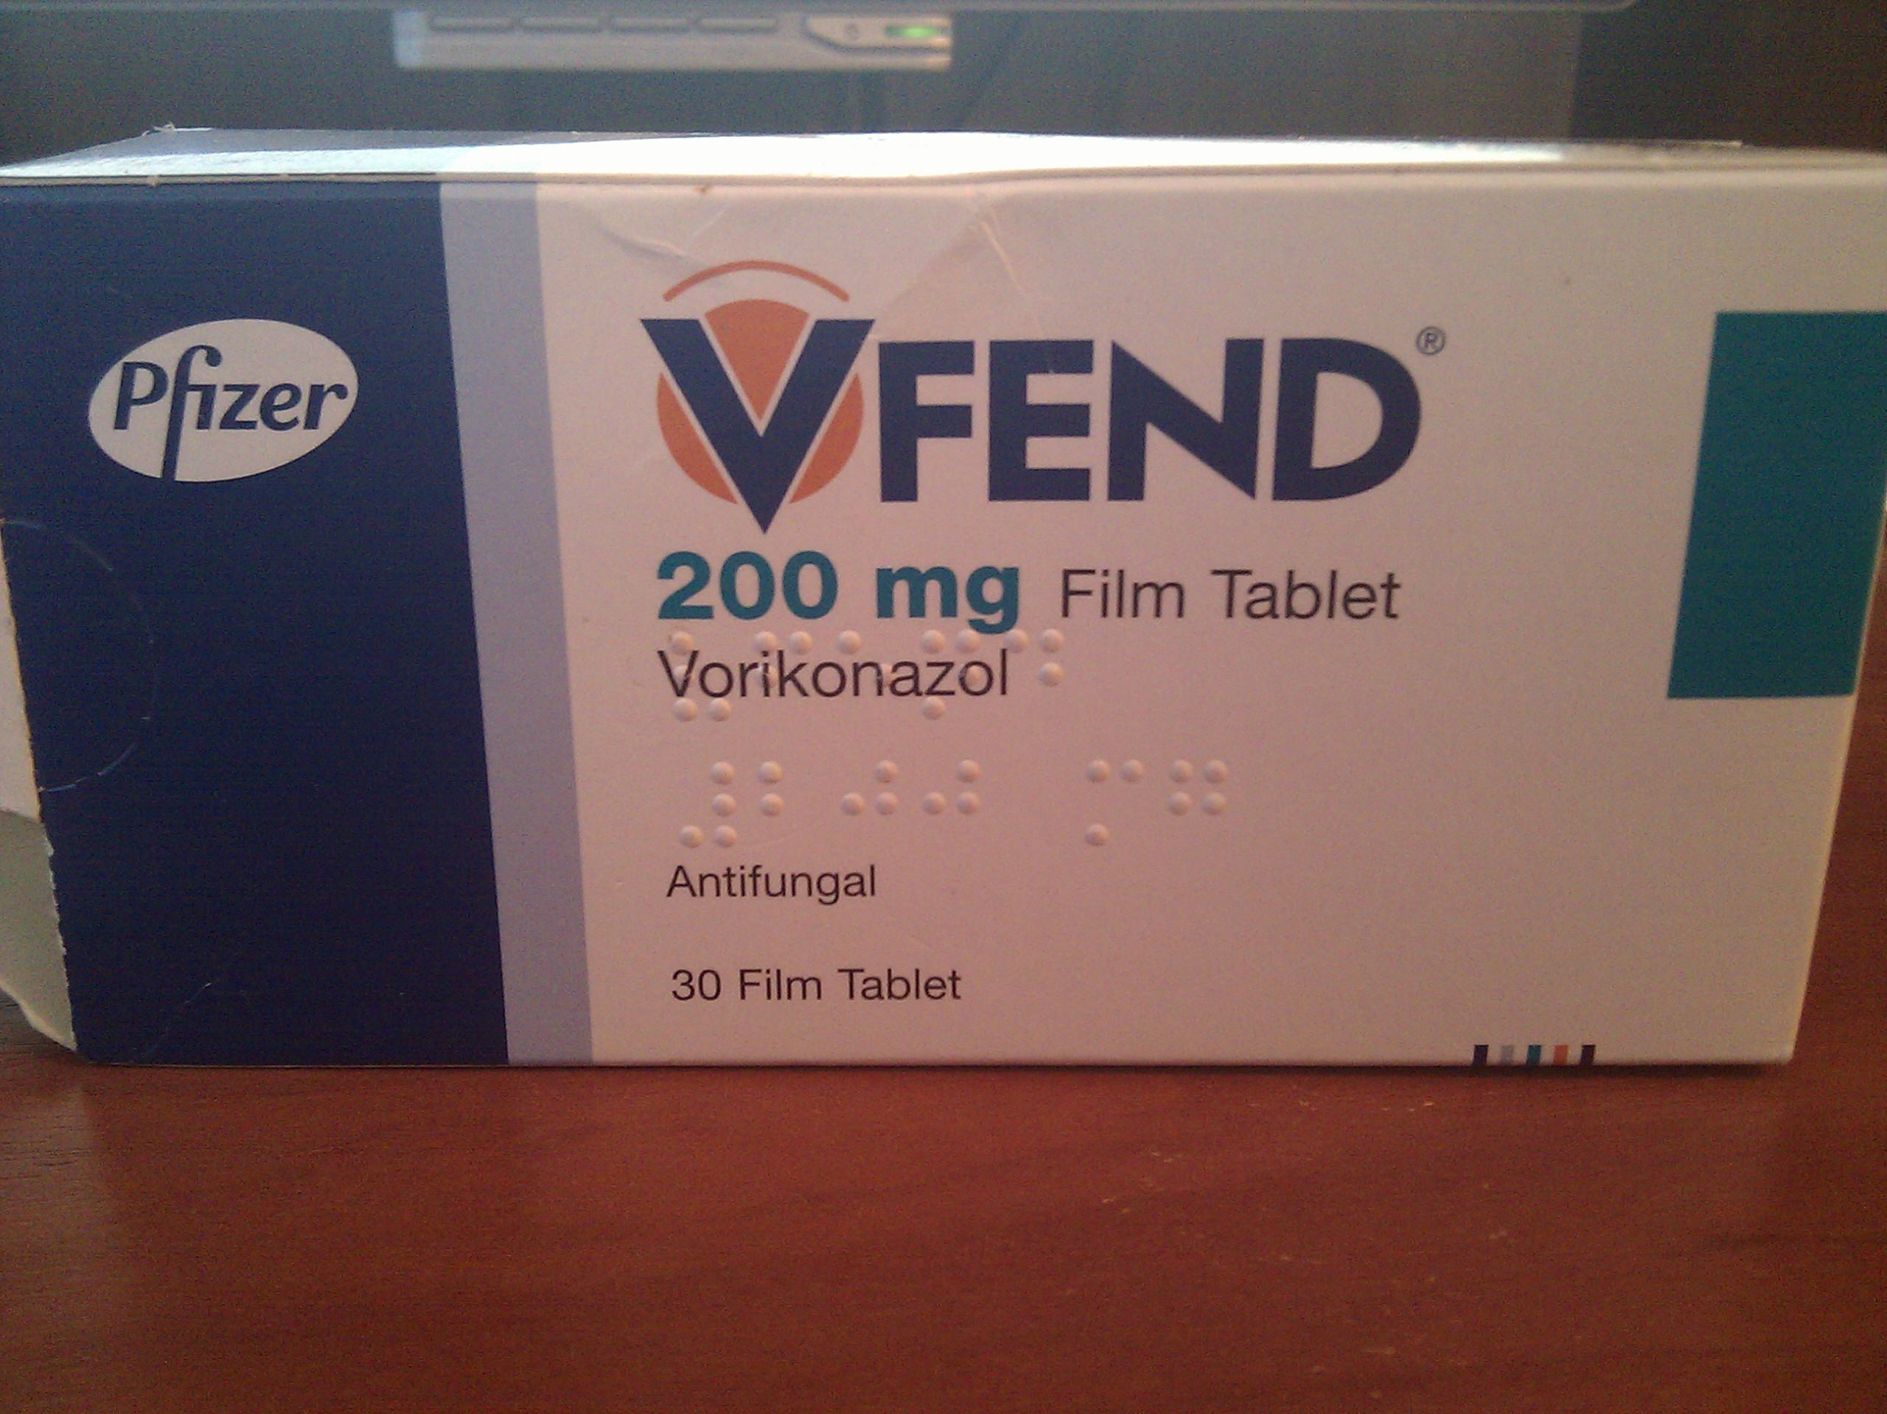
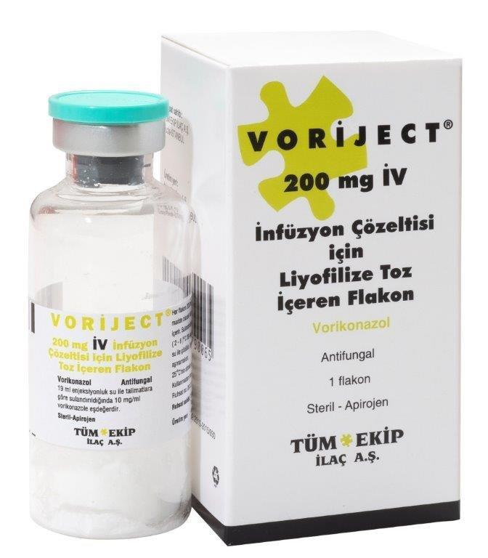

Slide 21
ECHINOCANDINS (Caspofungin, micafungin, anidulafungin )
Echinocandins are the newest class of antifungal agents to be developed.
Echinocandins are available only in intravenous formulations.
Dosage adjustments are required only in the presence of severe hepatic insufficiency.
Adverse Effects
the most common adverse effects being fever, rash, nausea, and phlebitis at the infusion site.
They can also cause a histamine-like reaction (flushing) when infused too rapidly.

Slide 22
Mechanism of Action
Echinocandins interfere with the synthesis of the fungal cell wall by inhibiting the synthesis of β–glucan. This results in disruption of the fungal cell wall and cell death.

Slide 23
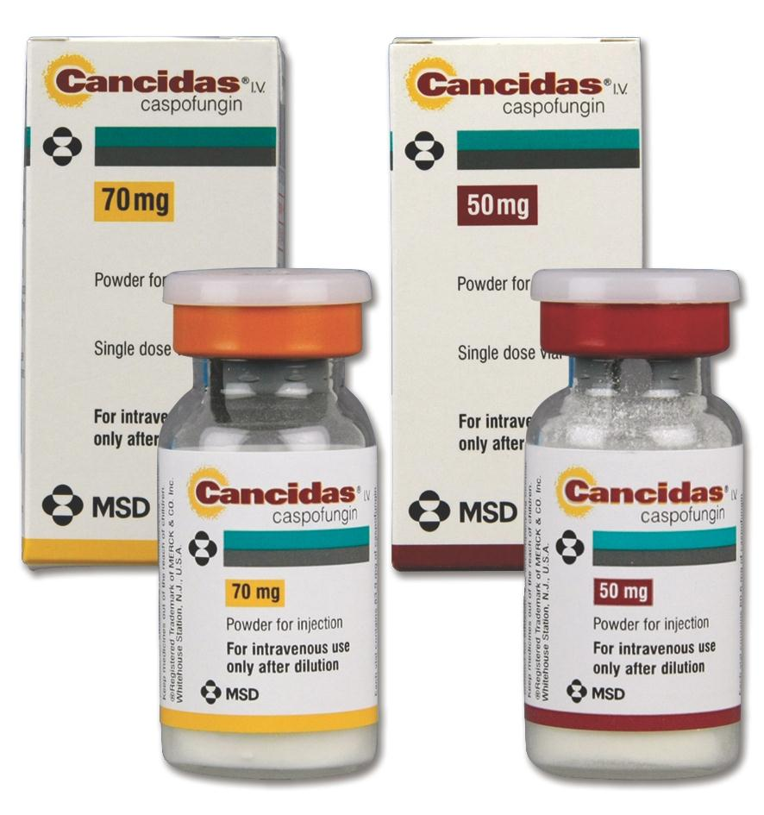
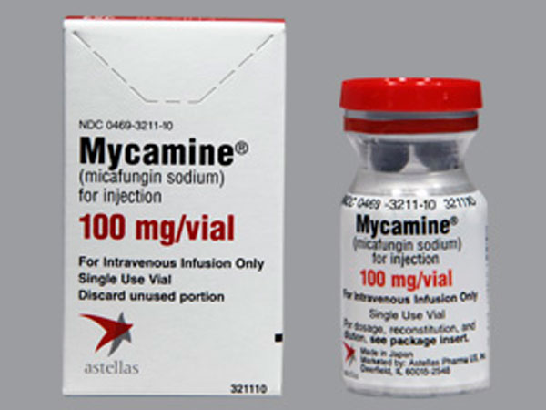
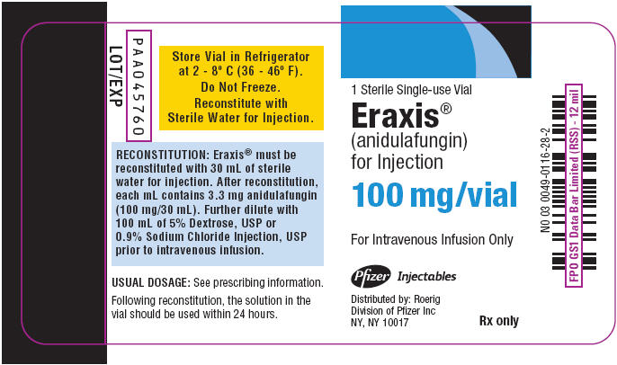

Slide 24
ORAL SYSTEMIC ANTIFUNGAL DRUGS FOR MUCOCUTANEOUS INFECTIONS
GRISEOFULVIN
Its only use is in the systemic treatment of dermatophytosis .
Griseofulvin has been largely replaced by newer antifungal medications such as itraconazole and terbinafine.
Absorption is improved when it is given with fatty foods.
Griseofulvin causes inhibition of fungal mitosis.
Adverse effects include an allergic syndrome much like serum sickness, hepatitis,
It induces hepatic drug-metabolising enzymes which in turns causes drug interactions with warfarin and phenobarbital.

Slide 25
TERBINAFINE
is available in an oral formulation
is used in the treatment of dermatophytoses.
Like the azole drugs, it interferes with ergosterol biosynthesis by inhibiting the fungal enzyme squalene epoxidase.
Adverse effects are rare, consisting primarily of gastrointestinal upset and headache.

Slide 26
TOPICAL ANTIFUNGAL THERAPY
NYSTATIN
is only used topically for suppression of local candidal infections.
Nystatin is currently available in creams, suppositories, and other forms for application to skin and mucous membranes
Because It is not absorbed to a significant degree from
skin, mucous membranes, or the gastrointestinal tract, nystatin has little toxicity

Slide 27
TOPICAL AZOLES
The two azoles most commonly used topically are clotrimazole and miconazole.
In cream form, both agents are useful for dermatophytic infections, including tinea corporis, tinea pedis, and tinea cruris.
Absorption is negligible, and adverse effects are rare.
TOPICAL ALLYLAMINES
Terbinafine, butenaphin and naftifine are available as topical creams .

