Slide 1
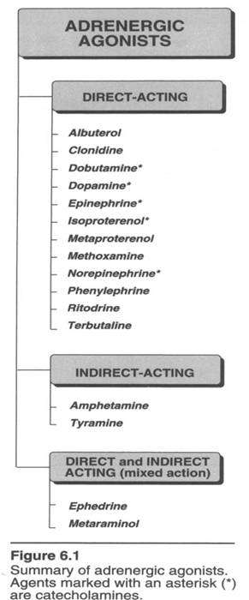
ADRENERGIC AGONISTS
(SYMPATHOMIMETICS)

Slide 2
CATECHOLAMINES
NE
Epinephrine
Dobutamine
Dopamine
Isoproterenol
No oral use
subcut absorption < im absorption

Slide 3
Transmitter/ Agent | α1 | α2 | β1 | β2 | Dopamine
Epi
Ephedrine*
Norepi
Dopamine
Phenylephrine*
Isoproterenol
Terbutaline*
Dobutamine
*Noncatecholamines

Slide 4
Effects of a drug depend on relative selectivity and to the expression of subtypes in a tissue
Selectivity (of agonists) is not absolute
Nearly absolute selectivity = specificity

Slide 5
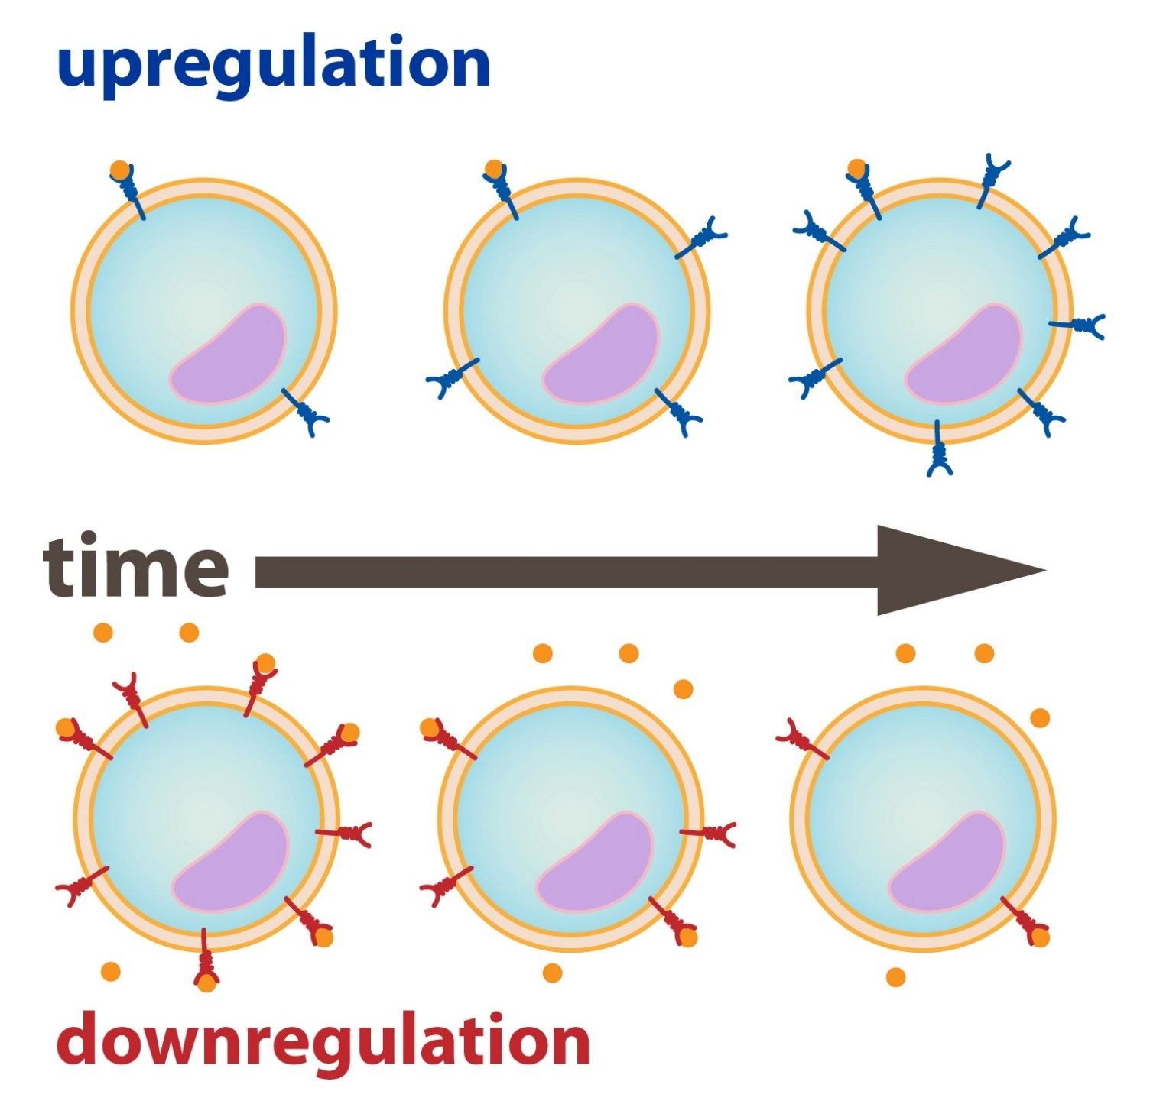
Adrenoceptor-mediated responses are not fixed and
static
Effects are mediated by age, disease, hormones and
drugs

Slide 6
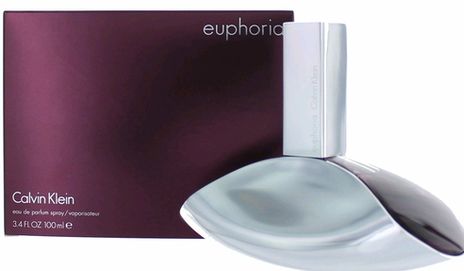
Effects of Sympathomimetics in CNS
Effects vary DRAMATICALLY
Catecholamines do not enter CNS, no CNS effect
Effects cannot be assigned to α or β
Indirect noncatecholamines readily enter CNS:
Mild alerting
Improved attention to boring tasks☺
Insomnia
anorexia

Slide 7
We know the effects that brought about by individual adrenergic receptors
Direct vs Indirect Acting

Slide 8
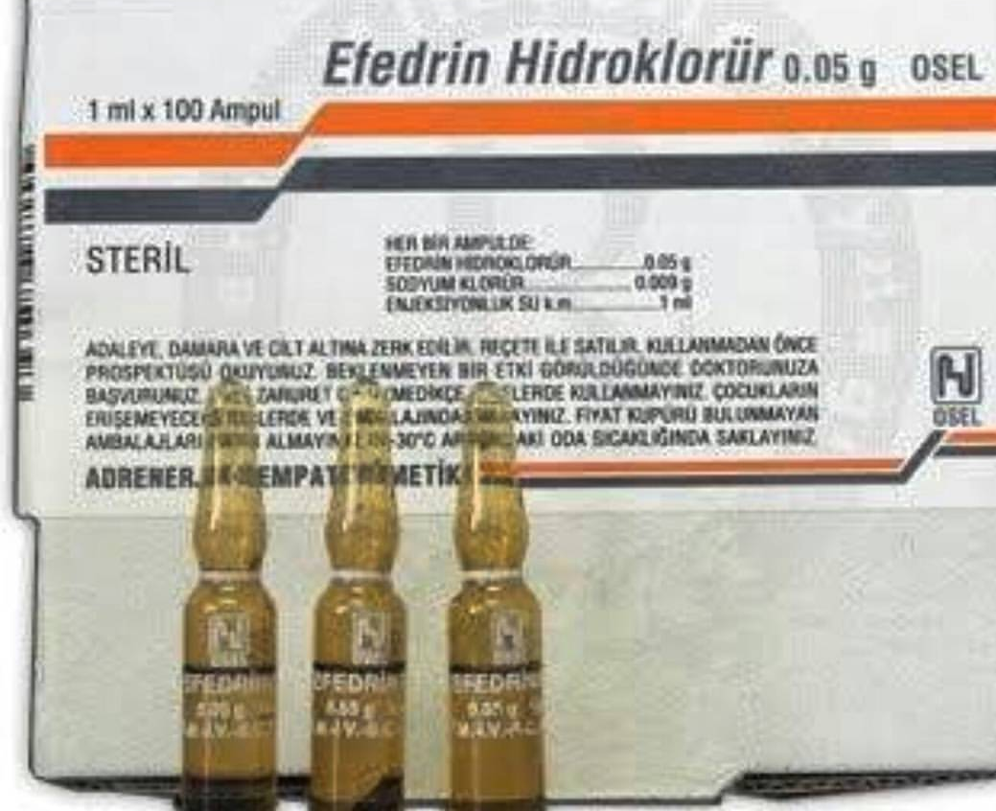
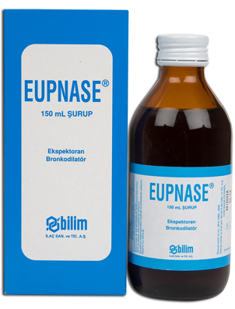
Ephedrine
Mixed-acting sympathomimetic
Has been used in China for > 2000 years!!
Noncatecholamine = enters CNS, long duration
of action (abused by CNS-stimulating effects)
Bronchodilator
(ALSO; appetite supresser)

Slide 9
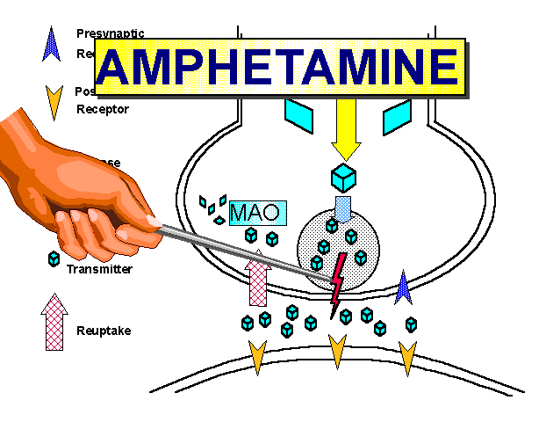
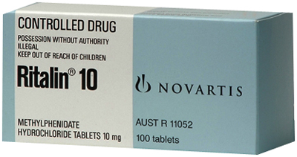
Indirect-Acting Sympathomimetics
I. DISPLACERS, AMPHETAMINE-LIKE
II. REUPTAKE INHIBITORS
Amphetamine (indication: ADHD, KIRMIZI REÇETE)
Methamphetamine (NA)
Methylphenidate

Slide 10
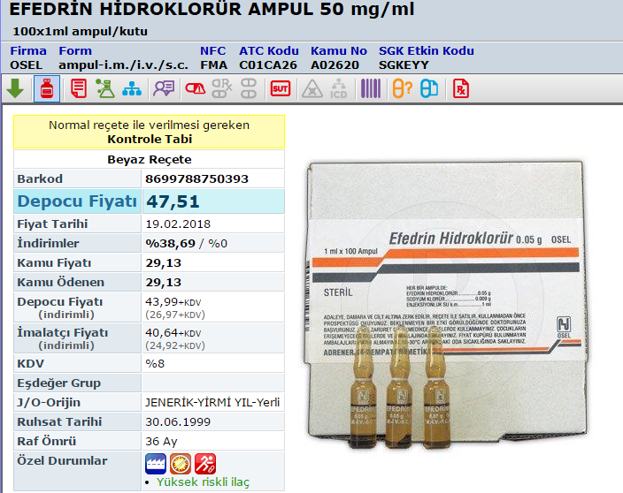
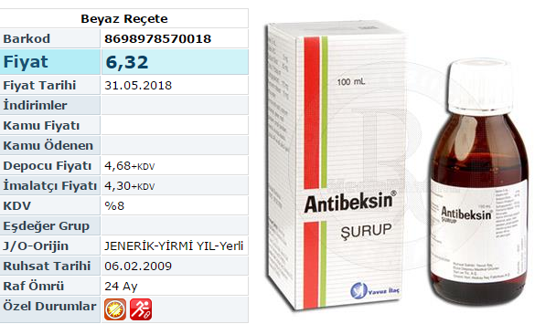
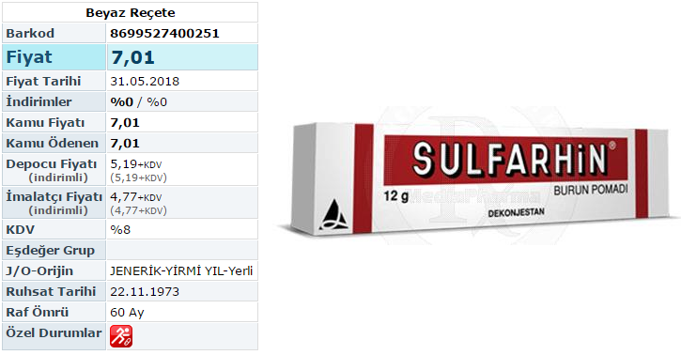
Oral (combination, single,
parenteral, topical

Slide 11
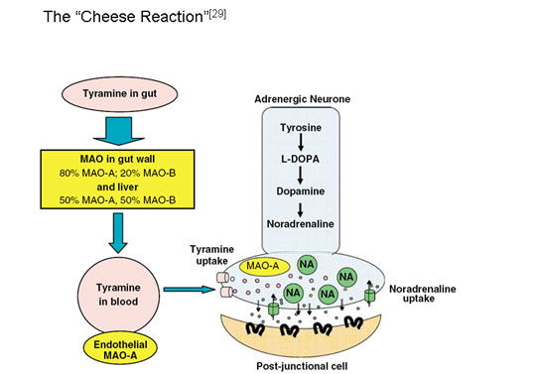
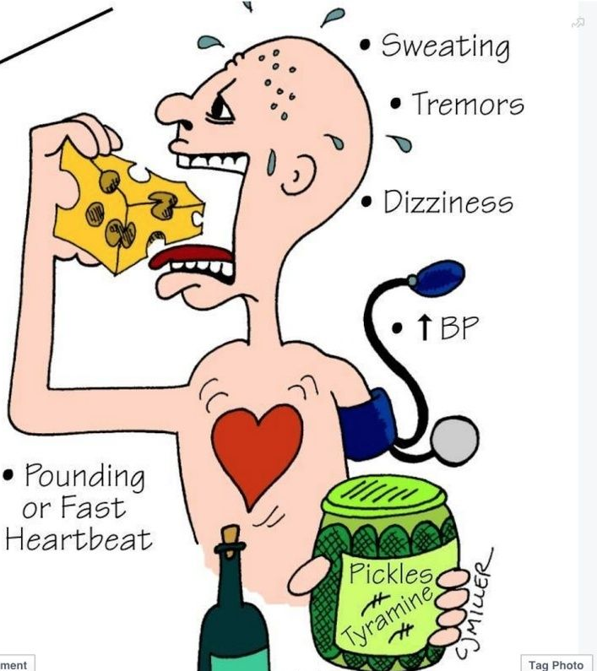
Thyramine
Normal by-product of thyrosine metabolism
High concentrations in
fermented food
Readily metabolised in
liver by MAO
if not metabolized, acts like amphetamine

Slide 12
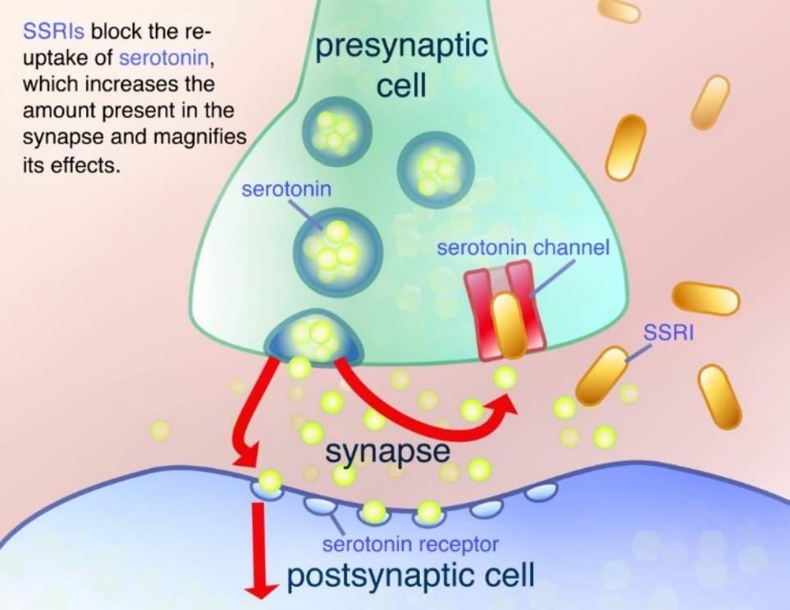
Indirect-Acting Sympathomimetics
II. REUPTAKE INHIBITORS
Inhibit reuptake of norepinephrine /serotonin/
dopamine

Slide 13
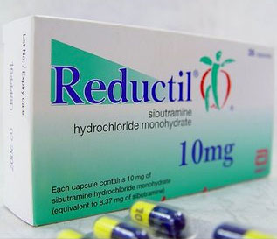
Catecholamine Reuptake Inhibitors
Many antidepressants particularly TCA inhibit
NE and 5-HT reuptake to varying degrees and induce
orthostatic tachycardia as a side effect
Atomoxetine (and reboxetine) is a
selective NE inhibitor and used for
ADHD (BEYAZ REÇETE)
Remember SIBUTRAMINE?

Slide 14
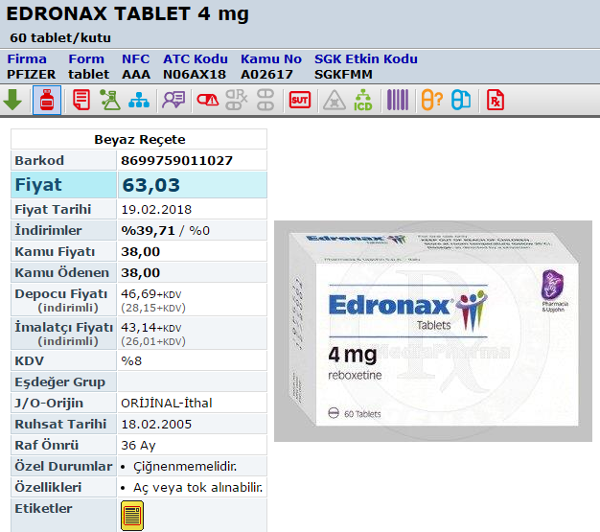
Reboxetine
Indication:
major depression

Slide 15
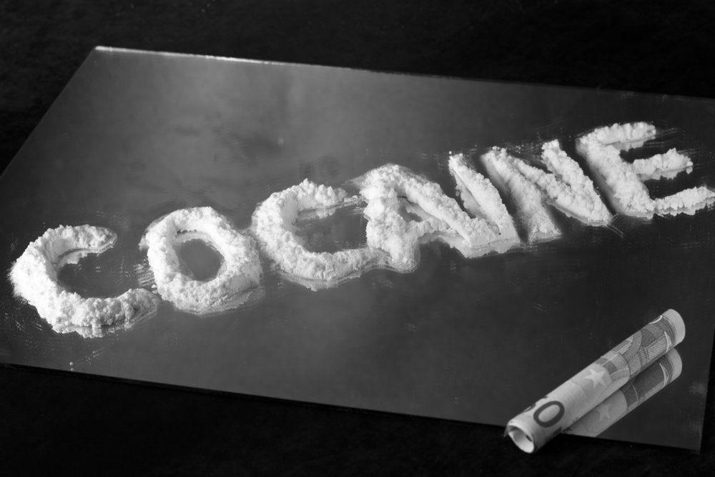

Slide 16
Cocaine
Local anesthetic; inhibits NE and dopamine
reuptake
Inhibiton of reuptake in «pleasure centers »
is the reason for abuse
No preps available in Turkey

Slide 17
DOPAMINE AGONISTS
LEVODOPA—converted to dopamine and dopamine
agonists with central actions are used in PARKINSON…
stay tuned
FENOLDOPAM is a selective D1 agonist and induces
vasodilation
indication: severe hypertension

Slide 18
THERAPEUTIC USES OF SYMPATHOMIMETICS

Slide 19
THERAPEUTIC USES OF SYMPATHOMIMETICS
Anaphylaxis
bronchospasm
mucous membrane
congestion
angioedema
severe hypotension

Slide 20
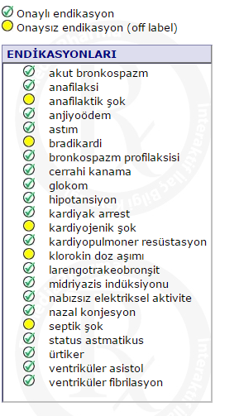
Ephedrine
(Only parenteral prep
available in Turkey)

Slide 21
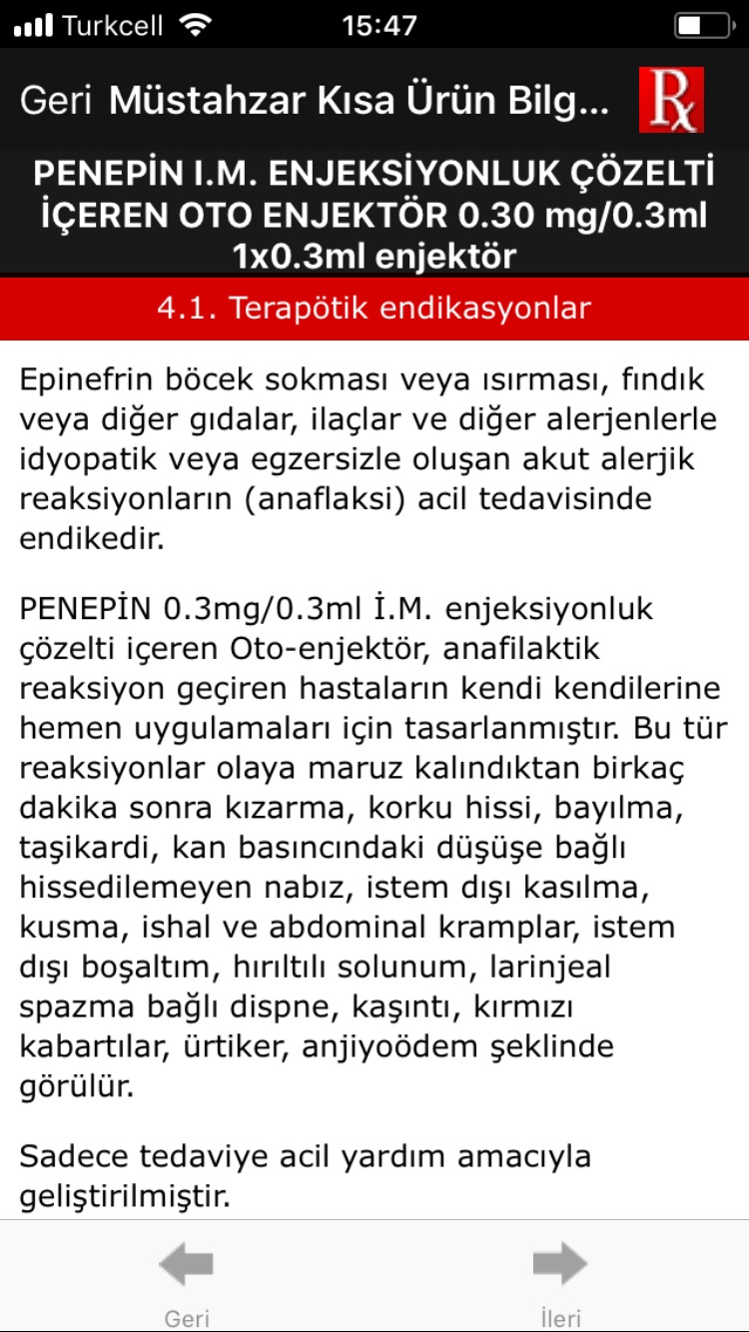

Slide 22
Epinephrine may be combined with local anesthetics

Slide 23
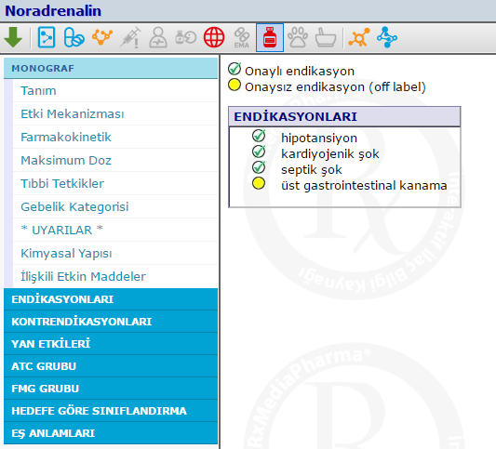
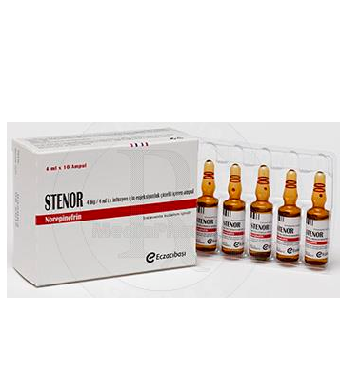
Norepinephrine

Slide 24
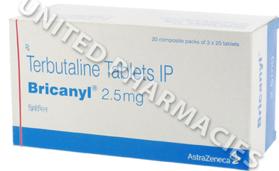
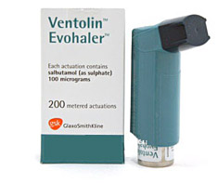
THERAPEUTIC USES OF SYMPATHOMIMETICS
Pulmonary Applications
Salbutamol
Terbutalin
Fenoterol
Vilanterol
Indacaterol
Olodaterol

Slide 25
Pulmonary applications
Short-acting β2 agonists may be used for the acute
treatment of asthma symptoms
Long-acting drugs MUST BE combined with steroids
Newest long-acting drug VILANTEROL (COPD; 1x)

Slide 26
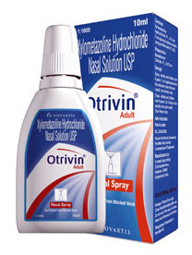
Nasal Decongestant
α1
Fenilefrin
Psödoefedrin
Nafazolin
Oksimetazolin
…….
Oral or intranasal?

Slide 27
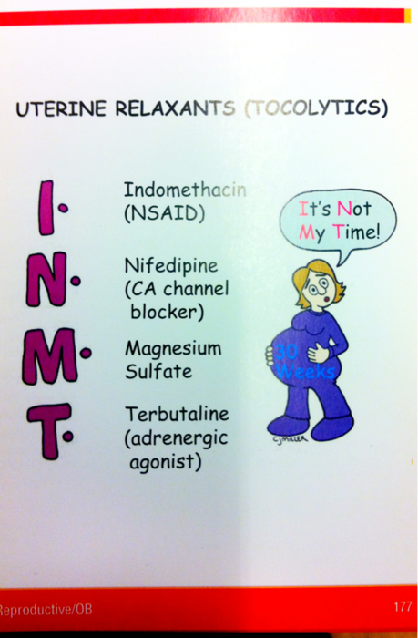
Ritodrin
parenteral / or PO

Slide 28
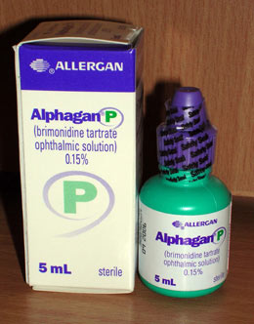
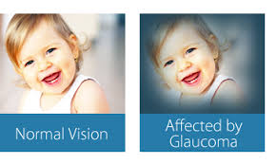
Ophtalmic
Phenylephrine (ophtalmic prep NA in Turkey)
Both α2 agonists (apraklonidin, brimonidin) and
β blokers are used for glaucoma

Slide 29
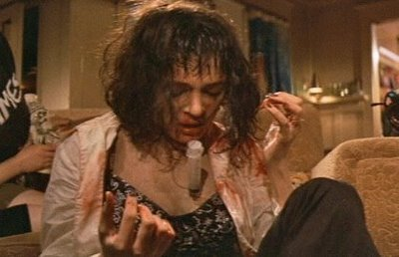
THERAPEUTIC USES OF SYMPATHOMIMETICS
Acute Hypotension
(norepinephrine, phenylephrine, methoxamine)
Chronic Orthostatic hypotension
(α-agonist:midodrine)
Heart block& arrest
(epinephrine)
Cardiogenic shock

Slide 30
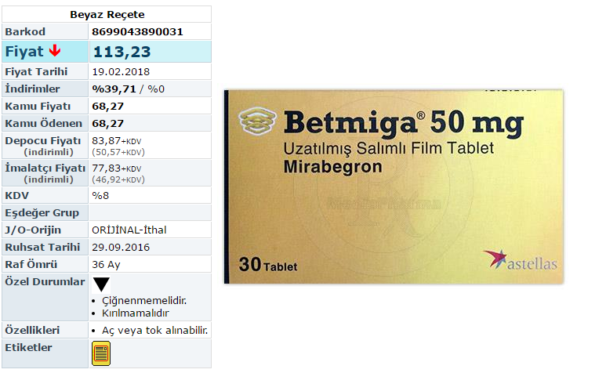
Β3 –agonist …. MİRABEGRON
For adults with overactive bladder sydrome
1x

Slide 32
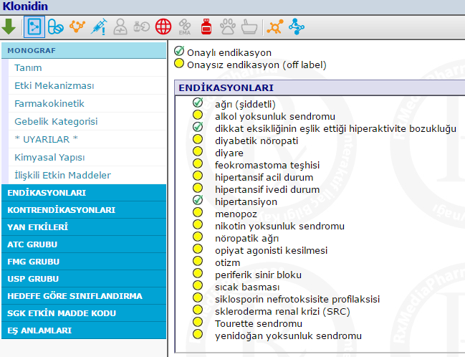
α2
YDİ

Slide 33
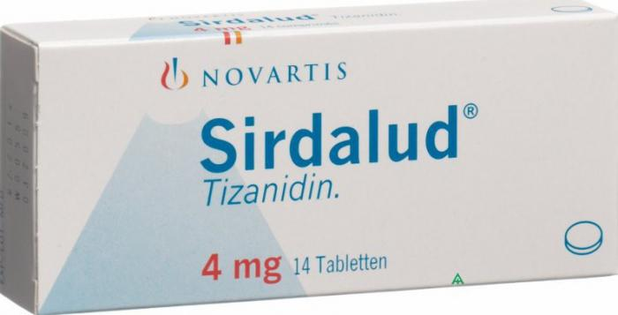
α2
Presynaptic α-2 agonist
For the treatment of neurologic spasticity
Less hypotensive than clonidine
Dose vary dramatically amongst patients
CYP1A2 inhibitor (please comment on drug interactions)
Drowsiness, dry mouth, dizziness

Slide 34
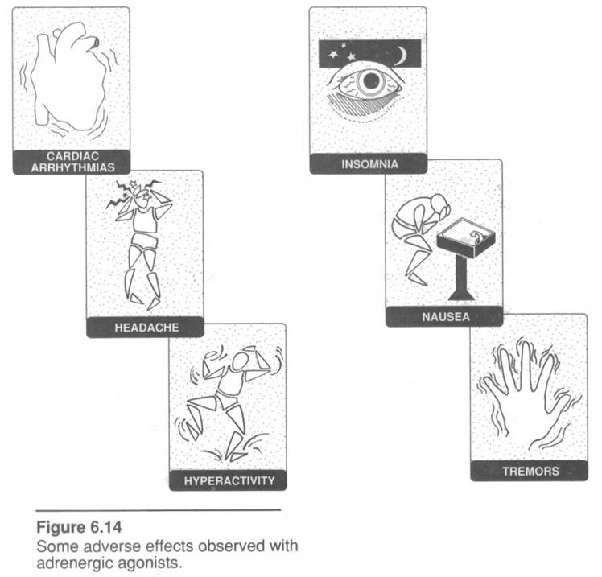
SOME adverse effects of adrenergic agonists

Slide 35
ADRENERGIC ANTAGONISTS

Slide 36
 | Reseptor affinity
α Antagonists Prazosin, terazosin, doxazosin Phenoxybenzamine Phentolamine (YDİ) Yohimbine, tolazoline | α1>>>>>α2 α1>α2 α1=α2 α2>α1
Mixed Antagonists Labetalol, carvedilol | β1=β2≥α1>α2
β Antagonists Metoprolol, acebutolol, alprenolol, betaxolol, esmolol, nebivolol Propranolol, carteolol, penbutolol, pindolol, timolol Butoxamin | β1>>>β2 β1=β2 β2>>>β1

Slide 37
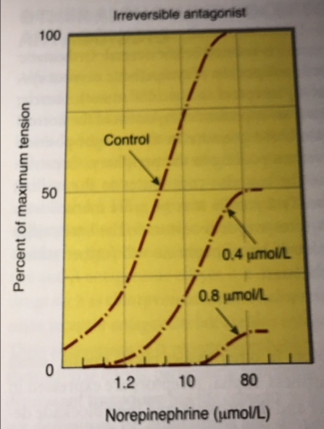
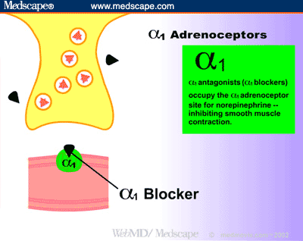
ADRENERGIC ANTAGONISTS
Basic Pharmacology
Some bind covalently:
irreversible antagonists
(phenoxybenzamine)

Slide 38
How is the dose-response curve of the agonist (?) in the presence of a reversible antagonist?
Response
log [agonist]

Slide 39
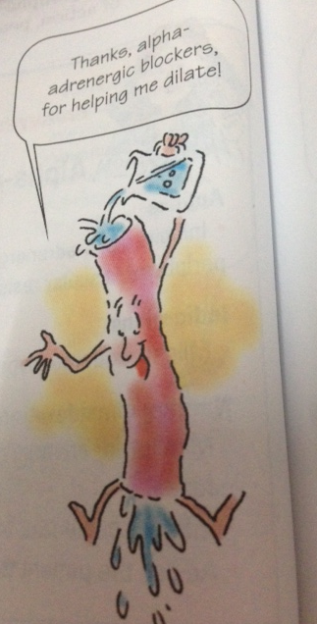
α- Antagonists
Cardiovascular Effects
Vascular tonus is determined by sympathetic nervous system

Slide 40
THERAPEUTIC USE OF ALFA BLOCKERS
Prazosin, terazosin, doxazosin
BP : tonus reduced in rezistance and
capacitance vessels
BPH + hypertension

Slide 41
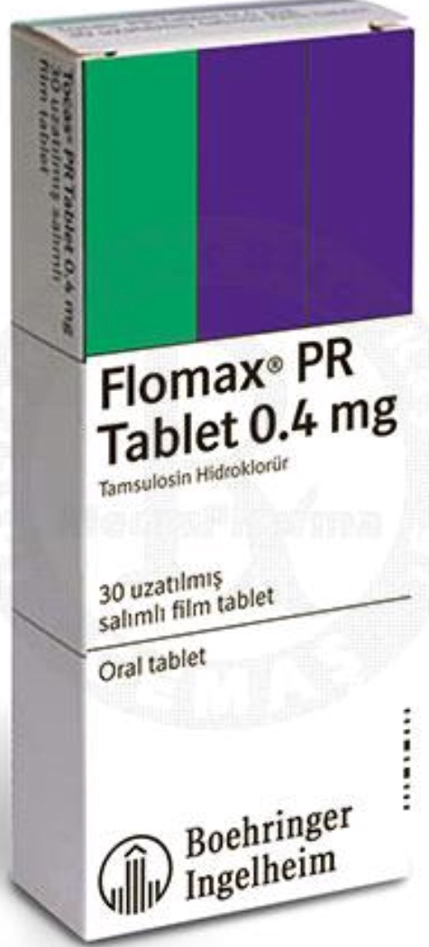
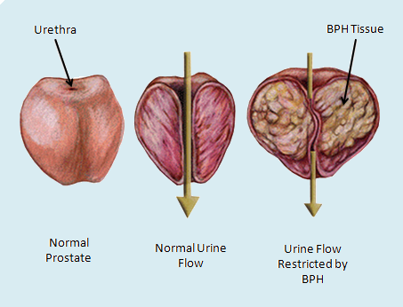
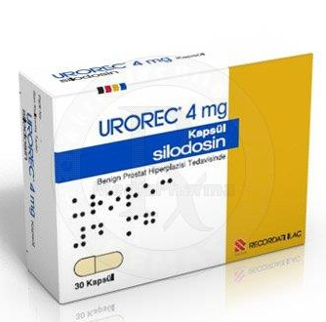
Tamsulosin
Alfuzosin Silodosin

Slide 42
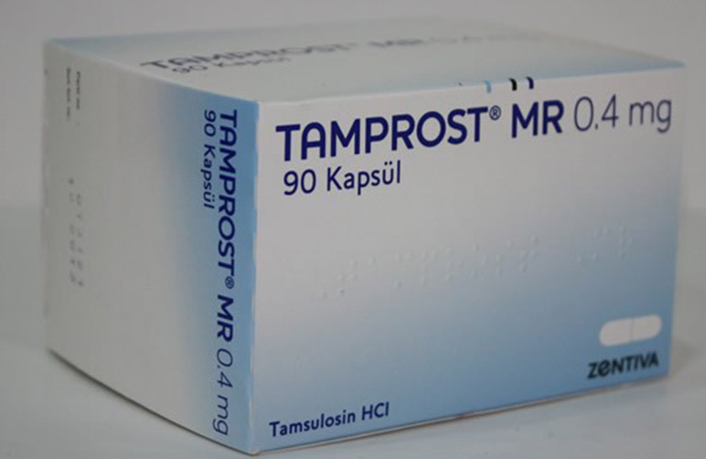
tamsulosin
t_{1/2} very long (+15 h); metabolized in liver
Treatment of BPH + hypertension
Associated with IFIS (intraoperative floopy iris syndrome) during cataract surgery

Slide 43
Pharmacological effects of Ergot alcaloids
are complex and not completely understood
DHE, α1-adrenoceptor antagonist
Antimigrene effects may be related to 5-HT_{1B/1D} receptors

Slide 44
Indications
For frequent, moderate or infrequent heavy migrene attacks
Should be taken asap
Clinical studies:
ergotamine+cafein < triptane

Slide 47
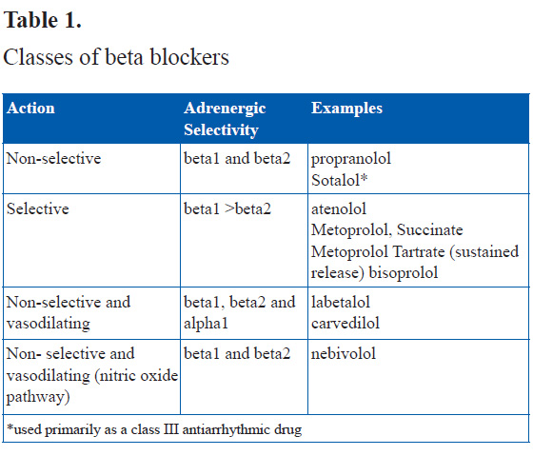
ISA
Local anesthetic activity

Slide 48
Basic Pharmacology

Slide 49
Pharmacokinetics
Absorbtion very good (bioavailability 30%- >90%)
t_{1/2} 3-10 h
Propranolol, carvedilol, metoprolol metabolized by
CYP2D6

Slide 50
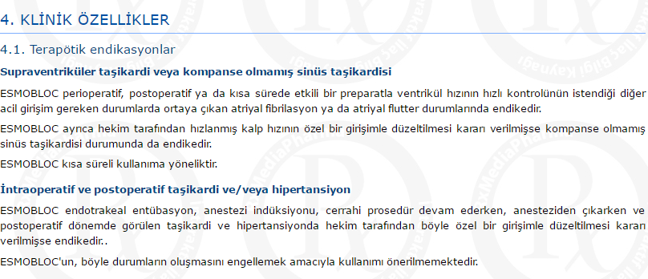
Esmolol, parenteral, short-acting

Slide 51
β-Blockers;
 Hypertension
 Angina pectoris
 Arrhythmia
Migrene
Glaucoma
Anxiety, symptomatic
treatment of hyperthyroidism

Slide 52
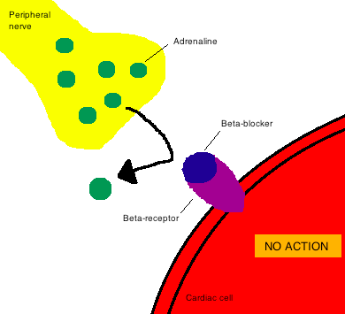
β- Antagonists
Cardiovascular effects
BP

Slide 53
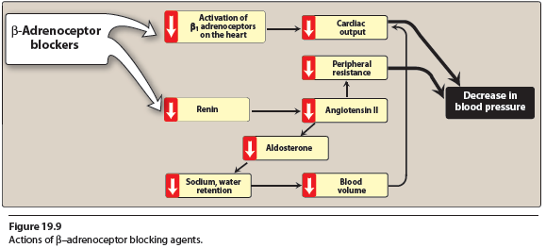

Slide 54
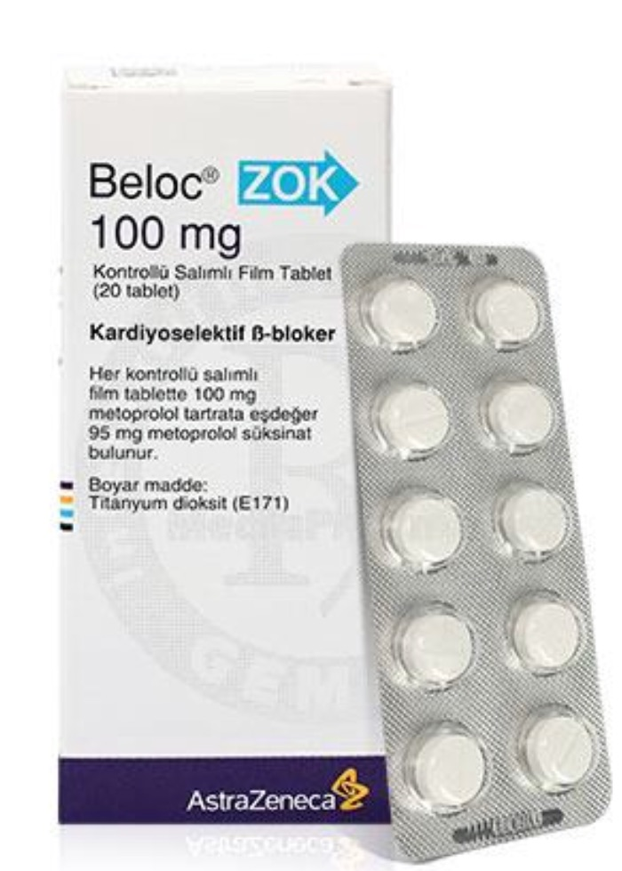
THERAPEUTIC USES OF BETA-BLOCKERS
Hypertension, Angina

Slide 55
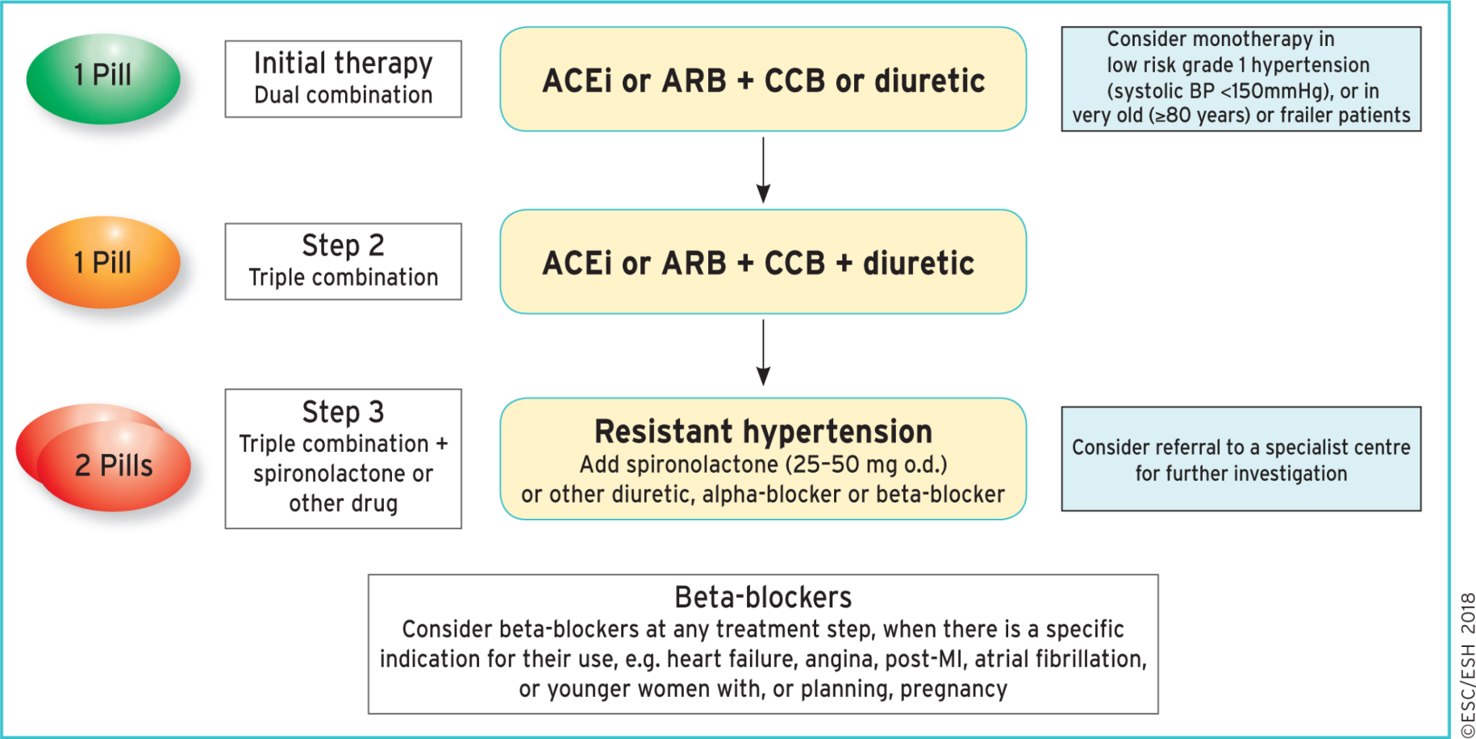
From: 2018 ESC/ESH Guidelines for the management of arterial hypertension
Eur Heart J. 2018;39(33):3021-3104. doi:10.1093/eurheartj/ehy339
Eur Heart J | This article has been co-published in the European Heart Journal (doi: 10.1093/eurheartj/ehy339) and Journal of Hypertension (doi:10.1097/HJH. 10.1097/HJH.0000000000001940), and in a shortened version in Blood Pressure. All rights reserved. ©European Society of Cardiology and European Society of Hypertension 2018. The articles in European Heart Journal and Journal of Hypertension are identical except for minor stylistic and spelling differences in keeping with each journal's style. Any citation can be used when citing this article.This article is published and distributed under the terms of the Oxford University Press, Standard Journals Publication Model (https://academic.oup.com/journals/pages/open_access/funder_policies/chorus/standard_publication_model)
Notes:
Figure 4 Core drug treatment strategy for uncomplicated hypertension. The core algorithm is also appropriate for most patients with HMOD, cerebrovascular disease, diabetes, or PAD. ACEi = angiotensin-converting enzyme inhibitor; ARB = angiotensin receptor blocker; CCB = calcium channel blocker; HMOD = hypertension-mediated organ damage; MI = myocardial infarction; o.d. = omni die (every day); PAD = peripheral artery disease.
55

Slide 57
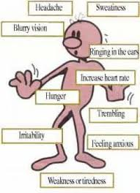
Suppression of hypoglycemia-related symtopms
Diabetics beware!!
Chronic use of non-selective and cardioselective beta blockers increases VLDL, and decreases HDL
Blockade of bronchial β2 receptors increase the resistance of airways

Slide 58
HOMEWORK
Name 3 contraindications of
β blockers

Slide 59
THERAPEUTIC USES OF BETA-BLOCKERS
Heart failure

Slide 60
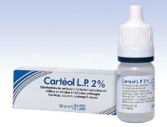
THERAPEUTIC USES OF BETA-BLOCKERS

Slide 61
