Slide 1
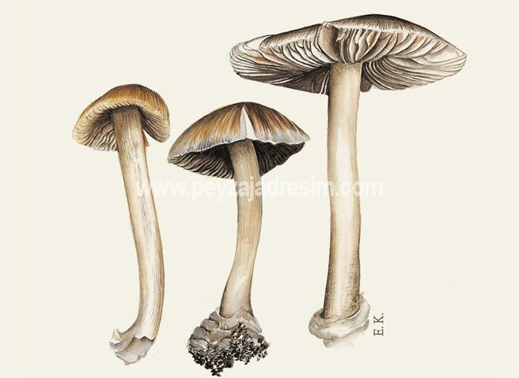
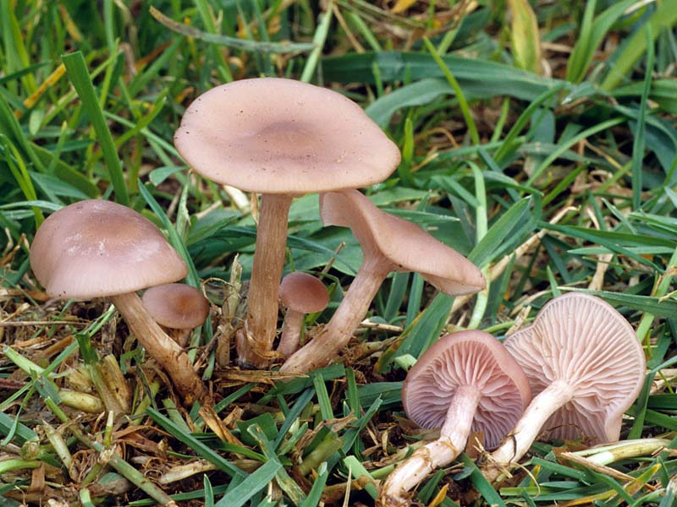
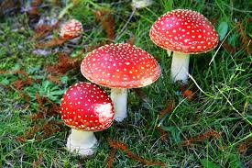
Muscarinic Agonists & Antagonists
Bind to muscarinic receptors receptor activation
Nearly all of them are associated with parasympathetic system (=responses resemble parasympathetic nerve stimulation)
Muscarinic Agonists = Parasympathomimetics
Inocybe
Clitocybe
amanita muscaria

Slide 2
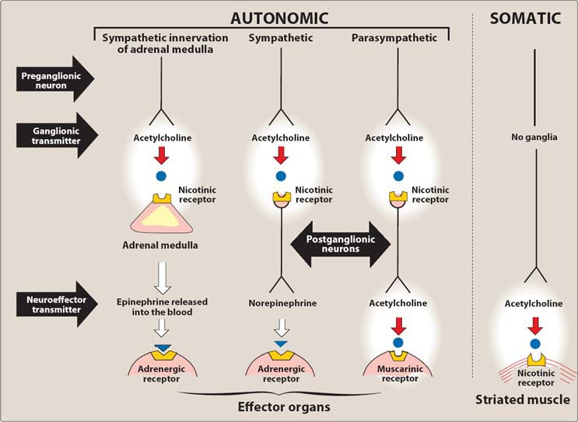
Q. Where are muscarinic receptors located?
A
B
C
D
E
F
G

Slide 3
Q. What is the endogenous agonist of a muscarinic receptor?
Acetylcholine (very rapidly hydrolyzed)
Q. Do you think that Ach can be used as a drug?

Slide 4
Q.What happens when M receptors are activated?
↑ glandular secretions
contraction of smooth muscle in bronchi and
GI system
slowing heart rate
miosis; eye adjustment to near vision
voiding

Slide 5
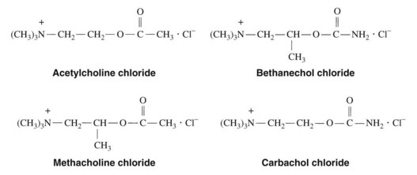
Choline esters
Hydrophilic or lipophylic?

Slide 6
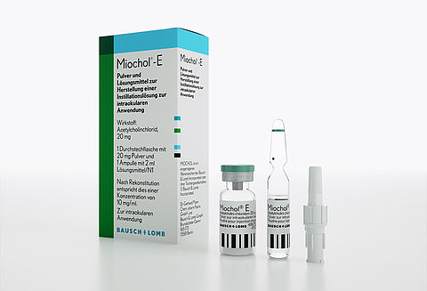
Acetylcholine
limited for eye applications to produce rapid miosis for lens delivery after cataract surgery
No longer imported
Q. What adverse effects do you expect from ACh?

Slide 7
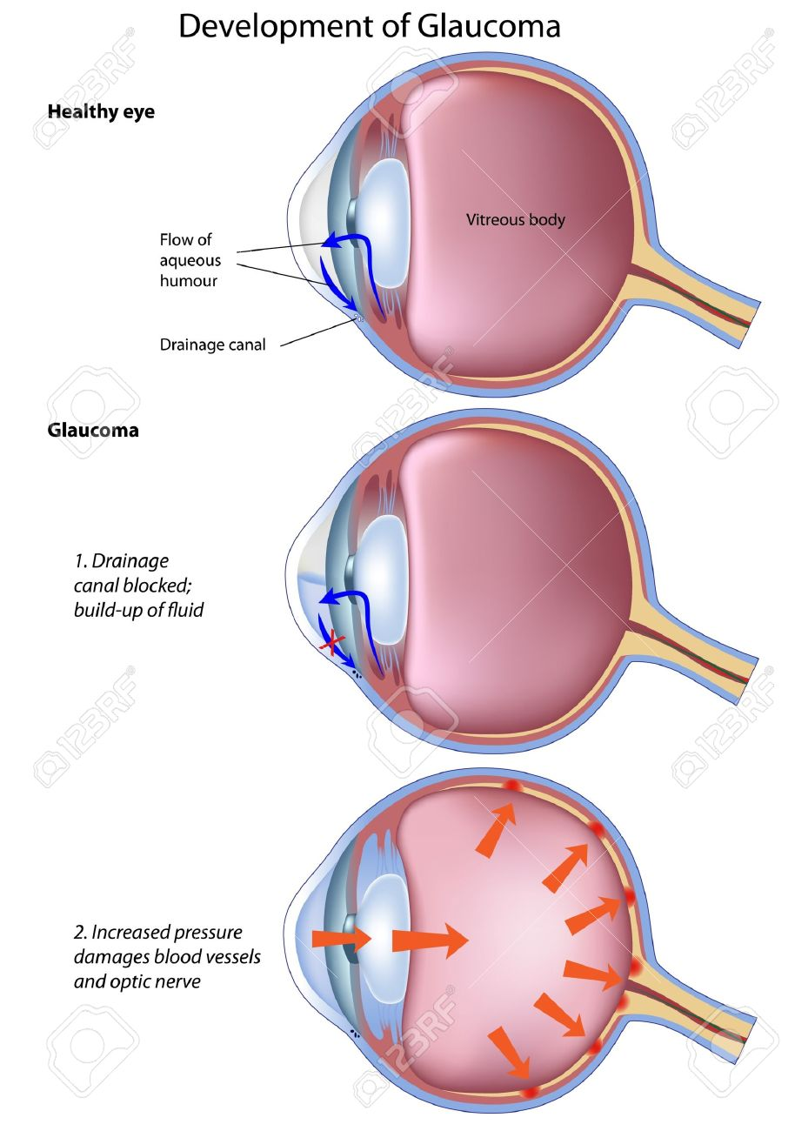
Pilocarpine
Carbachol
https://www.youtube.com/watch?v=f-tva2zj0H0

Slide 9
In the past, glaucoma was treated with direct agonists or cholinesterase inhibitors
Now, PG derivatives and topical β-blockers

Slide 10
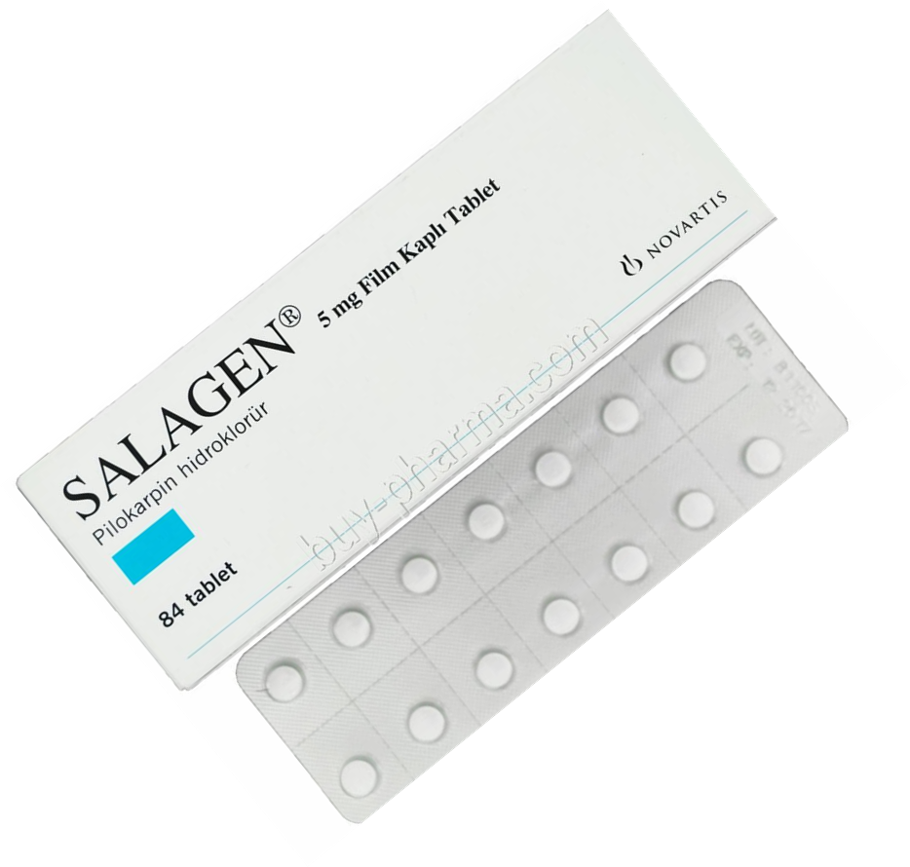
Dose: 3x1

Slide 11
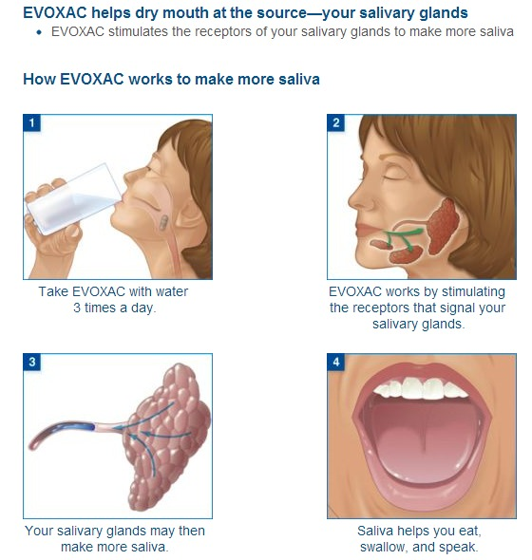
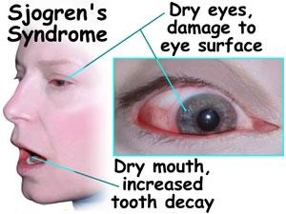
Pilocarpine
Cevimeline (imported)
well absorbed, eliminated mainly
by kidneys
for xerostomia in patients with Sjörgen’s syndrome

Slide 12
Q. What adverse effects do you expect from pilocarpine?
Do you expect this from the ocular preparation?

Slide 13
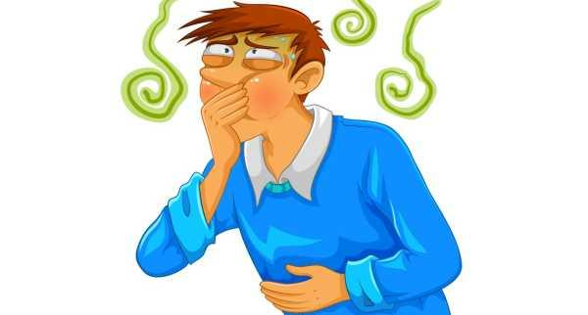
Q. What adverse effects do you expect from cevimeline?
Sweating
Nausea
Rhinitis
Diarrhea
Blurred vision

Slide 14
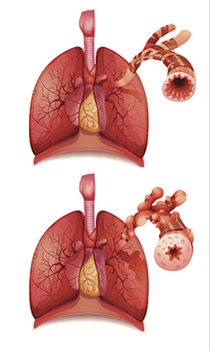
Q. What about contraindications?
Hint: Muscarinic activation increases airway resistance
Contraindicated
uncontrolled astma
Narrow angle galucoma and iritis
Caution
controlled astma
chronic bronchitis
chronic obstructive pulmonary disease

Slide 15
Q. Drug interactions?
Intensifies cardiac depression by β-blockers
Q. What may antagonize cevimeline’s beneficial effects ?
Any drug that antagonizes muscarinic receptors:
Atropin
TCA
Antihistamines
Phenothiazine antipsychotics

Slide 16
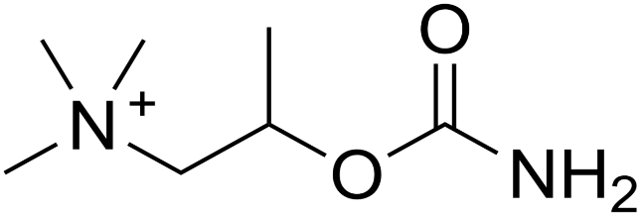
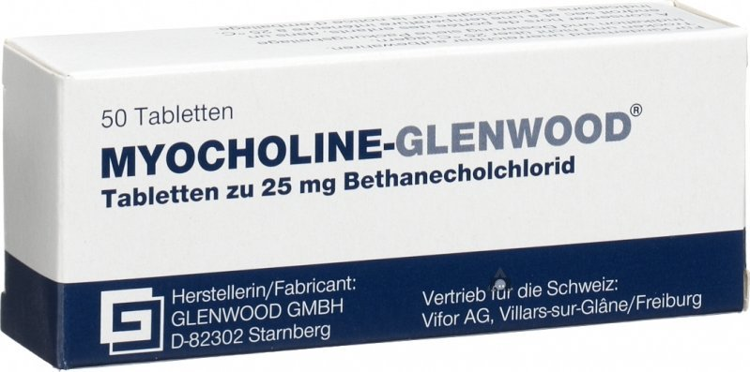
Bethanechol (imported)
A broad spectrum of pharmacologic effects
but indications are very limited
indication
urinary retention in postop and postpartum
patients

Slide 17
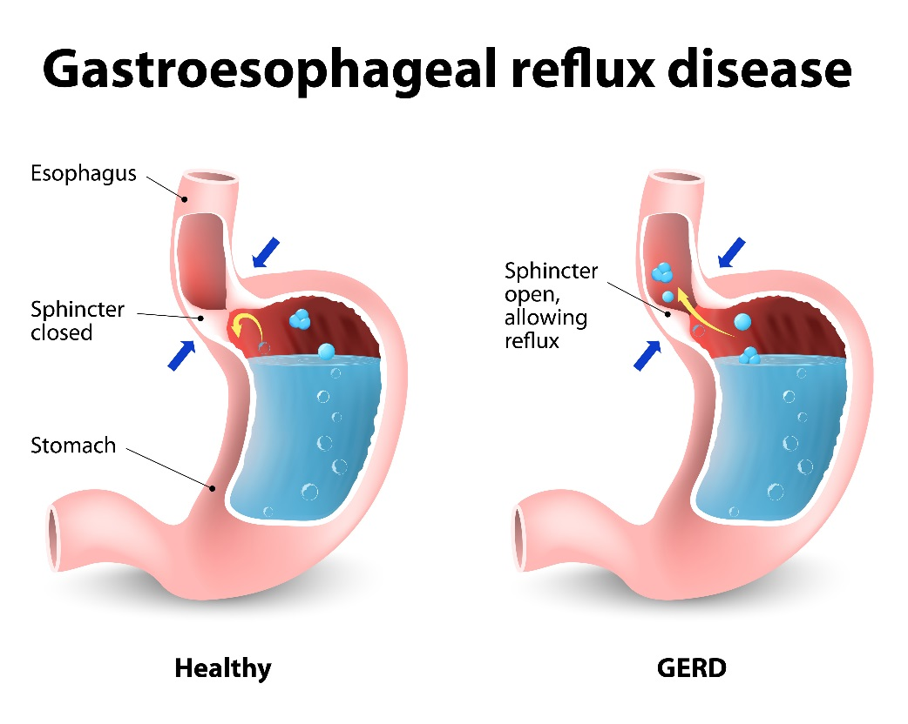
Bethanechol
gastroesophageal reflux, GI paralysis
indication
gastroesophageal reflux

Slide 18
Q. What adverse effects do you expect from bethanecol?
Cardiovascular system
bradycardia
hypotension (secondary to vasodilation)
Dysrythmias in hyperthyroid patients
Sweating
Nausea
Rhinitis
Diarrhea
Blurred vision
Q. What about contraindications?

Slide 19
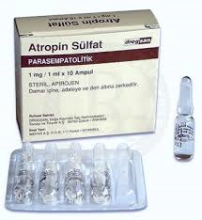
Muscarine & Muscarinic Poisining
profuse salivation
lacrimation
visual disturbances
bronchospasm
diarrhea
bradycardia
hypotension
TREATMENT?

Slide 20
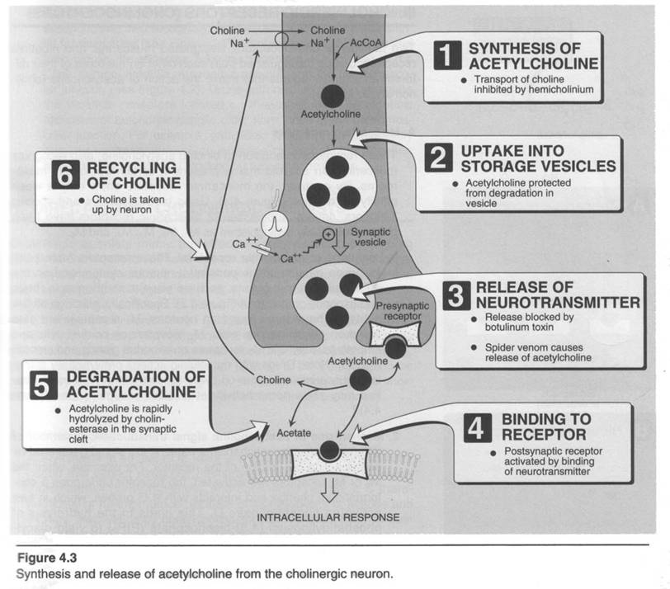
Indirect Cholinomimetics-
Cholinesterase Inhibitors
Lack selectivity
Limited
therapeutic
applications

Slide 21
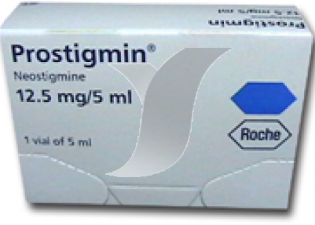
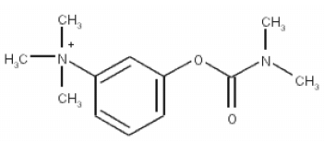
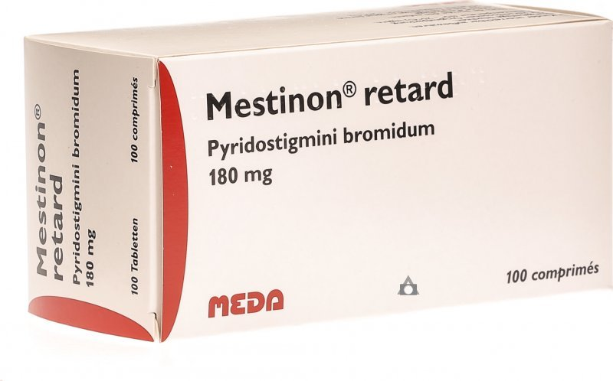
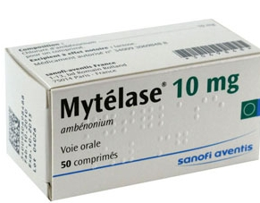
Neostigmine (parenteral)
No Access to CNS
Myastenia gravis
Reversal of neuromuscular blockade
Excessive M stimulation
Neuromuscular BLOCKADE
Obstruction of GI/urinary tract
Peptic ulcer
Astma
Hyperthyroidism

Slide 22
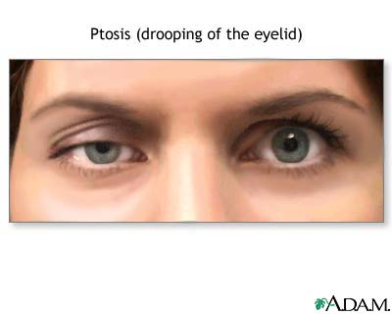
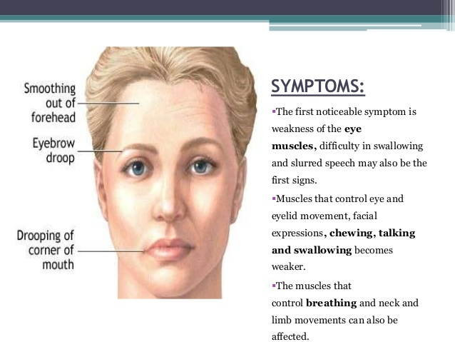
Myastenia gravis
Neostigmine
Physostigmine
Ambenonyum
Pyridostigmine
Edrophonium

Slide 23
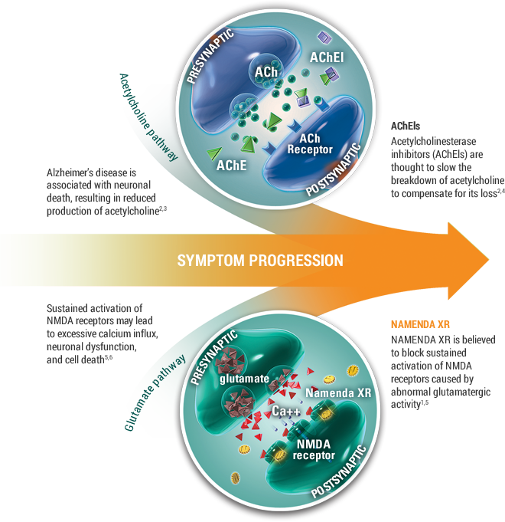
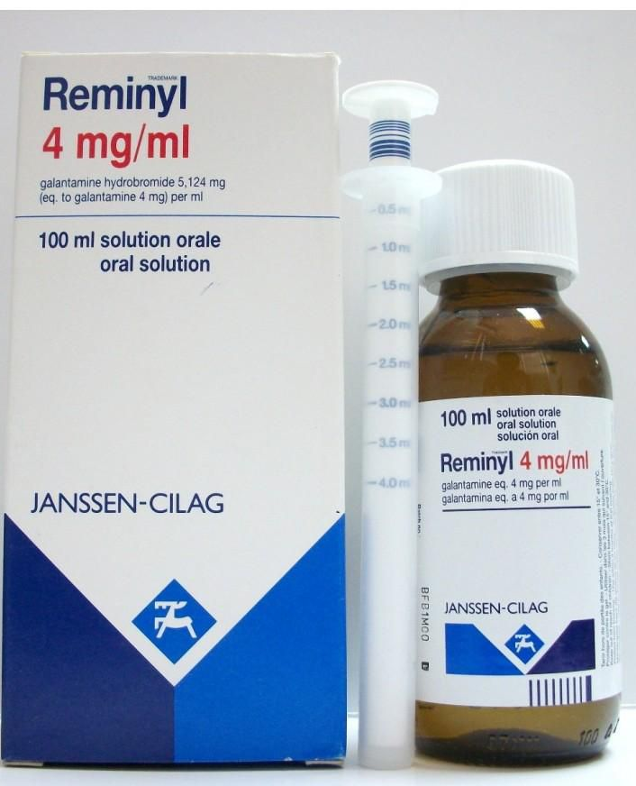
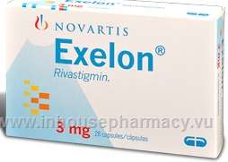
Drugs For Alzheimer’s Disease
Donepezil (PO)
Galantamine (PO)
Rivastigmine (PO)
Tacrine (PO, NA)

Slide 24
Single 5-10 mg, just before bed time
REMINYL ER- once Daily- IN THE MORNING and with meal
2x1, with meals

Slide 25
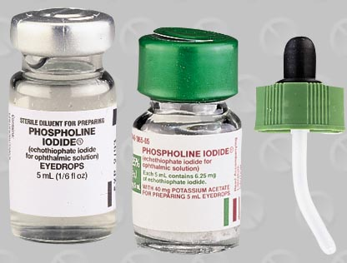
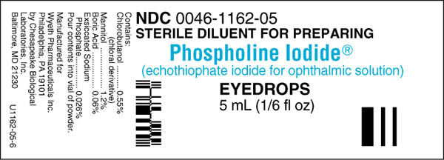
Irreversible Cholinesterase Inhibitors
Indication: ?

Slide 26
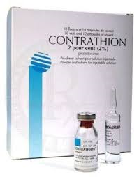
Pralidoxime
Antidote to organophosphate poisining

Slide 27
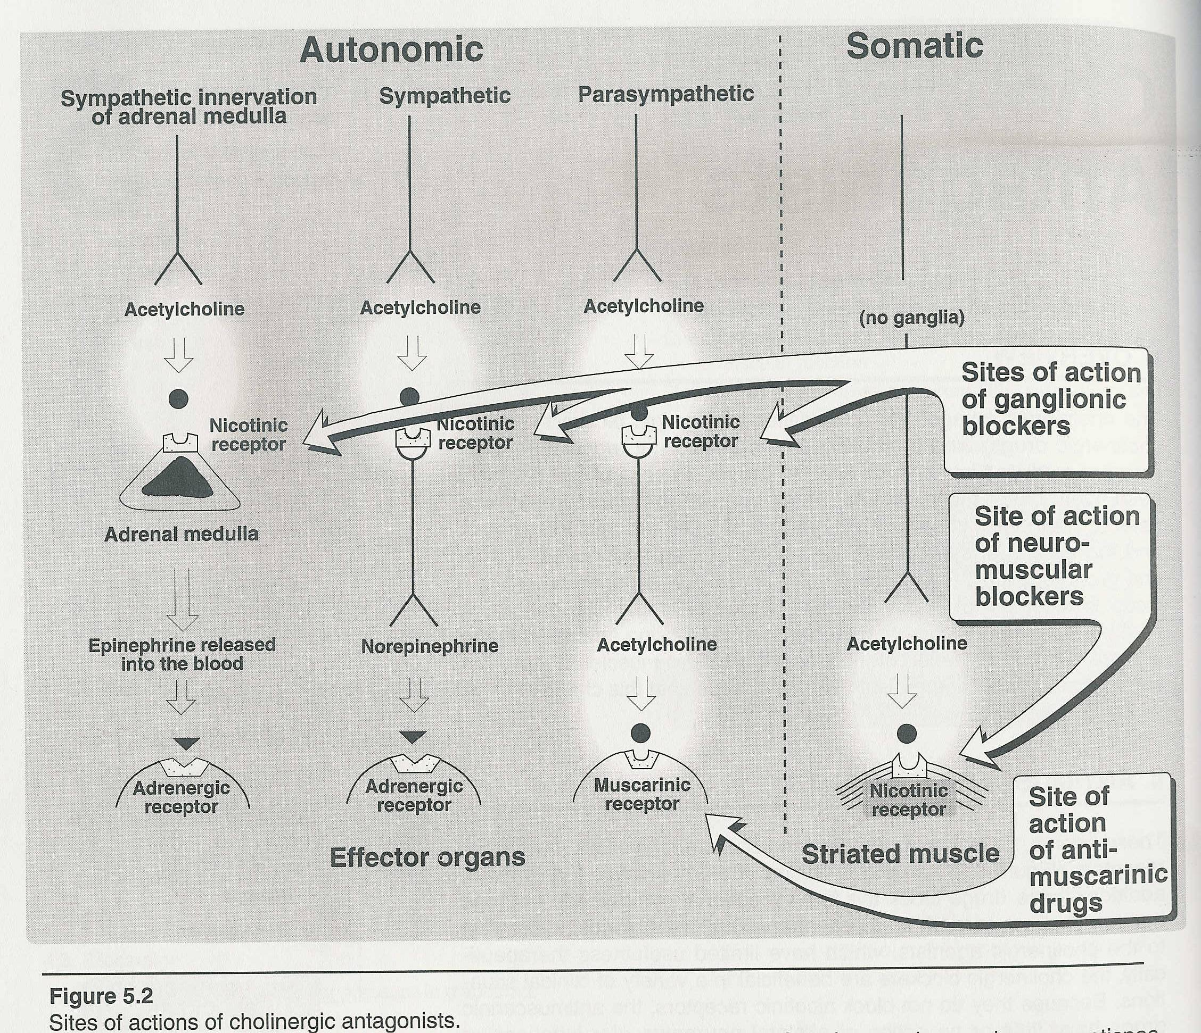
Muscarinic Antagonists
a.k.a parasympatholytic drugs; antimuscarinic drugs; anticholinergic drugs

Slide 28
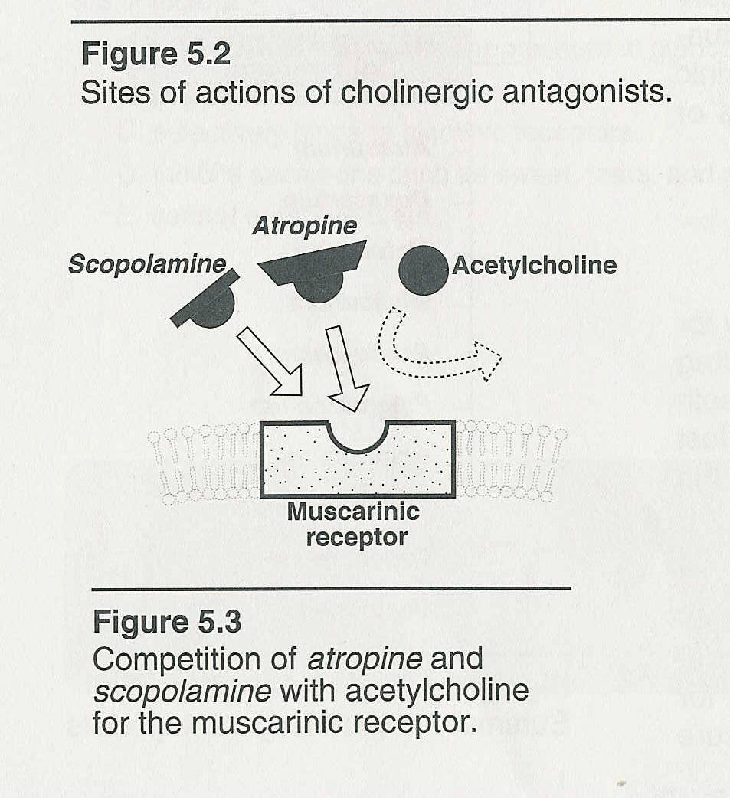
Mechanism of action

Slide 29
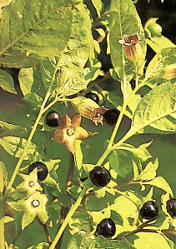
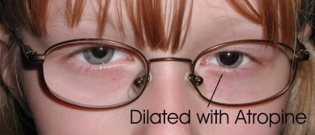
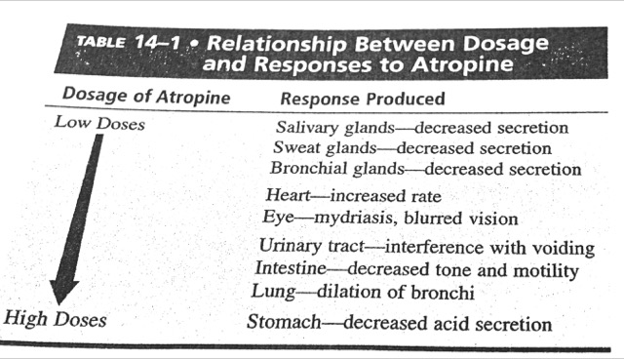
Q. Effects on the heart, exocrine glands,
smooth muscle, eye ?
Prototype:
Atropine
CNS: At therapeutic doses, mild exitation
Toxic doses, hallucination, delirium

Slide 30
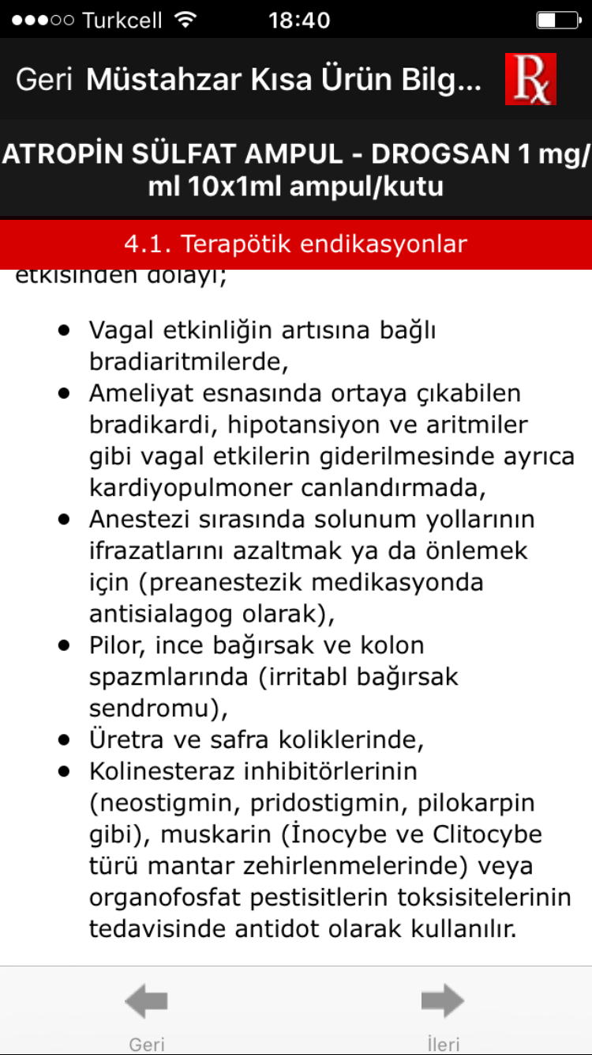
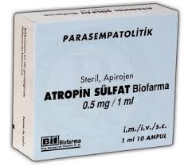
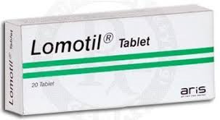
Atropin+difenoksilat
Önerilen başlangıç dozu 4 tablet; 6 saatte bir alınan iki tablet ile devam

Slide 31
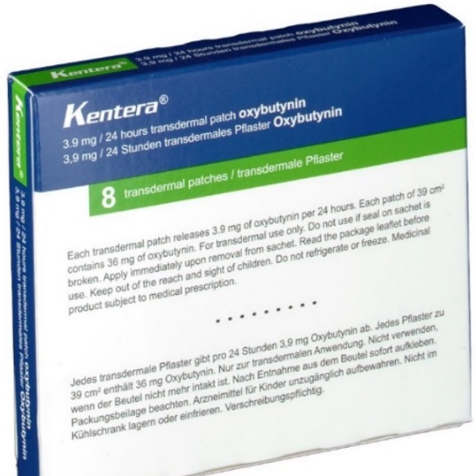
Anticholinergic Drugs For Overactive Bladder
Oksibutinin, M3-selective (Üropan®, Kentera® Transdermal Flaster)
Darifenacin, M3-selective (Emselex®)
Solifenasin, M3-selective (Vesicare®)
Tolterodin (Detrositol®)
Trospiyum (Spasmex ®)

Slide 32
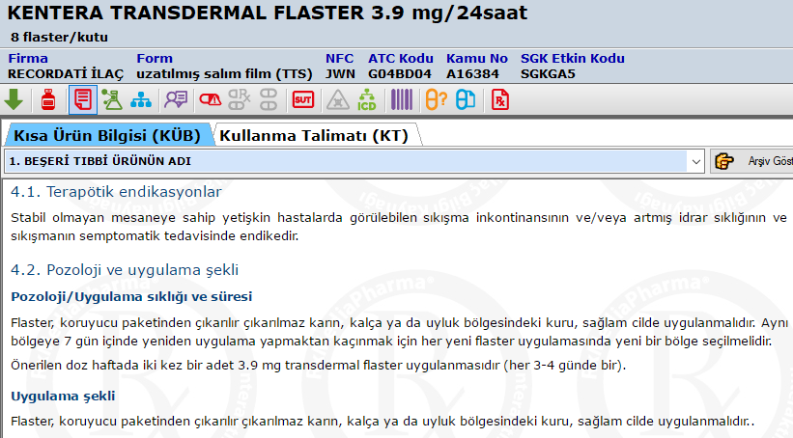
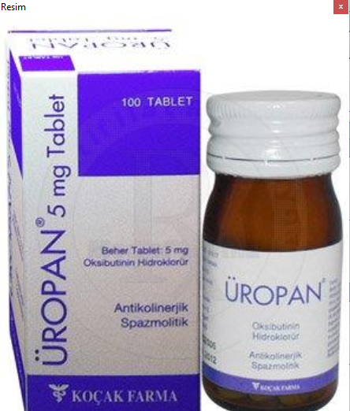
Oksibutinin, M3-selective
t_{1/2}: < 2 h
Elimination: renal
Contraindicated ???
(Üropan®, Kentera® Transdermal Flaster)

Slide 33
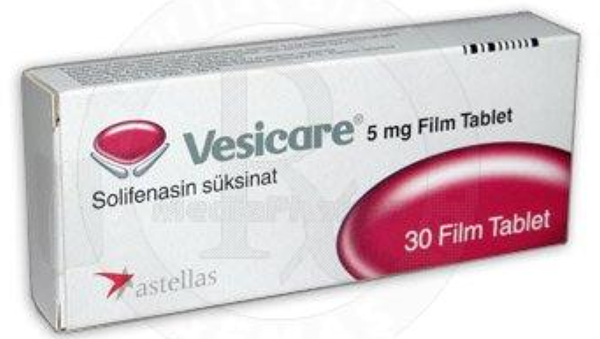
Darifenacin, M3-selective (Emselex®)
Solifenasin, M3-selective (Vesicare®)
1x1
Metabolized in liver
Elimination: kidney, feces

Slide 34
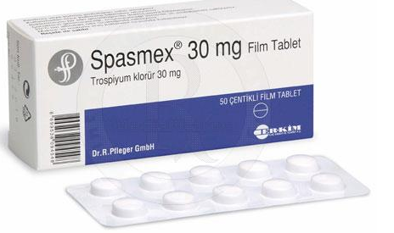
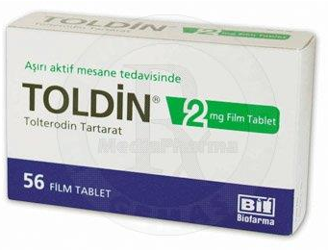
Tolterodin (Detrositol®)
Metabolized in liver (2D6?)
Elimination: renal
t_{1/2}: 2-4 or around 10h ?
Trospiyum (Spasmex ®)
Elimination: renal
t_{1/2}: 5-17 h

Slide 35
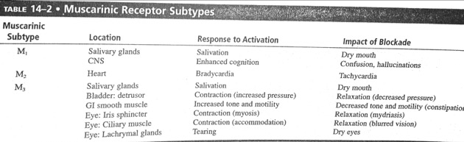
Anticholinergic Drugs For Overactive Bladder
Inhibit bladder contractions and reduce the urge to void

Slide 36
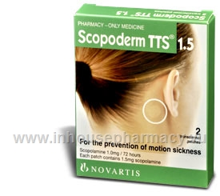
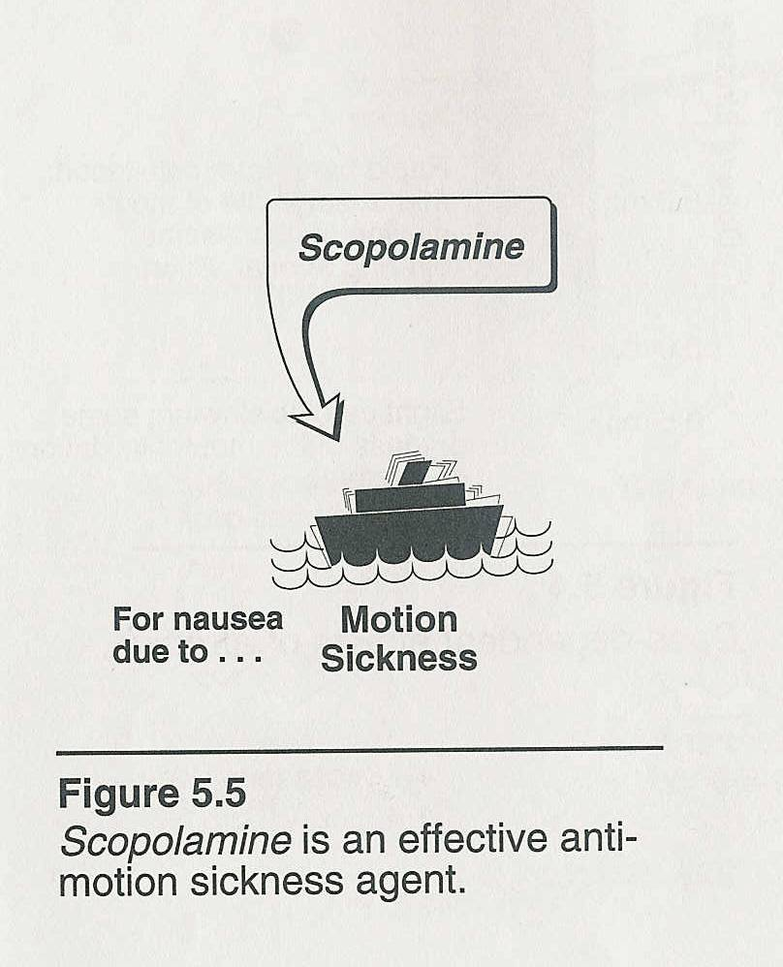
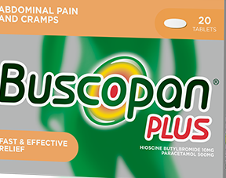
Scopolamine
Motion sickness
Produce sedation (not exitation like
atropine)
Suppresses emesis
Butylscopolamine
Paracetamol+hyocine-N-butylbromide

Slide 37
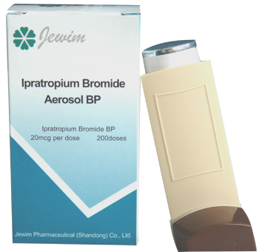
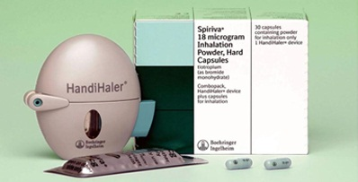
Anticholinergics for Astma, COPD and Rhinitis
Ipratropium (Atrovent®)
Tiotropium (Spiriva®)
Glycopyronium (Panthero®)
Umeclidinium (Trelegy®)
Neural reflex in astma is
regulated by Vagus nerve
Ipratropium is administered by inhalation, systemic absorption is minimal (meaning??)
Tiotropium and glycopyronium are administered by inhalation, allow once daily
dosing

Slide 38
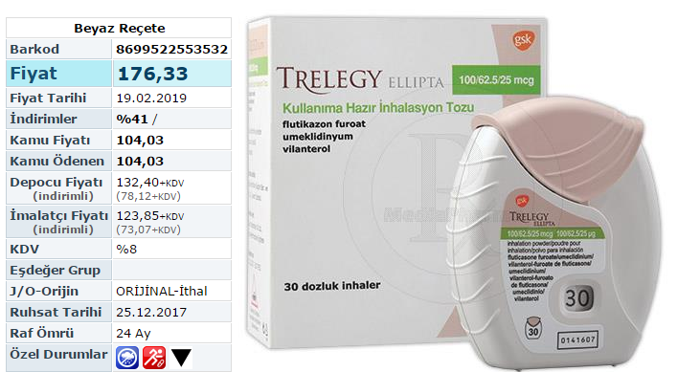

Slide 39
Handihaler

Slide 40
Glycopyronium (Panthero ®)

Slide 41
Ophtalmology
To produce mydriasis and cyclophlegia
Atropine (ophtalmic prep no longer available in Turkey)
Skopolamin (ophtalmic prep NA in Turkey)
Homatropin (NA)
Cyclopentolate (Sikloplejin®)
Tropicamide (Tropamid®)

Slide 44
Parkinson’s Disease
Benztropine (YDİ)
Biperiden (Akineton®)
Trihexyphenidyl (YDİ)
Atropine was the first drug
striatum
Problem: DAergic neuron

Slide 46
Tachycardia

Slide 48
BOTOX is used for??

Slide 49
Q. What are the indications of
anticholinergic drugs?

Slide 50
Nicotinic Agonists and Antagonists

Slide 52
NICOTINIC ANTAGONISTS
Ganglionic blockers
Neuromuscular blockers

Slide 55
Neuromuscular blockers
Non-depolarising agents (antagonist)
Prototype: tubocuraine

Slide 56
Parenteral- no CNS entry
For muscle relaxation during surgery,
endotracheal intubation, electroconvulsive therapy,
mechanical ventilation

Slide 57
Q1. Drug interactions of curar-like N_{M}
blockers ?
Q2. Adverse effects of curar-like N_{M}
blockers ?
Q3. N_{M} blocker with the shortest
duration of action?

Slide 58
Depolarising agent: Succinylcholine
Paralysis in 1’, lasts 4-10’

Slide 60
Q1. What is pseudocholinesterase?
Q2. Effect of cholinesterase inhibitor
on succinylcholine?
Q3. Effect of cholinesterase inhibitor
on curar-like N_{M} blocker?

Slide 61
NICOTINIC ANTAGONISTS
Ganglionic blockers
mecamylamine
Neuromuscular blockers

