Slide 1
Anti-allergic drugs
ÖMÜR AYDIN, MD, Assoc. Prof.
Ankara University School of Medicine
Dept of Allergy and Clinical Immunology

Slide 2
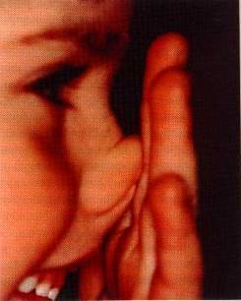
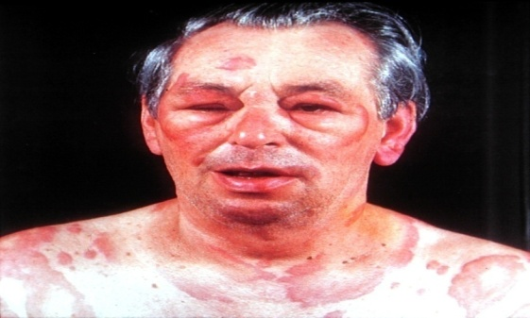
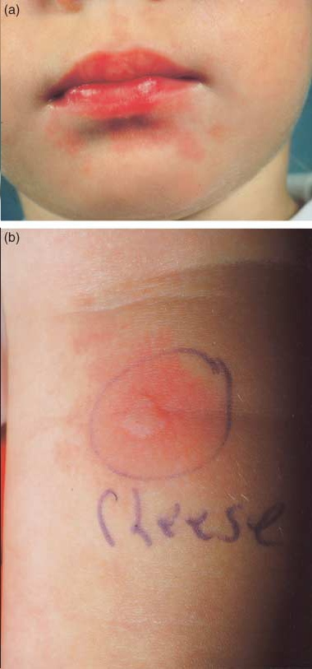
WHAT ARE THE ALLERGIC DISEASES?
ALLERGIC RHINITIS
ASTHMA
URTICARIA
ANGIOEDEMA
ANAPHYLAXIS
DRUG /FOOD/BEE VENOM ALLERGY

Slide 3
TREATMENT OF ALLERGIC DISEASES
Patient education
Prevention
Medical treatment
Treatment for allergy (allergen specific immunotherapy)

Slide 4
ANTI-ALLERGIC DRUGS
Primary care physician
Specialist
ANTI-HISTAMINES
CORTICOSTEROIDS
(nasal, inhaler, systemic)
BETA AGONISTS
ANTI-HISTAMINES
CORTICOSTEROIDS (nasal, inhaler, systemic)
BETA AGONISTS
ANTI-LEUCOTRIENES
ADRENERGIC DUGS
MONOCLONAL ANTIBODIES
Anti IgE (Omalizumab)

Slide 5
ANTI-HISTAMINES
H₁receptor blokers are used.
Bind to histamin receptor competetively and reverses the effects of histamine.
Indications:
Respiratory allergies (Rhinoconjunctivitis)
Skin allergies (Urticaria, angioedema)
Other allergies

Slide 6
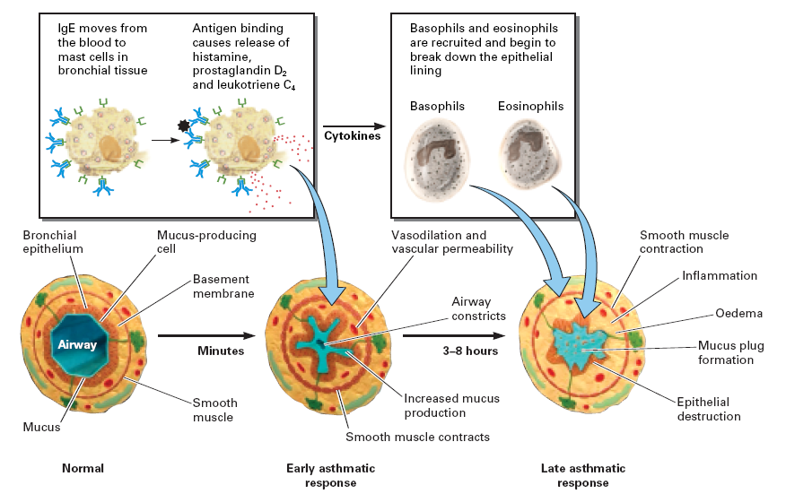
H1 Antihistamines
Decreases vascular permeability, vasodilatation and glandular secretions
Decreases rhinnorhea, erythema cutaneous edema, sneezing, itching
Bronchodilatation

Slide 7
H1 Antihistamines
Oral,
topical (nasal,ophtalmic),
parenteral forms are available

Slide 8
1 st generation
H1 Antihistamines
Azatadine
Brompheniramine
Klorpheniramine
Siproheptadine
Difenhidramine
Hydroxyzine
Tripellenamine
Ketotifen

Slide 9
Side effects of 1 st generation Antihistamines
They are lipophilic drugs and easily passes through the blood-brain barrier;
          Sedation
          Sleepiness
          Cognitive disfunction
They bind to muscarinic and cholinergic receptors
          Dry mouth,
          Blurry vision

Slide 10
2 nd generation
H1 Antihistamines
Cetirizine
Ebastine
Fexofenadine
Loratadine
Mizolastine
Acrivastine
Azelastine
Loratadin
Desloratadine
Levocetirizine
Rupatadine

Slide 11
Corticosteroids (Cs)
NASAL
Allergic rhinitis
INHALER
Asthma
SYSTEMIC
Severe forms and emergencies of all allergic diseases
CORTICOSTEROIDS

Slide 12
Corticosteroids (Cs)
Inhibition of the allergic inflammation in several steps:
  Antigen presenting (Langerhans) cells
  Eosinophils
  Basophyl and mast cell migration to the nasal mucosa
  T lymphocytes and cytokines (IL-3, -4, -5 ve -13)
  Histamine, triptase, prostanoids, leucotrienes

Slide 13
Nasal Cs
Decreases the symptoms of rhinitis
(sneezing, rhinorhea, itchy nose, nasal obstruction).
Effect starts later than antihistamines.

Slide 14
Nasal Cs
Beclomethasone dipropionate
Budesonide
Flunisolide
Fluticasone propionate
Fluticasone furoate
Mometasone furoate
Triamcinolone acetonide
Ciclesonide

Slide 15

Side effects
Local
  Dry nose
  Bleeding
  Septal perforation: Rare.
  Must be sprayed towards the lateral wall of the nose

Slide 16
Inhaler Cs
Used for asthma treatment
Decreases airway inflammation
QoL
Symptoms
Pulmonary functions improvement
BHR
Asthma exacerbations,
hospitalizations

Slide 17
Inhaler Cs
Beclomethasone dipropionate
Budesonide
Ciclesonide
Fluticasone propionate
Fluticasone furoate
Mometasone furoate
Triamcinolone acetonide

Slide 18
Side effects of inhaler Cs
Local (common side effects)
Hoarseness
Cough
Oral candida
Systemic (rare)
Adrenal supression
Cataract
Glaucoma

Slide 19
Systemic Cs
Most effective anti-inflammatory drugs that supresses chemokines and citokines
Daily dose (40-60 mg/day methyl prednisolon or equivalent)

Slide 20
When to use Systemic Cs
Used when we plan a short term but fast treatment
Asthma attack: short course
Step 5 severe asthma: short/long corse
Severe persistant allergic rhinitis when not responded to drugs: short course
Anaphylaxis: short course
Urticaria- angioedema: short/long corse

Slide 21
Systemic Cs
Side effects;
Diabetes
Osteopozis
Myopathy
Cushing
Cataract

Slide 22
ADRENERGIC DRUGS
Epinephrine (Adrenalin)
Stimulates alfa and beta adrenergic reseptors directly
First choice drug in anaphylaxis treatment
Main therapeutic effect: bronchodilatation, cardiac stimulation, skeletal muscle relaxation

Slide 23
Side effects of epinephrine
CNS;tremor, agitation, headache, disorientation,serebral hemorhage
CVS;palpitation,tachycardia,hipertension,ventricular fibrilation, angina,arithmia
Methabolic; Hyperglycemia, lactic acidosis
Skin; urticaria, local pain at injection-site

Slide 24
Decongestants
  α1-adrenergic agonist: Phenylephrin
  α2-adrenergic agonist: Oximethasoline,
  Xsilomethasoline
  Noradrenalin secreting agents: Ephedrin, pseudoephedrin

Slide 25
Decongestants
Intranasal
  Effective for nasal obstruction,
  Effects in 10 min.
  Rebound mucosal edema and rhinitis medicamentosa, when used >10 days
Oral
  Short/long time therapy
  Less effective for nasal obstruction compared to intranasal forms
  Effects in 30 min., lasts 6-8 hrs.

Slide 26
β-Adrenergic Receptor Agonists
Selective β₂ agonists are used as bronchodilators in asthma treatment
By activating β₂ receptor :
Inhibits mediator release, vascular permeability and edema
Bronchodilatation

Slide 27
Bronchodilators in asthma treatment
Early onset and short-acting β₂ agonists (SABA)
Salbutamol
Terbutalin
Early onset and long-acting β₂ agonists (LABA)
Formoterol (12 hrs)
Indacaterol (24 hrs)
Vilanterol (24 hrs)
Late onset and long-acting β₂ agonists
Salmeterol (12 hrs)

Slide 28
Beta₂ agonists side effects
Tremor
Headache
Hypopotasemia
Hyperglicemia
Hypercholesterolemia
Muscle cramps
Paradox bronchospasm
Urticaria
Cardiac toxicity (arrythmia, systolic hypertension, tachycardia)

Slide 29
Drugs used in asthma treatment
Controllers
ICS
ICS + LABA
Leucotrien receptor antagonists
Teophyllin
Systemic CS
Anti IgE (Omalizumab)
Symptom relievers
SABA
Systemic CS
Teophyllin
Anticolinergic drugs
INFLAMMATION
BRONCHOSPASM

Slide 30


Both controller and reliever asthma drugs are used via inhalation route !
Lower dose is required compared to systemic route
Fast acting drugs
Drugs can be given directly to the lungs
Side effecets are lower than systemic drugs
Need for good technique for inhalation

Slide 31
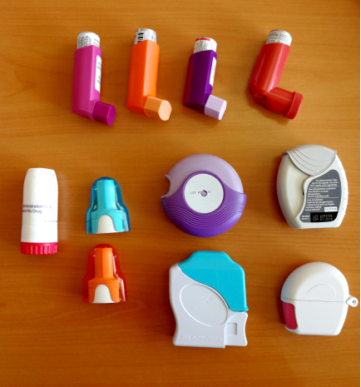
INHALER DEVICES
Metered dose inhalers (MDI)
Spacers
Dry powder inhalers (DPI)

Slide 32
Anti-leucotrienes
LTD4 Receptor Antagonists:
Montelucast,
Zafirlucast
Indications; Allergic rhinitis
Asthma,
Chronic idiopathic urticaria

Slide 33
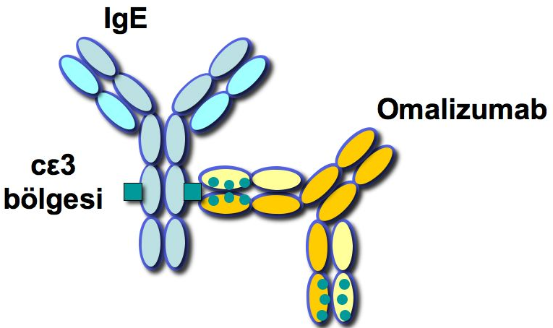
Humanized monoclonal anti-IgE antibody: Omalizumab is a treatment option for
Severe Asthma and Chronic Urticaria
Can be used by specialist !

Slide 34
Omalizumab for severe asthma
  Patients ≥ 12 yrs old
  Body weight <200 kg
  Serum Total IgE level: 30-1500 IU /ml
If there is no response to treatment in 16 weeks, treatment should be discontinued.
After administration of Omalizumab, the patient should remain under surveillance for 2 hours.
Injections should be done in an allergy clinic. The patient should be informed about anaphylaxis.
Notes:
34

Slide 35
Allergen Specific Immunotherapy
It is the only treatment that changes the natural course of allergic diseases.
It should be given in a long period of up to 3-5 years.
Can be used by specialist !

Slide 36
Allergen Specific Immunotherapy
  IgE related allergic diseases proven by allergy tests and patient history:
    Severe PersistantAllergic Rhinitis,
    Mild-Moderate Allergic Asthma (FEV₁ >70%)
    Bee-venom allergy (anaphylaxis)

Slide 37
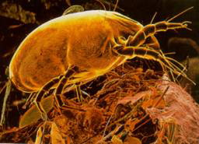

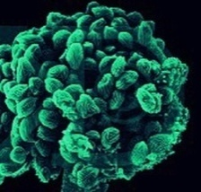
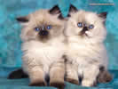
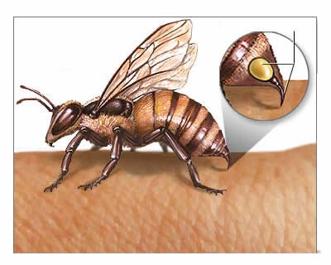

Which allergens are used in immunotherapy
HDM
  Dermatophogoides pteronyssinus
  Dermatophogoides farinea
Pollens
Moulds(alternaria, clodosporium)
Cat
Dog
Latex
Bee venom (Apis mellifera,
vespula)

Slide 38
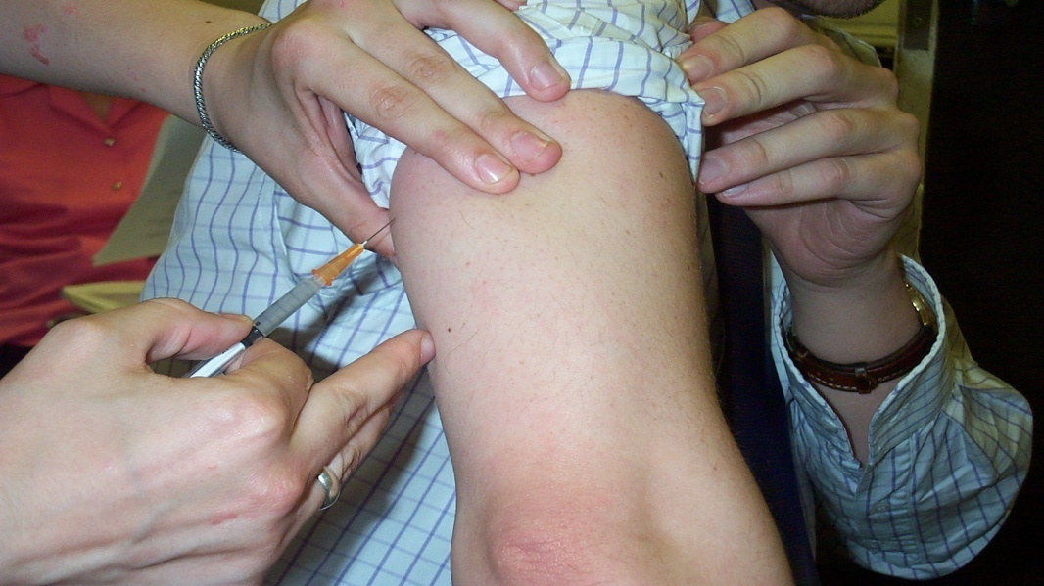

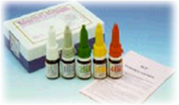
Subcutaneous
Sublingual
Oral

Slide 39
Thank you …

