Slide 1
Alcohols

Slide 2
Alcohols
General formula R-OH (R is a saturated C-atom)

Slide 3
Physical properties of Alcohols
Soluble in water
Diols and triols have higher b.p’s and are more water soluble
Boiling point of alcohols are always higher than corresponding alkane with the same hydrocarbon chain
Viscosity of alcohols increase as the size of the molecules increases
Viscosity is the property of a fluid that resists the force tending to cause the fluid to flow

Slide 4
Nomenclature
Start with the parent chain and replace the hydrocarbon –e ending with –ol
Number the hydrocarbon chain. The carbon containing the –OH group should
have the lowest number
Number the position of the –OH group
Number and name other side chains or functionalities using IUPAC rules

Slide 5
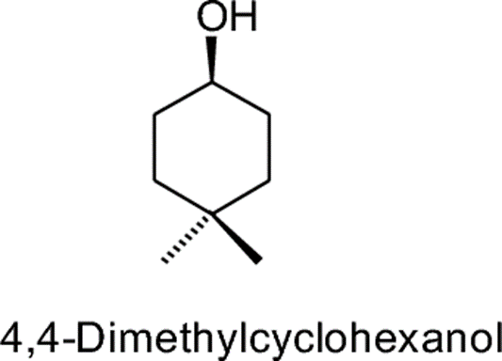
In a cyclic alcohol, –OH group is on C-1

Slide 6
Primary Secondary and Tertiary alcohols
Primary alcohols Primary alcohols are ones in which the carbon atom that is bonded to a hydroxyl functional group is bounded to only one other carbon atom.
Primary alcohols forms aldehydes when oxidized.

Slide 7
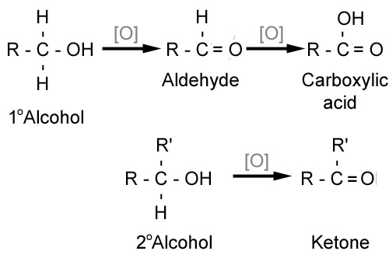
Secondary alcohols
Secondary alcohols Secondary alcohols are ones in which the carbon atom that is bonded to a hydroxyl functional group is bounded to two other carbon atom.
Secondary alcohols forms ketones when oxidized.

Slide 8
Tertiary alcohols
Tertiary alcohols Tertiary alcohols are ones in which the carbon atom that is bonded to a hydroxyl functional group is bounded to three other carbon atom.
Tertiary alcohols can not be oxidized.
there is no hydrogen with primary alcohol and oxidation is the removal of hydrogen

Slide 9
Preparation of alcohols
Hydration of alkanes
In the presence of an acid

Slide 10
Hydration of alkenes
Hydroboration-Oxidation

Slide 11
Hydration of alkenes
Oxymercuration-demercuration

Slide 12
Hydrolysis of
Alkyl-halides

Slide 13
Reduction of carbonyl compounds

Slide 15
Reactions of Alcohols
Dehydration reaction

Slide 16
Reaction with phosphorus trihalide

Slide 17
Ester formation

Slide 18
Oxidation of alcohols

Slide 19
ETHERS

Slide 20
Ethers
General Formula
R-O-R
Ar-O-R
Ar-O-Ar

Slide 21
Nomenclature of Ethers
R-O-R
Identify the parts labelled "R₁" and "R₂".
Naming similar to alkenes
Short chain R becomes the first par
-ane replaces with –oxy CH₃OCH₂CH₃ methoxyethane

Slide 24
Physical properties of ethers
Boiling point (BP) of ethers is approximately the same as alkanes with similar molecular weights.
Boiling point of ethers are lower than similar alcohols.
Solubility in water is about the same as alcohols.

Slide 25
Preparation of ethers
Williamson synthesis

Slide 26
Alkoxymercuration-demercuration of ethers

Slide 27
Dehydration of Alcohols

