Slide 1
Carbohydrates as a main food component
Carbohydrates are present in plants, muscle from animals, milk, and microorganisms in many different forms and levels.
Most carbohydrates are stored in the seeds, roots, stems, fruit of plants and in the muscle of animals.
Animals’ muscle have some carbohydrates in the form of glycogen, which is converted to lactic acid during slaughter. Therefore, meats have only 1% of carbohydrates.
FDE 101-BCFE
23.10.2018

Slide 2
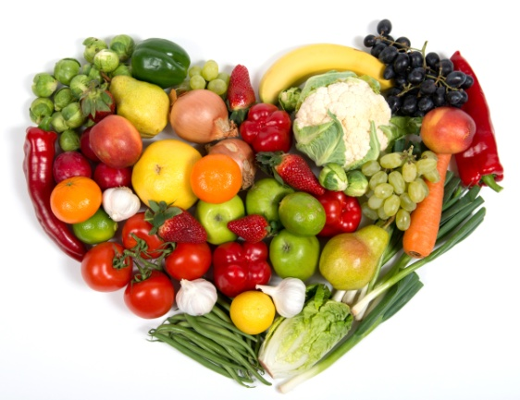
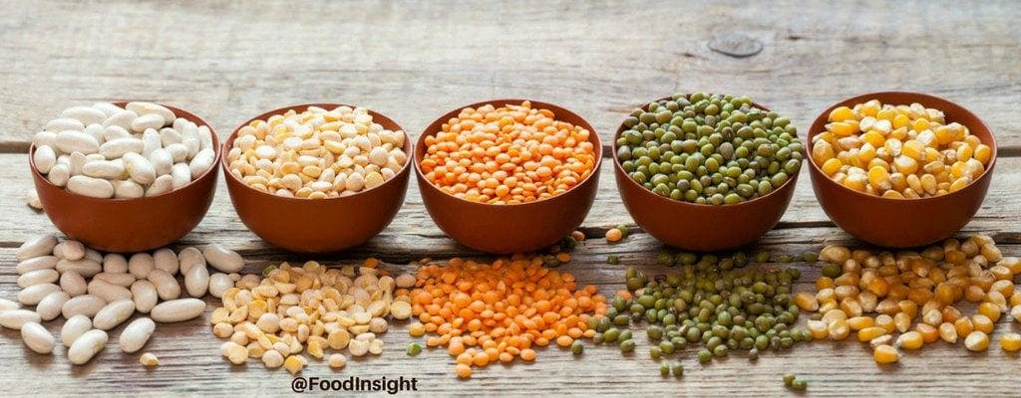
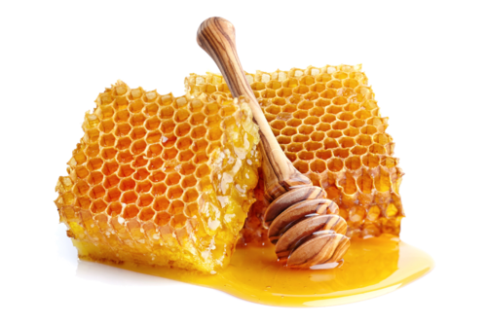
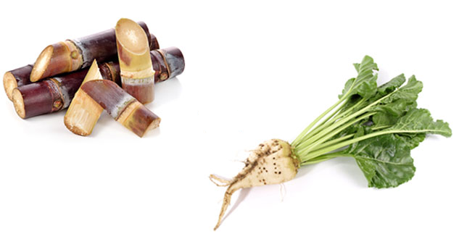
Common food sources for carbohydrates
Grains such as rice, wheat, rye, barley, corn
Fuits and vegetables such as carrot, potato, grapes
Legumes such as beans, peas, lentils
Sugar cane, sugar beet, honey
FDE 101-BCFE
23.10.2018

Slide 3
Carbohydrates content in some foods
Food/Food products | Total sugar (%) | Food/Food products | Total sugar (%)
Apple | 14.5 | Milk | 4.9
Grape | 17.3 | Honey | 82.3
Carrot | 9.7 | Sugar beet | 18.0-20.0
Potato | 17.1 | Peanuts | 18.6
Sweet potato | 26.3 | Meat | ~1
FDE 101-BCFE
23.10.2018

Slide 4
Composition of carbohydrates
Carbon (C), hdyrogen (H), and oxygen (O) are the elements of carbohydrates
The word “carbohydrate” can be broken down into “carbon (C)” and “hydro (H₂O)”.
The basic chemical formula of the carbohydrates is C_{n}(H₂O)_{n}
Carbohdyrates are also called as saccharides.
FDE 101-BCFE
23.10.2018

Slide 5
Classification of carbohydrates
Disaccharide
Polysaccharide
Hexoses (6-C long)
Glucose
Fructose
Galactose
Pentoses (5-C long)
Ribose
Arabinose
Sucrose
Maltose
Lactose
Raffinose
Stachyose
Digestible
Starch
Glycogen
Undigestible
Fibers such as cellulose, hemicellulose, pectin, gums, inulin etc…
Monosaccharide
Oligosaccharide
23.10.2018
FDE 101-BCFE
Notes:
Carbonhydrates are classified into 4 group, which are ……., depending on the type and number of saccharide units they contain.

Slide 6
Monosaccharides
Monosaccharides are classified by the number of carbons in the saccharide unit
Triose (three carbons)
Tetrose (four carbons)
Pentose (five carbons)
Hexose (six carbons)
The chemical name of many of the carbohydrates end in “-ose”, which means “sugar”.
Pentoses and hexoses are the common sugars that are found in many foods.
FDE 101-BCFE
23.10.2018

Slide 7
Homework
What is glucose syrup and fructose syrup?
How do they produce?
What is the purpose for their usage in food industry?
Due date: 30/10/2018
Just one page
FDE 101-BCFE
23.10.2018

Slide 8
Monosaccharides (pentoses)
Ribose is a component of nucleosides, which are part of the DNA, RNA and ATP.
It also play an important role in human life as part of vitamin B2.
Arabinose is found in the structure of many vegatable gums and fibers.
FDE 101-BCFE
23.10.2018

Slide 9
Disaccharides
Sucrose, known as a table sugar, is formed from one molecule glucose and one molecule fructose, which are linked together via glycoside bond.
A glucose molecule bound to a galactose molecule via glycoside bond to form lactose, called as milk sugar.
Maltose, in other words malt sugar, is formed binding of two glucose molecules via glycoside bond. It is especially used in the production of beer, breakfast cereals, and some infant foods.
FDE 101-BCFE
23.10.2018

Slide 10
Oligosaccharides
The sugars, which include 3-10 carbon atoms, are called oligosaccharides.
Raffinose and stachyose, the most common oligosaccharides, are found in legumes.
They are used as bulking agents in low-calorie diet foods such as confections, beverages, and yoghurt.
They also used as fat replacers in beverages.
FDE 101-BCFE
23.10.2018

Slide 11
Polysaccharides
Digestible
Starch
Glycogen
Undigestible
Fibers
Cellulose
Hemicellulose
Pectin
Gums
Inulin
FDE 101-BCFE
23.10.2018

Slide 12
Amylose is a straight-chain structure of glucose molecules, which are joined together with α-1,4 glycosidic bond
The glycosidic bond is occured between the first and fourth carbon atoms
FDE 101-BCFE
23.10.2018

Slide 13
Amylopectin is formed from glucose molecules, which are branched with α-1,6 glycosidic bonds in every 15-30 glucose units
α-1,4 linkage
α-1,6 branch point between the 1st and 6th carbon atoms
FDE 101-BCFE
α-1,4 linkage
23.10.2018

Slide 14
When glycogen is compared with amylopectin, more branched chain can be seen in the structure
Because of hydrogen bonding, amylose presents spiral structure which contains 6 glucose units for each turn

Slide 15
Fibers
Fibers are classified into two groups based on their solubility properties
Soluble fibers dissolve in water. They may positively affect the health by lowering high blood cholesterol and high blood glucose.
Dried beans, peas, lentils, oats, rice bran, barley and oranges are rich in soluble fibers.
Insoluble fibers do not dissolve in water. They regulate the urinary system by increasing softness and bulk of the stool and may thereby decrease the risk of colon cancer.
Whole wheat, rye products and banana contain high level of insoluble fiber.
FDE 101-BCFE
23.10.2018

Slide 16
FIBERS
Cellulose
Pectin
Hemicellulose
Gums
Inulin
FDE 101-BCFE
23.10.2018

Slide 17
Inulin consists of repeating fructose units with an end molecule of glucose
It is most commonly found in asparagus, garlic, and Jerusalem artichoke; however it is commercially extracted by chicory root
This soluble fiber is used to improve texture in margarins, fat free frozen dairy products, icings, fillings and whipped toppings
FDE 101-BCFE
23.10.2018

Slide 18
Sugar related compounds
There are also sugars with different functional groups and substituents in foods.
Glycosides
Sugar alcohol
Amino sugars
Anhydro sugars
Deoxy sugars
FDE 101-BCFE
23.10.2018

Slide 19
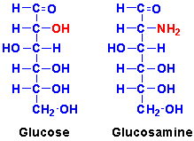
Amino sugars
The OH group of second carbon atom is subtituted with amine group (NH₂) to form amino sugars.
They are usually found as a component of high molecular weight compounds such as chitin of crustaceans and mollusks as well as in certain mushrooms.
FDE 101-BCFE
23.10.2018

Slide 20
Glycosides
The hydrogen atom of an anomeric hydroxy group is replaced by an alkyl or aryl groups (C_{n}H_{2n+1}).
FDE 101-BCFE
23.10.2018

Slide 21
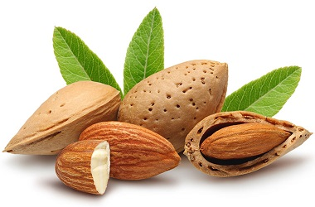
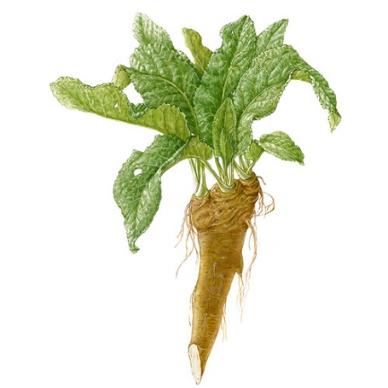
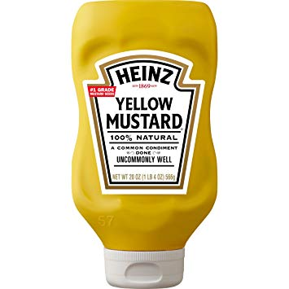
Glycosides
Amygladin is responsible for the bitter taste
Hesperidin and naringin are glycosides, which are found in citrus rind.
Sinigrin is a glycosides of mustard and horseradish.
FDE 101-BCFE
23.10.2018

Slide 22
Deoxy sugars constitute part of nucleotides (e.g. 2-deoxyribose occur as components of deoxyribonucleic acid)
Sugar alcohols are naturally found in foods or produced industrially as a food ingredients.
They are sweet as sugars.
They are slowly absorbed; therefore, they are used sweeteners in diabetic foods.
Sorbitol, mannitol, and xylitol are fruquently used sugar alcohols in food.
Anhydro sugars (e.g. alginate and agar) are present at the structure of seaweed polysaccharides.
FDE 101-BCFE
23.10.2018

Slide 23
References
deMan, J.M. (1999) Principles of food chemistry. (3rd ed.) Pages 163-183. An aspen publication, Maryland, USA.
Brown, A. (2008) Understanding food principles and preparation. (3rd ed.) Pages 31-37. Thomson Wadsworth, California, USA.
Chapter carbohydrates in book “Introduction to chemistry: General, Organic and Biological”. https://2012books.lardbucket.org/pdfs/introduction-to-chemistry-general-organic-and-biological/s19-carbohydrates.pdf
FDE 101-BCFE
23.10.2018

