Slide 1
Food processing operations
In the food industry, various operations are used to produce high quality and safety food products and extend their shelf life.
These operations can be grouped into different categories according to their usage principles or purposes.
These operations are also called unit operations.

Slide 2
Classification of unit operations
Unit operations, which are commonly used in the food industry from farm to fork, are classified into one of six groups as follow:
Ambient temperature processing
Heat processing using steam, hot water or oil
Processing using hot air or heated surfaces
Processing by direct and radiated energy
Processing by removal of heat
Post processing operations

Slide 3
Unit operations in food industry
Ambient temperature processing
Raw material preparation
Size reduction
Mixing, forming, and coating
Heat process using steam, hot water or oil
Blanching
Industrial cooking
Pasteurization
Separation process
Heat Sterilization
Evaporation and distillation
Processing using hot air or heated surfaces
Dehydration
Smoking
Baking and roasting
Extrusion cooking
Frying

Slide 4
Unit operations in food industry
Processing by direct and radiated energy
Dielectric heating
Processing by removal of heat
Refrigeration
Chilling
Freezing
Freeze drying and freeze concentration
Infrared heating
Ohmic heating
Post processing operations
Packaging
Filling and sealing of containers
Materials handling, storage and distribution

Slide 5
AMBIENT TEMPERATURE PROCESSING

Slide 6
Ambient temperature processing
Processing, which are performed at ambient temperatures, are explained under four main titles.
Raw material preparation
Size reduction
Mixing, forming, and coating
Separation process

Slide 7
RAW MATERIAL PREPARATION

Slide 8
Raw material preparation
Preparation of raw materials is one of the important steps for food production to produce high quality products or to offer for sale in the fresh market sector
In order to achieve this goal, application of one or more of unit operations, which are cooling, cleaning, sorting, grading or peeling, is neccessary

Slide 9
Cleaning of foods
Cleaning removes contaminating materials such as soil, stones, bone, metal fragments, microorganisms, fertilizers, pesticide etc…
Cleaning is one of the significant steps of food processing since it prevents spread of these contaminants to uncontaminated pieces and reduces the risk of spoilage and loss of food.
Cleaning is applied in two different ways:
Wet cleaning
Dry cleaning

Slide 10
Sorting and grading of foods
SORTING
GRADING
Sorting means the separation of foods according to their measurable physical properties such as size, shape, weight, color
Grading is the assessment of overall food quality using a number of attributes such as fat distribution for beef, roasting degree for coffee, aroma and flavor intensity for cheese

Slide 11
SIZE REDUCTION

Slide 12
Size reduction
Size reduction is applied to all food process in which the food is needed to cut or broken down into smaller pieces
The main benefits of size reduction are
an increased surface area which enhance the rate of heat or mass transfer
reduced particle size facilitate the mixing of ingredients

Slide 13
MIXING, FORMING AND COATING

Slide 14
Mixing, forming and coating
Mixing operation is required whenever an ingredient is added to a food
The main purpose of the mixing is obtain a homogenous final mixture by using two or more solid, liquid or gas components
Addition of water into corn syrup (liquid to liquid)
Addition of sugar into flour (solid to solid)
Addition of sugar into fruit juice (solid to liquid)
Diffusion of air into ice cream dough during ice cream making (gas to liquid)

Slide 15
Calculation of uniformity of mixing and required mixing time
: standard deviation
n : number of samples
c : concentration of the component in each sample
: the mean concentration of samples
: Standard deviation of a perfectly mixed sample
: Standard deviation of a sample at the start of mixing
: Standard deviation of a sample taken during mixing

Slide 16
Problem

Slide 17
Agitation of liquid materials
Agitation is used for liquid foods. For example
to blend one liquid into another miscible liquid
to disperse gas in a liquid
to disperse one liquid into another immiscible liquid
Access link https://www.youtube.com/watch?v=23X1eB5KryQ
Liquid agitator

Slide 18
Froude number
Froude number is a dimensionless number, which is ratio of the inertial force to gravitational force
If the vessel has blades, the role of the Froude number is negligible
If the vessel has no blade, we have to take into consider the role of the Froude number
N: Rotational speed (revolution/s)
Di: Diameter of the impeller (m)
μ: Viscosity of the liquid (kg/ms)
: Accelaration due to gravity (m/s²)

Slide 19
The curve drawn to find Np

Slide 20
Problem
A concentrated fruit juice with a viscosity of 0.03 kg/ms and a density of 1100 kg/m³ is being agitated in an agitation system containing a turbine impeller. The impeller has a disk with six blades. The tank diameter is 1.8 m. The height of the liquid in the tank is the same as the tank diameter. The impeller diameter is 0.5 m. The width of the blade is 0.1 m. The tank is equipped with four baffles, each with a width of 0.15 m. If the turbine is operated at 100 rpm, determine the required power.

Slide 21
SEPARATION PROCESSES

Slide 22
Separation process
This operation is designed for the separation or physical removal of food components
Centrifugation
Filtration
Extraction using solvents
Expression (pressing)
Membrane separation
Main separation processes

Slide 23
CENTRIFUGATION

Slide 24
Centrifugation
Two main applications of centrifugation used in the food industry are separation of immiscible liquids and separation of solids from liquids
The separation factor is centrifugal force, which is generated when materials are rotated.
The size of the force depends on the radius, speed of rotation and the density of the centrifuged materials.

Slide 25
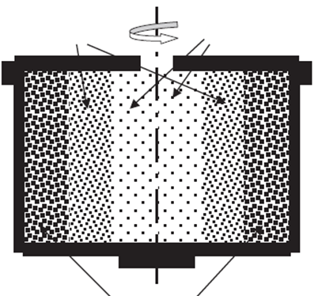
Working principles of centrifugation
Medium phase
Light phase
Centrifugal force acts outwards from the centre
Acceleration force acts towards the centre of the cycle
Heavy phase
When a material (milk) is exposed to centrifugation, the heavier phase (water in milk) moves to the wall of the centrifuge and the lighter phase (fat in milk) is displaced to an inner annulus of the centrifuge as a result of the effect of these forces

Slide 26
Animation for centrifugation
Access link : https://www.youtube.com/watch?v=sDhueH3q6Y4

Slide 27
Basic equations related with centrifugation
The centrifugal force is calculated by using this formula
Fc: centrifugal force
m: mass of the particle (kg)
r: radial distance to the centre of rotation (radius) (m)
ω: angular velocity of the particle (rad/s )
: acceleration due to gravity (9.81 m/s² )

Slide 28
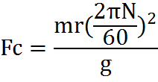
Calculation for centrifugal force
Centrifuge speeds are normally expressed as in revolution per minute (rpm)
N: revolution per minute

Slide 29
Calculation for the rate of seperation
The rate of separation as expressed by velocity is calculated by formula given below
This formula is used to calculate the separation rate between two phases (solid in liquid) with different densities

Slide 30
Calculation for the rate of seperation
D: Particle diameter (m)
N: Rotation speed (rpm)
r: Radius (m)
ρ_{p}: Density of the continous phase (kg/m³)
ρ_{s} : Density of the dispersed phase (kg/m³)
μ: Viscosity of the continous phase (kg/ms)
Velocity for separation (m/s)

Slide 31
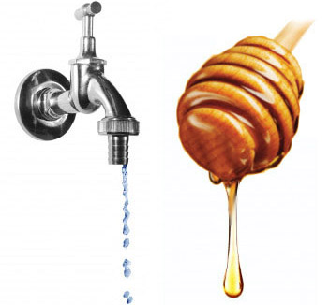
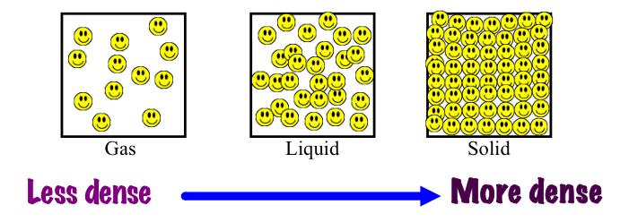
What is density and viscosity
Viscosity is defined as resistance to flow of a liquid
Water vs. honey
Density is the amount of material mass in a given volume

Slide 32
Problems
Beef is clarified from the unwanted compounds by using centrifugate operation at 2600 rpm, with a radius of 15 cm. Calculate the centrifugal force for this operation.

Slide 33
Problems
The solid particles in a liquid-solid suspension are to be separated by centrifugal force. The particles are 100 microns in diameter with a density of 800 kg/m³. The liquid is water with a density of 993 kg/m³, and the effective radius separation is 7.5 cm. If the required velocity for separation is 0.03 m/s, determine the rotation speed for the centrifuge.

Slide 34
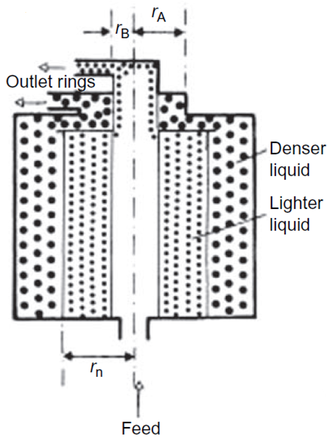
Liquid-liquid separation
r_{A}: radius for the heavy phase outlet
r_{B}: radius for the light phase outlet
r_{n}: radius for inlet (feeding)

Slide 35
Calculation of inlet radius
The formula given below is used to determine the position/radius of feed and discharge pipes and to design of the separation cylinder for liquid-liquid systems
ρ_{A}: Density of the heavier phasee
ρ_{B} : Density of the lighter phase
r_{A}/r₁: radius for the heavy phase outlet
r_{b}/r₁: radius for the light phase outlet
r_{n}: radius for the inlet

Slide 36
Problems
Cream is separated from the whole milk by using centrifugation. The density for the skim milk is 1025 kg/m³ and it has a 5 cm outlet radius. Radius of cream outlet is 2.5 cm and the density for cream is 865 kg/m³. Design the separation cylinder and suggest a required radius for the feeding (inlet).

Slide 37
FILTRATION

Slide 38
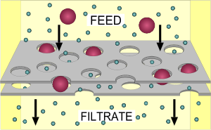
Filtration
Filtration is the removal of insoluble solids from a liquids by passing it through a porous material
Filtration is used to clarify wine, beer, juices, oils and syrups in the food industry
Filter medium

Slide 39
Formation of filter cake
The solids removed from the liquid accumulate in the filter medium, which is called filter cake.
The formation of filter cake and its thickness affect the filtration rate as shown in the figure
A significant decrease in the rate of filtration process

Slide 40
Factors that affect the filtration rate
The factors, which affect the filtration rate, are listed below
The presence and thickness of filter cake (the resistance of the filter cake)
The pressure drop across the filter medium
The area of the filtering surface
The viscosity of the filtrate
The resistance of the filter medium

Slide 41
Calculation of filtration rate
The rate of filtration can be described as the ratio of driving force (the pressure required to move the fluid through the filter medium) to resistance
The mathematical equation to calculate rate of filtration is given below
Volumetric flow rate (m³/s)

Slide 42
Filtration process
The filtration process may occur in two phases
Constant-rate filtration, which is normally occur during the early stages of the process
Constant-pressure filtration, which is occur during the final stages of the process

Slide 43
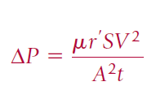
Constant-rate filtration
Constant-rate filtration is shown by the formula given below, which is used to determine the required pressure drop as a function of the filtration rate
If the thickness of the filter medium (L) is negligible, the equation is corrected
Reorganize the formula

Slide 44
Constant-rate filtration
The equation given below is used to predict pressure drop requirements for a filter during the early stages of the process
∆P: Pressure drop requirements (Pa)
µ: Viscosity of the fluid (kg/ms)
r’: The spesific resistance of the filter cake
S: Solid content of the fluid
A: Cross-sectional area of the filter (m²)
V: Volume (m³)
t: The filtration time (s)

Slide 45
Problem
An air filter is used to remove small particles from an air supply to a quality control laboratory. The air (0°C) is supplied at a rate of 0.5 m³/s through an air filter with a 0.5 m² cross-sectional area. If the pressure drop across the filter is 0.25 cm water after one hour of use, determine the life of the filter if a filter change is required when the pressure drop is 2.5 cm of water.
Assumption: Due to the nature of air filtration, constant-rate filtration can be assumed and the filter medium thickness is negligible.
Use the table (A.4.4) given at next slide to find the viscosity of the air.

Slide 47
Constant-pressure filtration
The equation used to define the constant-pressure filtration is given below
∆P: Pressure drop requirements (Pa)
µ: Viscosity of the fluid (kg/ms)
r’: The spesific resistance of the filter cake
S: Solid content of the fluid
A: Cross-sectional area of the filter (m²)
V: Volume (m³)
t: The filtration time (s)
If the medium thickness (L) is negligible, the equation is corrected

Slide 48
Problem
The liquid is filtered at a pressure of 200 kPa through a 0.2 m² filter. Initial results indicate that 5 min is required to filter 0.3 m³ of liquid. Determine the time that will elapse until the rate of filtration drops to 5x10⁻⁵ m³/s.
Assumption: Due to information given in the question, filtration is assumed to be constant-pressure condition and the filter medium thickness (L) is negligible.

Slide 49
Main factors affecting the filtration process
The rate of filtration is directly dependent on two main factors: filter medium and fluid being filtered
Formula for the calculation of filtration rate
Filter medium is described in terms of filtration area and the spesific resistance of filter medium.
When the area increases, the filtration rate increases.
When the resistance against to filtration increases as a result of filter cake formation, the filtration rate decreases.
Fluid being filtered as described by the viscosity of the fluid. The filtration rate and the fluid viscosity are inversely related.
As the viscosity of the fluid increases, the filtration rate decreases.

Slide 50
Design of a filtration system
The usage of equations given for constant-rate and constant-pressure filtration systems requires knowlegde of several parameters. However, in most cases, viscosity and spesific resistance values may not be known. Additionally, filter medium thickness (L) is not assumed to be negligible.
A small or pilot-scale operation in the food industry results in determination of filtration rate after given periods of time at a constant-pressure on the small scale filter.

Slide 51
Design of a filtration system
We can use the formula given below to design the filtration system, which is also used to define the constant-pressure filtration systems.

Slide 52
Design of a filtration system (an approach)
If we resemble this equation to another basic equation
b, which is called intercept, is equal to
y is equal to
y = ax + b
a, which is called slope, is equal to
x is equal to

Slide 53
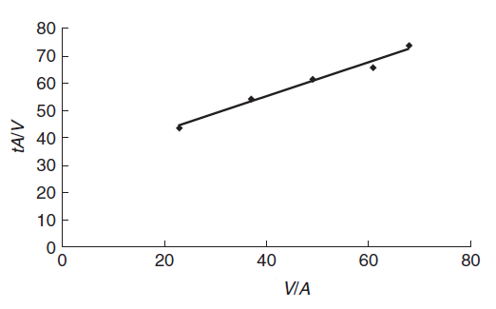
Design of a filtration system (an approach)
If we draw a filtration graph by using the information given in the slide, which is the previous one,
Y AXIS
y = ax + b
X AXIS

Slide 54
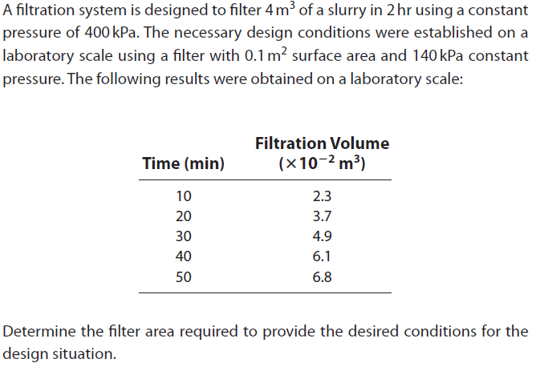
Problem

Slide 55
Problem (cont.)
Desired conditions
Designed conditions
Volume (V): 4 m³
Time (t): 2 hour
Pressure (∆P): 400 kPa
Area (A): 0.1 m²
Pressure (∆P): 140 kPa

Slide 56
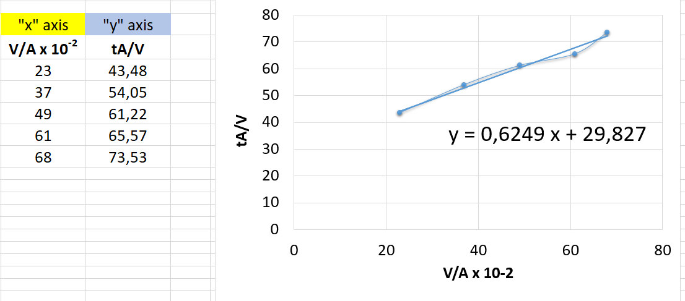
Problem (cont.)
slope
intercept

Slide 57
Problem (cont.)
Desired conditions
Designed conditions
Volume (V): 4 m³
Time (t): 2 hour
Pressure (∆P): 400 kPa
Ouestion:
Filter area ???
Area (A): 0.1 m²
Pressure (∆P): 140 kPa
Slope 0.6249
Intercept 29.827

Slide 58
EXTRACTION USING SOLVENTS
(Solid-liquid extraction)

Slide 59
Extraction using solvents
Solid-liquid extraction is defined as removal of a desired compound, which is called solute, from a food by using a liquid, which is called solvent
Extraction process has many application areas in the food industry such as
Extraction of oil from oilseeds and nuts
Extraction of essential oil and flavor compounds from herbs, spices, fruits and vegetables
Coffee, tea, and decaffeinated coffee and tea

Slide 60
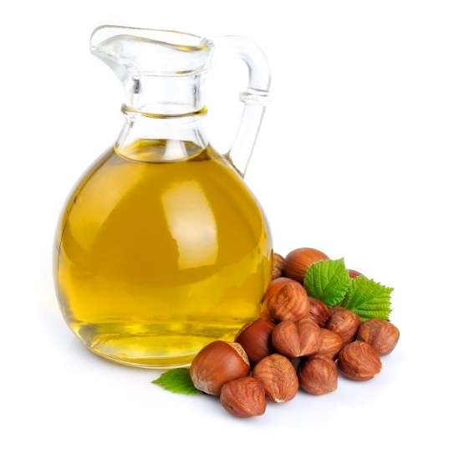
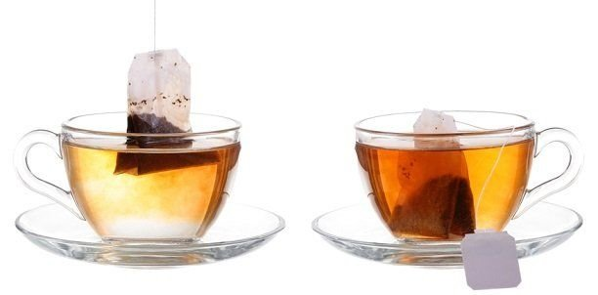
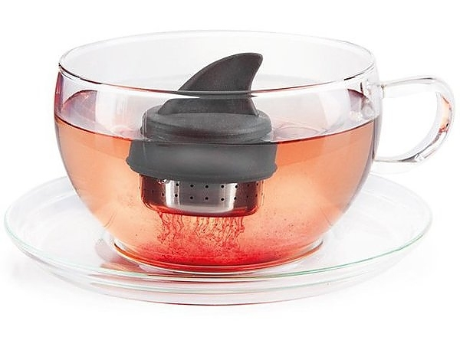
Some examples for the solid-liquid extraction process
Oil extraction from herbs
Oil extraction from nuts
Extraction of flavor and color compounds from tea by using hot water

Slide 61
Theory of the solid-liquid extraction
The solid-liquid extraction involves mixing the food and solvent together, holding for a time and then separating the solvent
During the holding period of time, the mass transfer of solid compounds occur in three stages:
The solvent enters into the food and dissolve the targeted solute
The solute trapped in the solvent moves through the surface of the food
The solute becomes dispersed in the bulk of the solvent

Slide 62
Extraction using solvents Access link: https://www.youtube.com/watch?v=cF4_RRNIGAc

Slide 63
Factors affecting the extraction process
1. The solubility properties of a solid compound in the solvent
2. The temperature of the extraction: Higher temperatures cause extraction of undesirable compounds and heat damage; although, it increases the rate of extraction
3. The surface area of the solid: Large surface increases the extraction rate
4. Viscosity of the solvent: As the viscosity decreases, the rate of extraction increases due to easily penetration ability of less viscosious solvents
5. Flowrate of solvent: As the flowrate increases, the rate of extraction increases

Slide 64
Extraction using solvents
Common types of solvents used for extraction process are water, organic solvents, and supercritical fluids
Water is the most convenient, cost-effective, and environmentally friendly solvent. It is widely used for the production of sugar, coffee, and tea
Oils and fats are needed organic solvents (such as acetone, butane, ethanol, hexane, methanol etc.) for extraction since they are water-insoluble
Among supercritical fluids, supercritical CO₂ is generally used for the extraction process

Slide 65
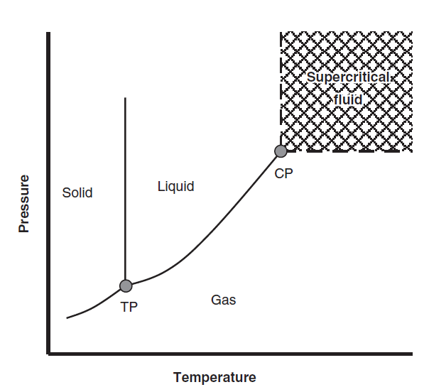
Supercritical CO₂
These fluids has different physical properties from liquids and gases
Supercritical CO₂ acts is a liquid but it difuses like a gas
It has low viscosity
It needs low temperature for extraction
It is effectively used in the extraction process due to the advantages of these properties
31.06°C

Slide 66
References
Singh, R.P. and Heldman D.R. (2009) Introduction to food engineering. Chapter 13: Supplemental processes. Pages 689-720. (4th ed.) Academic Press, California, USA (In the library of our department)
Fellows, P.J. (2017). Food processing technology principles and practice. Part II Ambient Temperature Processing. Pages 201-386. (4th ed.) Woodhead Publishing, Duxford, United Kingdom
Campbell-Platt, G. (2009). Food Science and Technology. Chapter 9: Food processing, Unit operations. Pages 219-234. Blackwell Publishing (In the library of our department)

