Slide 1
Reference Systems
Altug Yalcintas
Ankara University (faculty member) and TED University (visiting lecturer)
altug.yalcintas@politics.ankara.edu.tr

Slide 2
Important dates – reminder
First versions of research proposals: 28 July 2019, 23:59 hours*
Final versions of research proposals: 11 August 2019, 23:59 hours*
* Submit assignments on Turnitin (links will be provided)
Final exam: 21 August 2019, 12:00 hours (sit-in exam)
Make-up courses: 22 July and 29 July, 13:00-15:00 hours (G103)

Slide 3
Plan of this session
…
Why do authors cite articles / books?
How do authors cite articles / books and prepare lists of references?
How do authors use footnotes?
…
Applications: referencing in MS Word + EndNote X7
Keep yourselves updated about referencing systems!!!

Slide 5
A sample from the manuscripts of Karl Marx
Source: International Institute of Social History, Amsterdam

Slide 7
James Joyce, Finnegans Wake
Source: http://www.openculture.com/2018/06/james-joyces-crayon-covered-manuscript-pages-ulysses-finnegans-wake.html [Accessed July 2019]

Slide 8
Stages of research
1. Taking notes
2. Preparing manuscripts
3. Reading, re-writing, re-reading, rere-writing, rererere-reading, …
…
n. Publishing manuscripts
* Publication (yayım, neşriyat): making a manuscript or speech pub-lic

Slide 9
Stages of research
1. Taking notes
2. Preparing manuscripts
...
…
n. Publishing manuscripts
* Publication (yayım, neşriyat): making a manuscript or speech pub-lic
Nesir: düz yazı, prose
Neşr: yayma, disseminate

Slide 10
What do we publish?
Assignments
Theses (masters’ & PhD)
Research reports
(TÜBİTAK, EU etc.)
Working papers (NBER)
Conference presentations
Lecture notes
Popular science articles
Newspaper OpEds/articles
Social media messages
Blogs and vlogs
Academic journal articles
Book sections
Books
...
Unpublished materials (mimeo)

Slide 11
Where do we conduct research? (1/2)
Universities
TED University
Ankara University
Chicago University
Associations
American Economic Association
History of Economic Society
Türkiye Ekonomi Kurumu (Turkish Economic Association)
Türk Sosyal Bilimler Derneği (Turkish Social Sciences Association)

Slide 12
Where do we conduct research? (2/2)
National and international networks of research
International Network for Economic Methodology (INEM)
İktisadi Düşünce Girişimi
Skoda-Auto University (Czechia)
MOOCs (Massive Online Open Courses)

Slide 13
Massive Online Open Sources
Training by virtue of radio and TV broadcasts (“Açık öğretim”)
…
http://online.stanford.edu/
https://www.futurelearn.com/
https://www.coursera.org/
https://www.udacity.com/
https://www.edx.org/
…

Slide 14
author → authority

Slide 15
Mass-authorship: 3 sayfa uzunluğundaki bu makale 185 yazar tarafından yazılmıştır.

Slide 16
Contributions and acknowledgements
Contributors: your discussant, editors, referees
Do not list your contributors as authors.
But acknowledge them!
This is how: “Ahmet1, Ahmet2, Ayşe1, and Ayşe2 read the earlier versions of the article. Prof. İ. Terol provided detailed remarks. I am grateful for their contributions. I would also like to thank the editors and three anonymous referees for useful comments. The remaining errors are mine.”

Slide 17
(One of) The Shortest Paper(s)

Slide 18
Honorary authorship and ghost authorship
Honorary authorship: Listing name(s) of an individual(s) as an author(s) although they make no significant contribution to the work.
Ghost authorship: Omitting name(s) of an individual(s) as an author(s) although they make significant contribution to the work
Avoid inappropriate authorship!
Do NOT pay your peers to draft a paper on your behalf
Do NOT buy assignments online

Slide 24
Why do authors cite articles / books?
Demonstrate that the sources used are relevant and reliable
Make explicit the tradition that authors are members of
Let the readers know about further readings / watchings / listenings
Issues related to copyrights and “moral rights”

Slide 25
How do authors cite articles / books and prepare lists of references?
1. Within main text

Slide 26
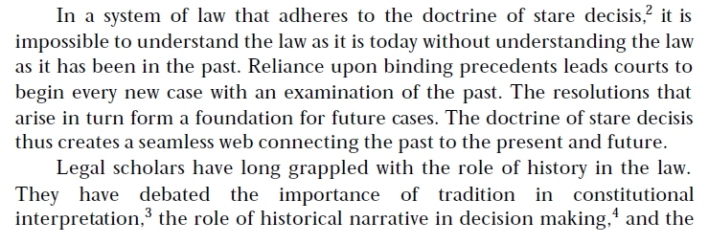
How do authors cite articles / books and prepare lists of references?
2. In footnotes

Slide 27
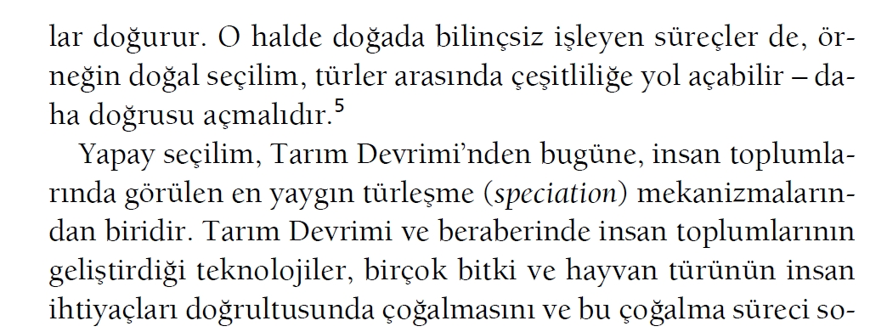
How do authors cite articles / books and prepare lists of references?
3. Hybrid

Slide 28
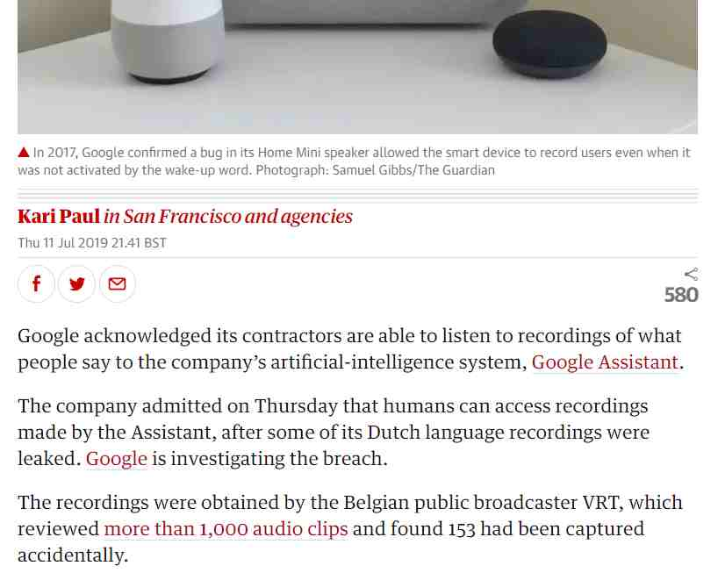
How do authors cite articles / books and prepare lists of references?
4. Hyperlinks
Source: Kari Paul. “Google Workers Can Listen to What People Say to Its AI Home Devices” https://www.theguardian.com/technology/2019/jul/11/google-home-assistant-listen-recordings-users-privacy [Accessed July 2019]

Slide 29
Which referencing system?
Audience matters!
Who is your intended audience
Classroom mates
Supervisor
Thesis committee
Conference participants
Professional academic journals
Popular science outlets
Familiarize yourselves with institutional specificities!

Slide 30
Referencing – Books
Name of author(s)
Name of book
Date of publication
City or state of publication
Publication house
Page number
Others: ISBN, name of translator, edition, name of series…

Slide 31
Referencing – Journal articles
Name of author(s)
Name of article
Date of publication
Name of journal
Volume and issue
Page number
Others: DOI, name of translator, edition, name of series…

Slide 32
Referencing – Internet sources
Name of author(s)
Name of article / blog post / social media message
Date of publication
Name of website and URL
Access date
Page number
Others: DOI, name of translator, edition, name of series…

Slide 33
Referencing – Other sources
Dictionaries & thesauruses
Conference presentations
Unpublished manuscripts (such as lecture notes)
…

Slide 34
Common styles
Chicago 16. Edisyon:
Yalcintas, Altug. 2013. "The Problem of Epistemic Cost: Why Do Economists Not Change Their Minds (About the 'Coase Theorem')?" American Journal of Economics and Sociology no. 72 (5): 1131-1157.

Slide 35
Common styles
Harvard:
YALCINTAS, A. 2013. The Problem of Epistemic Cost: Why Do Economists Not Change Their Minds (About the 'Coase Theorem')? American Journal of Economics and Sociology, 72, 1131-1157.

Slide 36
Common styles
American Economic Review:
Yalcintas, Altug. 2013. "The Problem of Epistemic Cost: Why Do Economists Not Change Their Minds (About the 'Coase Theorem')?" American Journal of Economics and Sociology, 72(5), 1131-57.

Slide 37
Common styles
Econometrica:
Yalcintas, A. (2013): "The Problem of Epistemic Cost: Why Do Economists Not Change Their Minds (About the 'Coase Theorem')?," American Journal of Economics and Sociology, 72, 1131-1157.

Slide 38
Common styles
Harvard, Chicago, APA, American Economic Association
You are free to pick a style as long as you are consistent throughout the manuscript
Read the regulations at your institution and decide accordingly
Consult your professor
Professional authors: Decide according to the journal

Slide 39
How do authors use footnotes?
Application: MS Word*
Difficulties with giving footnotes in mechanical typewriters

Slide 40
EndNote X7

