Slide 1
4 Drug biotransformation

Slide 2
Phase I (oxidization, reduction, hydrolysis)
Phase II (conjugation)

Slide 3
Lippincott Illustrated Reviews, Pharmacology, 6th edition

Slide 4
Pro-drug
To increase absorbtion
To slow absorbtion on the tissue
To mask undesired characteristics of the drug

Slide 5
Toxicity via biotransformation
Codein morphine
Methyl alcohol formaldehid formic acide
Paracetamol N acetil p benzokinonimin

Slide 6
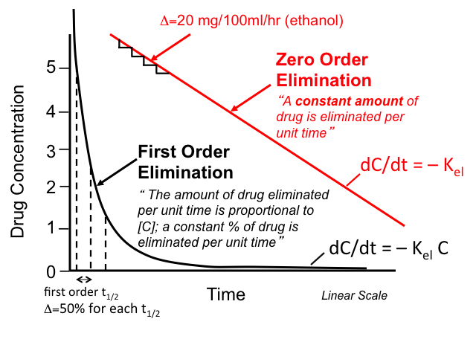
http://tmedweb.tulane.edu/pharmwiki/lib/exe/fetch.php/pk.png

Slide 7
Oxidation-Reduction
NAPDH cytochrome p450 oxidoreductase (POR)
Cytochrome p450 enzymes (CYP)
Microsomal drug oxidation requires p450, p450 reductase, NADPH, molecular oxygen

Slide 8
Lippincott Illustrated Reviews, Pharmacology, 6th edition

Slide 9
Human liver p450 enzymes
The most important forms:
CYP1A2
CYP2A6
CYP2B6
CYP2C9
CYP2D6
CYP2E1
CYP3A4 (responsible for the metabolism of over %50 of the prescribed drugs)

Slide 10
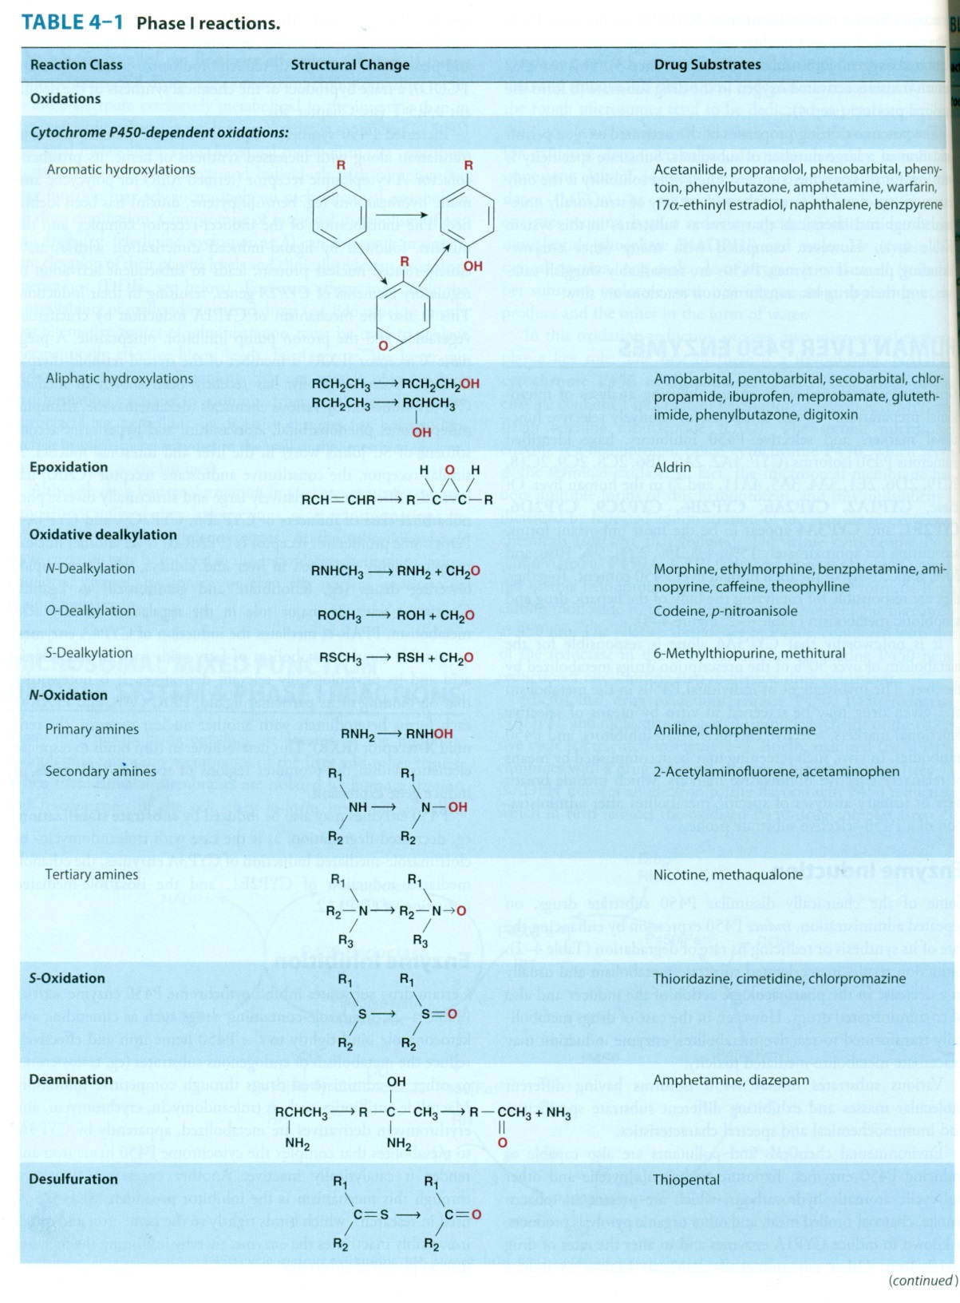
Katzung&Trevor Basic and Clinical Pharmacology, 13th edition

Slide 11
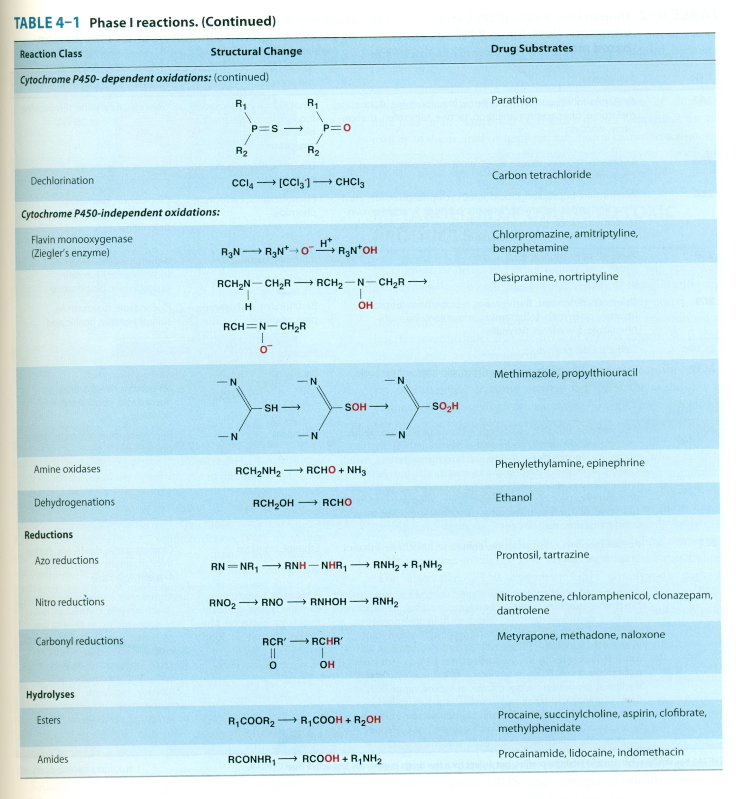
Katzung&Trevor Basic and Clinical Pharmacology, 13th edition

Slide 12
Lippincott Illustrated Reviews, Pharmacology, 6th edition

Slide 13
Enzyme Induction
Induction results in accelerated substrate metabolism and usually in a decrease in the pharmacological action of the inducer and also of co-administered drugs
Environmental chemicals and pollutants also induce p450 enzymes (ie. Tobacco induce CYP1A enzymes)

Slide 14
Enzyme Inhibition
Reduces the metabolism of the drug, results increased pharmacological effect
Cimetidine, ketokonazole, erythromycin

Slide 15
Enterohepatic cycle
Chloramphenicol
Chloropramazine
Digitoxin
Steroids

Slide 16
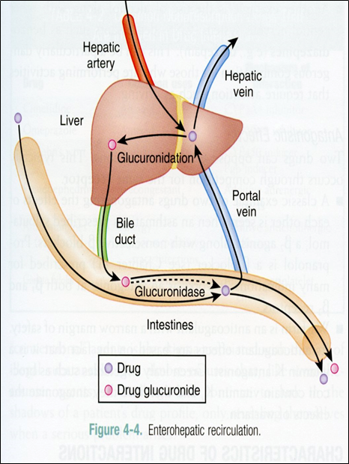
https://www.memorangapp.com/flashcards/190724/First+pass+metabolism+and+enter+and+more/

Slide 17
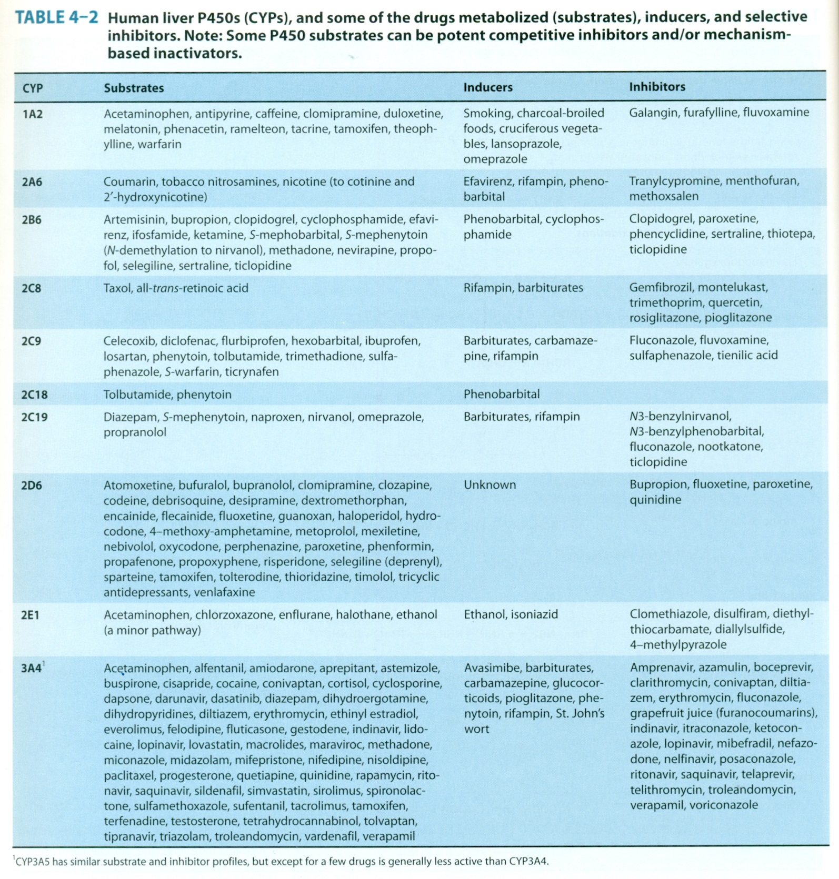
Katzung&Trevor Basic and Clinical Pharmacology, 13th edition

Slide 18
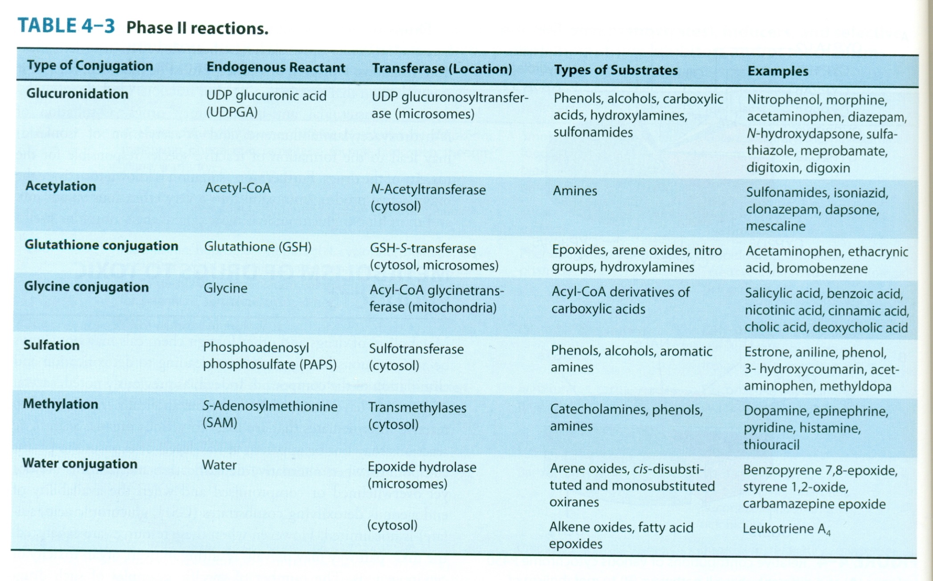
Katzung&Trevor Basic and Clinical Pharmacology, 13th edition

Slide 19
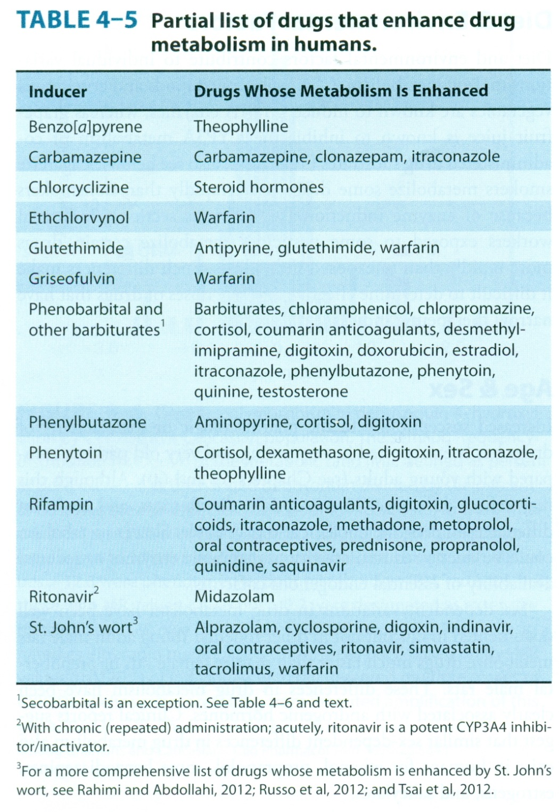
Katzung&Trevor Basic and Clinical Pharmacology, 13th edition

Slide 20
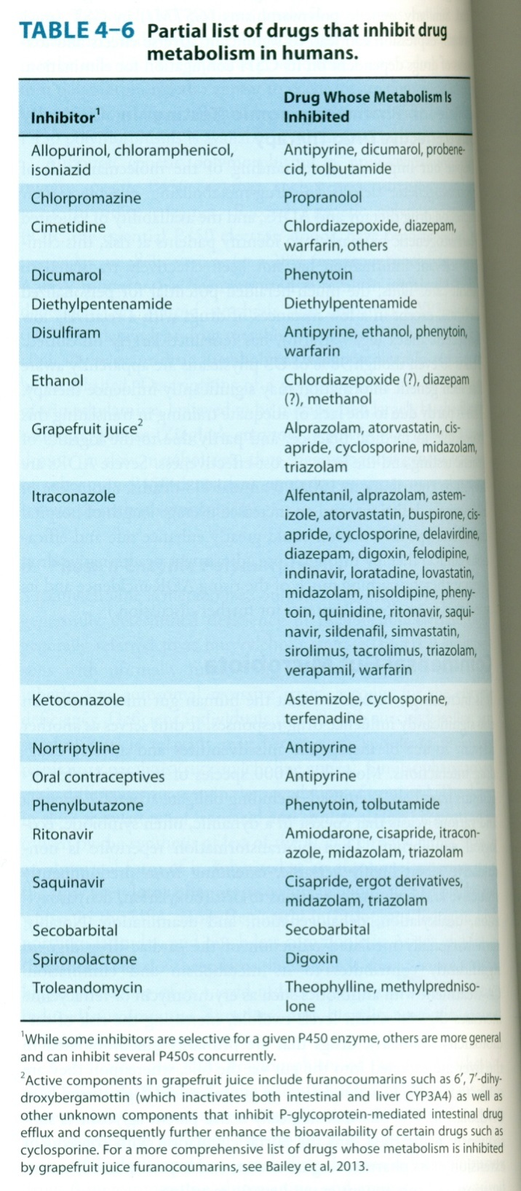
Katzung&Trevor Basic and Clinical Pharmacology, 13th edition

Slide 21
Phase II reactions
Conjugation reactions
Conjugates are polar molecules, readily excreted and often inactive
UGTs
SULTs
PAPS
GSH
GSTs
NATs

Slide 22
Metabolism to toxic compounds
Acetaminophen, when dosage exceeds therapeutic range , glucuronidation and sulfation pathways are saturated, hepatotoxicity

Slide 23
Clinical relevance of drug metabolism
Individuals differences, metabolic rate could differ, so plasma levels of drugs differ
Genetic factors (genetic polymorphism)
Commensal gut microbiota (digoxin-erytromycin, cardiotoxicity)
Diet and enviromental factors, charcoal broiled foods and cruciferous vegetables induce CYP1A, grapefruit juice inhibit CYP3A
Age and sex (ethanol, propranolol, benzodiazepines, salicylates, sex difference)

Slide 24
Elimination

Slide 25
Clearance
CL=rate of elimination/C
CL, clearance
C, drug concentration
For most drugs, clearance is constant over the concentration range encountered in clinical settings, elimination is not saturable, the rate of drug elimination is directly proportional to concentration
CL=rate of infusion/Css (steady state drug concentration)

Slide 26
Steady state concentration
Should be higher than min. efficient concentration
Should not reach to toxic concentration
Fluctuation may be a problem for the drugs with narrow therapeutic index
A drug readhs to steady state concentration in plasma after a duration of 4 X t1/2

Slide 27
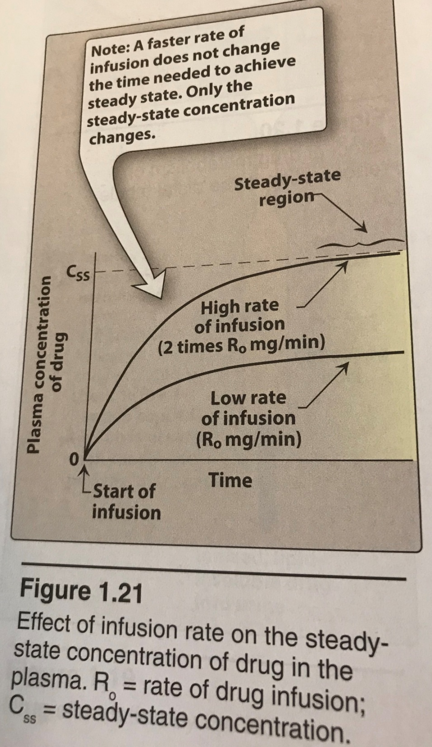
Lippincott Illustrated Reviews, Pharmacology, 6th edition

Slide 28
Lippincott Illustrated Reviews, Pharmacology, 6th edition

Slide 29
Lippincott Illustrated Reviews, Pharmacology, 6th edition

Slide 30
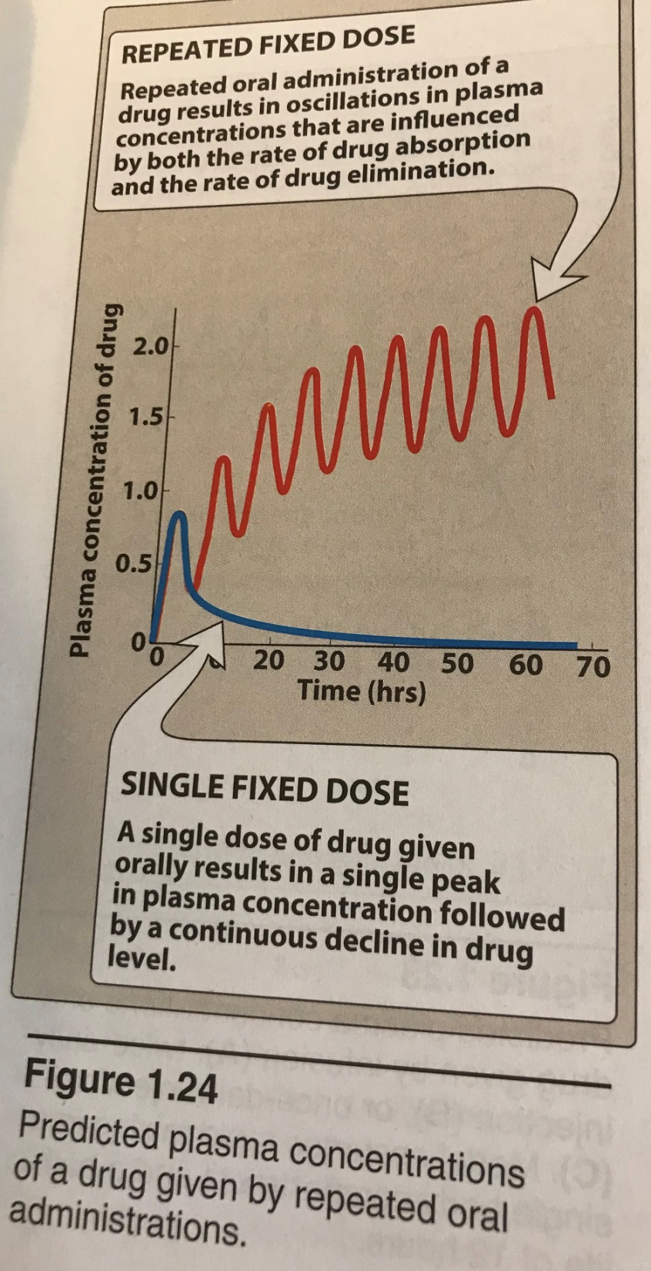
Lippincott Illustrated Reviews, Pharmacology, 6th edition

Slide 31
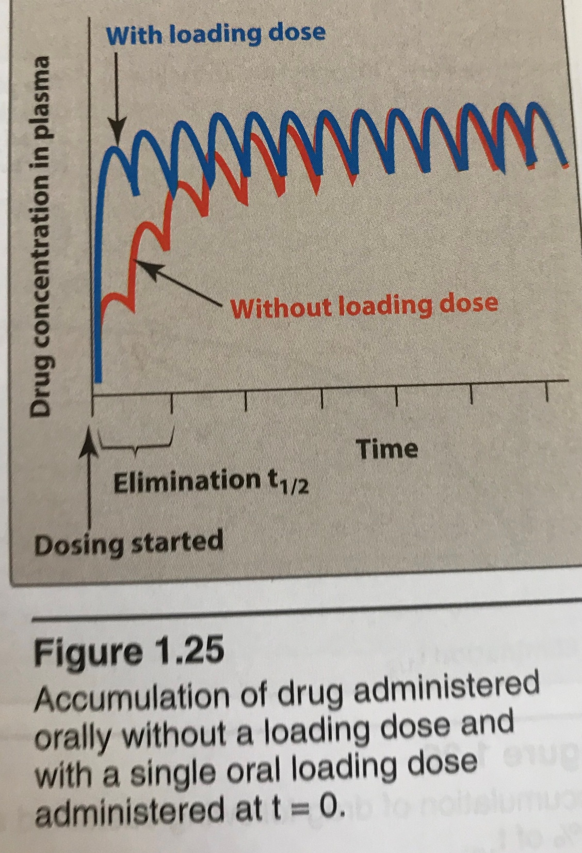
Lippincott Illustrated Reviews, Pharmacology, 6th edition

Slide 32
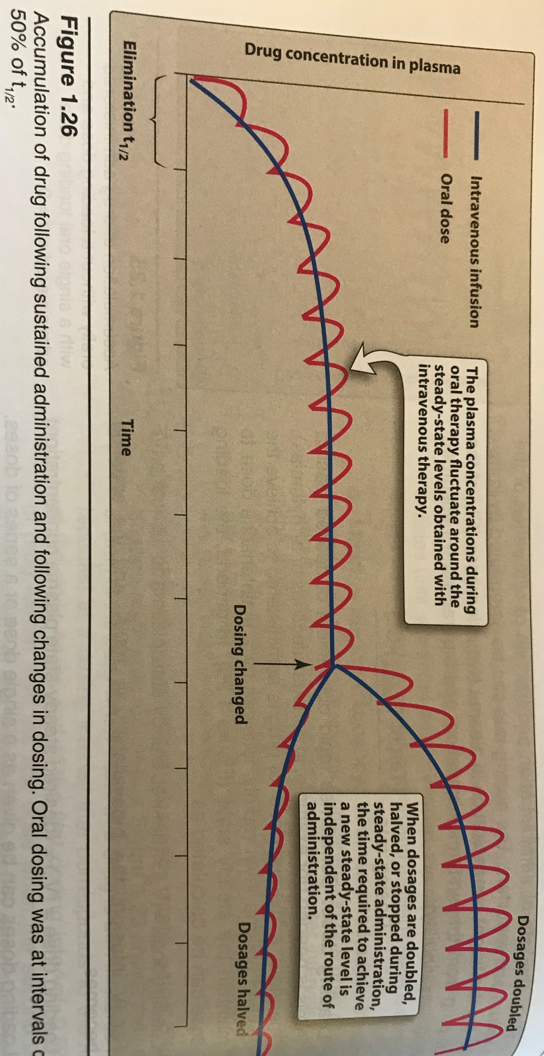
Lippincott Illustrated Reviews, Pharmacology, 6th edition

Slide 33
Binding to plasma proteins and tubular reabsorbtion affect renal clearance
Elimination half life and clearance, inverse correlation
If Vd is high, or CL is low, then the duration of the drug in the body is longer
If two drugs have the same CL, then the one with higher Vd stays more in the body
A drug with high Vd and CL has probably a slow elimination rate

Slide 34
Capacity limited elimination
Mixed order, saturable, dose/concentration dependent, nonlinear, Michaelis-Menten elimination
When blood flow to an organ does not limit elimination:
Rate of elimination=V_{max}x C/K_{m}+C
V_{max}, maximum elimination capacity
K_{m}, drug concentration at which the rate of elimination is %50 of V_{max}

Slide 35
Ethanol
Phenytoin
Aspirin
These drugs have capacity limited elimination, the concentration will rise if dosing continues
AUC should not be used to calculate clearance of these drugs

Slide 36
Flow dependent elimination
Elimination depends primarily on the rate of drug delivery to the organ of elimination
Drugs with high extraction
Blood flow to the organ is main determinant of drug delivery
Propranolol, morphine, nitrates, lidocain

Slide 37
Katzung&Trevor Basic and Clinical Pharmacology, 13th edition

Slide 38
Half life, t_{1/2}
Time required to change the amount of drug in body by one half during elimination
T_{1/2}=(0.7 x V)/CL
It is important because it indicates the time required to attain %50 of steady state

Slide 39
Hepatic Elimination
Drugs with high extraction(=blood flow limited): first pass effect is high, bioavailibility differs between the individuals, higly lipophilic
Propranolol, morphine, nitrates, lidocaine…
Drugs with low extraction
Other

Slide 40
Hepatic clearance
Excretion of drugs or metabolites of drugs from liver to bile depends to;
Chemical structure of the drug
Polarity of the drug
Molecular weight of the drug

Slide 41
Liver diseases affect elimination of the drugs;
Decreased number of hepatocytes
Impaired function of hepatocytes
Impaired liver blood circulation

Slide 42
Renal Elimination
Glomerular filtration
Tubular secretion
Glomerular reabsorbtion

Slide 43
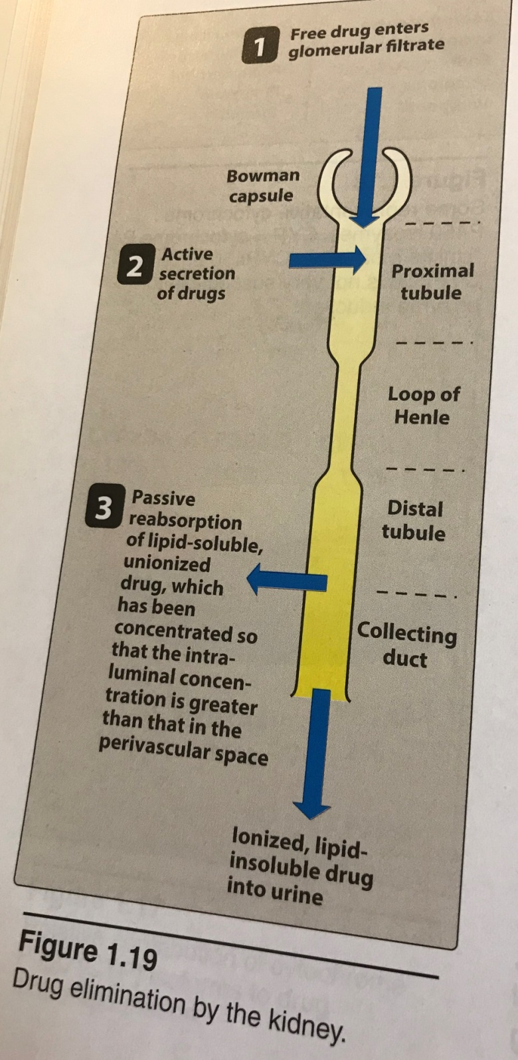
Lippincott Illustrated Reviews, Pharmacology, 6th edition

Slide 44
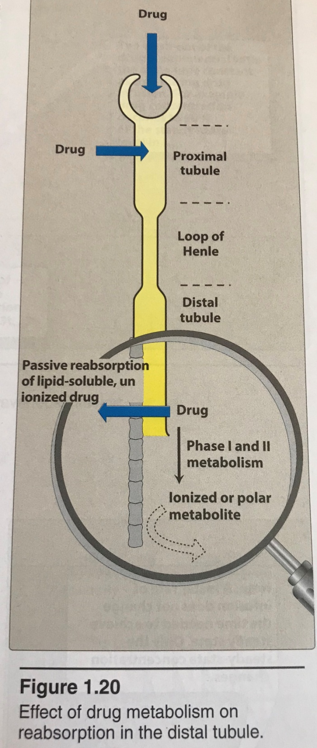
Lippincott Illustrated Reviews, Pharmacology, 6th edition

Slide 45
The rate of glomerular filtration is correlated with glomerular blood flow
Inversely correlated with binding to plasma proteins
Bound drug and huge molecules are not glomerulary filtrated
130 ml/min filtration,190 liter/day, but daily urine output is only 1.5 liter

Slide 46
Tubular secretion;
Occurs in proximal tubules
Acidic drugs with anionic transporter
Basic drugs with cationic transporter
Probenecid-penicillin, anionic t
Probenecid-uric acid, anionic t

Slide 47
Pulmonary Elimination
Gases
Volatile compounds
Passive difusion
Isofluorane, nitrogen protoxide, halothane

Slide 48
Other ways for elimination
Into the breast milk (ethanol, ether …)
Lacrima
Saliva (Li+, iodide, bromide…)

