Slide 1
Plant Nomenclature

Slide 2
What are two basic activities governed by the ICN?

Slide 4
International Botanical Congress

Slide 5
What are the Principles of Plant Nomenclature?

Slide 6
What are the Principles of Plant Nomenclature?

Slide 7
What are the rules vs. regulations of the ICN?

Slide 8
What is a scientific name?

Slide 9
Who first consistently used binomials?

Slide 11
Why common names are disadvantageous?

Slide 12
What is rank?

Slide 13
What are the ranks?

Slide 14
Major Rank Endings:

Slide 15
What is a ternary name?

Slide 16
Authorship?

Slide 17
E.g.,

Slide 19
Herbarium specimen

Slide 20
Types exist for all ranks up to family

Slide 28
What is a basionym?

Slide 29
Basionym

Slide 30
What is an autonym?

Slide 31
Autonyms:

Slide 32
Autonyms:

Slide 33
What are the main criteria of valid publication?

Slide 34
What are the main criteria of valid publication?

Slide 35
What are the main criteria of valid publication?

Slide 36
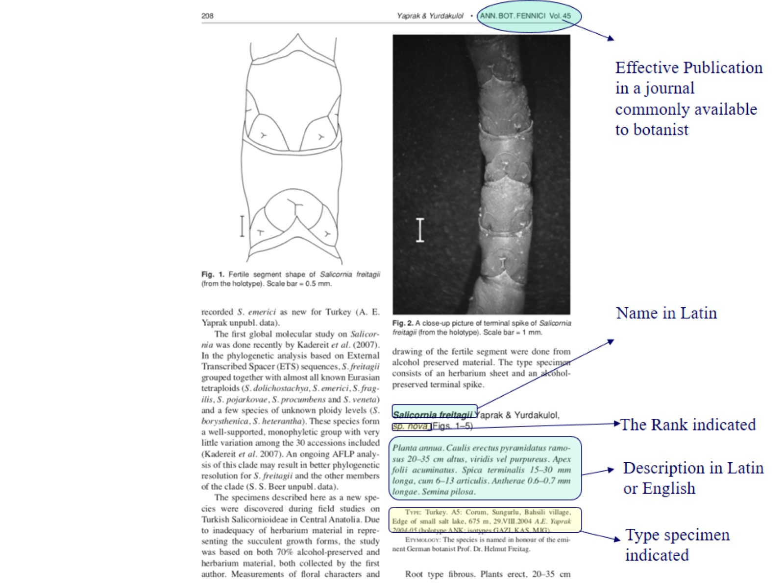

Slide 37
What is a synonym?

Slide 38
Two types of synonyms:

Slide 39
What is a correct name?

Slide 40
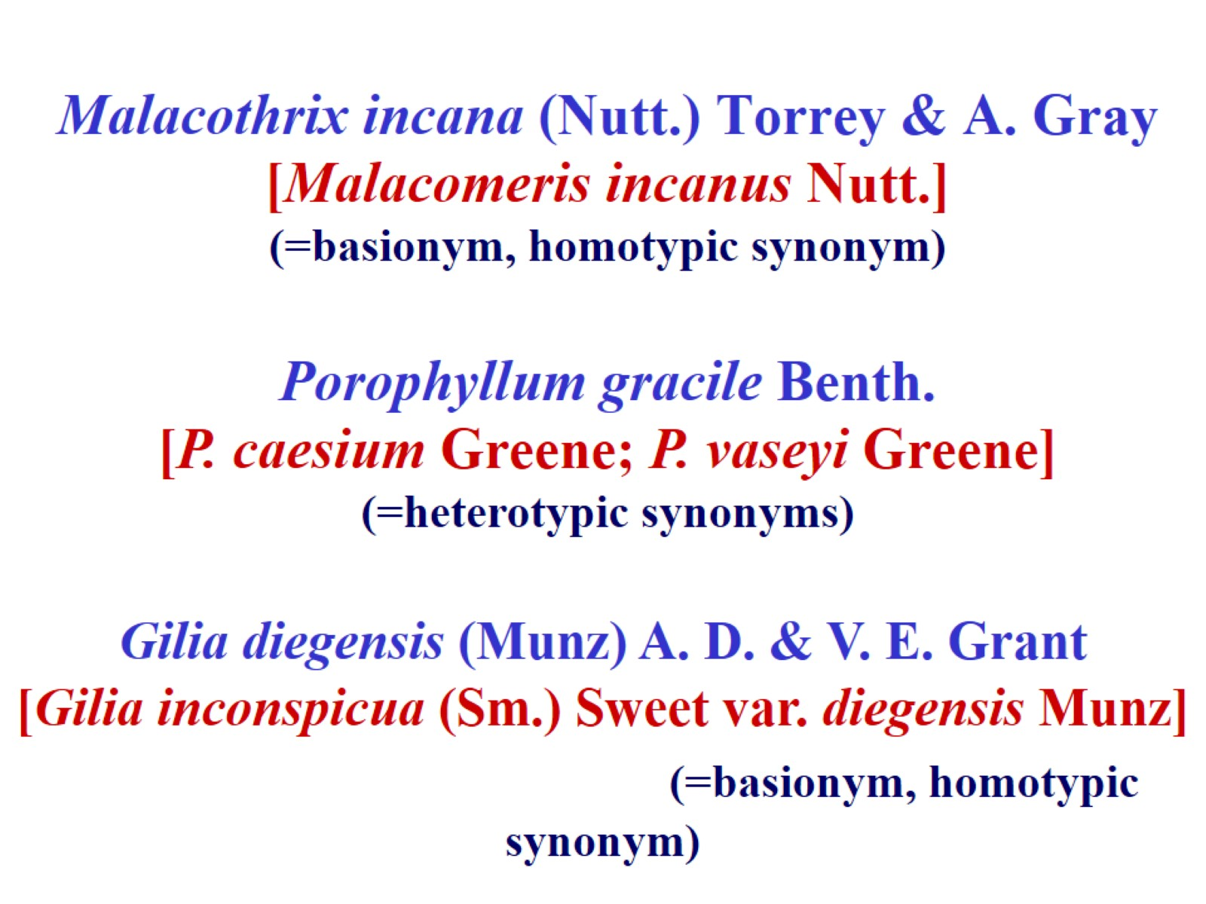
Malacothrix incana (Nutt.) Torrey & A. Gray [Malacomeris incanus Nutt.] (=basionym, homotypic synonym)

Slide 41
What is a homonym?

Slide 42
Abbreviations

